Slide 1
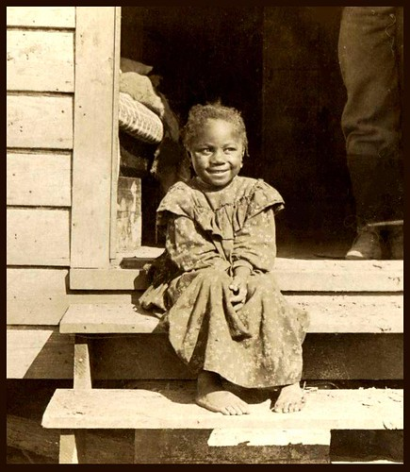
History of African American Assimilation in the United States Assimilation & Pluralism

Slide 2
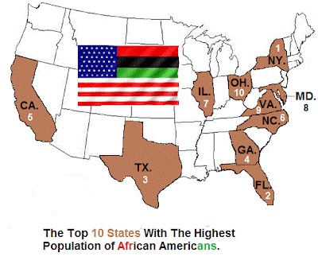
In 2021 US Census Bureau estimates 49,586,352 African Americans in the United States which is 14.9% of the total American population of 331.9 Million. This includes those who identify as ‘Black Only’ and as ‘Black in combination with another race’.
The United States of America is home to over 326 million United States (U.S.) citizens as well as to tens of millions of people from all over the world. The assimilation process of many of the ancestors to today’s citizens and migrants to the U.S. has been and continues to be an undertaking that is unique to each group, based on their ethnicity, heritage and cultural background. Assimilation is defined and understood as a process in which formerly distinct and separate groups come to share a common culture and merge together socially (Healy & Stepnick, 2016)
As a culturally diverse society goes through the assimilation process, the differences among those groups have a tendency to decrease. “One form of assimilation is expressed in the metaphor of the ‘melting pot’, a process in which different groups come together and contribute in roughly equal amounts to create a common culture and a new, unique society” (Healy & Stepnick, 2016).
History of African American Assimilation in the U.S. (ukessays.com)

Slide 3
As a society, we as Americans often envision the American experience of assimilation as a welcoming experience that migrants fully embrace. We all often hear the phrase “we are a nation of immigrants”, which is both truthful and a falsehood once we actually dissect the phrase under a metaphorical microscope.
The reality is that on the surface, the U.S. is a melting pot but there are thousands of “sub-cultures” within the U.S. culture which comprise our society.
25 American Sub-Cultures
New England | Body-Building | New Age Spirituality | Hip-Hop | Bronies
Motor Cycle Club | UFO Believers | Pepper (Survivalist) | Campus | Theatre
Military | Parents/Caregivers | The Amish | Sports | Video “Gamers”
Little Havana | Native Americans | West Coast – California | Homesteading | Korean
Deaf | Southern | LGBTQ | Fandom | Santa Barbara
Children without biological Parents or Relatives or Ancestors

Slide 4
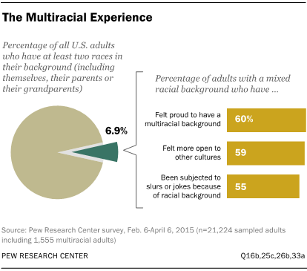
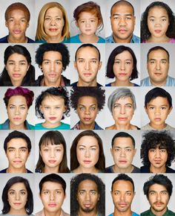
There are specific racial groups within the U.S. culture that have suffered immensely throughout their collective assimilation processes. Be it through no fault of their own, but rather because of the intentional and institutional actions and policies of those in the majority. American history has provided us all with evidence that the melting-pot theory is stemmed with an European-centric slant: “For better or worse, the white Anglo-Saxon Protestant tradition was for two centuries—and in crucial respects still is—the dominant influence on American culture and society” (Schlesinger, 1992). Contrary to popular belief and the images that are portrayed to the world that the U.S. is comprised of a “melting-pot” of people from a vast majority of countries, assimilation in this country has generally been a largely one-sided process which is actually described as Americanization or Anglo-conformity.
As America becomes more racially diverse and social taboos against interracial marriage fade, a new Pew Research Center survey finds that majorities a of multiracial adults are proud of their mixed-race background (60%) and feel their racial heritage has made them more open to other cultures (59%).

Slide 5
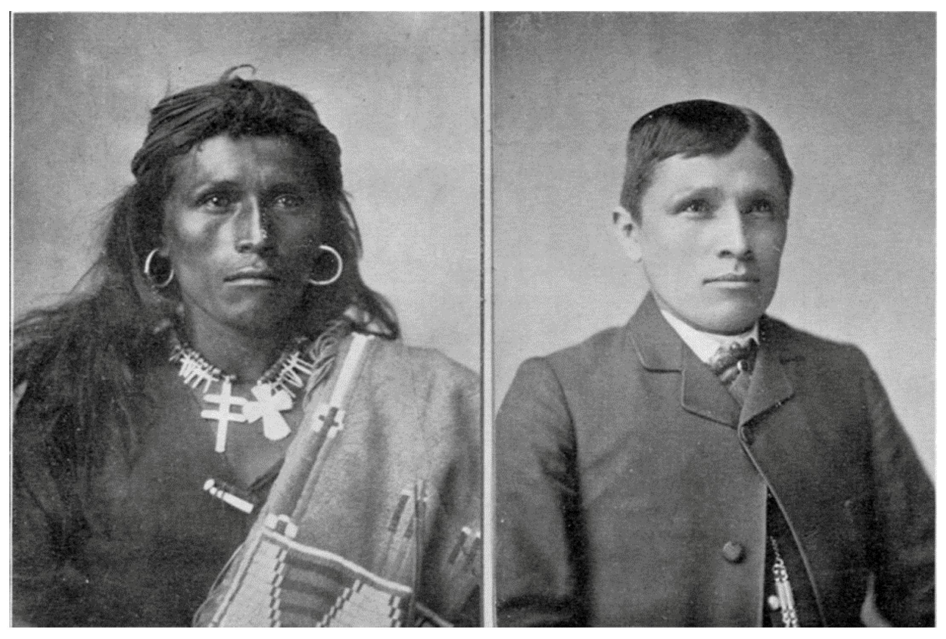
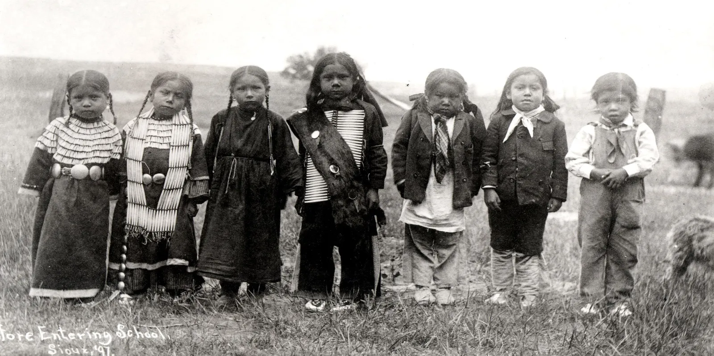
The U.S. has blatantly taken the approach to expansion by forcibly conquering lands that were previously occupied by natives of those lands rather than accepting the equal sharing those lands and natural resources. American history has taught us that assimilation in the new world was specifically designed to expand the legacies of the European culture that were cultivated during the infancy years of American society. Under what was termed as Anglo-conformity, those who migrated to the U.S. were expected to adapt to Pseudo-Christian culture as a precondition for acceptance into society as well to gain access to suitable employment, societal recognition, better educational opportunities for their families and communities as well as inclusion into the Anglo-American culture. The history of assimilation in these United States has most often translated into minority groups being forced to forego their cultural traditions and inculcate themselves into the accepted Anglo-American culture.

Slide 6
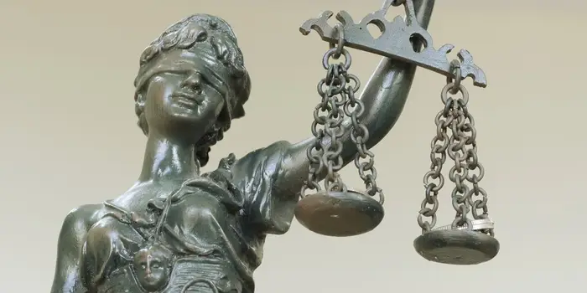
Equal Justice Under the Law
Robert Park, a renowned Sociologist was a firm believer in, and argued that assimilation was an inevitable process in American society. He attempted to justify this theory by arguing that in a society where the national political system is based on democracy, fair and blind justice, as it is in the United States, all those who reside in this country would eventually secure equal treatment under the law. He was of the belief that in an industrial economy such as that of the United States, people would tend to be judged on rational grounds, that is, on the basis of their abilities and talents and not by ethnicity or race. (Healy & Stepnick, 2016).
“8” Ways
America's Legal System Punishes People Who Are Poor
1. Money Bail
2. Private Bail Companies
3. Suspended Drivers Licenses
4. Excessive Mandatory Minimum Sentences
5. Wealth-Based Banishment That Outlaws Low-Income Housing
6. Private Probation Abuses
7. Parking Tickets to Debtors' Prison
8. Sex Offense Registration Laws

Slide 7
A History of “Injustice”
Jim Crow Laws Plessy v. Ferguson The state of Louisiana passed Act 111 –also known as, the Louisiana 1890 Separate Car Act Homer A. Plessy was arrested and jailed for boarding a car of the East Louisiana Railroad that was designated for use by white patrons only June 7, 1892 Homer A. Plessy v. Ferguson was argued in the Supreme Court of the United States April 13, 1896 In a 7 to 1 decision the "separate but equal" provision of public accommodations by state governments was found to be constitutional under the Equal Protection Clause. May 18, 1896 Result: Educational institutions, hospitals, transportation services, eating establishments, were all segregated. Individual literacy tests, ethnic poll taxes, and other so-called grandfather clauses not only prevented African Americans from exercising their rights to vote in local, statewide, and national elections prohibited them from serving on juries during trials or to run for public office within their communities. “The slavery that survived long past emancipation was an offense permitted by the nation, perpetrated across an enormous region over many years and involving thousands of extraordinary characters.” (Blackmon, 2008) | Capta: The Child Abuse Prevention and Treatment Act This law was the response to a long history of children being abused, neglected, forgotten, and misused . It provided funding and support to states that implement the law to protect children from abuse, neglect, misuse, and other deterrents to these social issues. Many children were saved and families reunited and healthier. Results: Findings on the first national survey they conducted on state’s compliance with the only federal child abuse law, the Child Abuse Prevention and Treatment Act (CAPTA). The reporters found that “not one” state complied with all of the legal requirements. Innocent children from innocent families were taken, destroying entire families and increasing the abuse of children. Children used in drug trials Children abused in Foster Homes Children used to care take other foster children Law enforcement fails to document child status Law enforcement fails to investigate and arrest abusers Law enforcement refuses take any action or arrest adults who abuse children

Slide 8
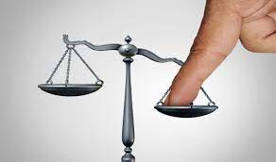
Injustice or No Justice
In 2021 there was
381,176 children in
Foster Care in the United States
One would anticipate that:
More than 381,176 individuals would have been arrested/jailed
The perpetrators would mirror the general population
Stats for graduation/reading/math scores would match p0pulation
Children have grandparents/ aunts-uncles/family relatives-siblings
Children with disabilities would have IEP’s/ Health Care Plans
Foster homes would be investigated with planned/unplanned visits
Reunification plans would be intense, frequent, and well funded
All parties will communicate all changes – fully informed
Parents that retain their rights are included in all activities
The Guardian ad Litem meets the children other than in court
The Judge steps down from cases where they have conflicts
Expert Witnesses can only wear one hat on a case, no conflicts
Help Me with the Math?

Slide 9
PUBLIC ATTENTION IS NEEDED Open Secrets and secret crimes. Just because Africian Americans are descendants of slavery does not mean you have the right to steal and sell our children. Arizona CPS advertises multiple times daily on the radio that they have 19,000 children up for adoption in this AD campaign you can adopt up to four children with cash assistance, tax breaks for singles and couples and much more. The numbers don't lie, CPS is not lying on itself. They are showing you and telling you and documenting the crimes they commit. These crimes are committed right in front of the everyone’s eyes and nothing is being done to stop this torture and genocide of Africian American Families. AFRICAN AMERICAN CHILDREN REPRESENT 5.0% OF POPULATION YET 14.8% ARE IN OUT-OF-HOME CARE. Child Welfare Statistics: Arizona Children in Out-of-Home Care (azcourts.gov)
THIS IS THE DEFINiTION OF TARGETING!
https://www.youtube.com/watch?v=lxH3-i05bbw

Slide 10
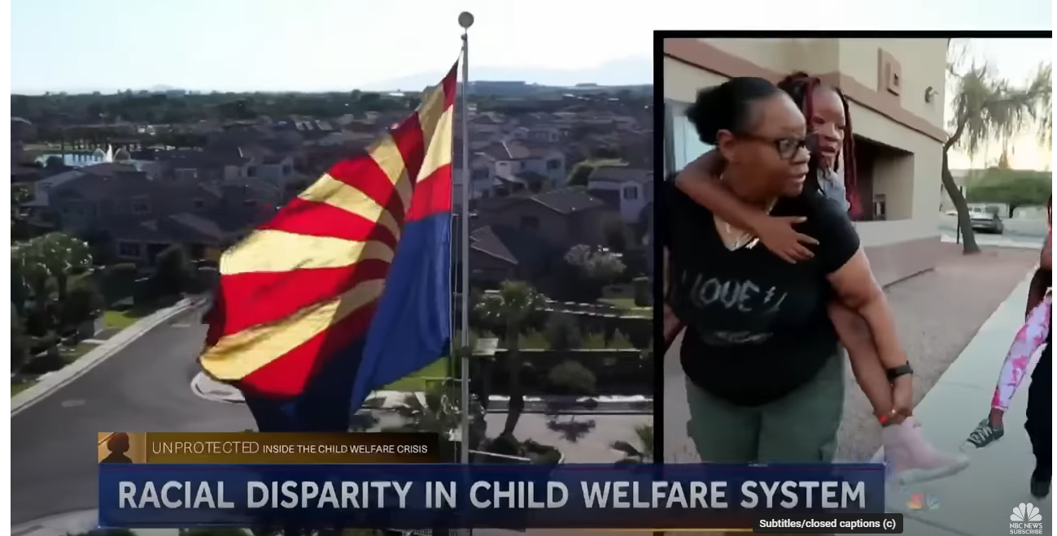
https://www.youtube.com/watch?v=lxH3-i05bbw
https://www.youtube.com/watch?v=lxH3-i05bbw

Slide 11
Silent Voices Speak Loud
https://svsloud.org/
SVS
P. O. Box 24696
Tempe, Arizona 85285
Never give up!

