Slide 1

CPS/DHS The worlds Deadliest Predators
Halloween conjures up visions of Charlie Brown’s “Great Pumpkin” and candy, while Halloween for other children and families it brings nightmares of “Predator” and kidnapping witches. If you have ever had that knock on the door and hear, “It’s DCS; with the police, then you know a “Nightmare”

Slide 2
CPS/DHS The worlds Deadliest Predators
There is no code of ethics in American Adoption Practice. The babies you buy are the babies you own. There is no code of ethics in Department of Child Safety/Child Protective Services. They steal and sell children. There is no ethics in the State and Federal government. There is no ethics in the hospital. There is no ethics in the court room and there is no ethics in the law. All of these groups are in partnership to steal children and destroy innocent families for profit.

Slide 3
CPS/DHS The worlds Deadliest Predators
These unethical predators work within the secret framework of State corruption for profit. Adoption agencies are no more than baby brokers that sale babies for the highest price for adopters. CPS steals and funnels children through the foster care system. This is illegal and a crime against humanity. Hundreds of thousand of children have been separated from families and these issues need to be addressed especially in areas of protecting families and children.

Slide 4
CPS/DHS The worlds Deadliest Predators
The stories are horrific and the damage is for life. The perpetrators who commit these crimes leave a trail so clear anyone who wants to know can easily follow the crimes. They are well documented. They control laws. They control the lies and the narrative and paint a perfect situation for kids by promoting and misleading the public by promoting FOREVER homes saying “we just want to love the kids.” That is a cleaver way to steal and sell the children. Children are stolen and forced into isolation from all family members. They are quickly absorbed into white/mainstream society to be assimilated. This involves losing their heritage, culture, history, language and opens all doors to be exploited and abused without anyone outside of the system from ever knowing what really goes on inside.

Slide 5
CPS/DHS The worlds Deadliest Predators
These children are alienated, from their sense of being, who they are and this takes away any chance of having their own identity nurtured. This has a profound impact on their identity and will cause unresolved grief and trauma for the rest of their lives. Children who become adults live with the aftermath of a system that is well designed to destroy human lives for profit. There is no laws that protects parents, children and extended family members from this corruption. With no code of ethics, no rights, no civil rights, no constitutional rights and no rights of any kind.
The thieves and baby brokers have the free will to Kidnap, Price and Sell your children right in your face. CPS/DCS Foster care, pretend parents, adoption agencies are all guilty of violations of children human rights. Every child they steal has a price on their head. Innocent parents and children live in this world of reality.

Slide 6
The Arizona Department of Child Safety
State advertises on TV/radio/internet
Arizona advertises daily on the radio that you can adopt up to 4 children and get incentives, that means they are selling children to the public. The States also offer Federal Tax breaks. Some States offer cash for Education.
One of the most expensive malls in the State. Scottsdale Fashion Square has a billboard advertising the same promotion that you can adopt 4 children with incentives with the State symbol on it. Who are buying the children?
Note: CPS always talks about confidentiality for the child and yet they advertise children’s pictures and information on television, news papers, and billboards

Slide 7
CPS/DHS The worlds Deadliest Predators
Are you advertising foster children to be adopted
in African American or Hispanic communities or
advertising on black and Hispanic radio stations?
Or are you only advertising in wealthy white communities?
The below picture was at a high end retail mall called Scottsdale Fashion Mall.
Why are these children not placed with families with the same cultural background?
Why can’t other ethnic groups adopt Caucasian children?

Slide 8
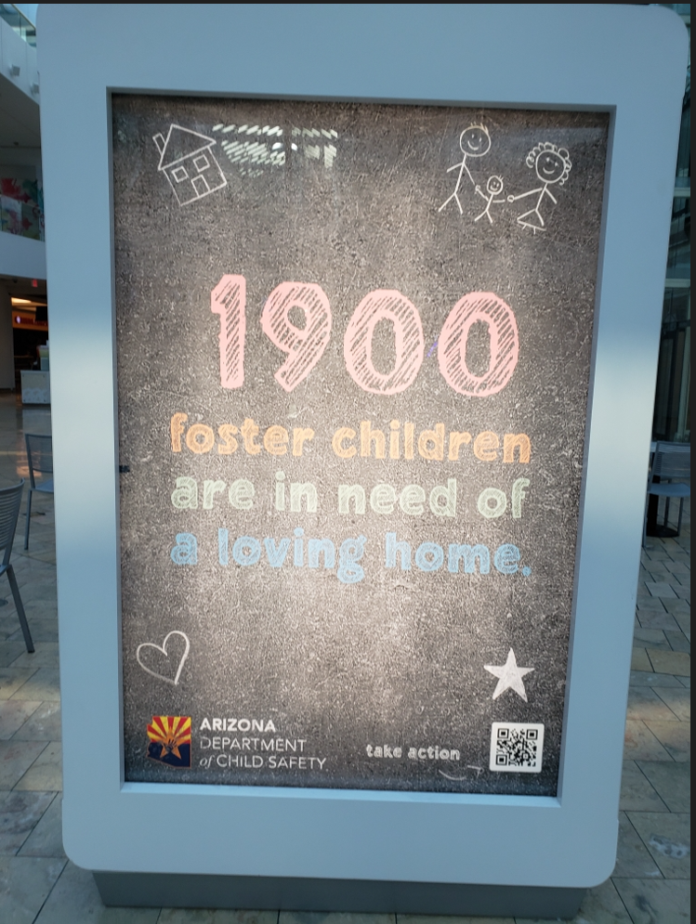
CPS/DHS The worlds Deadliest Predators

Slide 9
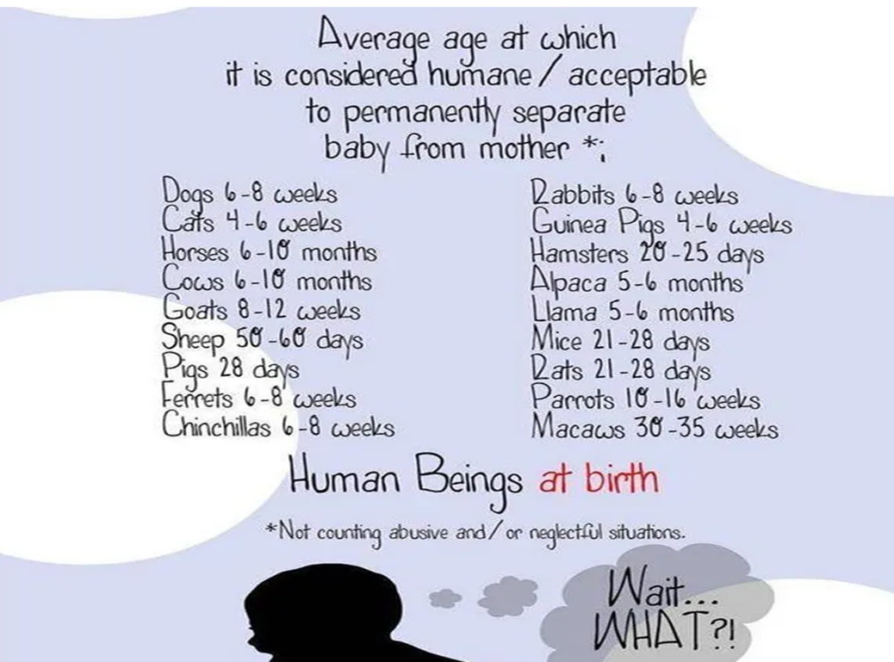
The Arizona Department of Child Safety
https://www.huffpost.com/entry/predatory-adoption-practices-what-is-an-adoptoraptor_b_59d1521ae4b0f3c468060fbc

Slide 10
CPS/DHS The worlds Deadliest Predators
Closing
It is racist and cruel to adopt a black child/children, really any child of color and stripe them of their culture, heritage, and language and put them into an all-white community. Where no one looks like them. These children are put in a situation that forces them to deal with racism on all levels. Even in your white homes racism is inescapable.
Silent Voices Speak Loud
www.svsloud.org

