Slide 1
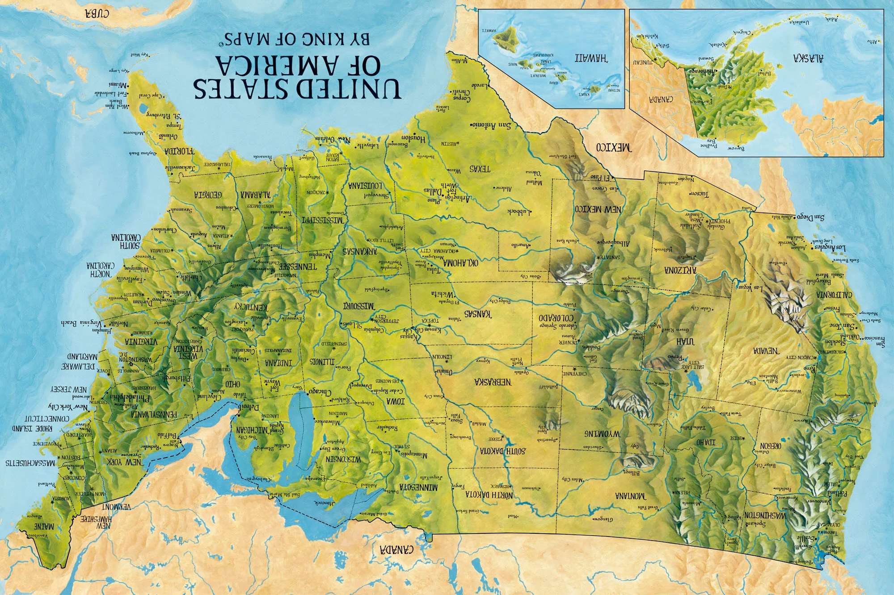

CPS/Foster Care System
Upside Down & Backwards
Antique Medical Model
Illness to Diagnosis to Cure
“An ounce of prevention is worth a pound of cure”
America ignores families in need, spending almost nothing for Prevention and even less for Reunification
America spends hundreds of millions of dollars for foster care that would have been better used to support families and keep them together.
Simply Backwards and Upside Down!

Slide 2
Upside Down & Backwards
Real Common
Example
Children from the same family are missing school and when they do their clothes are dirty and smelly.
The school nurse calls child protective services and a social worker removes the children.
Next the social worker informs the parent that the children are in state custody, the process has started, and an investigation is underway
The overworked and undertrained social worker simultaneously starts the paper work for reunification and severance.
The children change schools, lose friends, lose contact with family members and are traumatized by change and loss.
Reality: The Mother did not have a washing machine and the children were consistently dirty and smelly. If she was provided a washer and new clothes the problem would be resolved

Slide 3
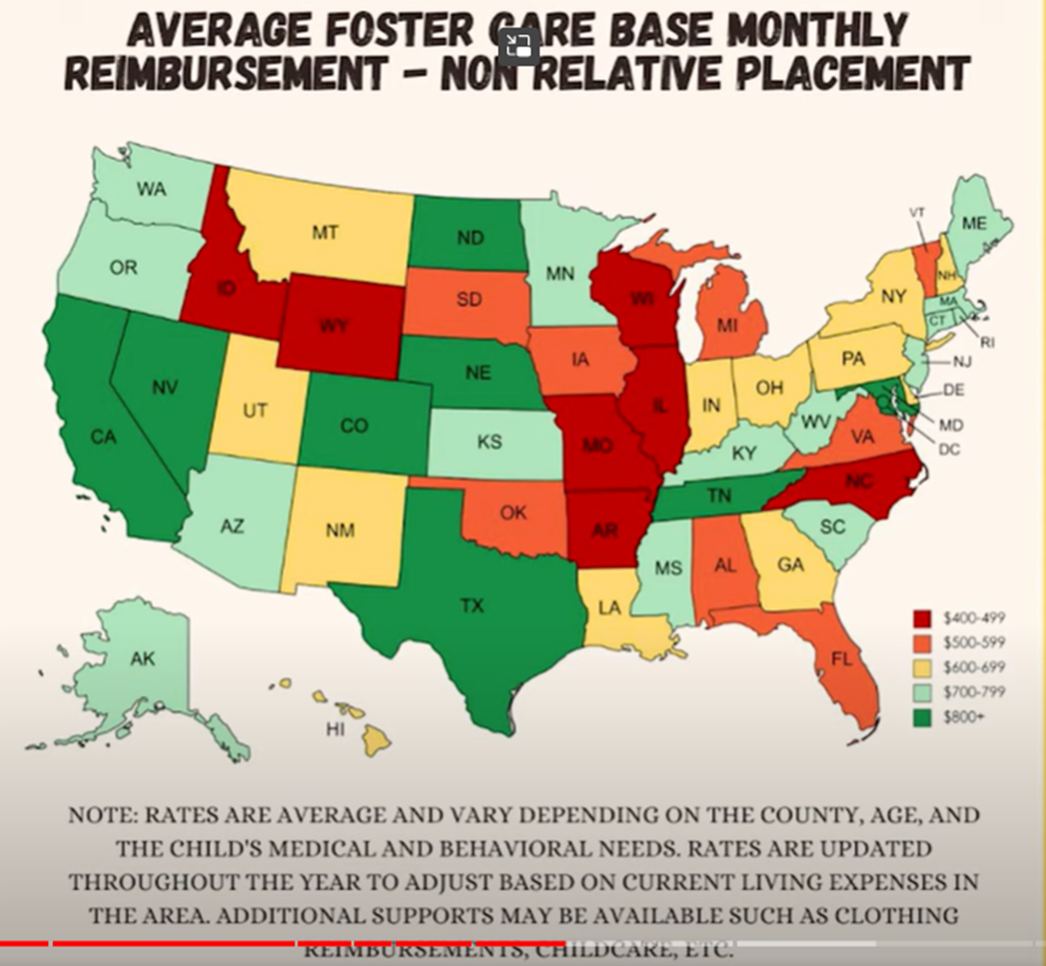
“Show Me the Money”
$
Q: What Is the Average Foster Parent Salary by State in 2022? (ziprecruiter.com)
ALL THINGS MONEY AND FOSTER CARE (How much do foster parents get paid in EACH STATE? 💰) - YouTube

Slide 4
“Show Me the Money”
Average Foster Parent Salary by State
1
State | Annual Salary | Monthly Pay | Weekly Pay | Hourly Wage
Hawaii | $105,178 | $8,764 | $2,022 | $50.57
Massachusetts | $103,979 | $8,664 | $1,999 | $49.99
Nevada | $103,262 | $8,605 | $1,985 | $49.65
Rhode Island | $102,019 | $8,501 | $1,961 | $49.05
Oregon | $100,504 | $8,375 | $1,932 | $48.32
Alaska | $99,922 | $8,326 | $1,921 | $48.04
North Dakota | $99,104 | $8,258 | $1,905 | $47.65
Washington | $97,181 | $8,098 | $1,868 | $46.72
New York | $94,769 | $7,897 | $1,822 | $45.56
South Dakota | $94,227 | $7,852 | $1,812 | $45.30

Slide 5
“Show Me the Money”
2
Maryland | $92,873 | $7,739 | $1,786 | $44.65
Virginia | $91,056 | $7,588 | $1,751 | $43.78
New Hampshire | $89,393 | $7,449 | $1,719 | $42.98
Nebraska | $88,900 | $7,408 | $1,709 | $42.74
Colorado | $88,850 | $7,404 | $1,708 | $42.72
California | $88,660 | $7,388 | $1,705 | $42.63
Delaware | $88,458 | $7,371 | $1,701 | $42.53
Idaho | $87,889 | $7,324 | $1,690 | $42.25
South Carolina | $87,451 | $7,287 | $1,681 | $42.04
Vermont | $87,006 | $7,250 | $1,673 | $41.83
Arkansas | $86,689 | $7,224 | $1,667 | $41.68
New Jersey | $85,891 | $7,157 | $1,651 | $41.29

Slide 6
“Show Me the Money”
3
New Jersey | $85,891 | $7,157 | $1,651 | $41.29
Connecticut | $84,440 | $7,036 | $1,623 | $40.60
Kentucky | $84,397 | $7,033 | $1,623 | $40.58
Tennessee | $84,185 | $7,015 | $1,618 | $40.47
Oklahoma | $83,957 | $6,996 | $1,614 | $40.36
Michigan | $83,893 | $6,991 | $1,613 | $40.33
Arizona | $83,430 | $6,952 | $1,604 | $40.11
Maine | $82,968 | $6,914 | $1,595 | $39.89
Wyoming | $82,906 | $6,908 | $1,594 | $39.86
Minnesota | $82,511 | $6,875 | $1,586 | $39.67
Illinois | $81,860 | $6,821 | $1,574 | $39.36
Montana | $81,705 | $6,808 | $1,571 | $39.28

Slide 7
“Show Me the Money”
4
Indiana | $80,890 | $6,740 | $1,555 | $38.89
Missouri | $80,668 | $6,722 | $1,551 | $38.78
West Virginia | $79,657 | $6,638 | $1,531 | $38.30
Pennsylvania | $78,193 | $6,516 | $1,503 | $37.59
Texas | $77,960 | $6,496 | $1,499 | $37.48
Wisconsin | $77,912 | $6,492 | $1,498 | $37.46
Ohio | $77,734 | $6,477 | $1,494 | $37.37
Iowa | $76,983 | $6,415 | $1,480 | $37.01
Utah | $76,613 | $6,384 | $1,473 | $36.83
Kansas | $74,597 | $6,216 | $1,434 | $35.86
New Mexico | $74,289 | $6,190 | $1,428 | $35.72
Alabama | $73,840 | $6,153 | $1,420 | $35.50

Slide 8
5
North Carolina | $73,712 | $6,142 | $1,417 | $35.44
Mississippi | $72,706 | $6,058 | $1,398 | $34.95
Florida | $71,568 | $5,964 | $1,376 | $34.41
Georgia | $66,727 | $5,560 | $1,283 | $32.08
Louisiana | $66,061 | $5,505 | $1,270 | $31.76

Slide 9
States with Highest Salaries for Foster Parent
The five states where Foster Parent jobs get higher salaries in the United States are: Alaska, California, District of Columbia, New Jersey, and Massachusetts. Compared with the average salary of a Foster Parent in the United States, the state of Alaska with the highest job income for this job. The second and third states are California and District of Columbia respectively. The high or low salary paid to Foster Parent by the US has a greater relationship with the demand for jobs and the cost of living.
https://www.salary.com/research/salary/hiring/foster-parent-salary

Slide 10
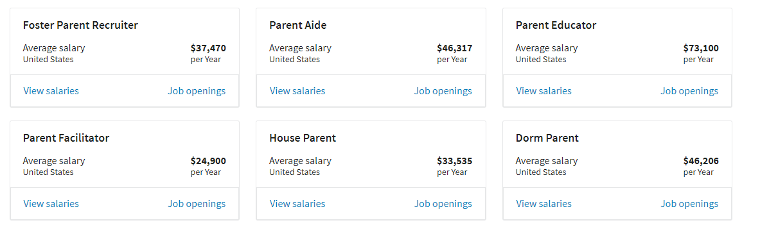
How Much Do Similar Professions Get Paid in the United States?
There are some different titles for Foster Parent jobs, and the job title of Foster Parent will vary in different companies. The job title has a lot to do with the department and responsibilities, and the same job title will vary in different departments. The following list is the salary of jobs similar to Foster Parent, start to view Foster Parent-related jobs you are interested in.

Slide 11
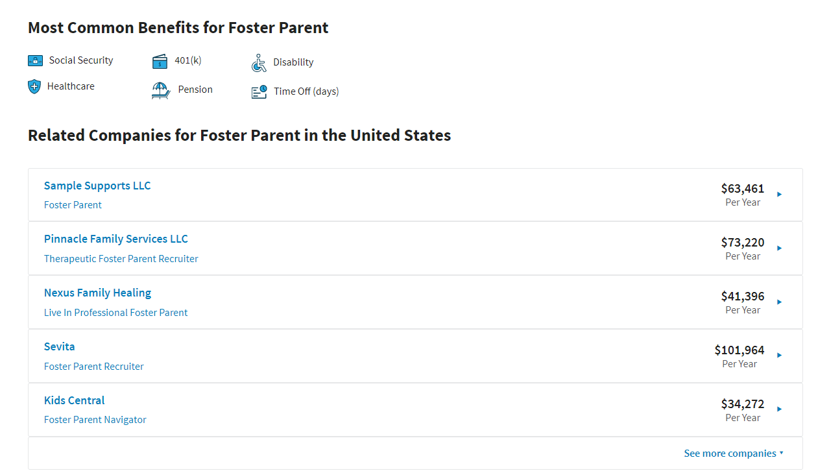

Slide 12
WHO ARE THOSE WHO ARE EMPLOYED BY THE INDUSTRIAL CHILD STEALING COMPLEX
The government is the creator of these legal crimes. Making laws and enforcing crimes they made legal. The stealing of children is employing CPS/DCS, foster parents, adoption agency, and many other State agencies. All these organizations are involved in the stealing and kidnapping of children from innocent families. These unseen crimes that work its way through the legal system create jobs and employ tens of thousands of people. As you can see there are thousands of people and agencies making alot of money. This INDUSTRIAL CHILD STEALING COMPLEX is a $$$BILLION$$$ DOLLAR BUSINESS. From CPS/DCS, lawyers, doctors, foster pretend parents, social workers, psychologist ect. They advertise “THIS IS IN THE BEST INTEREST OF THE CHILD.” This is their signature phrase. To end this Reign of Terror and destruction of families. We must put an end to the CHILD SLAVE TRAFFICKING MARKETS. EXPOSURE, EXPOSURE, EXPOSURE.

