Slide 1
SVS Modern Slavery. Selling children. The Human Cost.
CPS Foster Care System and Adoption Agencies
Repeating History
African American families have a long history of their children being stolen and sold by the government and slavers. This always resulted in separation and destruction of millions of black families and to this day these systems are still destroying African American families. History is circular and continues to repeat itself.
The suffering, the trauma, and the loss that these families endure is beyond any human understanding.
These modern day systems have parallels to slavery.

Slide 2
HUMAN DISCOUNT: WHY DO BLACK CHILDREN COST LESS TO ADOPT?
BLACK AND WHITE
SVS LOUD
Without legal fees included, it was approximately $35,000 to adopt a white child but $18,000 for a black child. That $17,000 difference proves that it costs less to adopt children who are black, suggesting a devaluing of the lives of black children in America.
Since black kids are harder to place for adoption, the lower cost is meant to be an incentive for families who may find it financially challenging to adopt.
Although costs are covered for adoption from foster care, there is proof of racial disparity when it comes to foster care and adoption specifically.
Human Discount: Why Do Black Children Cost Less
to Adopt? (foster-care-newsletter.com)

Slide 3
$$$$ Government & Business $$$$
The federal government gives adopters a big break in the form of an income tax credit of $10,160.00 for adoption expenses. If you adopt two children, then you can take double the adoption expenses as a credit, or up to $20,320.00
https://www.familyeducation.com/life/adoption-cost/government-funding-adoption
Child Protective Services and Foster Care are big business.
Adoption Costs - Adoptions from U.S. Foster Care
Home study Fee: $396
Legal Fees: $1,075
Travel Expenses: $378
All Other Expenses: $1,819
TOTAL: $3,668
Government Funding for Adoption – Family Education
Adoption Costs - [[:Template:Adoption Wiki]]

Slide 4
$$$$ Government & Business $$$$ Adoption Tax Credit and subsidy payments.
And if you adopt three children … well, you do the math. The adoption tax credit can be applied to all allowable expenses, which include agency fees, attorney fees, court costs, travel (including meals and lodging), medical expenses for the birthmother, and other fees related to the adoption. Expenses that are not allowed under this law are expenses for stepparent adoptions or surrogate parent arrangements. The adoption must also comply with federal and state laws.https://www.familyeducation.com/life/adoption-cost/government-funding-adoption
In addition, you may also be eligible for a monthly subsidy payment and Medicaid medical benefits for the child. Subsidy programs have increased considerably in the past several years, as states have worked hard to place children for adoption.
Not everyone is eligible for the tax credit. If your adjusted income is over about $152,000, it disappears altogether.
The adoption tax credit may be taken the year before the adoption becomes final, the year it becomes final, or the year after, depending on various circumstances.
Government Funding for Adoption – Family Education
Adoption Costs - [[:Template:Adoption Wiki]]

Slide 5
$$$$ Government & Business $$$$ Adoption Grants
Adoption Grants from National Adoption Foundation
Most experts agree that one of the principal barriers to adoption is the expense. The National Adoption Foundation offers financial aid to families to help offset expenses directly associated with the adoption process and the formation of families.
Families can apply for outright grants from the Foundation. The grant program is open to all legal adoptions including public or private agency adoptions, international, special needs or adoptions facilitated by an attorney. There is no income requirement. There is a simple one page application and the only requirement to apply is a home study, or one in progress. The Foundation’s board meets four times a year, during the last week of each quarter, to award adoption grants.
https://fundyouradoption.org/adoption-grants/
Government Funding for Adoption – Family Education
Adoption Costs - [[:Template:Adoption Wiki]]

Slide 6
$$$$ Government & Business $$$$ Best Loans for Adoption/Buying Children
LightStream personal loans Finder rating 4.83 / 5 ★★★★★ | SoFi personal loans Finder rating 4.45 / 5 ★★★★★ | Discover personal loans Finder rating 4 / 5 ★★★★
LightStream might be your best choice if lowering costs is your top priority. It offers financing specifically for adoption costs with loans Wells Fargo offers financial support in two ways, via an adoption expense loan or an adoption grant. With an adoption expense loan, they will provide funds up to $15,000 which must be repaid at 6.99% APR over a 10 year time period. https://adoptionloans.net/adoption-loans-using-wells-fargo/ | SoFi also offers highly competitive rates starting at 6.99% and loans up to $100,000. But in addition to financing, it offers borrowers services like free financial advice. This can help you stay on track of your finances while you adjust to the cost of a new family member. | Discover personal loans Finder rating 4 / 5 ★★★★★ With Discover, you can return your loan at no cost within 30 days of receiving the funds. This kind of flexibility can be helpful if you're not sure an adoption is going to go through but want to have the funds ready. But it doesn't accept joint applicants, so you can't apply with your spouse. https://www.finder.com/baby-adoption-loans
Government Funding for Adoption – Family Education
Adoption Costs - [[:Template:Adoption Wiki]]

Slide 7
$$$$ Government & Business $$$$ Public and Private Adoptions/Buying Children
With public adoption, there is no profit motive as the state looks outward to place children. With private adoption, there is a profit motive as agencies look inward at the state pool to select adopter's. Consistently, parents willing to pay privately have more choice than those adopting through the state foster care system. With the public adoption the States get Title IV funding to steal our children and that is their profit motive.gives adoptive parents more rights than biological parents. Adoptive parents have absolute control and authority over other parents children. Adoptive children have no rights in foster care and no rights to see siblings or extended family members. Once they are trapped in the system of Legal crimes. The callous method of this system destroys life and has no safeguards to protect parents and children rights. This wicked system is a terror on every child sold as a commodity. Parents are powerless to challenge or intervene against the sell of their children. The adoptive parents have no obligation by law to keep adopted children in touch with extended family. Documents and research of child abuse in CPS/DHS system have horrible stories of brutality and inhuman treatment of children own and sold by State custody. Children deal with sexual abuse, emotional abuse and PTSD. Child are forced to suffer in silence this is cultural genocide. Lambs to slaughter. Racism has always divided this family, people of color have always been controlled by whites in a position of power and people of color have never had any rights or any rights of any kind. Inequality lives in our society in white communities all over america. Black culture, brown culture or any culture is not white culture. What allows white culture to override and oversee everyone else’s culture.
Government Funding for Adoption – Family Education
Adoption Costs - [[:Template:Adoption Wiki]]

Slide 8
$$$$ Government & Business $$$$ Adoption Assistance through employer/Buying Children
Working Mother compared their 100 Best Companies withcompanies nationwide:
▪92 percent of the WM 100 Best offered adoption assistance,
compared to 20 percent nationwide.
▪54 percent of the WM 100 Best offered paid adoption leave,
compared to 18 percent nationwide.
▪62 percent of the WM 100 Best offered infertility treatment
coverage, compared to 41 percent nationwide.
Kudos to MBNA America Bank, which offers the best benefits
package for adoptive parents for the second year in a row. Its package includes
$14,953 in aid to employees adopting a non-family member, plus six weeks of
fully paid leave for the adoption of a child.
https://www.laurachristianson.com/laura/u-s-companies-that-offer-the-best-adoption-assistance/
Government Funding for Adoption – Family Education
Adoption Costs - [[:Template:Adoption Wiki]]

Slide 9
$$$$ Government & Business $$$$ Adoption Benefits
Also in the top 11 for offering adoption benefits: ▪Abbott Laboratories – $9,645 average adoption reimbursement
▪Avon Products, Inc. – $10,000 average adoption
reimbursement; 2 weeks of fully paid leave for new adoptive parents
▪Eli Lilly and Company – $9,042 average adoption
reimbursement; 1 week of fully paid leave for new adoptive parents
▪Fannie Mae – $10,000 average adoption reimbursement; 4 weeks
of fully paid leave for new adoptive parents
▪Freddie Mac – $8,300 average adoption reimbursement
▪Inova Health System – $7,000 average adoption reimbursement;
2 weeks of fully paid leave for new adoptive parents
▪JPMorgan Chase – $10,000 average adoption reimbursement; 1
week of fully paid leave for new adoptive parents
▪Motorola, Inc – $7,000 average adoption reimbursement
▪Pfizer Inc. – $8,611 average adoption reimbursement
▪Timberland Company – $10,000 average adoption reimbursement;
2 weeks of fully paid leave for new adoptive parents
Government Funding for Adoption – Family Education
Adoption Costs - [[:Template:Adoption Wiki]]

Slide 10
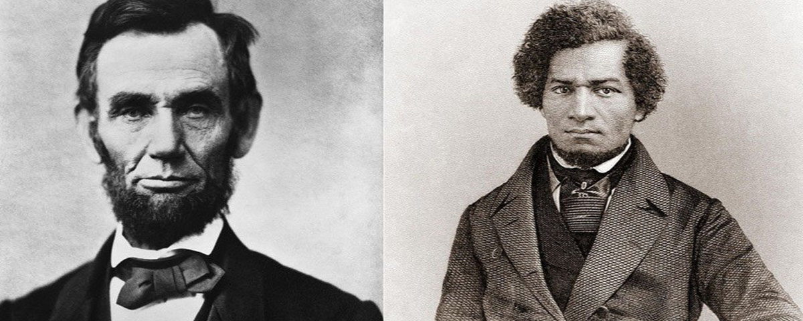
Abraham Lincoln/Frederick Douglas On Color and Value
“You say A. is white, and B. is black.
It is color, then; the lighter, having the right to enslave the darker?
Take care. By this rule, you are to be slave to the first man you meet, with a fairer skin than your own. “
July 1st, 1854.
---Abraham Lincoln
“It is easier to build strong children than to repair broken men.”
― Frederick Douglass
HUMAN DISCOUNT: WHY DO BLACK CHILDREN COST LESS TO ADOPT?

Slide 11
Research suggests that the skin color issue continues to be a problem across the U.S. A study similar to that of the ACLU’s was conducted in 2010 in the state of Michigan. This study looked at 1,183 adoptive Michigan families who adopted children from 2007 to 2009, through both public and private adoption agencies. According to the findings, 42 percent of adoptive parents’ most recently adopted children were “very fair or somewhat fair” in skin color, while 31 percent were “somewhat dark or very dark.”

