Slide 1
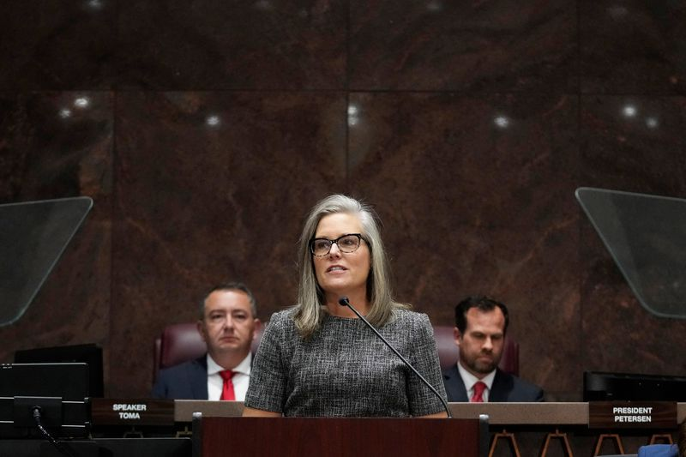
Arizona Child Welfare Director Dismissed
Amid GOP Attacks Speaks Out
Gov. Katie Hobbs said she appointed Matthew Stewart to “transform” Arizona’s troubled child welfare system. But as an election-denying Republican was gearing up to attack him,
she gave up on her pick.
https://www.propublica.org/article/arizona-matthew-stewart-katie-hobbs-dcs

Slide 2
by Eli Hager March 1, 6 a.m. EST
ProPublica is a nonprofit newsroom that investigates abuses of power. Sign up to receive our biggest stories as soon as they’re published.
Arizona’s newly elected Democratic governor, Katie Hobbs, has given up on another of her Cabinet nominees in the face of misleading attacks from Republicans in the state Legislature. Matthew Stewart was forced out last Wednesday after serving just a month and a half as Hobbs’ director of the Department of Child Safety, the state child protective services agency.
When Hobbs selected Stewart in December, she called him one of “the best minds Arizona has to offer” and a leader on racial justice issues who would “transform” a child welfare system that ProPublica and NBC News had found investigated the families of 1 in 3 Black children in metro Phoenix during a recent five-year period.
Now, Hobbs has forced Stewart to leave his post before he could defend his record in a public hearing.

Slide 3
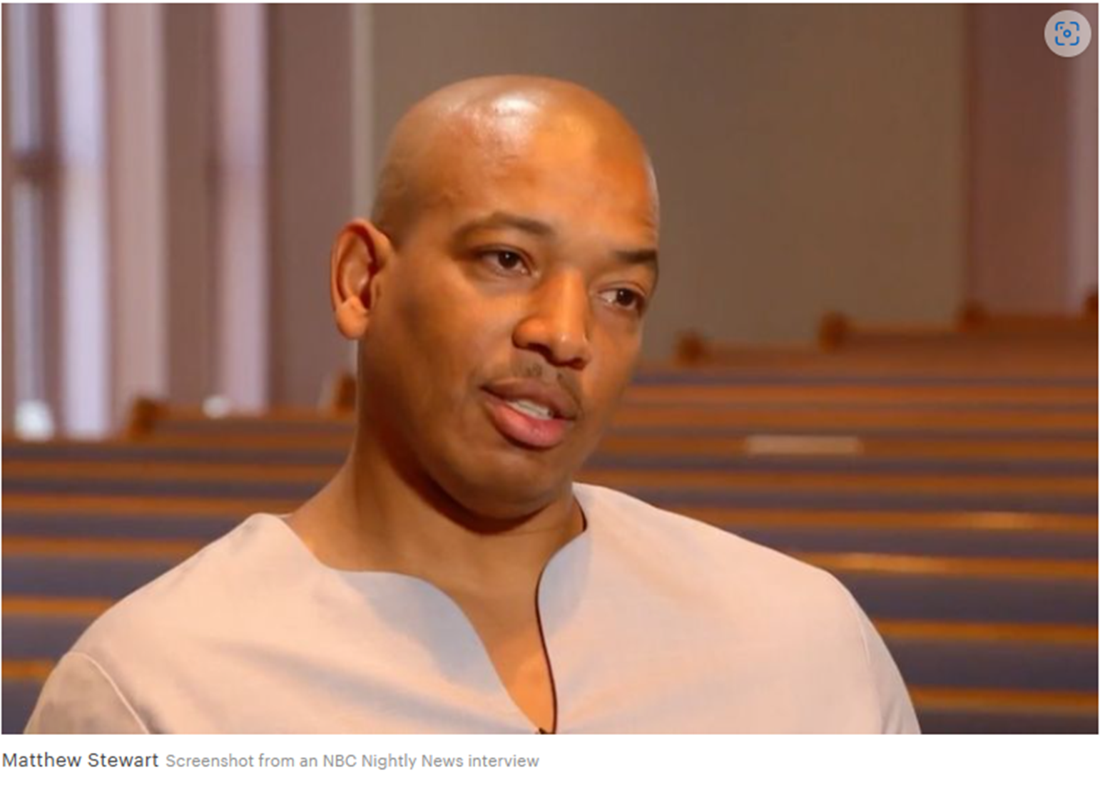
In an interview with ProPublica, the first since his ouster, Stewart said the Republicans’ attacks on him are inaccurate and reputation-damaging. More than a dozen current and former DCS employees, all of whom were contacted independently by the news organization and not at Stewart’s recommendation, confirmed that the allegations about him that have since been circulating in the news media are unfounded.
“If you believe change is needed, and you make a decision to bring in a person who will create change, then you stand behind that person,” Stewart said of the governor abandoning him. “I’m an example of someone willing to take a risk going into a bureaucratic, deeply ingrained system trying to bring new thinking, new energy.”
“I wanted to have the opportunity to go through [the confirmation process] and defend myself,” Stewart said, adding that dismissing him was a “way for the governor to stay safe.”

Slide 4
It all started with a vaguely worded news release issued Wednesday by state Sen. Jake Hoffman, a Republican who has been banned from social media platforms for spreading misinformation and running an online troll farm. He has also denied Hobbs’ legitimacy as governor.
Hoffman chairs the Arizona Senate Committee on Director Nominations, a panel for vetting Cabinet appointments that was formed after Hobbs’ November victory over Republican Kari Lake and that never existed before 2023.
In his statement, Hoffman said that “Katie Hobbs openly touted skin color as her seemingly only priority in the search for the next potential DCS director.”
Stewart is Black and the son of the longtime senior pastor of Phoenix’s most prominent Black church. He previously worked at DCS for over a decade as a case manager and training supervisor before quitting over the racial disproportionality he saw in the agency’s enforcement.
Hoffman also said, without providing supporting detail, that Stewart had committed insubordination and taken an unauthorized absence during his prior stint working at the agency.

Slide 5
DCS disciplinary records, obtained by ProPublica from the department, show Stewart received this reprimand (his only complaint during his more than a decade on the job) because he asked to work from home in the spring of 2020, at the onset of the pandemic. His daughter is severely asthmatic, and a doctor had warned him against going in to the office.
Stewart said he informed Hobbs about this when he interviewed with her team, and they said it wasn’t a problem.
Hoffman, the Republican lawmaker, also cast aspersions on Stewart’s recent decisions to dismiss four top DCS officials — adding that some of those who’d been let go are
“openly gay.”
Applicants, employees and former employees are protected from employment discrimination based on race, color, religion, sex (including pregnancy, sexual orientation, or gender identity), national origin, age (40 or older), disability and genetic information (including family medical history). Applicants, employees and former employees are also protected from retaliation (punishment) for filing a charge or complaint of discrimination, participating in a discrimination investigation or lawsuit, or opposing discrimination (for example, threatening to file a charge or complaint of discrimination).
U.S. Equal Employment Opportunity Commission

Slide 6
But Stewart had already told ProPublica in multiple interviews over the last year that those individuals were part of an institutional culture that had led to the agency’s high rate of investigations and separations of low-income families as well as its problem with turnover among overworked caseworkers — and that for DCS to change direction, they would have to go.
Trying to reform any agency, he has consistently said,
“requires replacing people in leadership positions.”
Stewart said in an interview Sunday that his decisions to part ways with the four officials were run by the governor’s office and went through normal HR channels at the Arizona Department of Administration, and that he didn’t know each of the individuals’ sexual orientation.

Slide 7
Five current and former DCS employees who identify as LGBTQ also said in interviews or emails with ProPublica that Stewart has consistently supported them and worked closely with them, and that the implication of any discrimination by him is, in their view, without merit. The governor’s office agrees that none of the issues brought up by the Republican committee had anything to do with Hobbs dismissing Stewart.
“Completely baseless,” said Ben Henderson, the governor’s director of operations, of the implication that there was anti-LGBTQ bias in Stewart’s personnel decisions.
Henderson told ProPublica that the real reason for forcing Stewart out was that while he had the “vision” to change the direction of DCS, he didn’t have the day-to-day administrative acumen to run an agency with a billion-dollar budget and thousands of employees.

Slide 8
The governor’s team declined to specify what exactly Stewart wasn’t capable of as an administrator or how a month and a half was enough time to know that he wasn’t up to the task.
Stewart said it is “news to me” that there was any issue with his performance, and that the governor’s office had never contacted him about this. He said that on Wednesday morning, they scheduled a meeting and told him it was clear to them that his confirmation wouldn’t make it past Republican opposition, and that they would therefore be withdrawing his nomination.
Nothing substantive about his record or managerial abilities was mentioned then or at any point in the past month and a half, Stewart reiterated, saying that he’d only received positive if sparse feedback from Hobbs’ office on his hiring and other executive decisions.
The version of events from the governor’s office “sounds like controlling the narrative,” Stewart said.

Slide 9
“The bottom line, Cabinet members serve at the pleasure of the Governor, and this is a decision that was made in everyone’s best interest,” Hebert said.
The governor’s staff said they’re having internal conversations about repairing the reputations of both Stewart and Dr. Theresa Cullen, who too was recently pulled from consideration as head of the state’s health department after similar attacks from Hoffman and his committee.
In Cullen’s case, several supporters of Stewart pointed out, the governor did at least issue a statement defending her.
After Stewart’s dismissal Wednesday, he was sent back to the DCS office to pack up his belongings and go home. Later that day, Hoffman, the Republican legislator, released his statement taking credit for the governor’s decision to remove Stewart and citing it as evidence of the need for his new Cabinet nominee vetting committee.

Slide 10
Claire Louge, executive director of the child maltreatment prevention organization “Prevent Child Abuse Arizona” said she met with Stewart the morning before he was forced to leave. She said she asked him what he was looking for in the high-level positions he had dismissed people from.
Part of his answer was that he really wanted DCS leadership to have optimism and “show up differently” in the lives of struggling families, Louge said.
“What did they expect?” she said of the governor’s office. “Matthew Stewart is a known visionary, a known advocate, who did not have extensive administrative experience. They knew that.”

Slide 11
DCS staffers — some of whom took jobs at the agency since Stewart was hired because they wanted to work with him — say they are upset by the way he was treated, as are many people in Arizona’s Black community.
Dustin Sallaz, a case manager and later supervisor at DCS from 2017 to 2022 who is openly gay and has worked extensively with Stewart, said “Stewart was always an “amazing” and “communicative” DCS colleague who took time to get to know the families he worked with — and that he was right to fire the people he fired.”
Samantha Aiello was a case manager and program specialist at DCS from 2016 to 2022, when she left the department to work with Stewart’s nonprofit organization, Our Sister Our Brother, which advocates for vulnerable families caught up in the child welfare system. She also identifies as LGBTQ, noting that Stewart knew this and sent her an Edible Arrangement for her wedding.
“Matt is the most compassionate person I’ve ever had the chance to work for,” she said.

Slide 12
The current and former DCS employees interviewed by ProPublica agreed that the officials whom Stewart fired, all key figures in charge of the department’s day-to-day operations, were widely known for contributing to long-standing problems at the agency, including staff retention.
ProPublica has requested that DCS provide documentation of the officials’ complaints about Stewart but has not received the records.
The four officials could not immediately be reached for comment.
In an interview, Kim Quintero, director of communications for the Arizona Senate Republicans, said the allegations about Stewart came from a whistleblower whose identity Hoffman and his team are protecting. “We have attorneys that review these things before they even go out, so we did everything legally accurate,” she said, referring to documentation she said the committee reviewed.
Regarding the allegation that discrimination had something to do with Stewart’s decisions about which DCS officials to dismiss, Quintero said that “obviously, an investigation hasn’t been done.”

Slide 13
Meanwhile, Hoffman, the committee chair, is leading a group of conservatives who plan to sue Hobbs for issuing an executive order guaranteeing equal employment opportunities for LGBTQ people working at state agencies. He also wrote a bill that would have banned books from schools that depict “acts” of “homosexuality.”
Stewart said that many of the changes he made in the short time he was director “were ones that needed to happen for years, maybe decades,” adding that his goal was to reshape “what the community experiences when DCS knocks on their door.”
He also said that during his initial interviews with Hobbs’ team, he was asked what it would mean to the public if he were picked as DCS director. “I said it would mean she wants change,” Stewart said of the governor.
“That was my charge,” he said. “I believe that is why I was hired.”
https://www.propublica.org/article/arizona-matthew-stewart-katie-hobbs-dcs

Slide 14
Racism continues to be a big problem in Arizona. Katie Hobbs fires DCS director after less than 2 months. African American children and families in State custody are systemically terrorized by Arizona CPS/DCS.
Children are ATM Cash Cow Machines for the State.
The unchecked power to kidnap your child is at an all time high.
The governor Katie Hobbs worked as a social worker so she knows she can’t clear up that CPS house of corruption from the inside.
So she knew she had to fire Matthew Stewart the First Black DCS director in Arizona
Matthew Stewart is a black community advocate that worked at DCS as a case manager, trainer and supervisor for a decade. Before quitting in 2020.
Saying he was ashamed of the racial disproportionality he was seeing in his work.
Now lets put true eyes on this. Only two of the 90 state legislator are black. Arizona has a population of less than 7% African Americans. It is estimated that Maricopa County will send 63% of black children through an investigation by the time they turn 18. This means black children in Arizona have cross hairs and a bounty on their heads for kidnapping.

Slide 15
You said you wanted to reform the agency and this is the shout out lie you tell the world. If you can’t fix a system in more than four decades. You’re not trying your lying.
Let’s keep it real and honest. You hired Matthew Stewart to come in and supposedly allow him to fix this 45+ year old problem you say you are having. When you realize he wanted to clean the house of corruption you decided to attack him and fire him from the position. This is what you claim you hired him to do. The threat that Mr. Stewart brought to the table was he would find out or he knew exactly where the money river of corruption was flowing and the fear would be that all criminals involved would be exposed. If this inside exposure was to reach the public. Hundreds of millions of dollars and thousands of State corrupt jobs would come to an end and the crimes would be exposed and criminals would have to be punished. You lied and deceived the public saying you were going to have transparency within the department and all agencies. But when you hired a person who was in the process of fulfilling a promise you gave to the public. You fired him.
The truth will always expose hidden crimes that the law protects!
Silent Voices Speaks Loud

Slide 16
We meet in Zoom Meeting:
The 2nd Thursday of every month
6:00pm MST visit us at www.svsloud.org for the link to join in the conversation.
The truth will always expose hidden crimes that the law protects! Silent Voices Speak
https://www.propublica.org/article/arizona-matthew-stewart-katie-hobbs-dcs

