Slide 1
Taking, Buying & Selling Children in America
Why did they take our children?
$
$
$
$
$
Buying & Selling Children is Big Business in America

Slide 2
Priorities of Child Welfare – Follow the Money
Federal Foster Care Financing: How and Why the Current Funding Structure Fails to Meet the Needs of the Child Welfare Field | ASPE (hhs.gov)
Foster care funding represents 65% of federal funds dedicated to child welfare purposes
Adoption Assistance makes up another 22%
Prevention and Reunification services represent only 11% of federal child welfare program funds.
Clearly, the Prevention of Child Abuse & the Reunification of Children with their family is “NOT” a priority for Child Welfare.

Slide 3
The current funding structure has not resulted in high quality services.
Strengths and weaknesses of States' child welfare programs are identified through federal monitoring visits called Child and Family Services Reviews. States reviewed have ranged from meeting standards in 1 to 9 of the 14 outcomes and systemic factors examined (the median was 6). Significant weaknesses are evident in programs across the nation, but many of the improvements needed cannot be funded through title IV-E.

Slide 4
States' title IV-E claiming bears little relationship to service quality or outcomes.
There are States with both high and low levels of federal title IV-E claims at each level of performance on Child and Family Services Reviews. In addition, there is no relationship between the amounts States claim in title IV-E funds and the proportion of children for whom timely permanency is achieved.

Slide 5
The current funding structure is inflexible, emphasizing foster care.
Title IV-E funds foster care on an unlimited basis without providing for services that would either prevent the child's removal from the home or speed permanency. Foster care funding represents 65% of federal funds dedicated to child welfare purposes, and adoption assistance makes up another 22%. Funding sources that may be used for preventive and reunification services represent only 11% of federal child welfare program funds.

Slide 6
The financing structure has not kept pace with a changing child welfare field.
The structure of the title IV-E program has continued without major revision since it was created in 1961, despite major changes in child welfare practice. The result is a funding stream seriously mismatched to current program needs. It is driven towards process rather than outcomes and constrains agencies' efforts to achieve improved results for children.

Slide 7
The Child Welfare Program Option, first proposed in HHS's Fiscal Year 2004 budget request and currently included in the President's Fiscal Year 2006 budget request, would allow States a choice between the current title IV-E program and a five-year capped, flexible allocation of funds equivalent to anticipated title IV-E program levels. It would allow innovative State and local child welfare agencies to eliminate eligibility determination and claiming functions and redirect funds toward services and activities that more directly achieve safety, permanency and well-being for children and families.
The proposed Child Welfare Program Option offers substantial benefits.

Slide 8
2) The combination of detailed eligibility requirements and complex but narrow definitions of allowable costs within the federal title IV-E foster care program force a focus on procedure rather than outcomes for children and families. The Administration's proposed Child Welfare Program Option is intended to introduce flexibility while maintaining a focus on outcomes, retaining existing child protections, and providing a financial safety net for states in the form of access to the TANF Contingency Fund during unanticipated and unavoidable crises. The result will be a stronger and more responsive child welfare system that achieves better results for vulnerable children and families.
The proposed Child Welfare Program Option offers substantial benefits.

Slide 9
The federal government currently spends approximately $5 billion per year to reimburse States for a portion of their annual foster care expenditures. (5 Billion dollars divided by 473,000 children = $11,500. per child
Foster care services are intended to provide temporary, safe alternative homes for children who have been abused or neglected until such time as they are able to return to their parents' care safely or can be placed in other permanent homes. Federal foster care funds, authorized under title IV-E of the Social Security Act, are paid to States on an uncapped, entitlement basis, meaning any qualifying expenditure by a State will be partially reimbursed, or matched, without limit. Definitions of which expenses qualify for reimbursement are laid out in regulations and policy interpretations which have developed, layer upon layer, over the course of many years. Each may have made sense individually, but cumulatively they represent a level of complexity and burden that fails to support the program's basic goals of safety, permanency and child well-being.

Slide 10
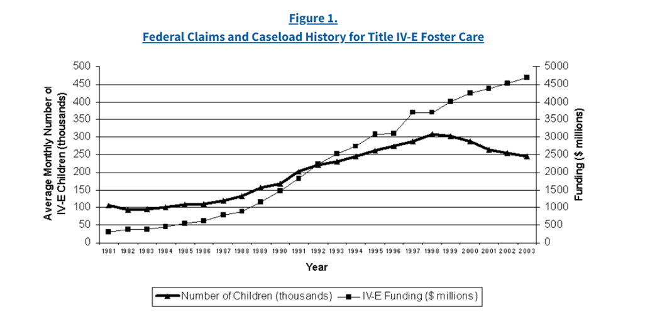
$5 Billion Dollars a Year for a System that Fails & Hurts more Children and Families than it helps?

Slide 11
Categories for Funding
Foster care maintenance payments for eligible children (matched at the Medicaid rate which varies by State and by year, but currently ranges from 50 to 80%)
Short- and long-term training for State and local agency staff who administer the title IV-E program, including those preparing for employment by the state agency, as well as for foster parents and staff of licensed child care institutions in which title IV-E eligible children reside (75% federal match)
Administrative expenditures necessary for the proper and efficient administration of the program (50% federal match)
Costs of required data collection systems (50% federal match)

Slide 12
Eligibility Requirements for Title IV-E Foster Care
Continuation in the home would be contrary to the child's welfare, or that placement in foster care would be in the best interest of the child.
Note: This standard is vague and immeasurable. Decided by a judge with little to no background in child development, family dynamics, cultural background, and language etc.
Reasonable efforts determination: State agency must obtain a judicial determination within 60 days of a child's removal from the home that it has made reasonable efforts to maintain the family unit and prevent the unnecessary removal of a child from home
Note: This standard is vague, lacks measurable outcomes, and the absence of evidence demonstrates the lack of valid attempts to maintain the family unit
State agency placement and care responsibility:
Note: The overwhelming evidence demonstrates that children in Foster Care have a high runaway rate, a high abuse rate, and simple disappearance of thousands of children in Foster care
Pre-welfare reform AFDC eligibility:
Note: The State must document that the child was financially needy and deprived of parental support at the time of the child's removal from home

Slide 13
Eligibility Requirements for Title IV-E Foster Care
Licensed Foster Family Home or Child Care Institution
Note: Many states have watered down their oversight/licensure standards. Example: Visits 1.5 years in place of yearly
Criminal background checks or safety checks
Note: The majority of states do a good job with Background Checks. The Safety Checks are fewer and less significant due to lack of trained and qualified employees
State agency placement and care responsibility
Note: The overwhelming evidence demonstrates that children in Foster Care have a high runaway rate, a high abuse rate, and simple disappearance of thousands of children in Foster care
Special Requirements in the Case of Voluntary Placement Determinations that remaining in the home is contrary to the child's welfare and that reasonable efforts have been made to prevent placement are not required in these cases.
Note: If Parents request Voluntary Placement in times of need, they risk losing their children forever.
There are little to no incentives to return a child to their family. While there are lots of incentives to take children permanently.

Slide 14
“Show Us the Money”
The United States government funds Child Welfare at $5 Billion Dollars a Year
Foster care funding represents 65% of federal funds dedicated to child welfare purposes $3.2 Billion
Adoption Assistance makes up another 22% $1.1 Billion
Prevention/Reunification services represent only 11% of federal child welfare program funds. $ .7 Billion
In 2019 there was approximately 422,490 children in Foster Care and increasing every year because of population growth and the many incentives states have for taking and keeping children in the system.
This equates to $11,835.00 per child per year.
It would be more cost effective to focus on early intervention, family preservation, reunification, and “Kinship Care”?

Slide 15
Federal Foster Care Financing: How and Why the Current Funding Structure Fails to Meet the Needs of the Child Welfare Field | ASPE (hhs.gov)
How to Become a Foster Parent - HRT AZ
Foster Care Funding and Federal Programs – FindLaw
https://www.statista.com/statistics/255404/number-of-children-in-foster-care-in-the-united-states-by-race-ethnicity/
https://www.aecf.org/resources/2021-kids-count-data-book?msclkid=ff2c76014f091d7241ab1789196bdf43&utm_source=bing&utm_medium=cpc&utm_campaign=Foster%
20Care%20-%20Topics&utm_term=what%20is%20foster%20care&utm_content=What%20is%20Foster%20Care
https://aspe.hhs.gov/reports/federal-foster-care-financing-how-why-current-funding-structure-fails-meet-needs-child-welfare-field-0#:~:text=Background%20and%20History%20of%20Title%20IV-E%20Foster%20Care,time%20foster%20care%20was%20entirely%20a%20State%20responsibility.

