Slide 1
State & National CPS Survey
By Professor Steven R. Isham

Slide 2
“We take these stories to heart. We use them as fuel to motivate us to action as we work together to end human trafficking once and for all.”
– U.S. Secretary of State, Michael R. Pompeo
The U.S. providing 50 to 60% of those trafficked from foster care.
Michael R. Pompeo – U.S. Secretary of State
So far states like Arizona have reaped the financial rewards of a corrupt system of “Kiddie Kourts” with questionably competent judges, attorneys, guardian ad litems, scared Child Protective Service (CPS) case managers and supervisors and so called expert witnesses that would never, ever be allowed in the adult criminal justice system.

Slide 3
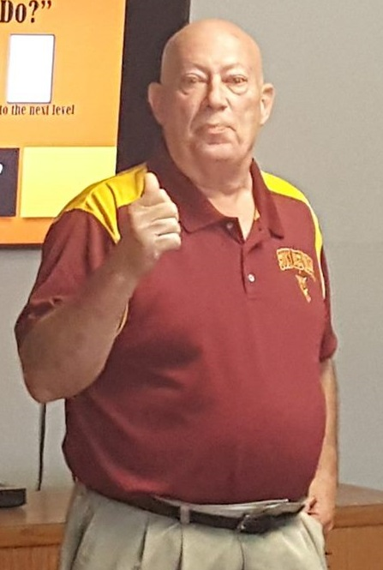

Steven Isham brings 47 years of experience and interacting with every single system that could possibly touch the life of a child and their family. He literally wrote the book on child & family advocacy, wrote the curriculum on child & family advocacy, and taught it for 17 years in the community colleges in Arizona.

Slide 4
This State & National Survey completed by 350 random individuals provides a window into America’s Child Protective Services (CPS) System
The slides that follow mirror how these 350 individuals perceive Child Protective service

Slide 5
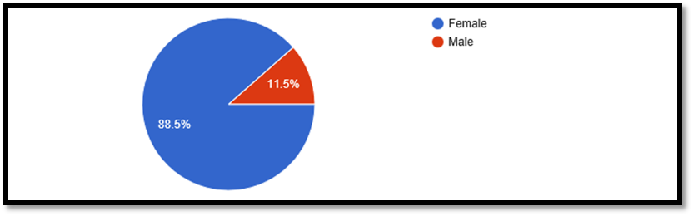
Gender 348 responses

Slide 6
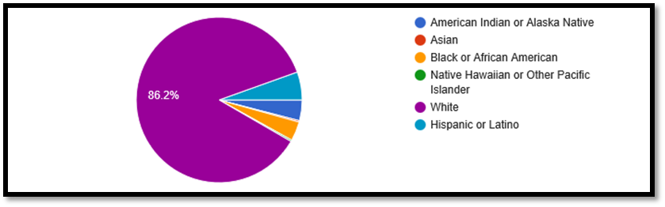
Race 347 responses

Slide 7
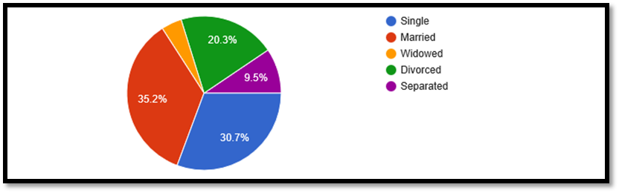
Marital Status 349 responses

Slide 8
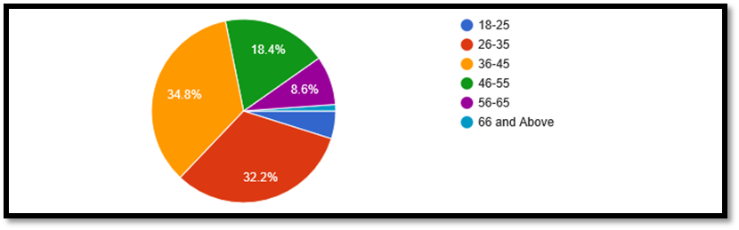
Age 348 responses

Slide 9
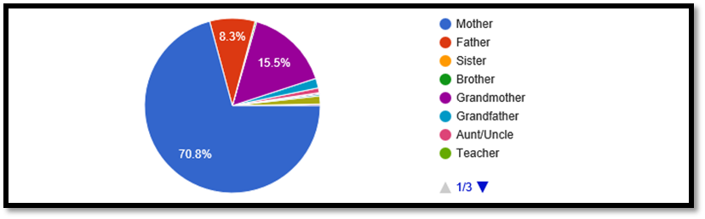
Title/Role 336 responses

Slide 10
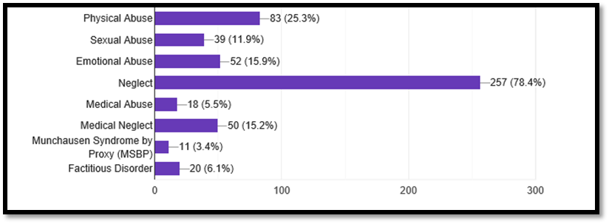
Accusations 328 responses

Slide 12
Accuser(s) 332 responses
Accuser | Number / %
Social Worker | 173 = 52.1%
Hospital | 41 = 12.3%
Physician | 25 = 7.5%
Spouse | 16 = 4.8%
Nurse | 13 = 3.9%
Ex Boyfriend | 2 = 0.6%
Faith Leader | 2 = 0.6
Other | 54 = 0.3 each

Slide 14
Care while in State Custody 245 responses
Physical Abuse | 109 44.5%
Sexual Abuse | 47 19.2%
Emotional Abuse | 200 81.6%
Neglect | 153 62.4%
Medical Abuse | 71 29.0%
Medical Neglect | 91 37.1%
Medical Malpractice | 30 12.2%
Genetic Abnormalities | 11 4.5%

Slide 27
Author’s Critical Highlights – Part 1
1. Children: are subjected to a host of activities and procedures directed by the state agencies.
2. Women: are the primary family victim of child protective services (88.5%)
3. Race: There is an over representation of Black/African American & Hispanic/Latino children in foster care
4. Accusations: The significantly high use of the vague and subjective accusation of “neglect” and “medical neglect” is the primary reason for taking children
5. Household Income: More than half the respondents earned less than $30,000. Per year
6. Neglect: 78.4% of seized child were from the vague and subjective term “Neglect”
7. Warrant: Only 29 out of 312 surveyed said a “warrant” was involved
8. Threats/CPS: 176 respondents out of 312 identified being threatened (56.4%)
9. State Custody-Emotional Abuse: 200 of 245 respondents site Emotional Abuse (81.6%) in state custody

Slide 28
Author’s Critical Highlights – Part 2
9. State Custody-Emotional Abuse: 200 of 245 respondents site Emotional Abuse (81.6%) in state custody
10. State Custody-Neglect: 153 out of 245 respondents site Neglect (62.4%) in state custody
11. Education: Identified issues include lack of transferring school records/health records and significant Discipline Problems (58.5%)
12. Case Manager: Out of 338 respondents 311 (92%) said the case manager lied/misrepresented their child; said the case manager withheld information/evidence 274 out of 263 (51.1%) respondents said the attorney for the state collaborated with the guardian ad litem of 338 (81.1%); and only 7 out of 338 (2.1%) said the case manager helped their child and only 2 out of 338 said the case manager helped them.
13. Guardian ad Litem: 172 out of 281 (61.2%) respondents said the guardian ad litem (the eyes and ears of the court) never spoke with or interviewed them. 194 out of 281 respondents said the guardian ad litem lied or misrepresented them to the court
14. My Child's Attorney: 141 out of 196 (71.9%) of respondents their child’s attorney withheld evidence in the case.
15. Attorney for the State: 193 out of 263 (73.4%) respondents said the attorney withheld evidence and 145

Slide 29
Author’s Critical Highlights – Part 3
16. My Attorney: 191 out of 328 respondents (58.1%) stated their attorney advised them to “just go along” and 180 out of 328 respondents (54.1%) stated their lawyer withheld evidence to their innocence was withheld from the court.
17. Therapist/Counselor: Only 15 respondents out of 222 (6.8%) said the therapist respected their family and only 16 out of 222 (6.8%) said the therapist maintained fairness, honesty, and impartiality
18. Juvenile Court Judge on the Case: 116 out of 244 (47.5%) respondents stated the juvenile judge had conversations with participants in the case without their knowledge or the knowledge of their attorney. Oddly, only 5 out of 244 respondents said the trial transcripts matched what was said and done in the courtroom.
19. Expert Witness for the State: Only 4 out 175 respondents said the expert witness for the state acted professionally; 55 out of 175 respondents (31.4%) stated the expert witness performed multiple activities outside the scope of authority; and only 9 out of 175 (5.7%) respondents said the expert witness maintained fairness, honesty, and impartiality.
Special Note: 124 out of 175 (70.9%) of respondents stated the expert witness lied/misrepresented my child and me to the court
20. Drugs/Pharmaceuticals/Research/Medical: 128 out of 202 (63.4%) of respondents said their child had medical procedures without their knowledge and 49 out of 202 (24.3%) said their child had surgery while in state custody w/o their knowledge or permission.

Slide 30
Conclusions
In my 45+ year career I have seen every single one of these issues in the survey multiple times.
They do exist every day in America somewhere and to some degree.
“It was once said that the moral test of government is how that government treats those who are in the dawn of life, the children; those who are in the twilight of life, the elderly; and those who are in the shadows of life, the sick, the needy and the handicapped.” - Hubert H. Humphrey
Clearly and measurably state and national government has failed the moral test when it comes to our children.
The measurement of our government’s failure are those individuals in our prisons, the children in our foster homes, the children in our homeless population, the children in sex trafficking that come from foster care, and in our cemeteries.
Like the kids say to each other: “What you gonna do about it?”

