Slide 1
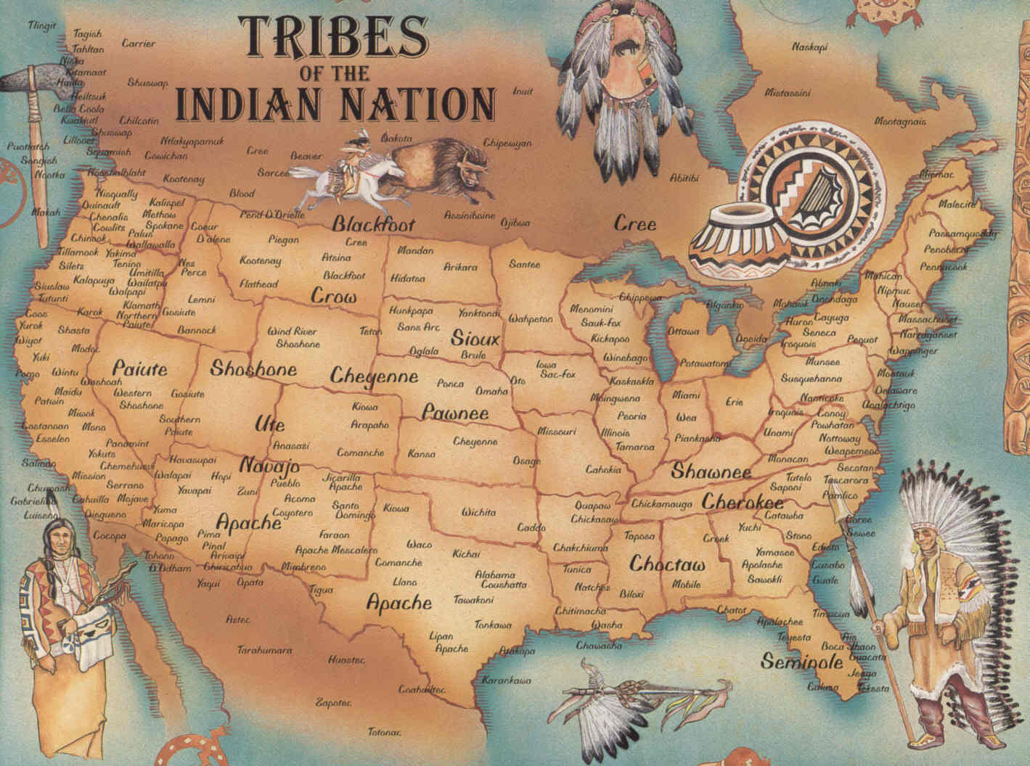

Slide 2
The constitution is superior to any law or treaty. The United States Government promised and guaranteed tribes with protection, food, clothing, medical care, education and any other services in exchange for peace and land. When the American Indian relinquished their homeland and agreed to live on smaller territory they paid in full for anything they would ever need to live in peace and harmony with nature and their tribe. But the government is structured to control laws and have the power to make laws to disappear or reappear. Nothing explains better than history. This country has never had plans for the north American Indian to be part of Americans future. The thief of their land. The thief of their children and the separation of their land and the genocide of millions of families is proof of a sinistered plan of elimination.
Which functioned under the model, kill the Indian, save the man. The boarding schools were found all across the United States in the late 1800. The forced simulation of the North American Indian children into the white mans Christian religion proved to be devastating. Upon arriving to the schools children were stripped of their clothing, washed in chemical lye bath and put into uniforms, their hair was cut off and they were given Christian names. They were often punished or beaten for speaking their native language or practicing any tribal traditions. children were forced to work on farms to fund schools and the construction of new buildings. Living arrangements were horrible and disease ran rampid, tuberculosis measles and other highly infectious disease. death was common. sexual abuse, rape by priest and staff was part of daily life. native boarding schools was the pit of hell for native children for decades. The atrocities are not acknowledged, the secrecy, trauma and death have clearly been hidden. The genocidal tactics are still applied today on the American Indian people.

Slide 3
https://www.historyassociates.com/legacy-american-indian-boarding-schools-united-states/
Confrontation with the Past:
The Legacy of American Indian Boarding Schools in the United States
By Justin Broubalow, Research Historian
In May 2021, Canadian First Nation (indigenous) investigators found the remains of 215 children, some as young as three years old,buried in unmarked graves at the former Kamloops Indian Residential School in Kamloops, British Columbia, Canada. A month later, investigators uncovered another 751 unmarked graves at the Marieval Indian Residential School in Saskatchewan. Marieval Indian Residential School, like the one in Kamloops, was run by the Catholic Church on behalf of the Canadian federal government, with the goal of forcibly assimilating First Nation children into white Canadian society.
Now, as a result of the findings at Canadian schools, United States Interior Department Secretary Deb Haaland, the first Native American person to serve as a cabinet secretary, announced an investigation into the American Indian boarding school system the DOI oversaw for over a century.

Slide 4
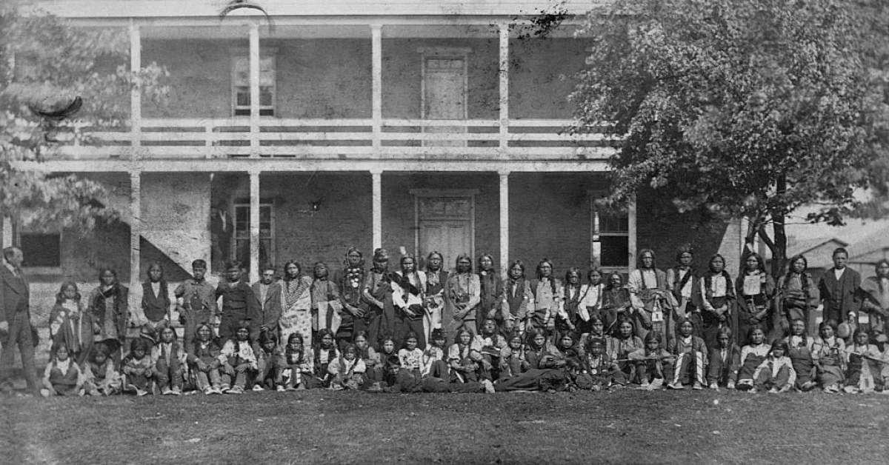
What were American Indian boarding schools, and what purpose did they serve?
American Indian boarding schools, which operated across the United States beginning in the late nineteenth century, represent a dark chapter in American history. Also called industrial schools, these institutions prepared boys for manual labor and farming and girls for domestic work. The boarding schools, whether on or off a reservation, carried out the government’s mission to restructure Native Americans’ minds and personalities by severing children’s physical, cultural, and spiritual connections to their tribes.
Many Indian boarding schools were far-removed from Native American reservations (orange areas) to minimize the influence of students’ tribes. Source: Dickinson College (annotations) and Library of Congress (map).

Slide 5
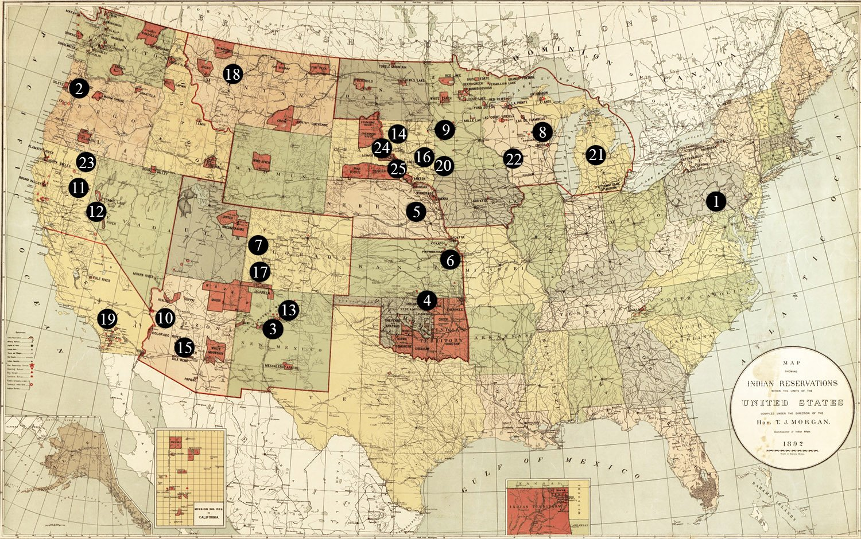
Many Indian boarding schools were far-removed from Native American reservations (orange areas) to minimize the influence of students’ tribes. Source: Dickinson College (annotations) and Library of Congress (map).

Slide 6
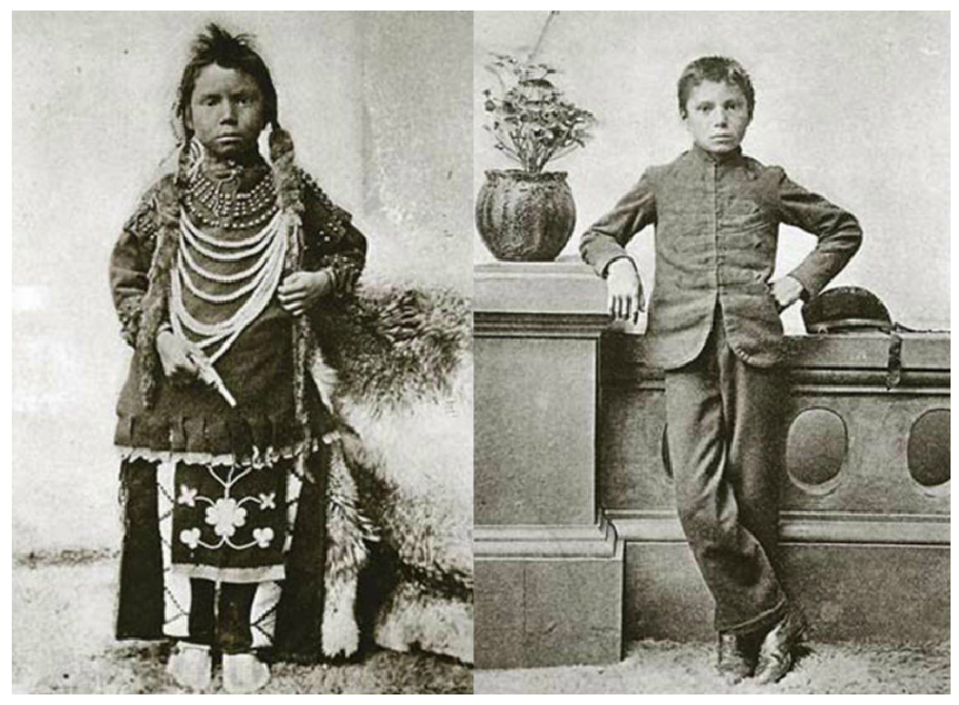
A Policy of Family Separation for Native Americans
Similar to the modern day Child Protective Services transition of children; The boarding school system dates back to the mid-nineteenth century, when Indian Agents—federal representatives responsible for carrying out policy toward Native Americans—forcibly abducted children as young as four from their homes and enrolled them in church- and government-run boarding schools, often far-removed from their tribes and families.

Slide 7
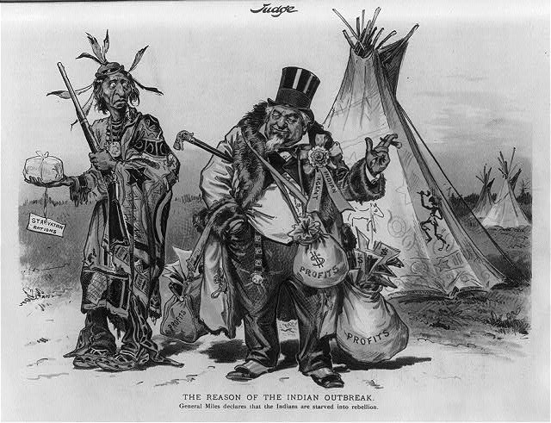
While this cartoon relies on stereotypical imagery, it correctly points out that some Indian agents were corrupt and skimmed off the top of government-provided annuities or colluded with white settlers to steal Native American land.
Source: Library of Congress.
“History has a way of repeating itself.”
The similarities between modern day Child Protective Services and the abduction and transition of Native American children away from their families is hauntingly the same.

Slide 8
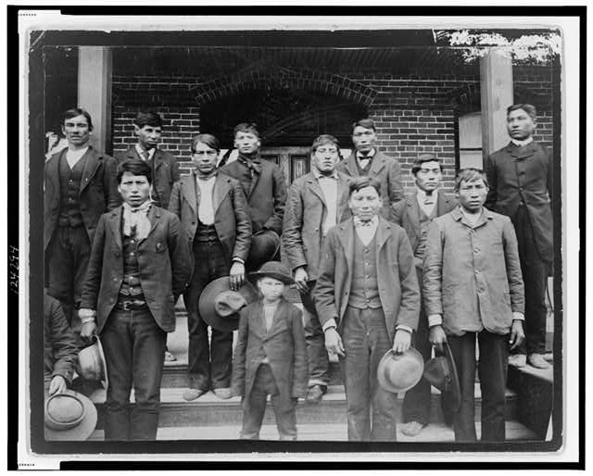
Against Native American cultural customs, male students at the Carlisle Indian Industrial School were required to cut their hair short in line with white Western standards. Source: Library of Congress.
Today Child Protective Services does not have a specific focus for transitioning children from their families other than anything different from the family they are taken from.
“Woke” social workers seek to transition children from their family, religion, history, culture, gender, sexuality, and other elements of being a person.
The focus is proving that what they learned in college and on the job from their peers is the goal rather than what is in the best interest of the child.

Slide 9
History
On March 3, 1891, Congress authorized the Commissioner of Indian Affairs to create regulations that required Native American children to attend these boarding schools. It also authorized the Indian Office to withhold rations, clothing, and other annuities from Native American parents or guardians who would not send their children to school.
Then-Lieutenant Richard H. Pratt, a veteran of the post-Civil War conflicts between the United States government and Native American tribes, created the template for those federal boarding schools when he founded the Carlisle Indian Industrial School in 1879. After teaching captives from the Indian wars about American culture and how to speak English, Pratt became a staunch assimilationist. He believed that the federal government could and should “Americanize” Native Americans. To this end, he offered a variation of the offensive slogan—popular in the American West—that stated the only good Indian was a dead one. Instead, the proper goal, Pratt claimed, was to “kill the Indian…and save the man.”
The Child Abuse Prevention and Treatment Act (CAPTA), passed by the federal government in 1974 and reauthorized in 2010, is the largest body of legislation with regard to the fair, ethical, and legal treatment of children and is intended to keep them free from all forms of abuse including physical, sexual, emotional, and psychological.
This law meant well but in the long run it has done as much damage as it has good for children and the American family.

Slide 10
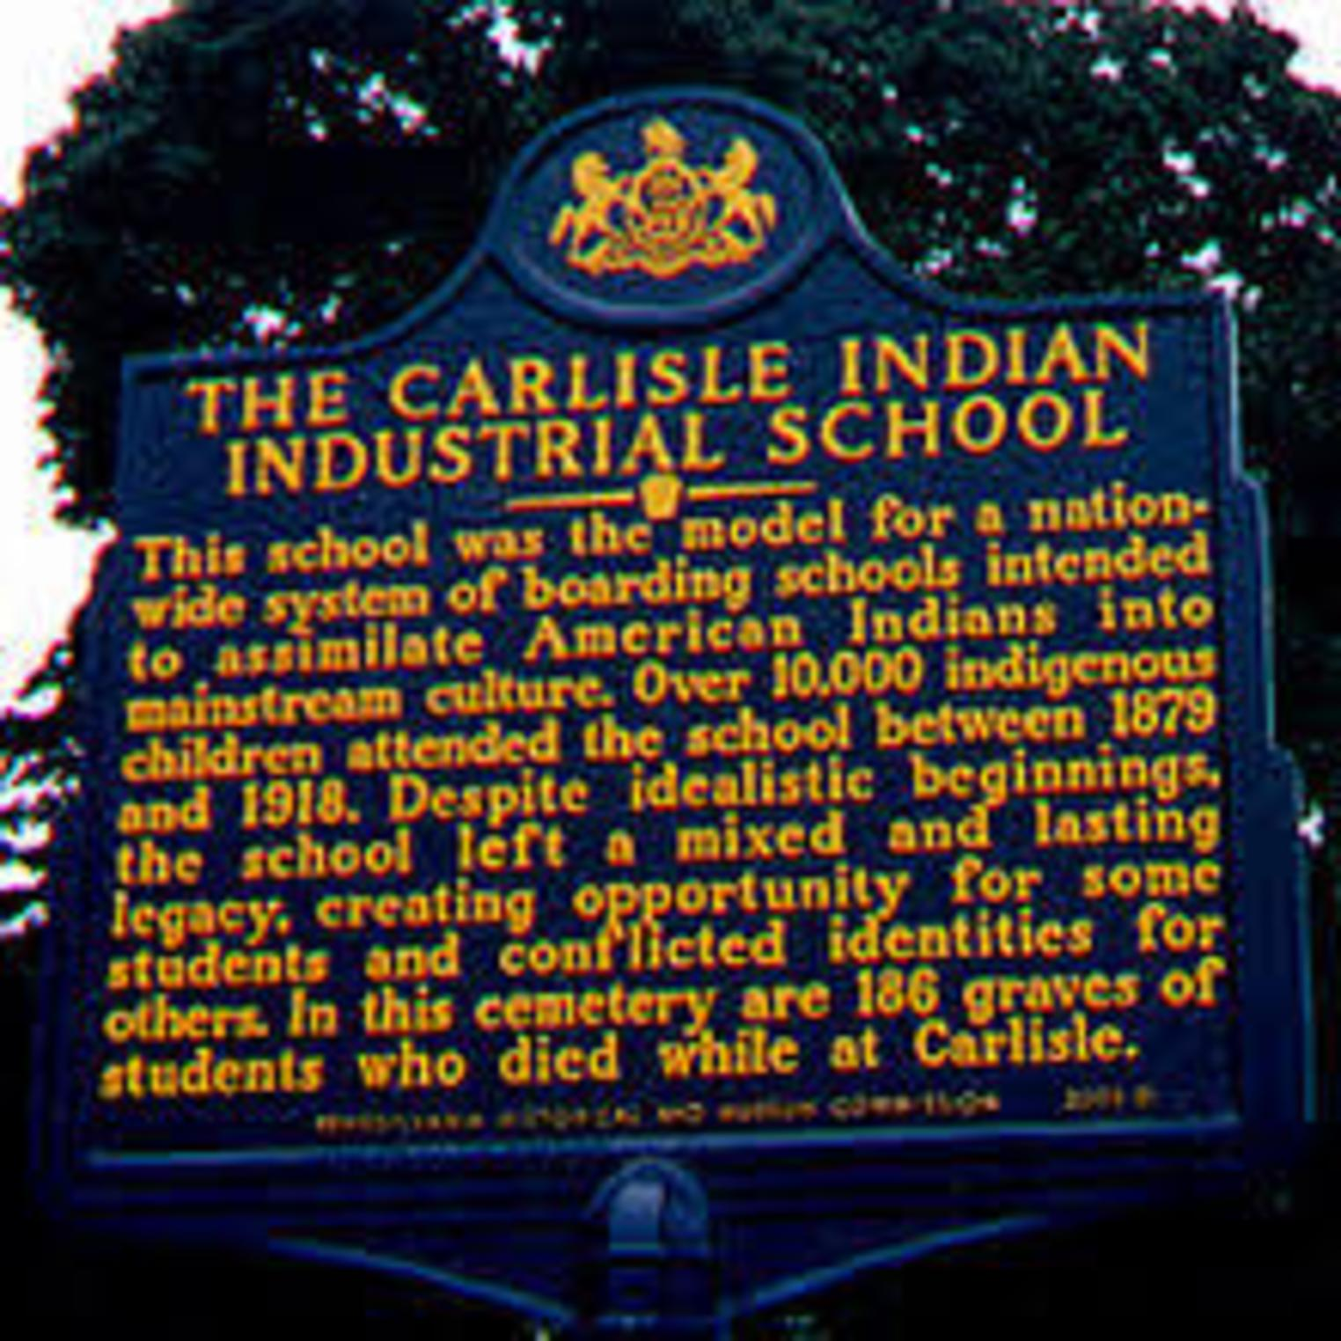
Carlisle Indian Industrial School
From Wikipedia, the free encyclopedia
Jump to navigationJump to search
Carlisle Indian Industrial School
U.S. National Register of Historic Places
U.S. National Historic Landmark
Pennsylvania state historical marker
Carlisle Indian School Logo.png
Carlisle Indian School logo
Carlisle Indian Industrial School is located in PennsylvaniaCarlisle Indian Industrial School
Show map of Pennsylvania
Show map of the United States
Show all
Location 122 Forbes Ave
Carlisle, Pennsylvania
Area 24.5 acres (9.9 ha)
Built 1757 and after
Architectural style Colonial Revival
NRHP reference No. 66000658[1]
Significant dates
Added to NRHP October 15, 1966[1]
Designated NHL July 4, 1961[3]
Designated PHMC August 31, 2003[2]
From 1879 until 1918, over 10,000 Native American children from 140 tribes attended Carlisle.[4]
The United States Indian Industrial School in Carlisle, Pennsylvania, generally known as Carlisle Indian Industrial School, was the flagship Indian boarding school in the United States from 1879 through 1918. It took over the historic Carlisle Barracks, which was transferred to the Department of Interior from the War Department. After the United States entry into World War I, the school was closed and this property was transferred back to the Department of Defense. All the property is now part of the U.S. Army War College.
Founded in 1879 under U.S. governmental authority by Lieutenant Richard Henry Pratt, Carlisle was the early federally funded off-reservation Indian boarding school initiated by the U.S. government. This was similar to the Choctaw Academy in Scott County, Kentucky, which was the first boarding school, but was initiated by Choctaw leaders and then funded by the U.S. government through the 1819 Civilization Act.[5] In his own words, Pratt's motto was, "Kill the Indian, save the man;" a mentality which was then applied to the cultural assimilation efforts of the larger American Indian boarding school system [6] Pratt wrote that he believed that Native Americans were 'equal' to European-Americans, and that the School worked to immerse students into mainstream Euro-American culture, believing they might thus be able to advance and thrive in the dominant society, and be leaders to their people.[7][8]
Pratt founded the Carlisle Indian Industrial School at the site of an unused cavalry barracks at Carlisle, Pennsylvania, organizing the institution along rigid military lines. Pratt’s program of half days in the classroom and half days spent at performing some sort of manual labor soon became the standard Indian boarding school curriculum. Government expenditures for boarding schools were always small, and the schools exploited the free labor of Native American children to function.
Carlisle Indian Industrial School
From 1879 until 1918, over “10,000” Native American children from 140 tribes attended Carlisle.
The United States Indian Industrial School in Carlisle, Pennsylvania, generally known as Carlisle Indian Industrial School, was the flagship Indian boarding school in the United States from 1879 through 1918. It took over the historic Carlisle Barracks, which was transferred to the Department of Interior from the War Department. After the United States entry into World War I, the school was closed and this property was transferred back to the Department of Defense. All the property is now part of the U.S. Army War College.
https://en.wikipedia.org/wiki/Carlisle_Indian_Industrial_School

Slide 11
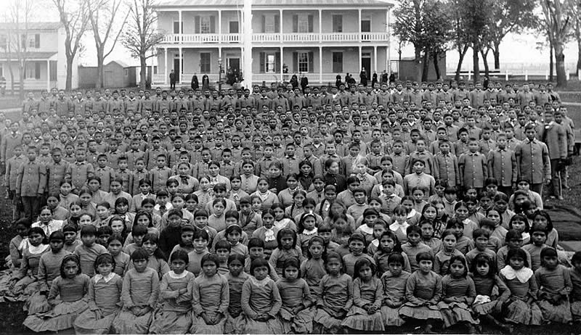
https://en.wikipedia.org/wiki/American_Indian_boarding_schools#History_of_education_of_Native_Americans_by_Europeans

Slide 12
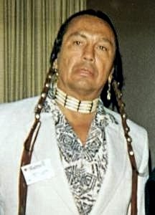
1989 - American Indian Activist Russell Means testifies at Senate Hearing
Russell Charles Means (November 10, 1939 – October 22, 2012) was an Oglala Lakota activist for the rights of Native Americans, libertarian political activist, actor, musician, and writer. He became a prominent member of the American Indian Movement (AIM) after joining the organization in 1968 and helped organize notable events that attracted national and international media coverage.
Means was active in international issues of indigenous peoples, including working with groups in Central and South America and with the United Nations for recognition of their rights. He was active in politics at his native Pine Ridge Indian Reservation and at the state and national level.
Beginning an acting career in 1992, he appeared on numerous television series and in several films, including The Last of the Mohicans and Pocahontas and released his own music CD. Means published his autobiography Where White Men Fear to Tread in 1995.
Russell Means - Statement to Congress
https://www.youtube.com/watch?v=fRipKGsLkTQ

Slide 13
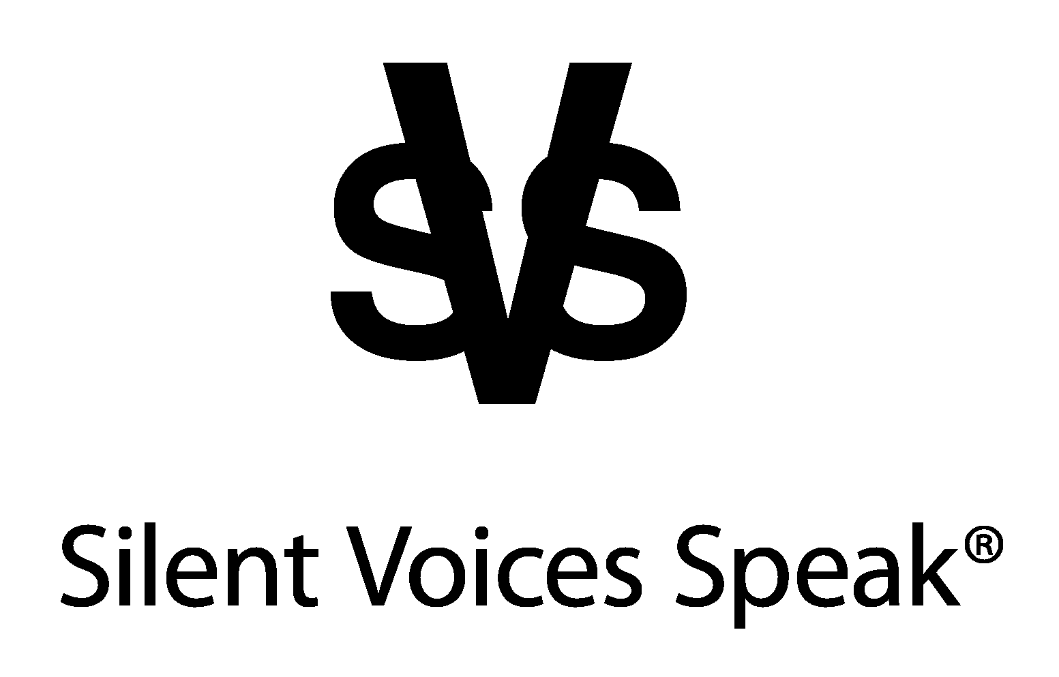
The government has been teaching and living a lie. When you live a lie, the truth will always tell on you. The system has failed the families and the children. It is a lie that you do not make money when adopting a foster child. It is a lie that you do not make money on children in foster care. It is a lie that you want to just love them. It’s a lie that you are not racist. It’s a lie you want to do what is in the best interest of the children. The truth is you steal the children and kill their identity. As you can see these genocidal tactics have been enforced on tens of millions of families and children for hundreds of years. These tactics have directly affected North American Indians, Africans/ Africian Americans and Latino/Mexican Americans.
By: Darrell Smith
The system has failed. What is the price of a child’s identity?

Slide 14
If you are neutral in situations of injustice, you have chosen the side of the oppressor. If an elephant has its foot on the tail of a mouse and you say that you are neutral, the mouse will not appreciate your neutrality.
Desmond Tutu
www.svsloud.org
We meet in Zoom Meeting:
The 2nd Thursday of every month
6:00PM visit www.svsloud.org for the link to join in the conversation.

