Slide 1
Hypothermia Management
“You’re Not Dead Until You’re Warm and Dead”
Libby Windell, DO
Director of Trauma, Salem Hospital

Slide 2
Objectives
Define hypothermia
Understand the physical exam findings in hypothermia
Determine necessary workup/imaging
Understand the various modes of treatment and special considerations

Slide 3
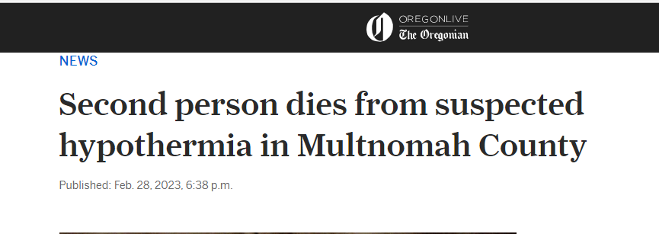
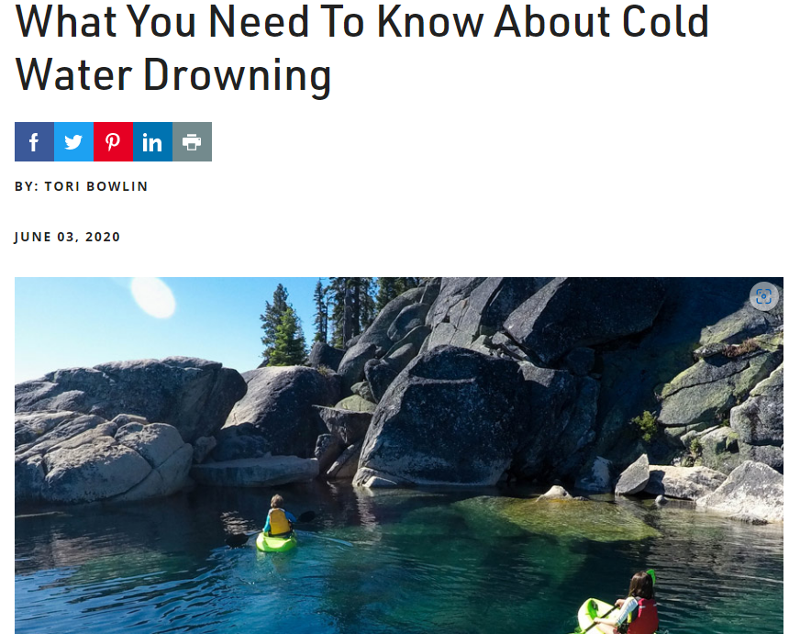
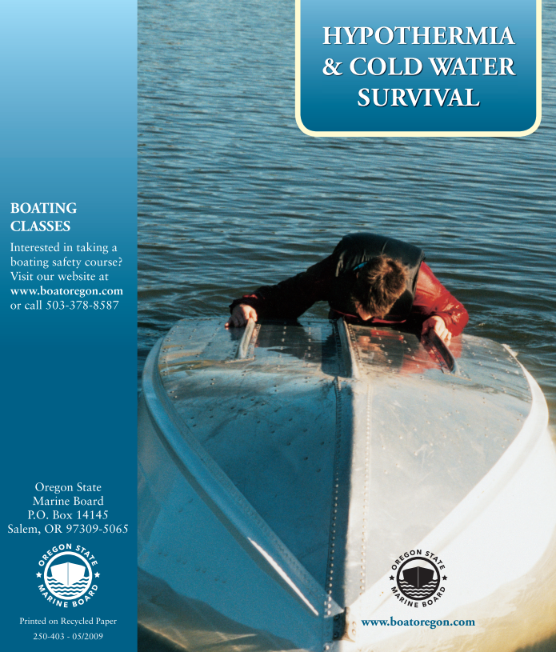
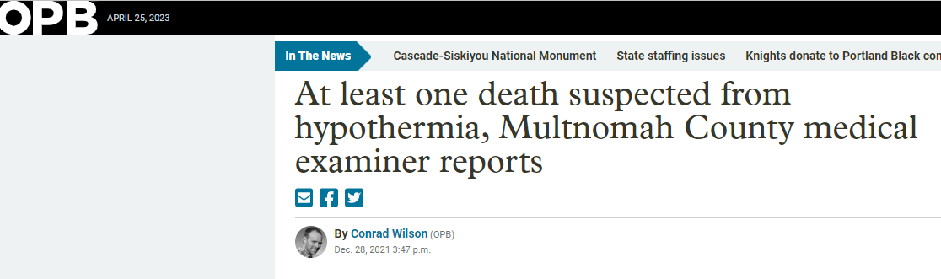

Slide 4
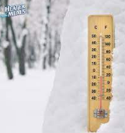
Hypothermia Definition
Core temperature < 35°C (95°F)
Mild: 32-35°C (90-95°F)
Moderate: 28-32°C (82-90°F)
Severe: below 28°C (82°F)
Profound: <24°C (75°F)
Hypothermia with associated comorbidities or trauma is considered more severe
Notes:
Need a low-reading temperature probe → standard oral thermometers do not read below 34°C (93°F)
Measure Esophageal temperatures in patients with tracheal tube or supraglottic airway in place
Rectal probe readings may rise following peritoneal lavage or fall if adjacent to cold feces
esophageal probes advanced to the upper two-thirds of the esophagus may read falsely high if heated, humidified oxygen is used.
Infrared tympanic thermometers and so-called temporal artery thermometers are not accurate
Bladder temperatures are commonly used and are adequate in mild to moderate hypothermia. However, bladder and rectal temperatures should not be used in critical patients during rewarming. Changes in rectal and bladder temperatures significantly lag behind core temperature changes during rewarming. Core temperature may be increasing in response to rewarming while rectal and bladder temperatures are still dropping.

Slide 5

Hypothermia
Risk Factors:
Homelessness
Alcohol and drug abuse
Cold water submersion
Medical condition → trauma, DM, CVA, hypothyroidism, anorexia, SCI, Parkinson's
Medications → antidepressants, antipsychotics, narcotics, sedatives
Mountaineering accidents
Mental Illness and Suicide attempts
Elderly or young children
Causes ~1500 deaths annually
Notes:
Rates of death increasing

Slide 6
Physical Exam
Vitals:
Mild – tachypnea, tachycardia, hyperventilation
Moderate – bradycardia (can see tachycardia in hypoglycemia, hypovolemia or overdose), hypotension, hypoventilation
Severe – hypotension, cardiovascular collapse
Notes:
Thermoregulation ceases below 30 degrees C.
Renal cell dysfunction and decreased levels of ADH lead to production of large volume of dilute urine. Diuresis plus fluid leakage into the interstitial tissues causes hypovolemia
Vasoconstriction may mask hypovolemia which then manifests as sudden shock or cardiac arrest w/ rewarming when peripheral vasculature dilates
Hypothermia in cold water immersion triggers diving reflex and may protect brain from hypoxia by decreasing metabolic demands

Slide 7
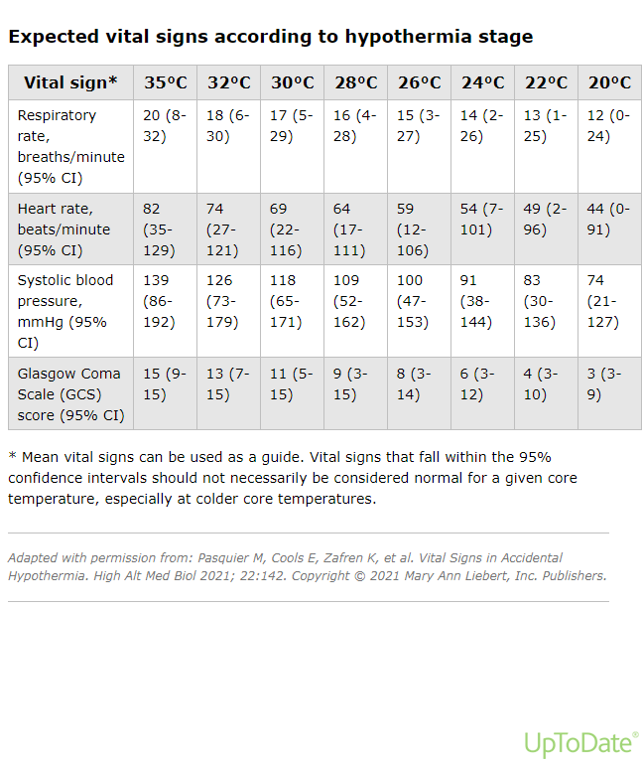

Slide 8
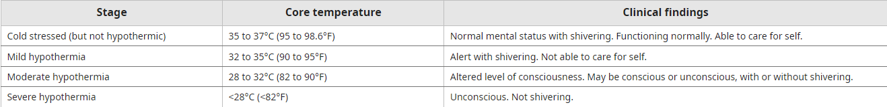
Physical Exam
***Neuron function stops below 20°C and Shivering ceases below 31°C***
Notes:
Fixed and dilated pupils are not a contraindication to stopping CPR. Apparent rigor mortis is not a reliable sign of death. Mandibular rigidity can simulate rigor mortis
Neuro exam:
Mild – ataxia, dysarthria, impaired judgement (suggest CNS pathology if pt comatose)
Moderate – CNS depression
Severe – areflexia, coma

Slide 9
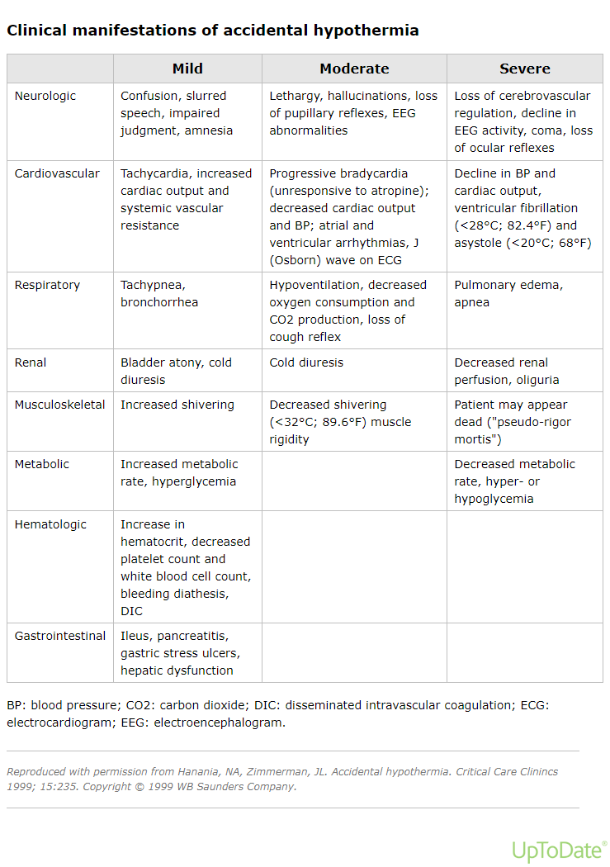
Physical Exam
Notes:
Resp:
CO2 retention and resp acidosis w/ severe hypothermia
Bronchorrhea due to decreased ciliary motility and non-cardiogenic pulm edema
Hypoxia can occur due to decreased offloading of O2 as Hg increasingly binds O2 as temp drops.
Renal:
Impaired renal concentrating abilities
Cold-induced diuresis and hypovolemia
Potential Rhabdomyolysis → ATN
GI:
Pancreatitis
Pancreatic necrosis
Hematologic
Hemoconcentration
Increased blood viscosity
Decreased flow in capillaries
Potential for thrombosis
Potential for DIC

Slide 10
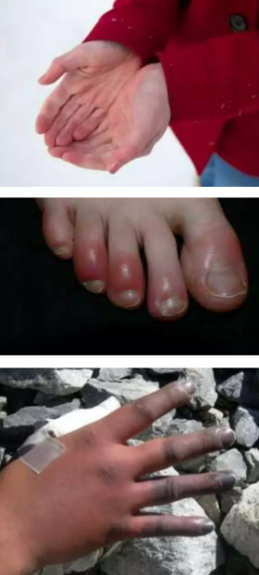
Physical Exam
MSK:
Crystallization of blood in capillaries of extremities
Cutaneous vasoconstriction occurs
Frostbite
Gangrene

Slide 11
Labs
Fingerstick glucose
Coagulation studies
CBC
Basic electrolytes, include K, Ca and Mg
BUN/Creatinine
Lactate
EKG
CXR
CK
Fibrinogen
Lipase
ABG
UDS
Cortisol/TSH
**Check labs frequently as rapid and unpredictable changes can occur**
Notes:
Consider cortisol and TSH studies in pt’s with mod-severe hypothermia who aren’t rewarming despite aggressive measures.
Hyperglycemia that persists during rewarming suggests pancreatitis or diabetic ketoacidosis.
Pancreatitis is common in hypothermia
Insulin is ineffective below 30°C
Frequent assessment necessary as rapid or unpredictable changes in electrolytes can occur
Inhibition of the enzymes of the coagulation cascade from hypothermia leads to bleeding diathesis. These tests are performed at 37C.
pH, PaCO2 and PaO2 vary with temp due to gas tensions and hydrogen ion concentrations decline as temp drops.

Slide 12
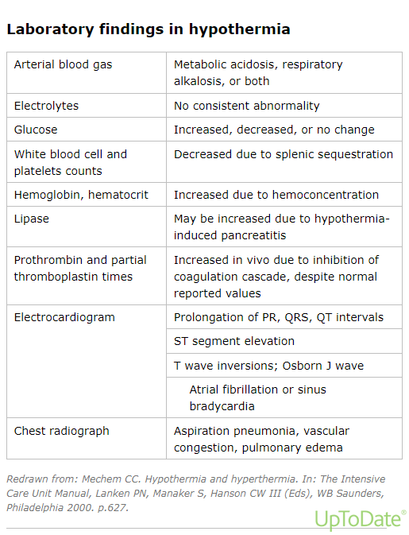
Notes:
Clinical coagulopathy may be present despite normal measured coagulation times (due to temp)
Increased Hct may reflect hemoconcentration → increases 2% for each 1°C drop in temp
May see low bicarb, suggesting anion-gap acidosis. If so → ABG or VBG.
Pancreatitis is common in hypothermia

Slide 13
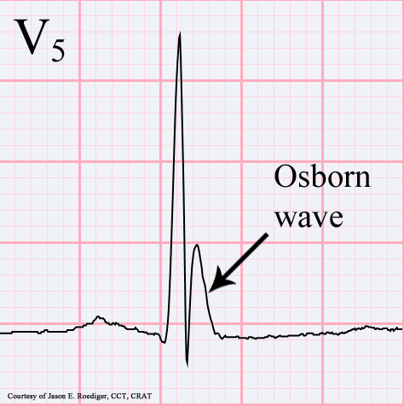
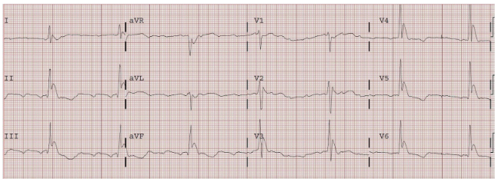
EKG
Rhythm abnormalities common
Intervals may be prolonged (PR, QRS, QTc)
Osborn J waves
Notes:
EKG changes occur due to slowed impulse conduction through K channels → prolonged intervals.
Occur at junction of QRS and ST segments, most prominent in V2 to V5
Distortion of the earliest phase of membrane depolarization
Computer may misinterpret as ischemic injury pattern
Height of the J wave is roughly proportion to the degree of hypothermia.

Slide 14
Treatment
ABCDE’s are the priority!
Intubation → obtunded or unconscious pts or pt w/ bronchorrhea
Avoid rough movements → ventricular fibrillation
Start warmed, isotonic crystalloid (40-42°C)
Start passive rewarming immediately
Vasopressors (NE preferred) if necessary
Notes:
Intraosseous (IO) access may be easier to obtain than IV access in cold, vasoconstricted patients. IO lines should be primed with a 10 mL bolus of isotonic crystalloid with or without lidocaine immediately after insertion to open the marrow space and to help ensure good flow.

Slide 15
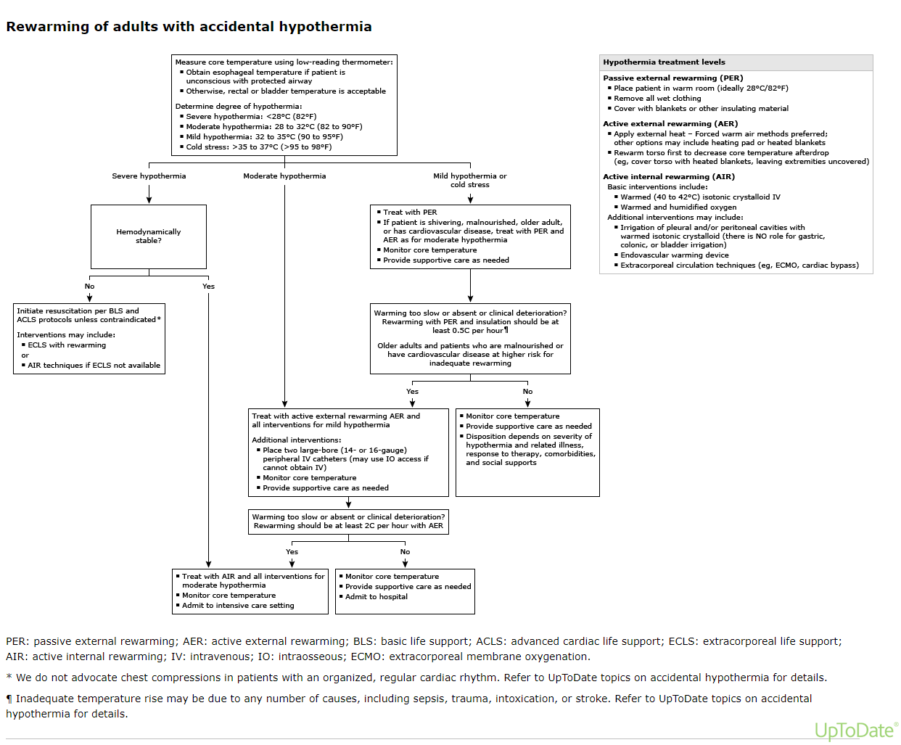

Slide 16
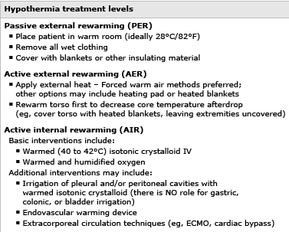
Notes:
Gastric, esophageal, bladder and rectal lavage → shown to be no better than external rewarming due to limited surface areas, limited heat exchange. Recommend as last resort when other modalities not available.

Slide 17
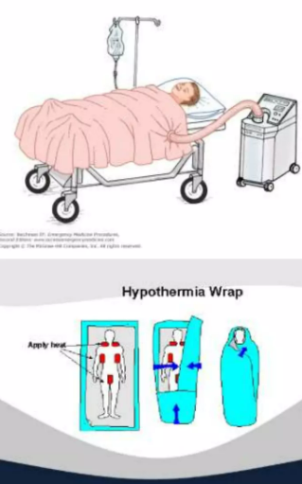
Rewarming Techniques – Mild Hypothermia
Remove wet clothing
Cover with warm blankets
Keep room temp at ~28°C (82°F)
Active External Warming:
Bair Hugger
Warm blankets
Heating pads
Radiant Heat Source
Avoid burning skin!

Slide 18
Rewarming Techniques – Moderate Hypothermia
Provide Active External Warming
Give warmed IV fluids (40-42°C) and warmed humidified O2 (42-46°C) as adjuncts (raises temp 1-2°C/Hr)
**Beware of Afterdrop**
drop in core temp caused by return of cold blood from extremities to core circulation
Rewarm Trunk first to minimize afterdrop
Notes:
Up to 30% of heat production lost through airway.

Slide 19
Rewarming Techniques – Severe Hypothermia
Perform interventions for moderate hypothermia
For HD stable pt’s → endovascular temperature catheter (Alsius) → raises temp 3-4°C/hr
For HD unstable pt’s:
ECMO
Cardiopulmonary Bypass (9.5°C/hr)
Venovenous rewarming with HD (2-3°C/Hr)
Arteriovenous rewarming
Peritoneal lavage of warmed, isotonic saline (40-42°C)
Pleural Irrigation with warmed, isotonic saline (40-42°C)
Notes:
CPB has 47% long term survival benefit
Advised for 5 degrees/hr.
Venoarterial ECMO, when available, is generally preferred to CPB because it allows prolonged oxygenation as well as circulatory support and can be used to treat noncardiogenic pulmonary edema, a common complication of hypothermia, and appears to improve survival [99,109-111]. In a meta-analysis of 23 observational studies with 464 patients, overall survival after hypothermic cardiac arrest was better with ECMO compared with CPB (44 versus 31 percent, RR 1.41, 95% CI 1.11-1.80). In survivors, 80 percent had good neurologic outcomes that were slightly worse with ECMO compared with CPB (75 versus 87 percent, RR 0.86, 95% CI 0.75-0.99) [112]. Use of ECMO requires the administration of heparin, limiting its use in cases of hypothermia associated with bleeding problems including trauma [113].

Slide 20
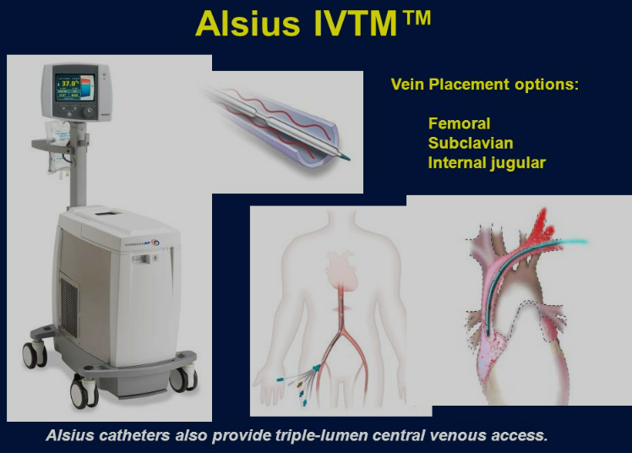
Call RRT/ICU and have them bring equipment to ED
Raises temp ~2-4°C/hr
Notes:
We are looking to trial Artic Sun 5000 – external rewarm device

Slide 21
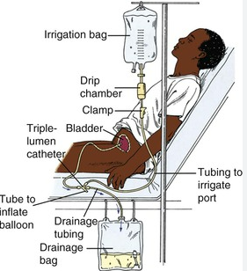
Bladder Irrigation
Triple Lumen Catheter
Instill warmed (42°C), sterile fluid
Warms at 1-3°C/Hr

Slide 22
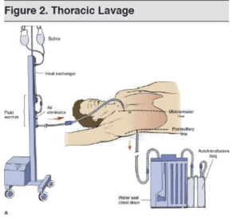
Pleural Lavage
2 large bore ipsilateral chest tubes → 38-42
1st → 2nd/3rd anterior intercostal space, midclavicular
2nd→ 5th/6th intercostal space, posterior axillary line
Instill NS at 42°C
Avoid Left side catheters in perfusing patients as can cause arrhythmias
Notes:
Leave inferior tube after rewarming

Slide 23
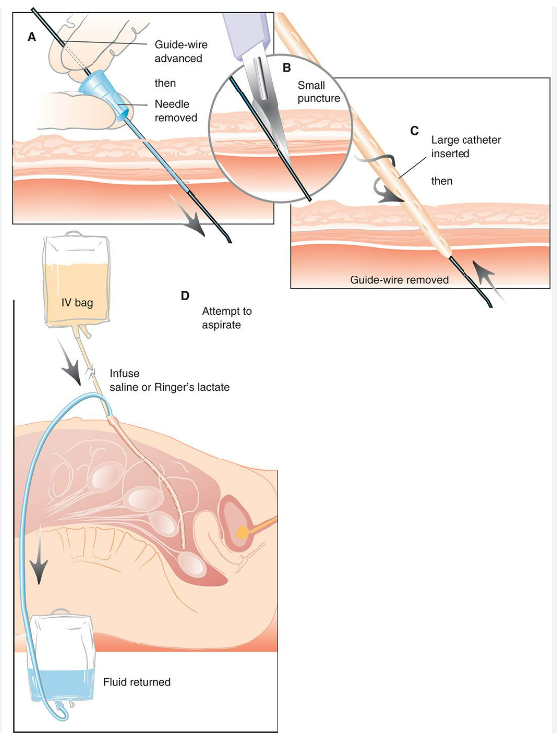
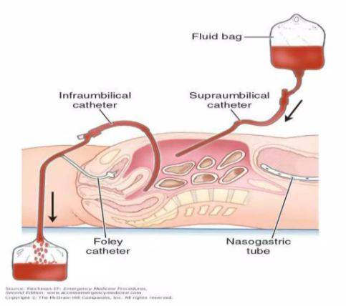
Peritoneal Lavage
Increases temp 2-4°C/Hr
Notes:
Fluid at 40-45C
Up to 12L/hr
Potassium free
Renal support when dialysate is used
CI – abdominal trauma, acute abdomen, free intraabdominal air

Slide 24
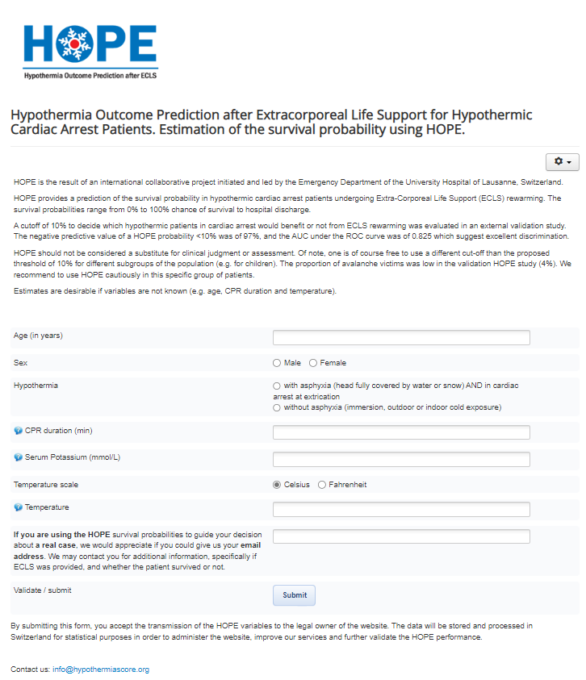
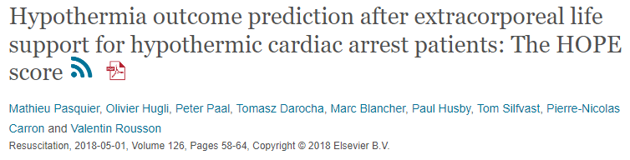
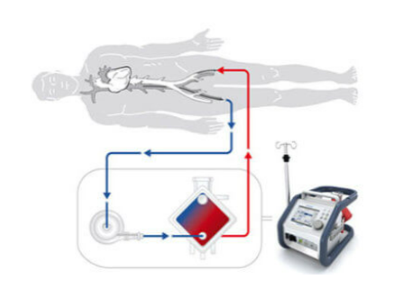
Hope (hypothermiascore.org)
Notes:
Hypothermic arrest and outcomes probability

Slide 25
Treatment of Arrhythmias
Arrhythmias may persist until patient is rewarmed
Ignore atrial arrhythmias with slow ventricular response
Ventricular fibrillation is common
Defibrillation may be attempted but is rarely successful until core temp is above 30°C
Shock 3 times, then wait until warm
Some studies recommend holding medications or space at longer intervals (epinephrine, amio, etc)
Initiate CPR in all pt’s with cardiac arrest
Notes:
Although evidence is scant, we believe that chest compressions should not be performed in patients who manifest an organized rhythm on a cardiac monitor even if they have no palpable pulses and no other signs of life. Our reasoning is that such rhythms may reflect successful perfusion that could be disrupted by chest compressions, and that any pulseless electrical activity is likely to be transient. There is little downside to withholding CPR briefly in these hypothermic patients. Should pulseless electrical activity become asystole, chest compressions should be started immediately. Chest compressions should also not be started if cardiac contractions are seen on bedside echocardiogram or pulses can be detected with blood pressure monitoring or with Doppler ultrasound. Transesophageal echocardiography (TEE) is more sensitive than standard bedside echocardiography. TEE is preferred if it is available at the bedside.
Further single attempts can be made with every 1 to 2°C increase in core temperature. Above 30°C, follow ACLS guidelines for normothermic patients.

Slide 26
Duration of Resuscitation
Resuscitative efforts should only be withheld when there is a nonsurvivable injury or fatal illness, if the body is so frozen that chest compressions are impossible or if the nose and mouth are blocked with snow or ice.
Efforts should be continued sometimes for several hours
Do NOT terminate for low end-tidal CO2 → may reflect the low metabolic rate and not poor perfusion
Notes:
Avoid hypovolemic collapse with dilation of peripheral vasculature

Slide 27
Poor Prognosis – Biochemical Markers
K > 12 mEq/L
Lactate > 13.3
pH < 6.9
Fibrinogen < 50 mg/DL → indicative for intravascular thrombosis
Ammonia > 420 mcg/dL
Elevated Na and Cr levels

Slide 28
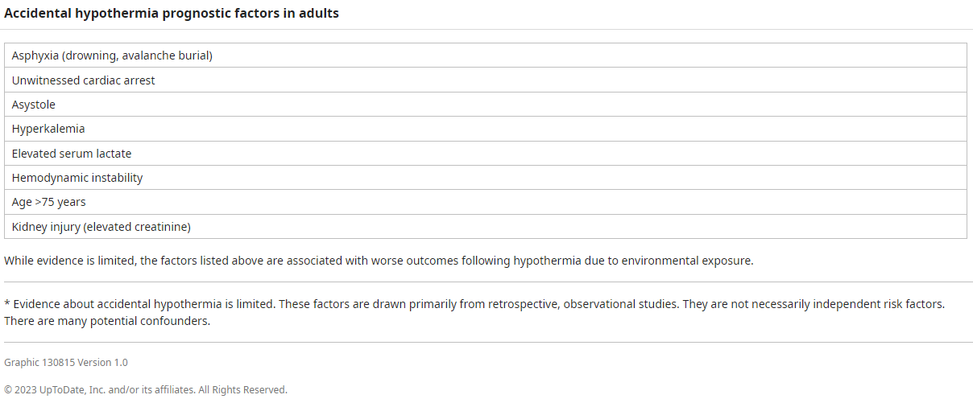
Poor Prognosis Factors

Slide 29
Failure of Rewarming
Ensure rewarming techniques are in process
Reverse contributing causes (e.g. hypoglycemia, hypothyroid, adrenal insufficiency, sepsis)
Give Empiric Abx if unable to raise core temp > 0.7°C/hr.
Consider Afterdrop and ensure central re-warming first.
Consider dexamethasone 4 mg IV
Notes:
Avoid Afterdrop → must stabilize core temp before rewarming the extremities → rewarming collapse

Slide 30
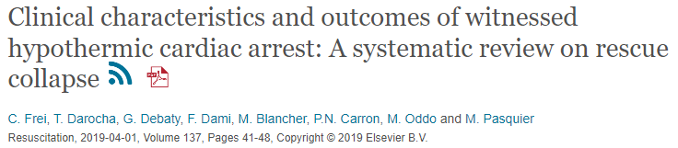
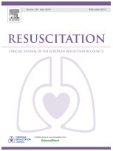
Systemic review of 214 pts, average body temp of 23.9 +/- 2.7°C
30% had asystole
Survival rate was 73%
Most survivors had favorable neurological outcomes (89%)
Notes:
highest temperature of a patient surviving hypothermic witnessed cardiac arrest without other associated risk factors for cardiac arrest was 29.4 °C
The survival rate at hospital discharge of these hypothermic cardiac arrest patients was 73% (153 of 210 patients) and most survivors had favourable neurological outcome (89%; 102 of 105 patients).

Slide 31
Conclusions
Call for help early → these are labor intensive treatments
There are multiple modalities for rewarming and all can occur simultaneously
Avoid unnecessary movements as can precipitate arrhythmias
Typical ACLS adjuncts may not be effective when temp <32°C
They are not Dead Until Warm and Dead

Slide 32
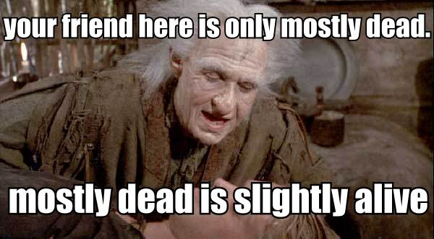

Slide 33
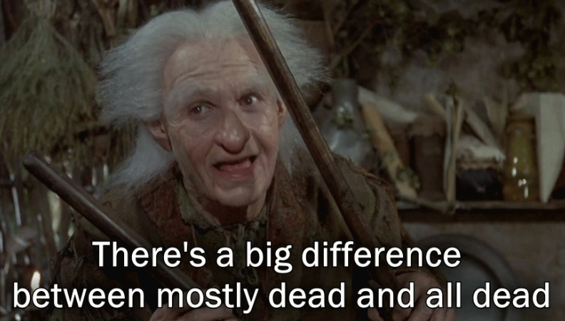
Questions?

