Slide 1

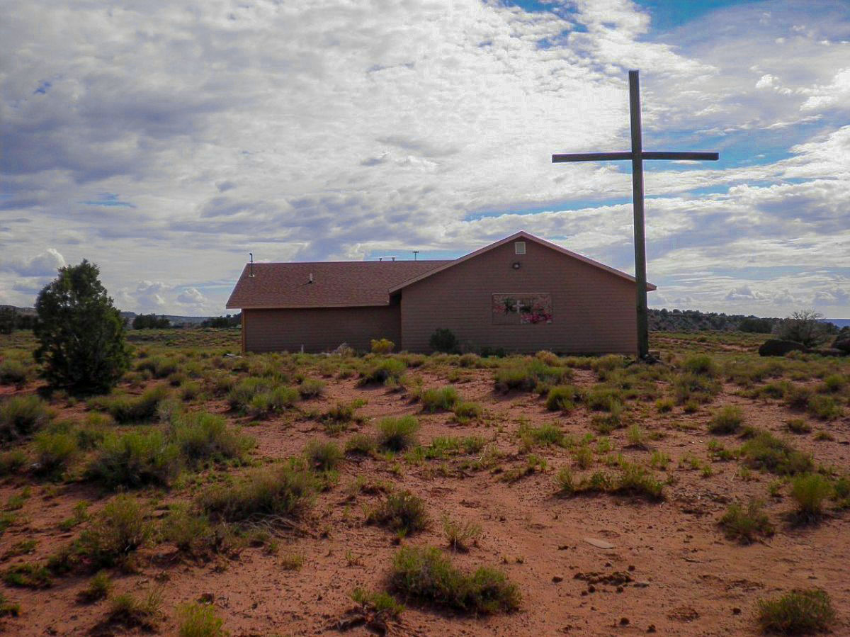

NAVAJO NATION FAMILY BURIAL & CEMETERY REGULATIONS
RDCF-07-24
April 28, 2026

Slide 2
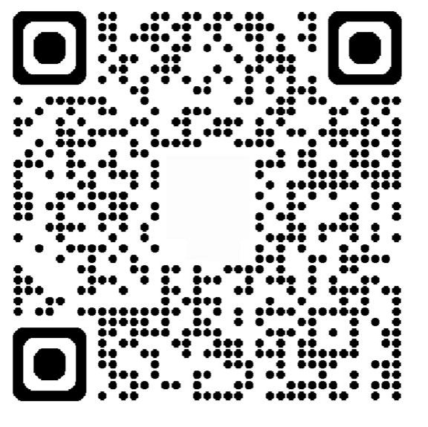


Scan Me
GLDD

Slide 3
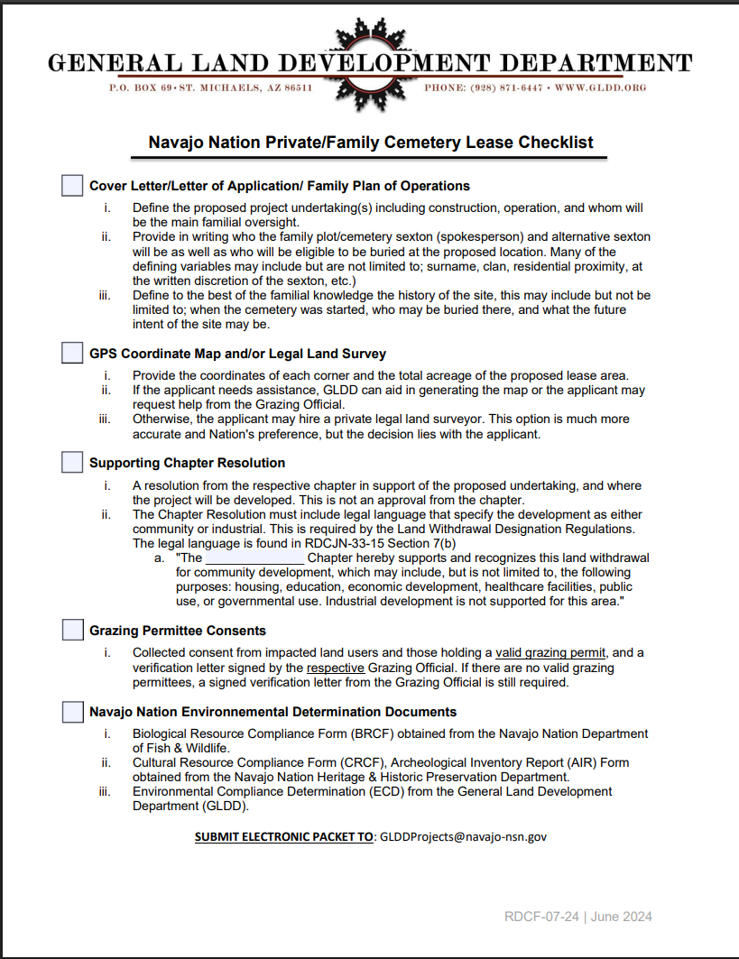
Checklist for Burial Plot Lease Applicants
To begin a land withdrawal for family plots, a representative (sexton) must submit:
A brief project summary for 0.5 acres,
GPS coordinates or legal land survey,
a chapter resolution,
grazing‑permittee consent, and
required environmental clearances Biological (BRCF) and Cultural (CRCF).
Land Withdrawal Designation RDCJN-33-15
GLDD
SUBMIT: GLDDProjects@navajo-nsn.gov

Slide 4
Legislation RDCJN-33-15​
Relating to the Resources and Development; Delegating the authority to the Director of the Navajo Land Department to approve land withdrawals on the Navajo Nation; and approving the administrative rules and regulations for land withdrawals.
Legislation Purpose:
To clarify and expedite the Land Withdrawal Designation process on the Navajo Nation Trust and Fee lands.
GLDD

Slide 5
Cover Letter / Plan of Operations
Sexton - means the person(s) authorized to sign legal records and responsible for managing operation, maintenance of the cemetery.
Define the proposed project undertaking(s) including construction, operation, and whom will be the main familial oversight. Include total acreage for land withdrawals
Provide in writing who the family plot/cemetery sexton (spokesperson) and alternative sexton will be as well as who will be eligible to be buried at the proposed location. Many of the defining variables may include but are not limited to; surname, clan, residential proximity, at the written discretion of the sexton, etc.)
Define to the best of the familial knowledge the history of the site, this may include but not be limited to; when the cemetery was started, who may be buried there, and what the future intent of the site may be.
GLDD

Slide 6
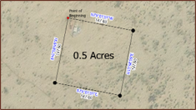
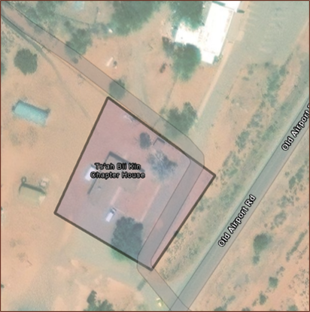
GPS Coordinate Map/Legal Land Survey
Provide the coordinates of each corner and the total acreage of the proposed lease area of 0.5 acres.
If the applicant needs assistance, GLDD can aid in generating the map or the applicant may request help from the Grazing Official.
Note: a perfect half-acre has equal length/width of 147.6 feet.
The best method, a corner coordinate could become the Point Of Beginning (POB)
Otherwise, the Land Withdrawal Designation will hire a Registered Land Surveyor stamped plat.​
GLDD

Slide 7
Supporting Chapter Resolution
A resolution from the respective chapter in support of the proposed undertaking and location. ​
The Chapter Resolution must include legal language that specify the development as either community or industrial. This is required by the Land Withdrawal Designation Regulations.​
The legal language is found in RDCJN-33-15 Section 7(b) a. ​
  "The _______ Chapter hereby supports and recognizes this land withdrawal for community development, which may include, but is not limited to, the following purposes: housing, education, economic development, healthcare facilities, public use, or governmental use. Industrial development is not supported for this area.“​
For industrial development, include the language: "The ____Chapter hereby supports and recognizes this Land Withdrawal Designation for the sole purpose of industrial development. Industrial development shall be considered the economic activity concerned with the manufacture, and processing of materials or construction." ​ ​
GLDD

Slide 8
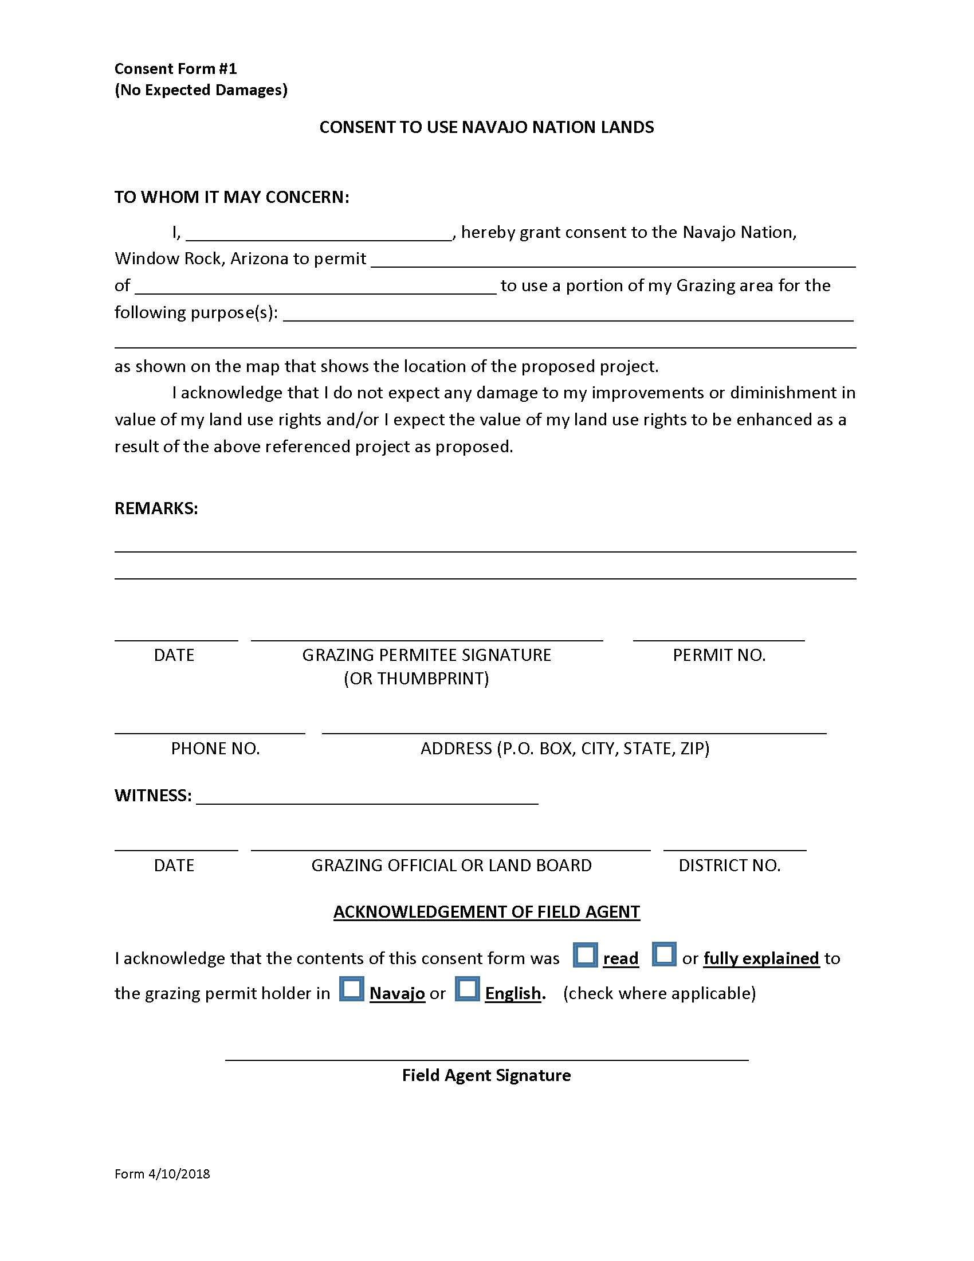
Grazing Permittee Consent
Collected consent from impacted land users and those holding a valid grazing permit, and a verification letter signed by the respective Grazing Official. For land withdrawals a Field Clearance Checklist is required.​
If you’re having issues locating a Grazing Official please contact the Department of Agriculture.
GLDD

Slide 9
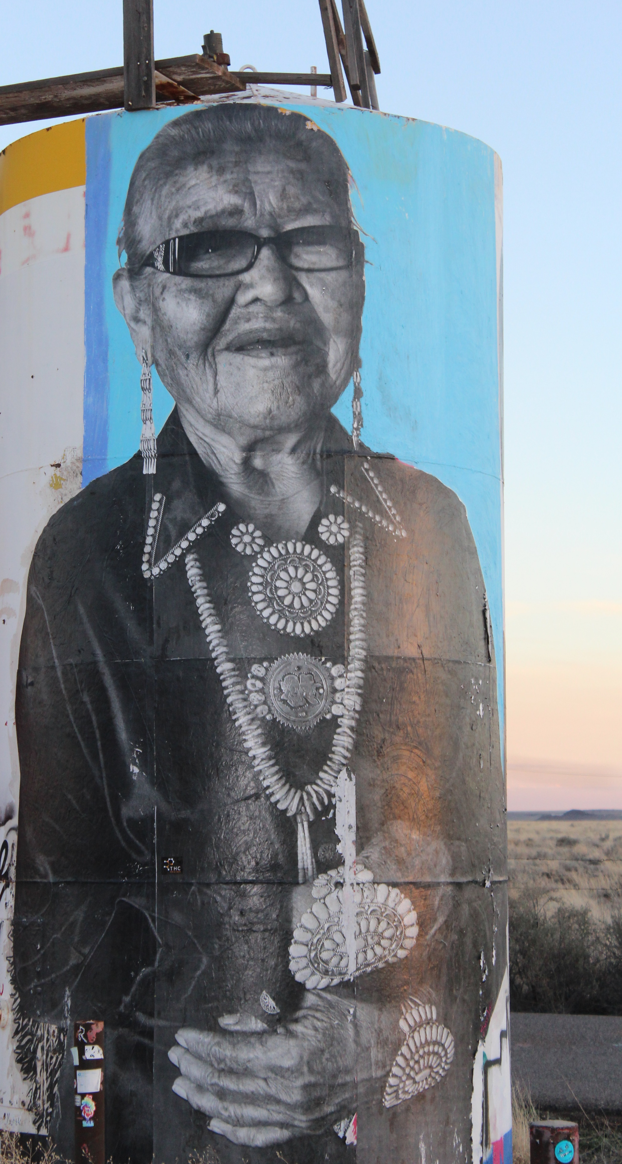
General Land Development
Land Withdrawal Designation Process
**Submitting the four (4) requirements above will allow your chapter to reserve the area for five (5) years until the environmental documents are provided. The BRCF and CRCF must be submitted to complete the entire land withdrawal process. You may NOT construct, operate and/or maintain during this time period**
GLDD

Slide 10
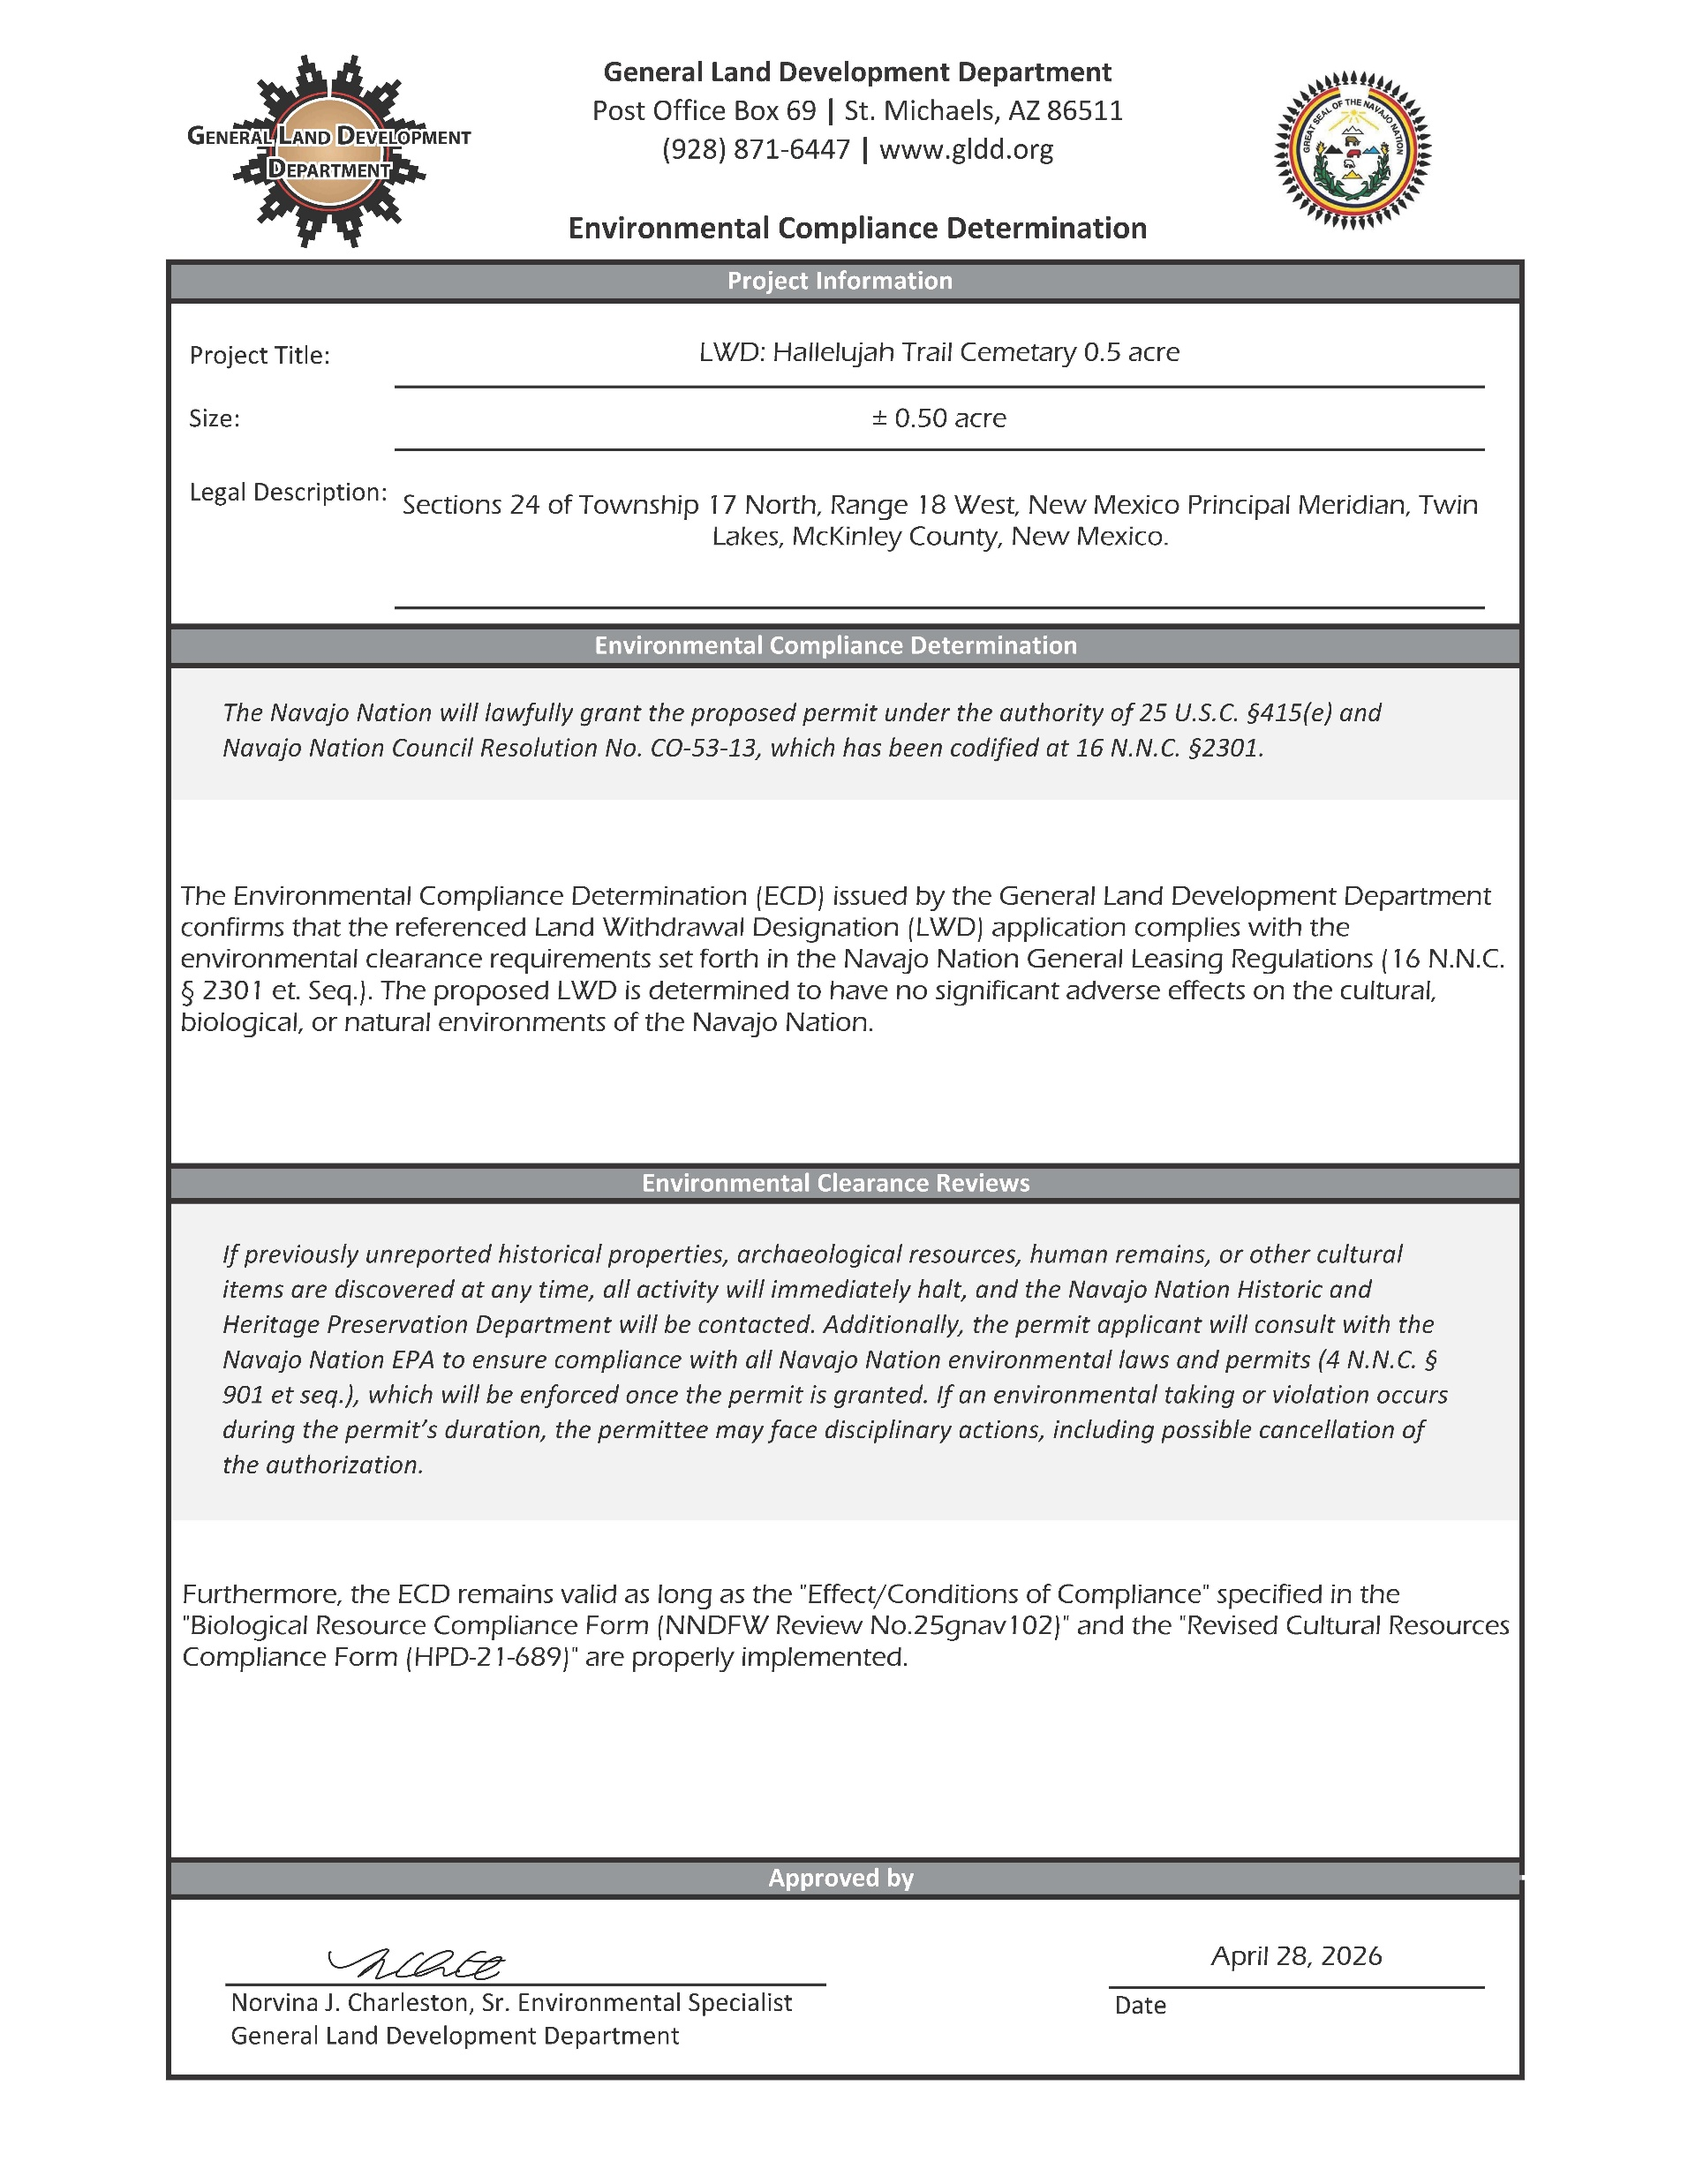
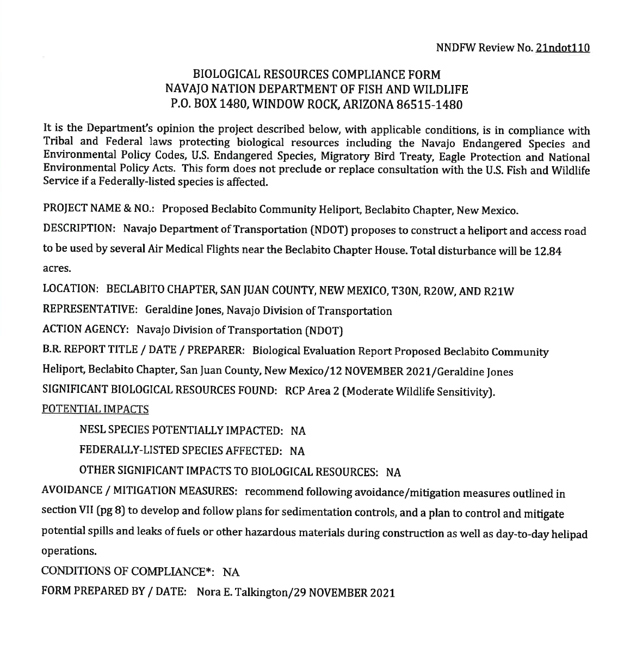
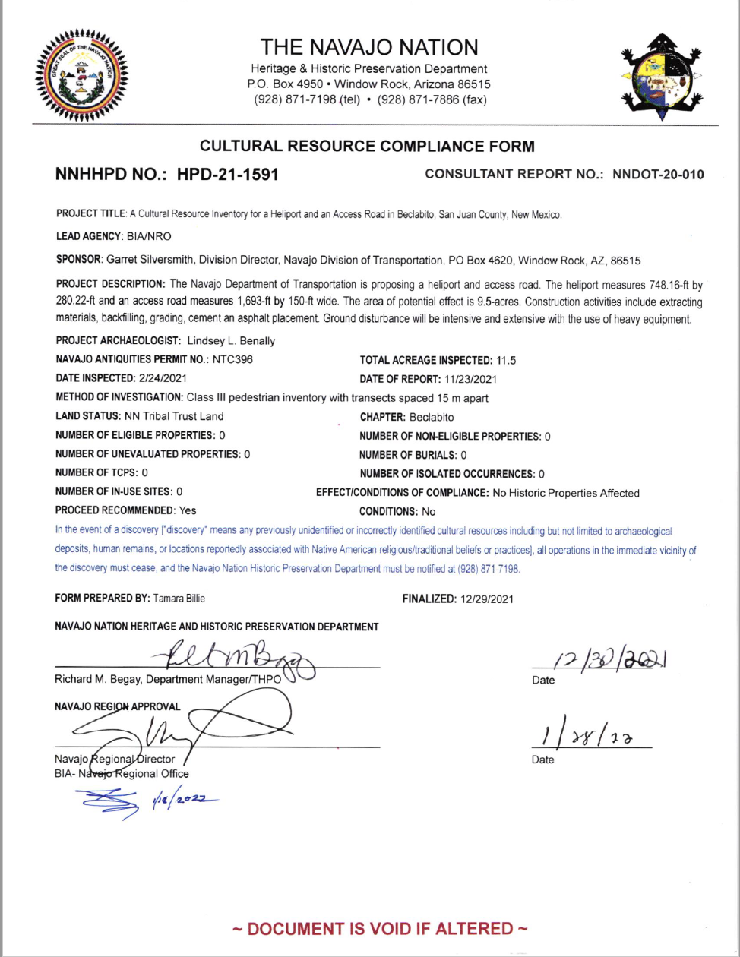
Environmental Determination Documents
Biological Resource Compliance Form (BRCF)
  Navajo Nation Department of Fish & Wildlife
Cultural Resource Compliance Form (CRCF), Archaeological Inventory Report (AIR) Form
  Navajo Nation Heritage & Historic Preservation Department
Environmental Compliance Determination (ECD)
  General Land Development Department (GLDD)
GLDD

Slide 11
Family Plot Flowchart for Existing
Grazing Permittee Consent
Resolution (RDCJN-33-15)
Land Support Agent
Land Status Review
Environmental Compliance Determination
Biological Resource Compliance Form
Cultural Resource Compliance Form
Submit Packet to GLDD
Internal Review
(GLDD)
Supporting Chapter Resolution
GPS Coordinates Legal Land Survey
Cover Letter /
Plan of Operations
Final Land Withdrawal signed by Navajo Nation Land Department Manager
GLDD

Slide 12
Transfers of Land Withdrawals Designation for
Navajo Government Entity
A transfer can occur if the Consent is acquired from the valid permittee.
As long as no development or disturbance has taken place.
The purpose of the new designation is in accordance with the resolution of support.
An agreement is made with the transferee and the terms of the Land Withdrawal Designation.
The NLD agrees to the transfer.
GLDD

Slide 13
Oversight and Enforcement
The Navajo Nation shall have the authority to enforce the provisions set forth in these Regulations in accordance with applicable Navajo Nation and Federal law.
If a Designation Holder develops or otherwise disturbs the land without first having a valid lease, the Designation Holder is subject to trespass, and a penalty will be assessed by the NLD pursuant to (16 N.N.C. 2251 and 2252).
Once the Land Withdrawal Designation process is complete, the applicant will be awarded a letter to proceed administered by NLD Manager as listed in the RDC Delegation.
GLDD

Slide 14

BURIAL SITE CLEARANCE FORM

Slide 15
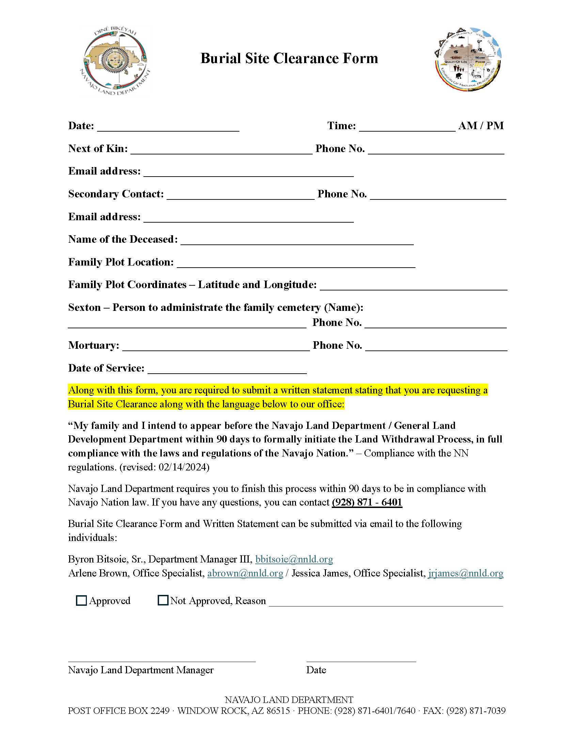
Burial Site Clearance Form
Sexton submit a written statement requesting for a Burial Site Clearance Form
Navajo Nation Land Status – NN Fee & Trust
GPS Coordinates Latitude and Longitude
Navajo Nation Land Department will create a map
No approvals on new burials and no Indian Allotments
Allotments are referred to BIA – depending on site location, contact the local agency

Slide 16
Written Statement & Burial Site Clearance Form
Provide a written statement requesting for a temporary clearance for a burial site & BSC form
The legal language shall include:
  “My family and I intend to appear before the Navajo Land Department / General Land Development Department within 90 days to formally initiate the Land Withdrawal Process, in full compliance with the laws and regulations of the Navajo Nation.”
Compliance with the NN Burial and Cemetery Regulations RDCF-07-24 (revised: 02/14/2024)
Navajo Land Department requires you to finish this process within 90 days to be in compliance with Navajo Nation laws and regulations

Slide 17
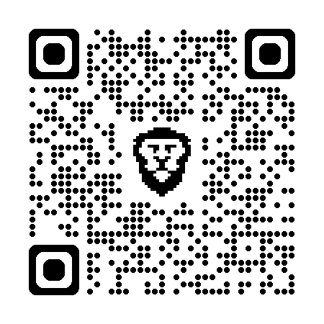

Contacts
Burial Site Clearance Form and Written Statement can be submitted via email to the following individuals:
Byron Bitsoie, Sr. bbitsoie@nnld.org
Department Manager III
Arlene Brown abrown@nnld.org
Office Specialist
Jessica James jrjames@nnld.org
Office Specialist (NLTDS)
(928) 357-6965

Slide 18
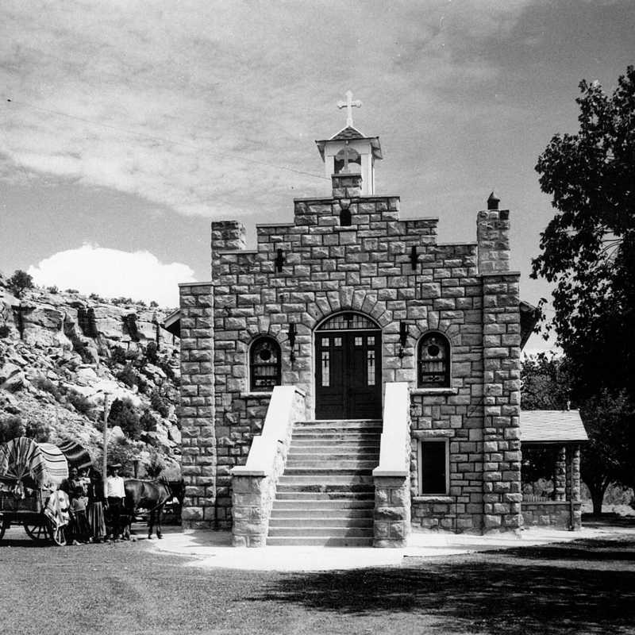
Take Home Message
Protection of the Family Cemetery
Organization to Burials on NN
Respectful and Compliance to laws & regulations
Proper Authorization for Land Use
Submit to GLDDProjects@navajo-nsn.gov
  AHXE’HEE’
GLDD

Slide 19
Ahxe’hee
928-357-6969
GLDDProjects@Navajo-nsn.gov
www.gldd.org

