Slide 1
DARDANO AEROTECH
Quality,Honesty and Professionalism.

Slide 2
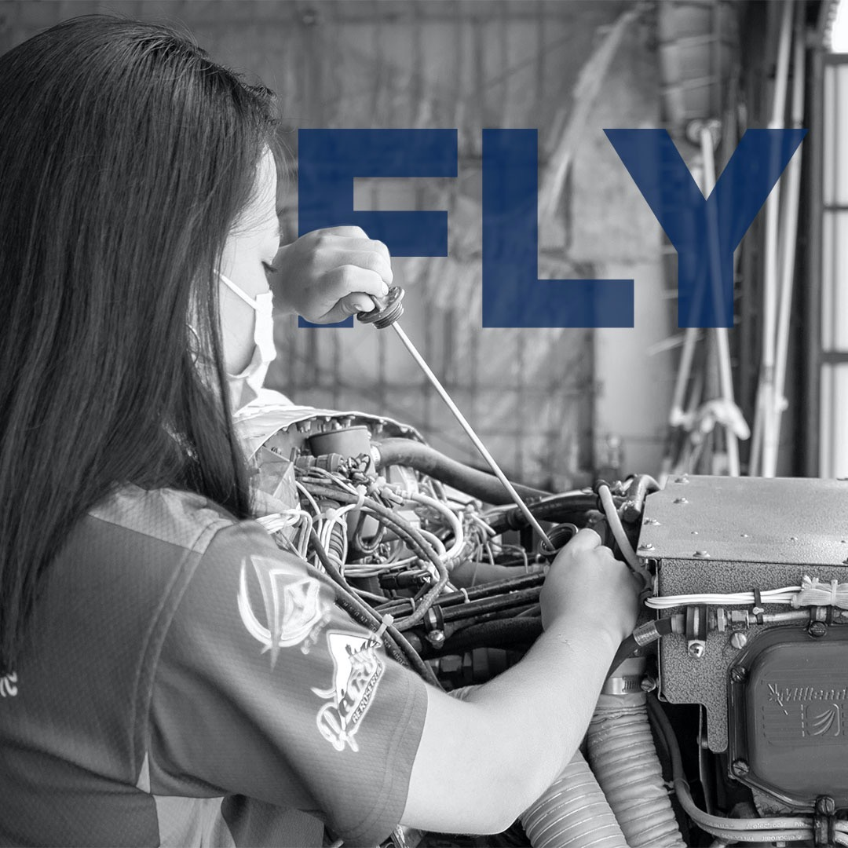
Who we are:
PROFESSIONAL Pilots and maintenance technicians that understand the meaning of QUALITY. We are fully aware that HONESTY is the key component for a well preformed job.

Slide 3
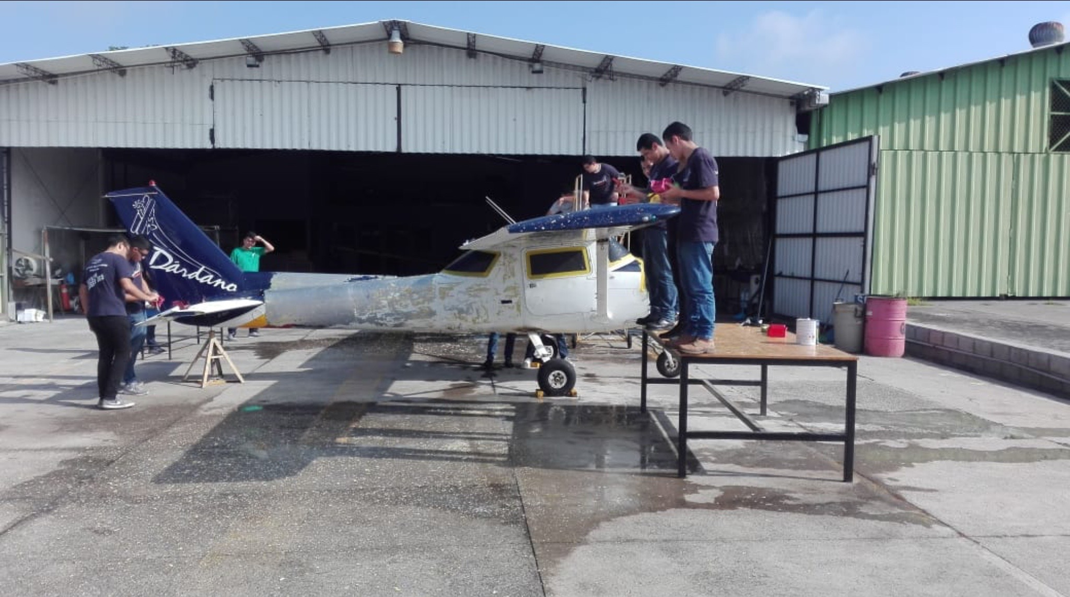
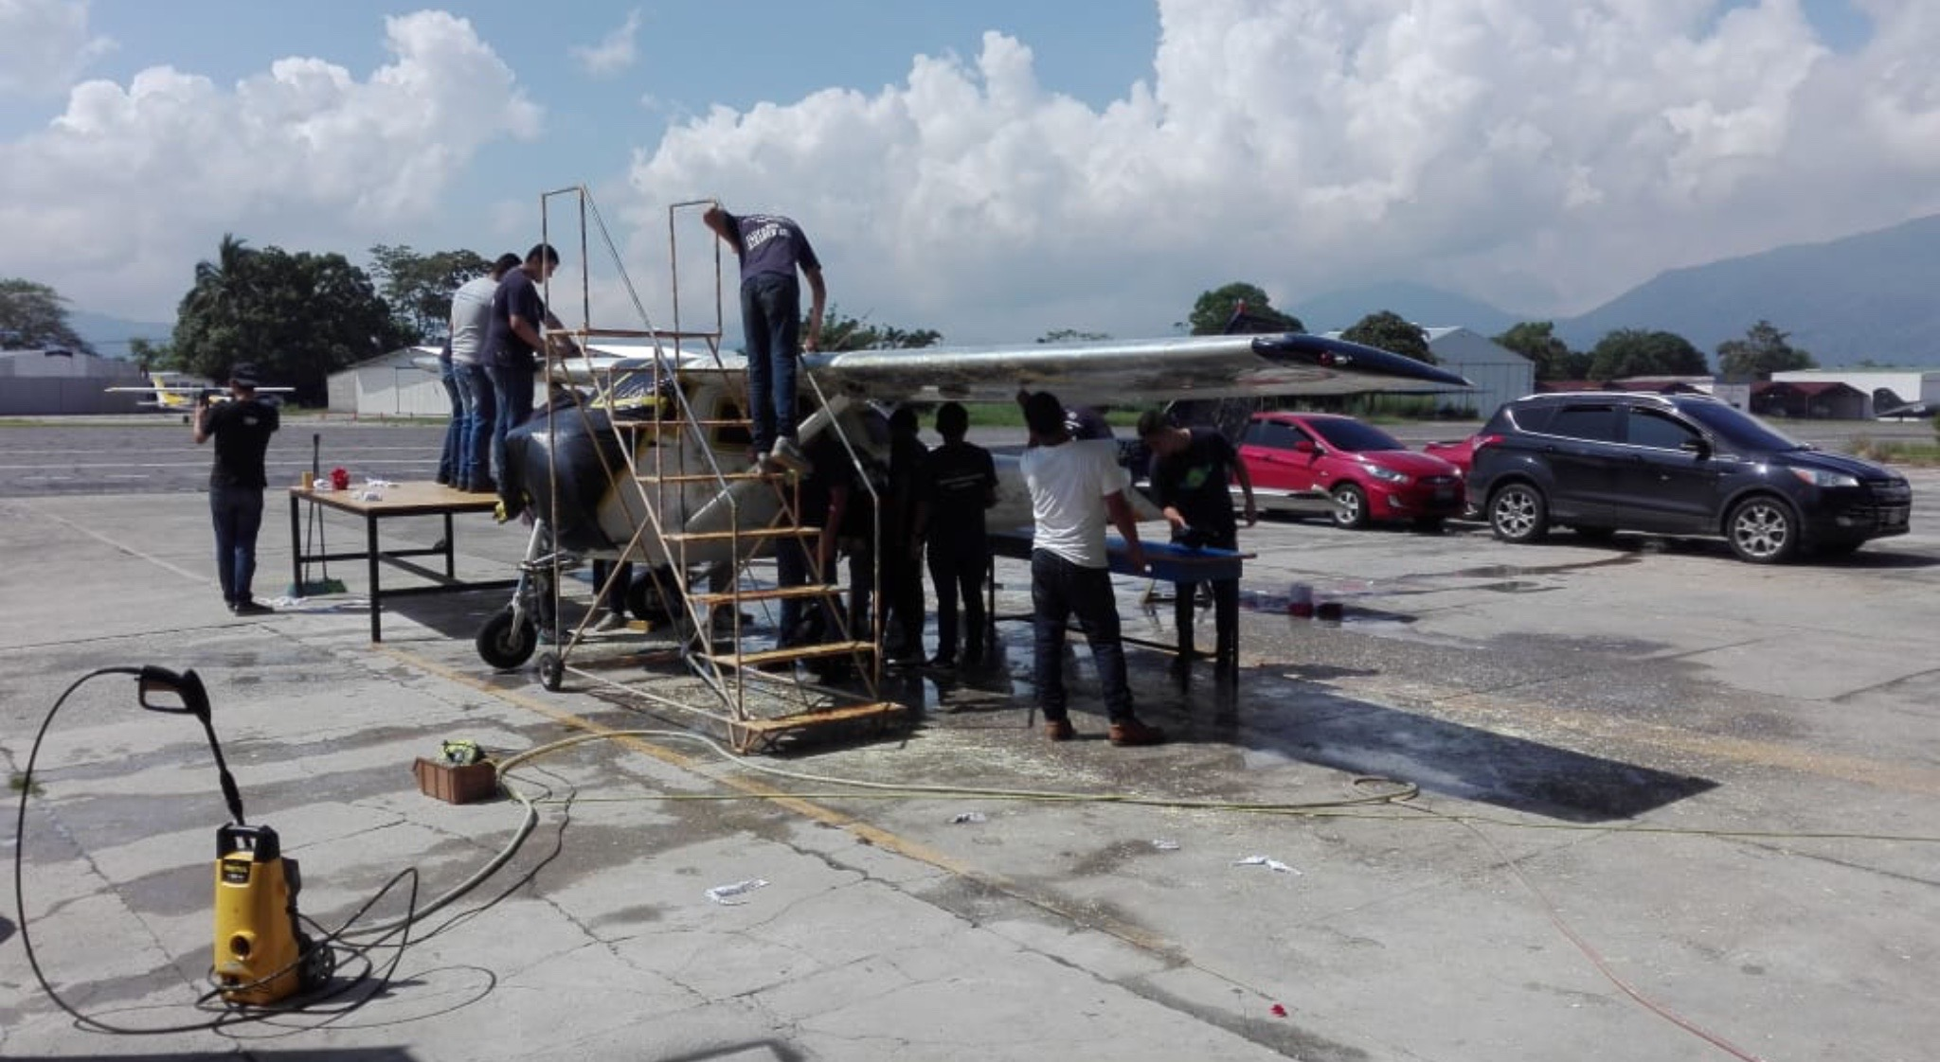
We have more than 20 years of experience.
Planes we have worked throughout the years:
-Cessna 150/152
-Pipper Comanche 250.
-Pipper Twin Comanche.
-Grumman AT-CAT
-Stearman PT-17
-Super Decathlon 8KCAB.
-Mooney M20C
-Cessna 310
-Pipper Cherokee

Slide 4
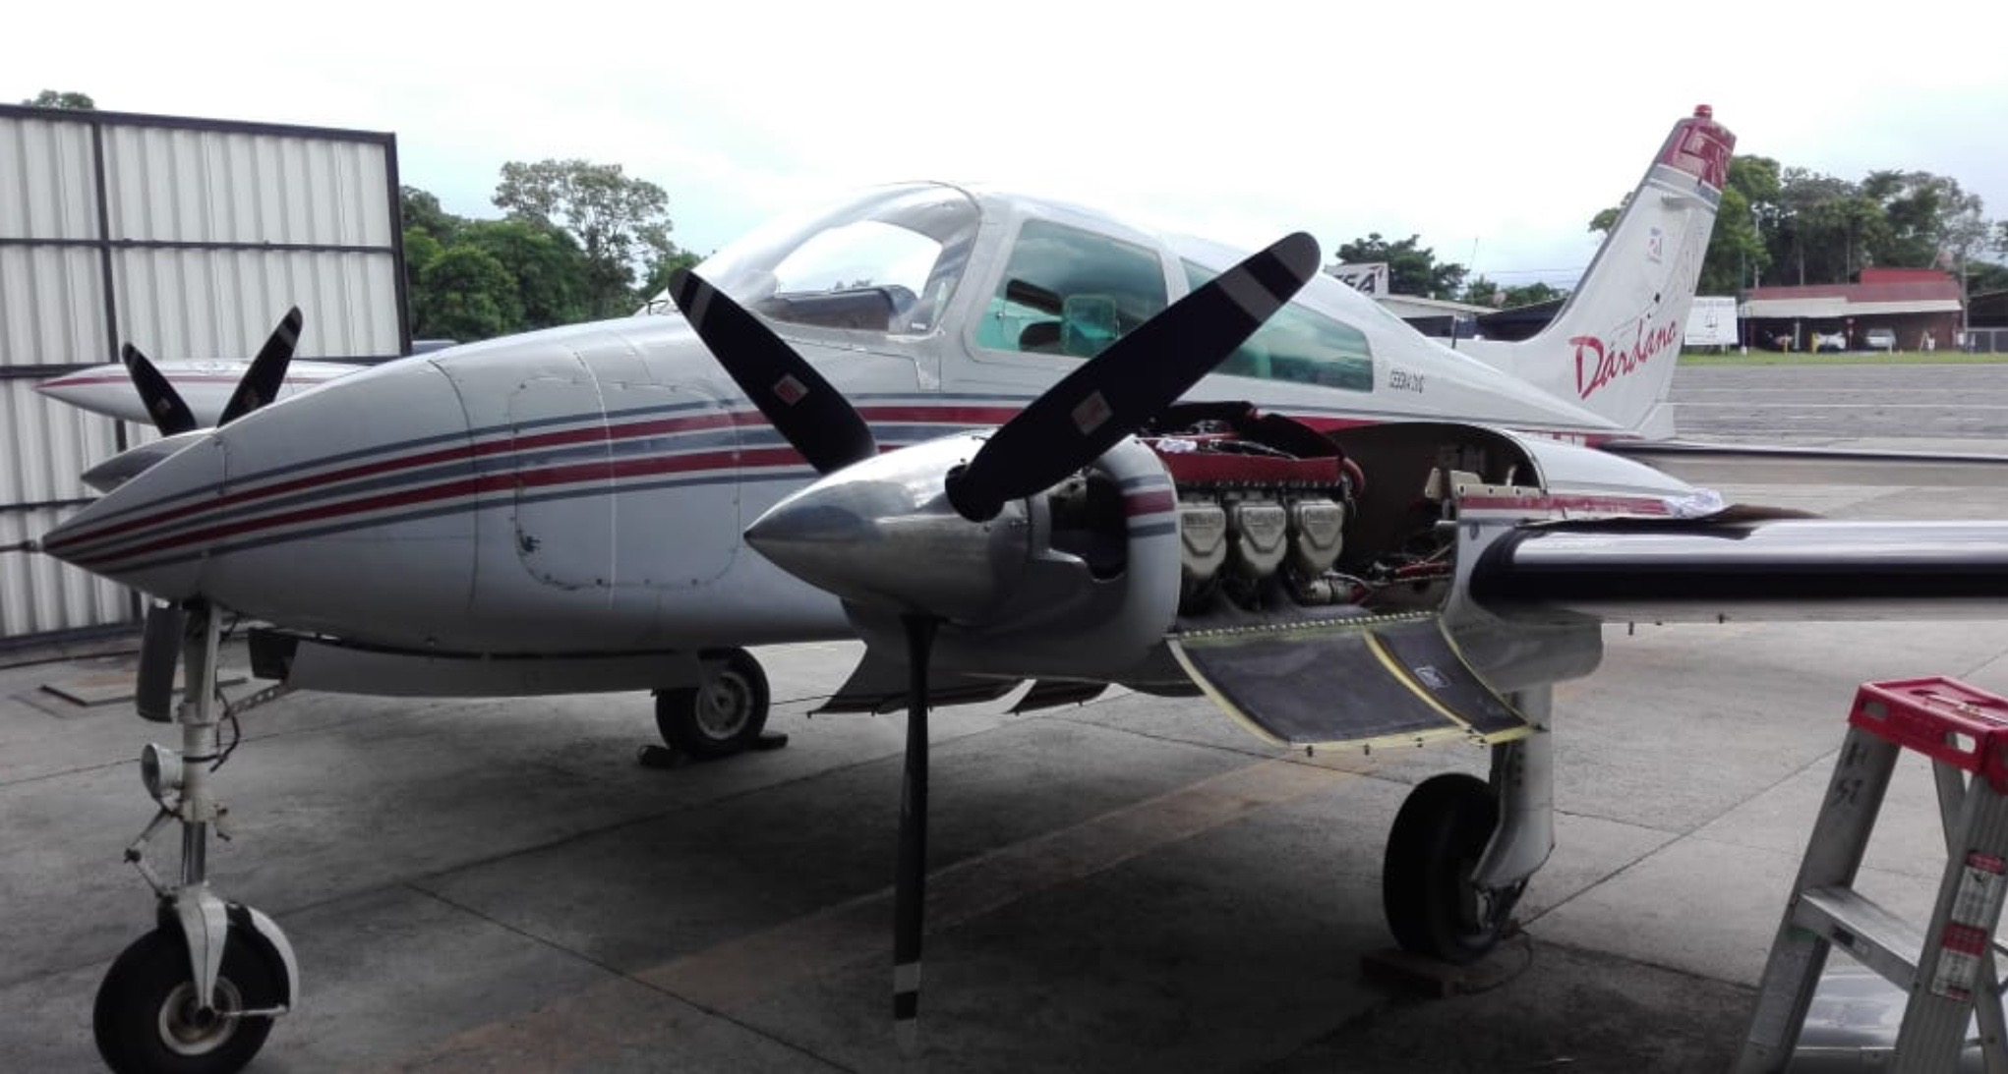
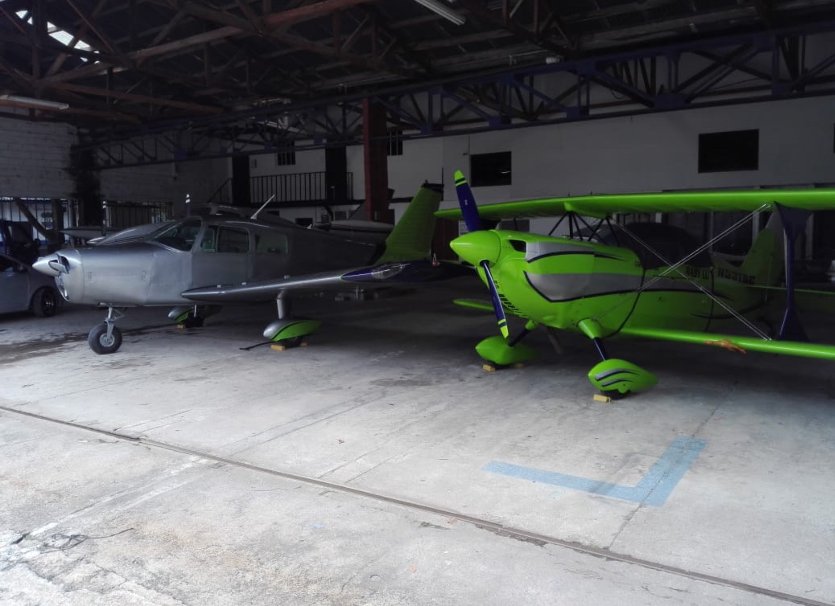
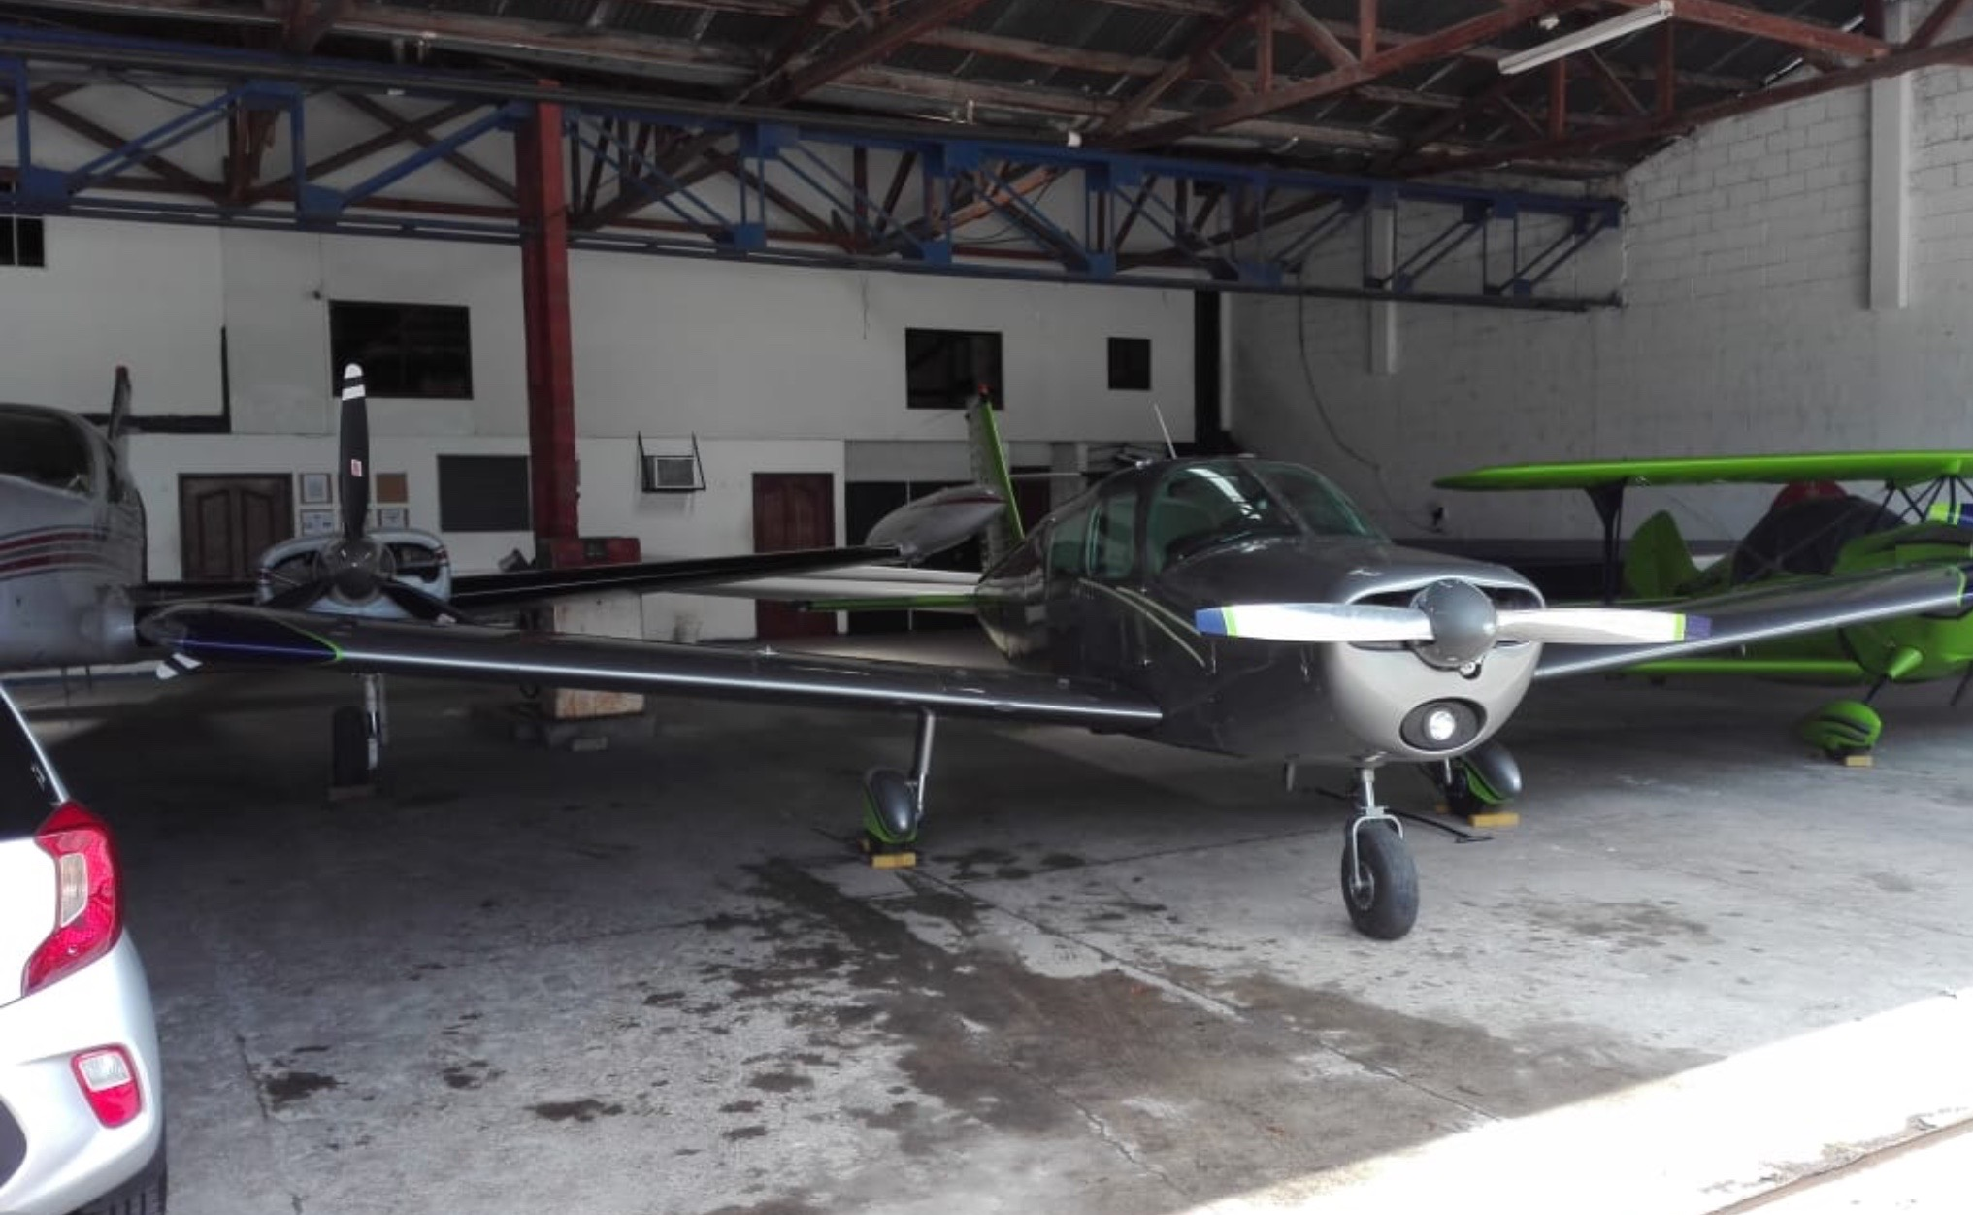
OUR FLEET

Slide 5
OUR SERVICES:
-COMPOSITES
-SHEETMETAL
-GENERAL PAINT
INTERIORS (LEATHER AND FABRIC)
EXTERIOR FABRIC
- RECIPROCAL ENGINES
-RADIAL ENGINES
-GENERAL MAINTENANCE.

Slide 6
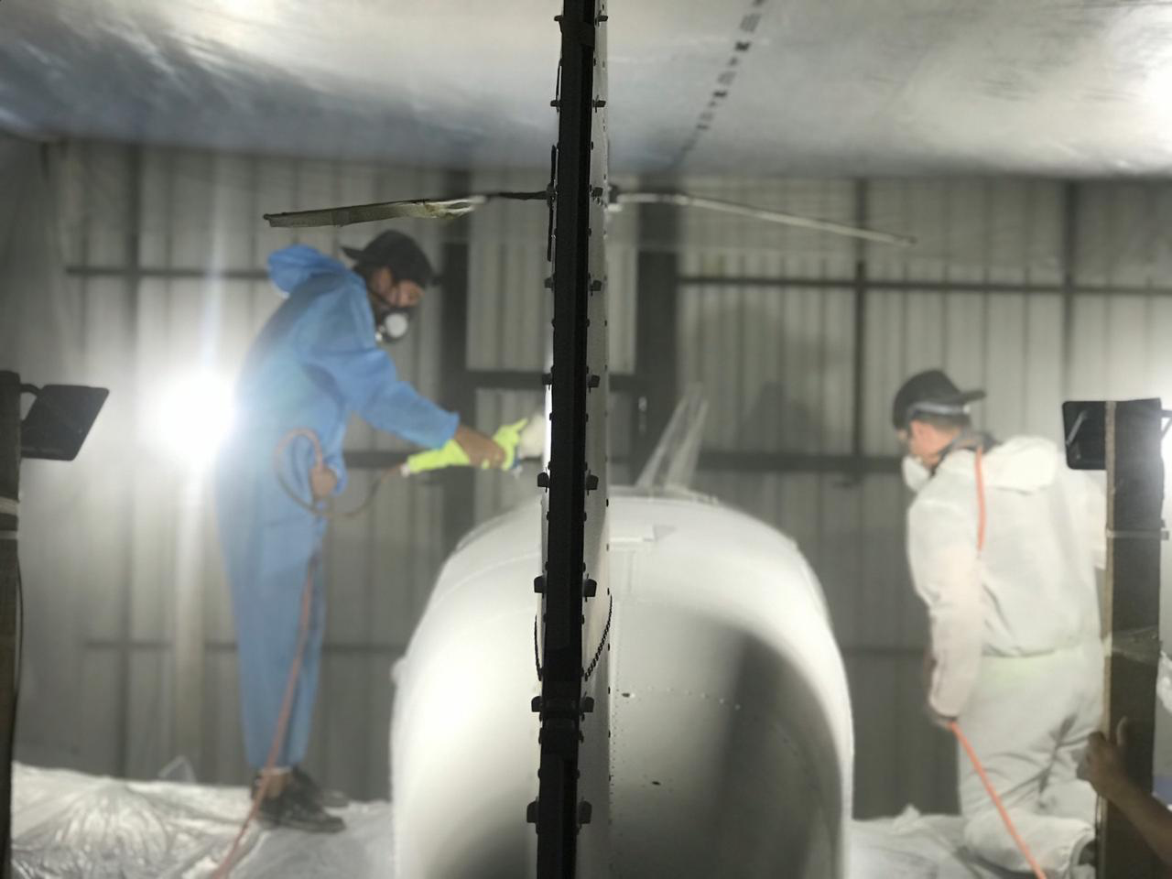
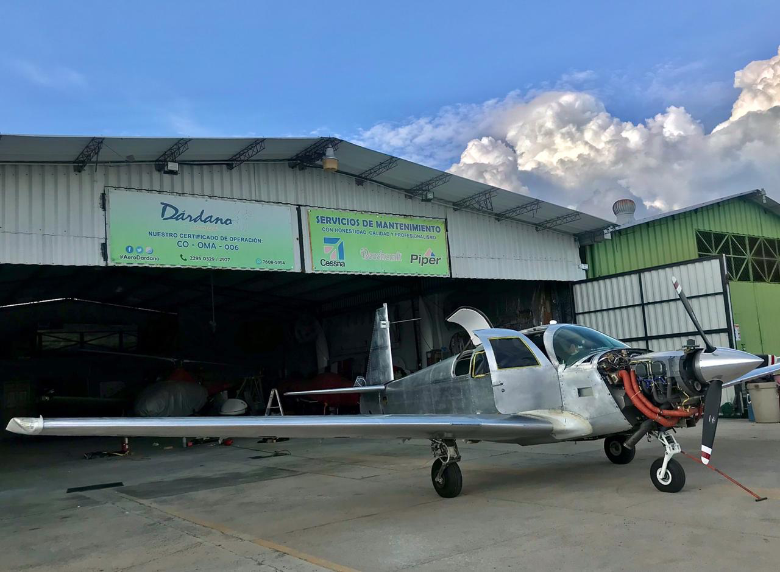
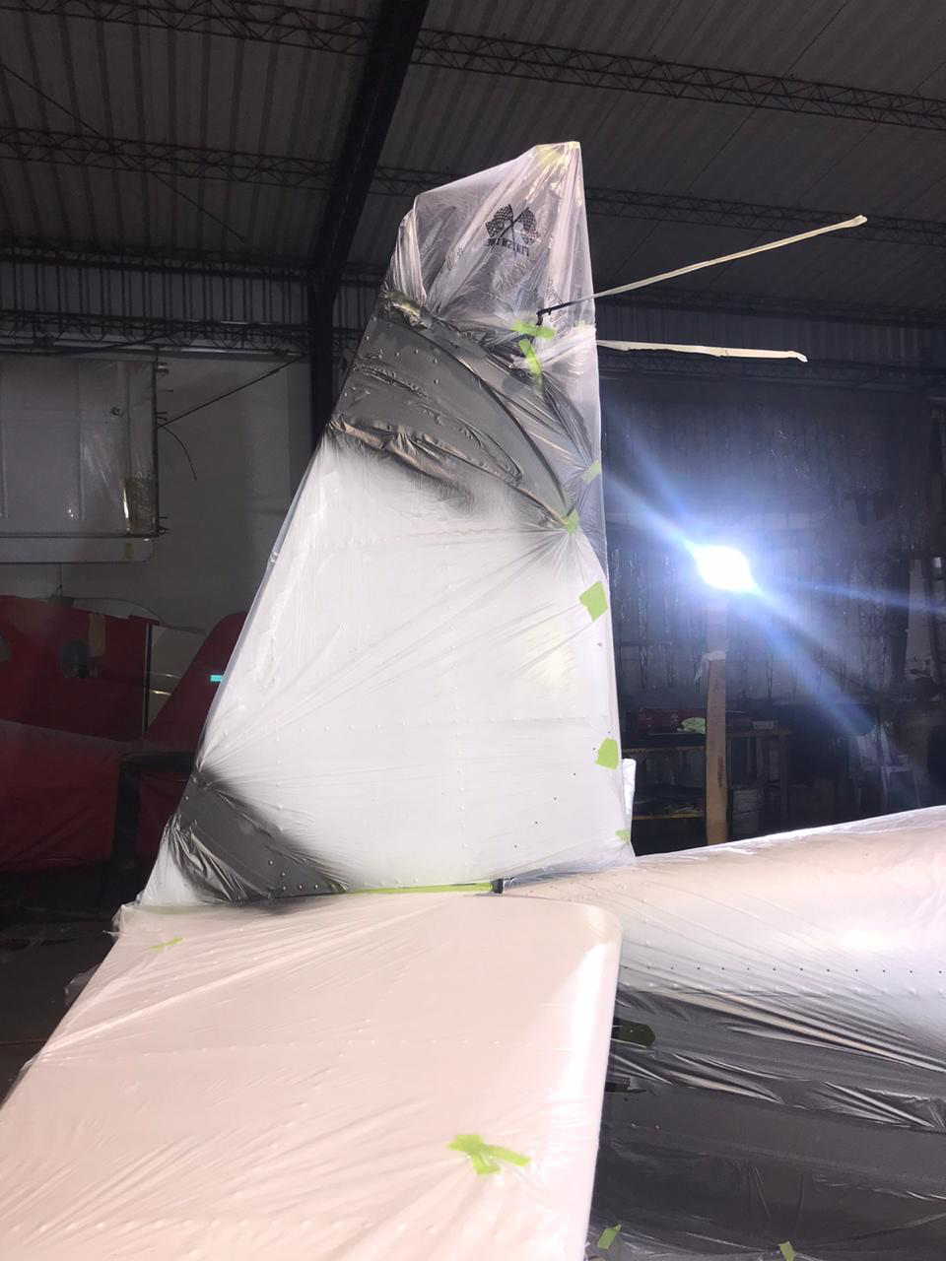
MOONEY M20C PROJECT.

Slide 7
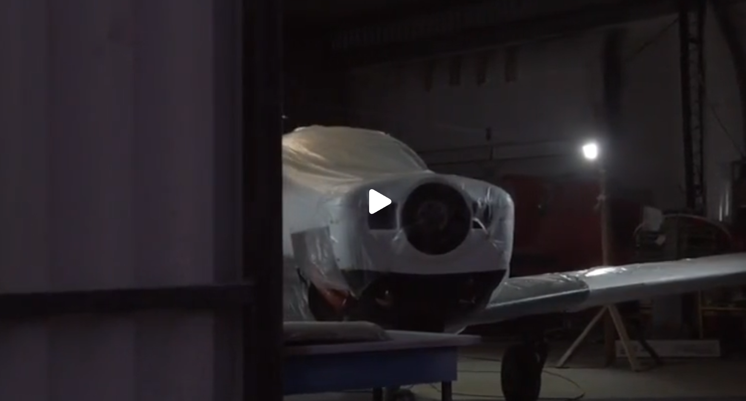

Slide 8
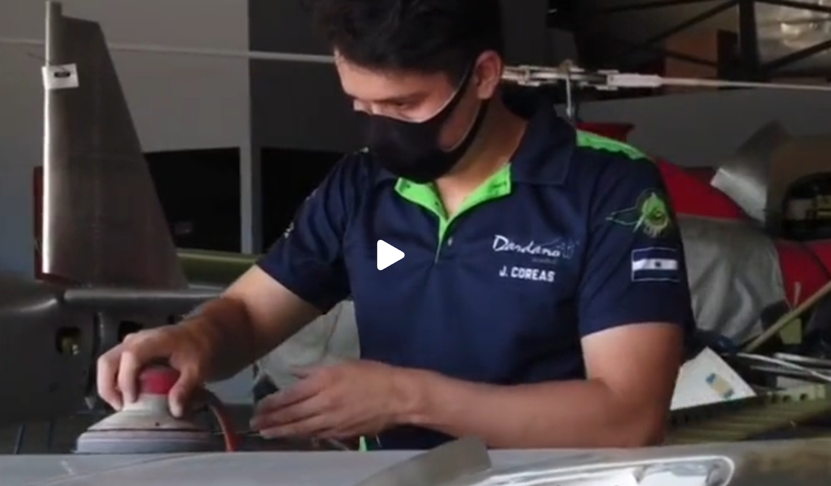

Slide 9
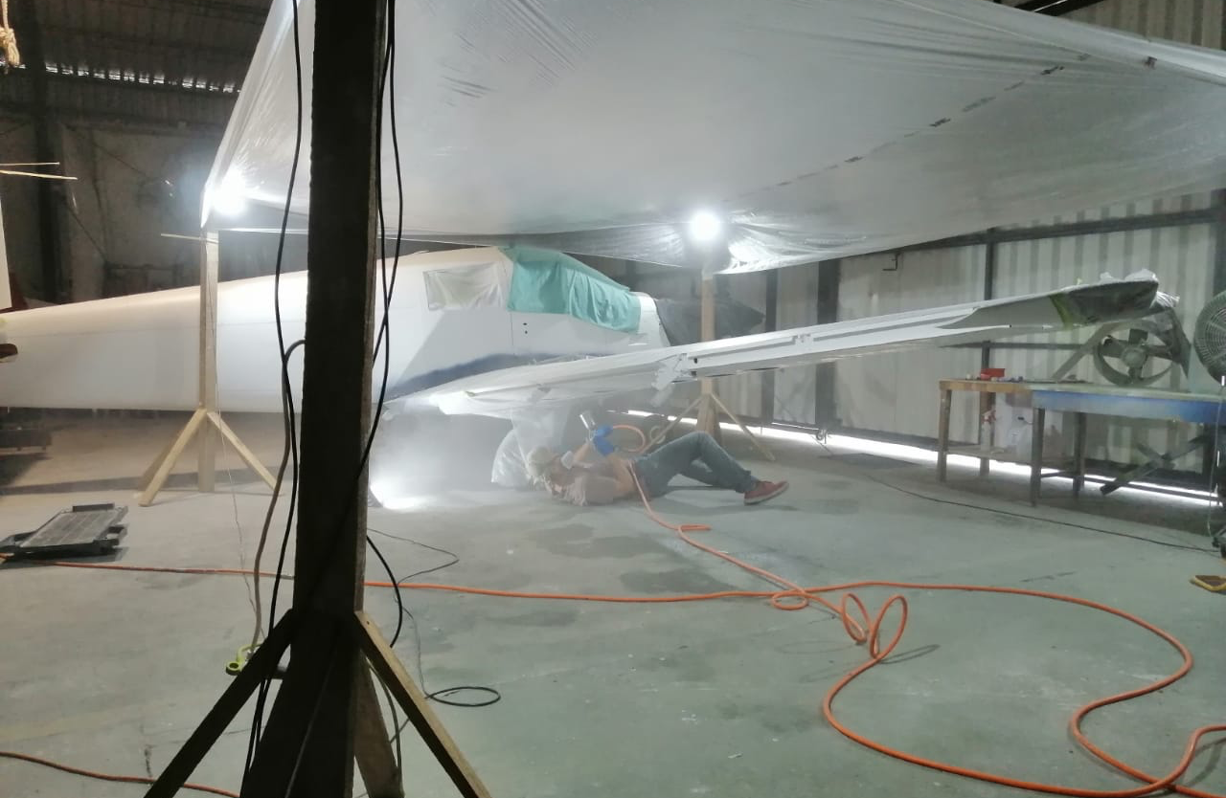
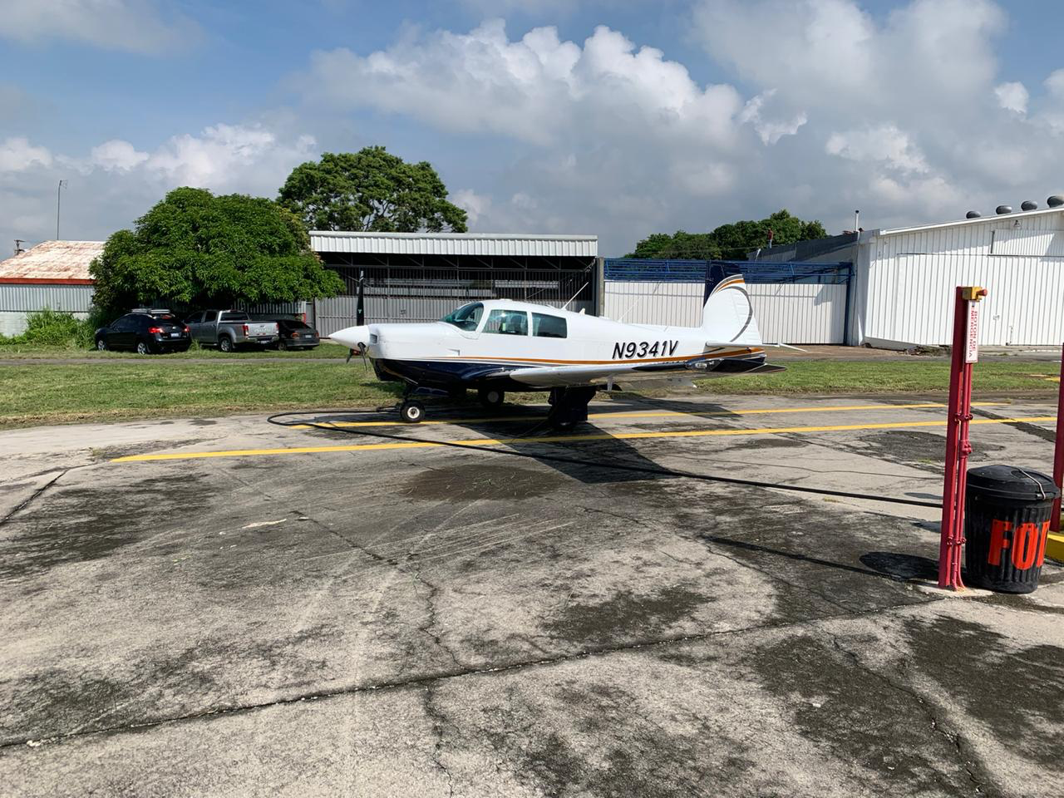
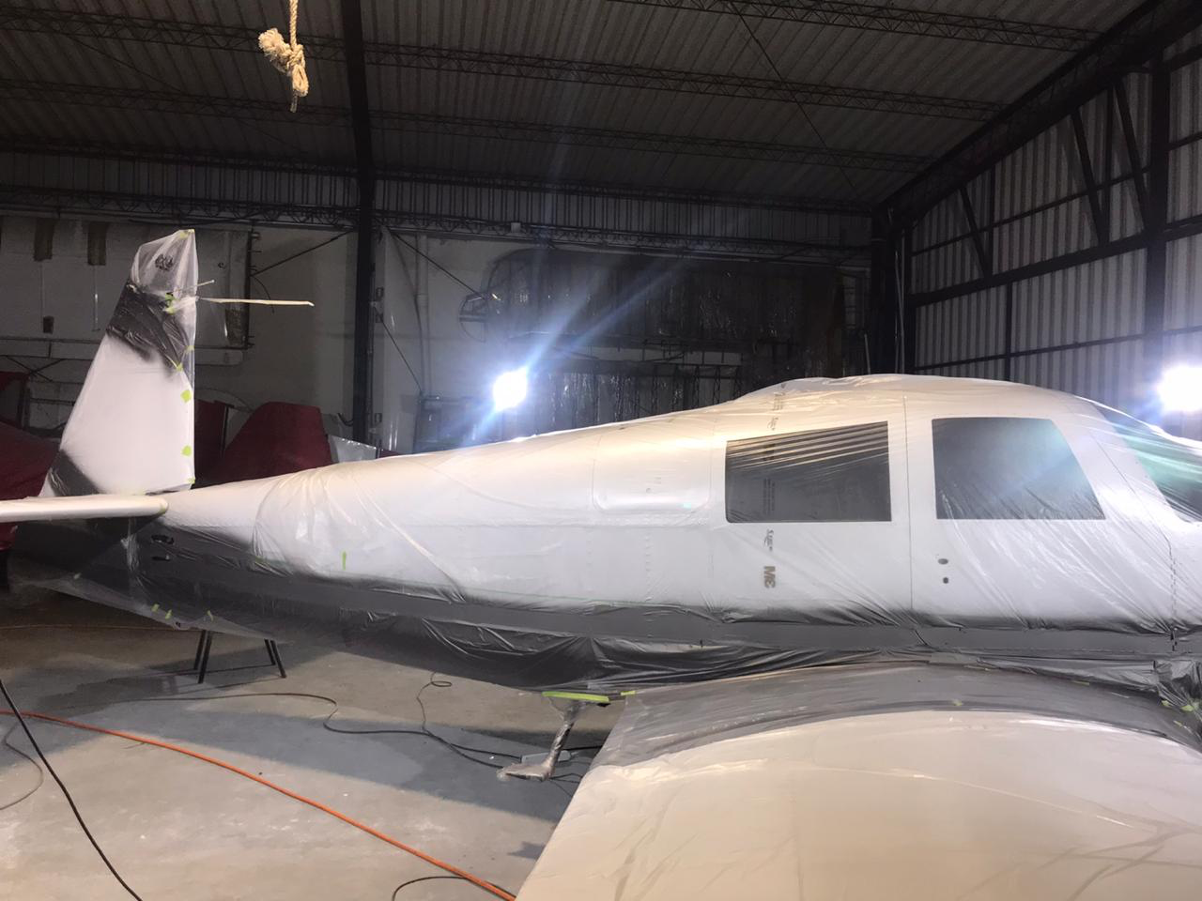
PROJECT COMPLETED

Slide 10
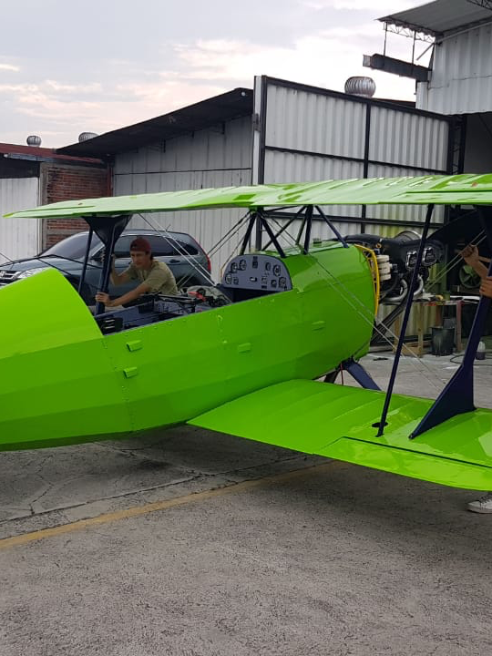
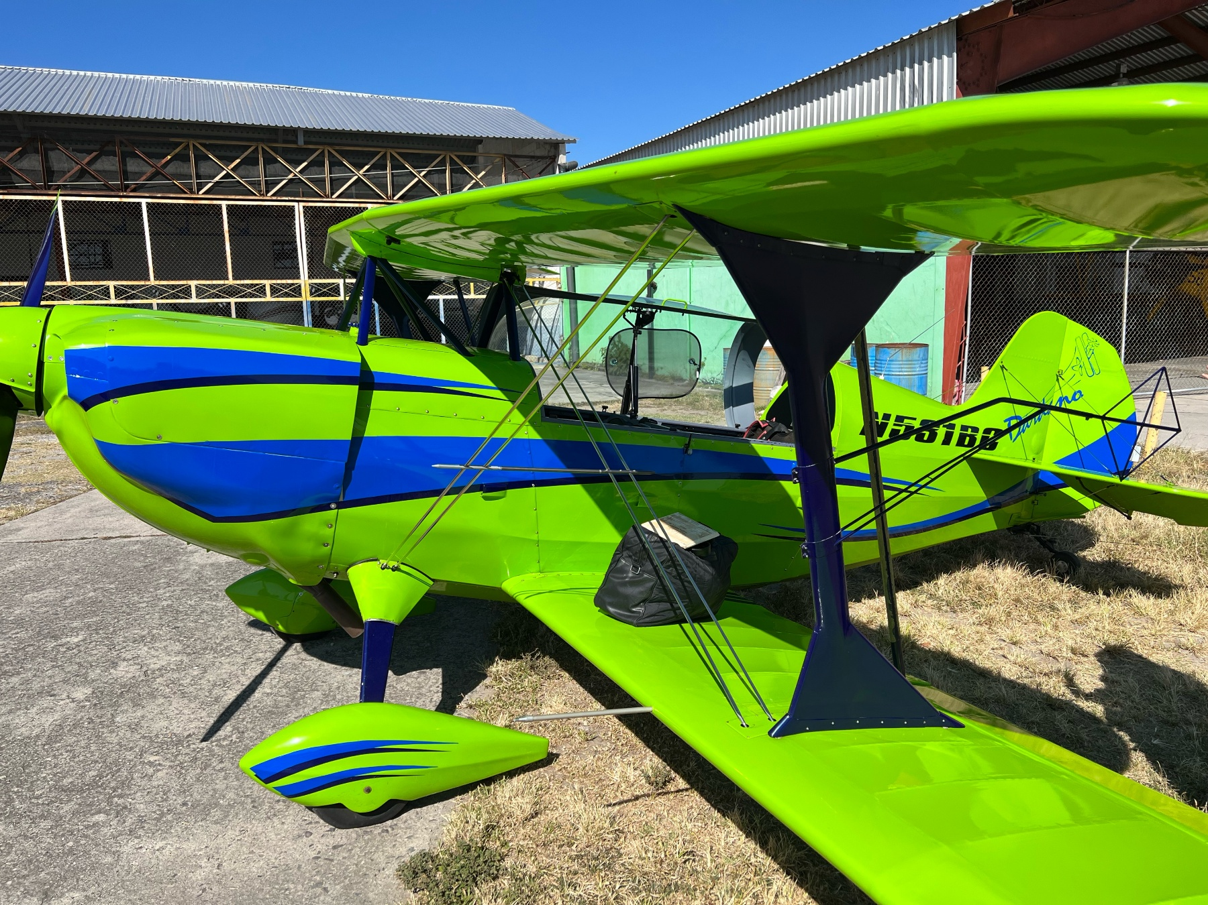
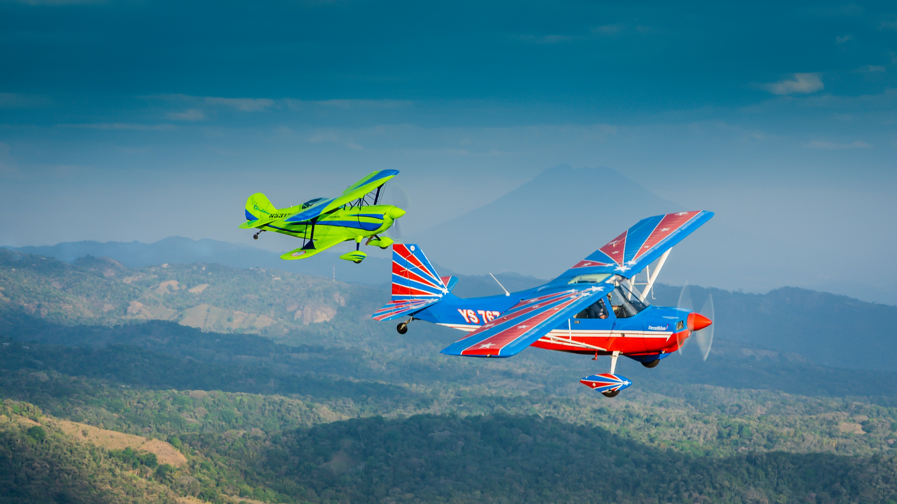
CHRISTEN EAGLE
PAINT JOB

Slide 11
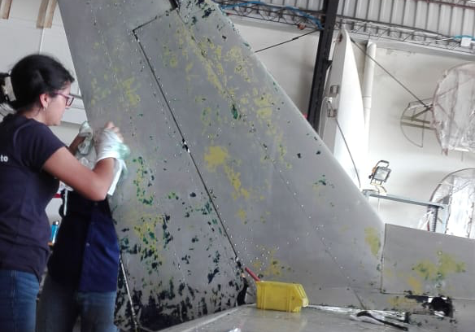
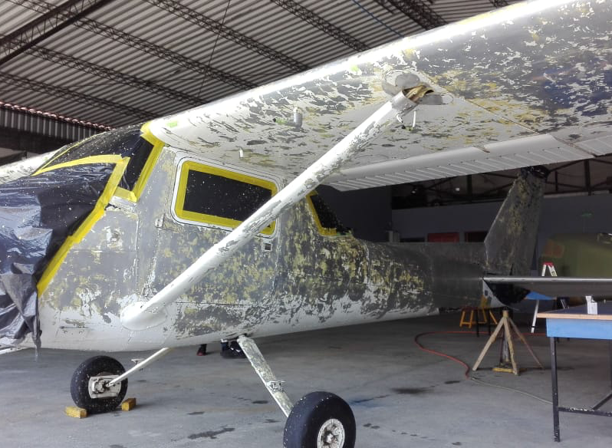
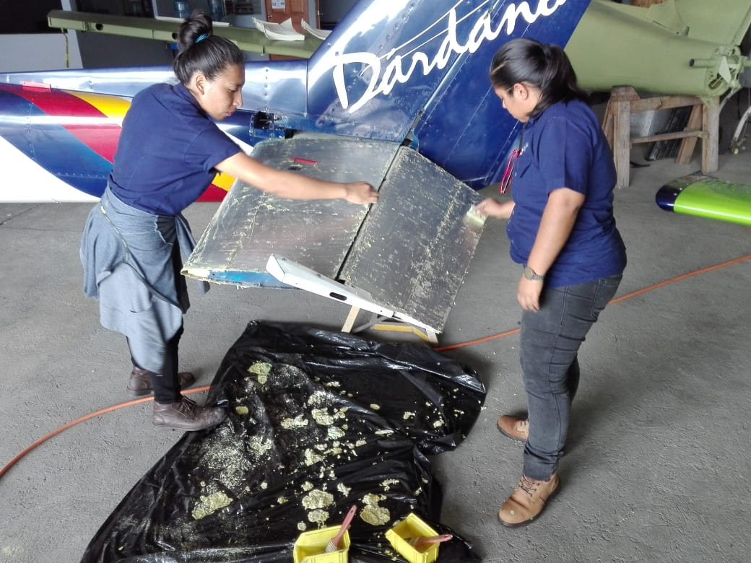
CESSNA 152 PROJECT

Slide 12
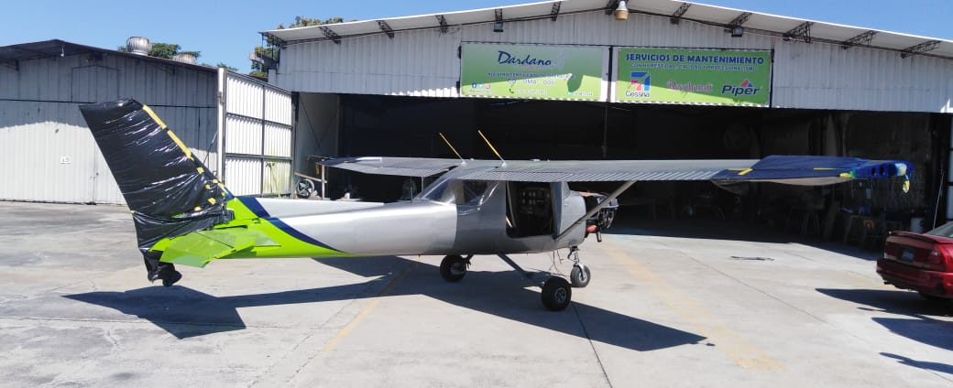
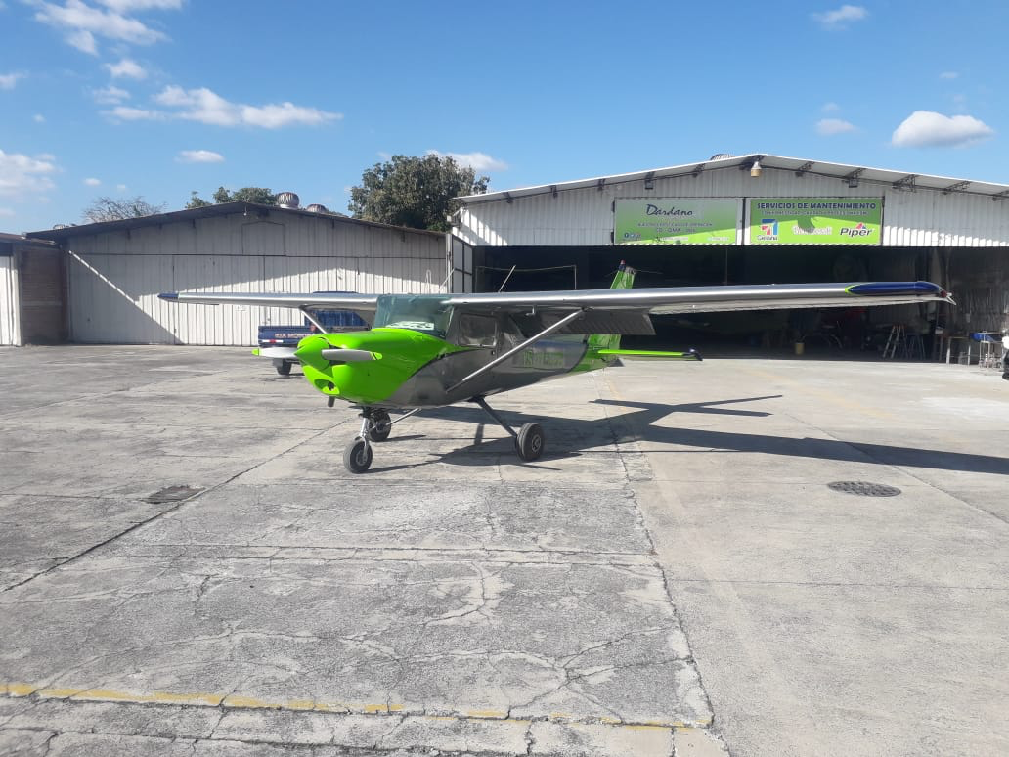
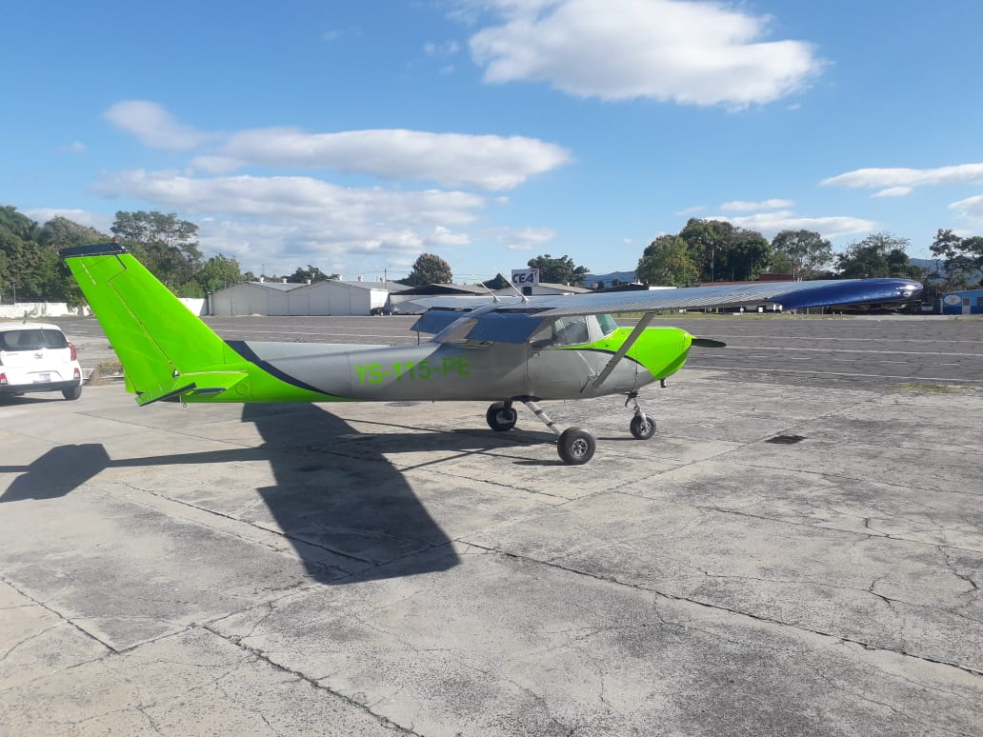

Slide 13
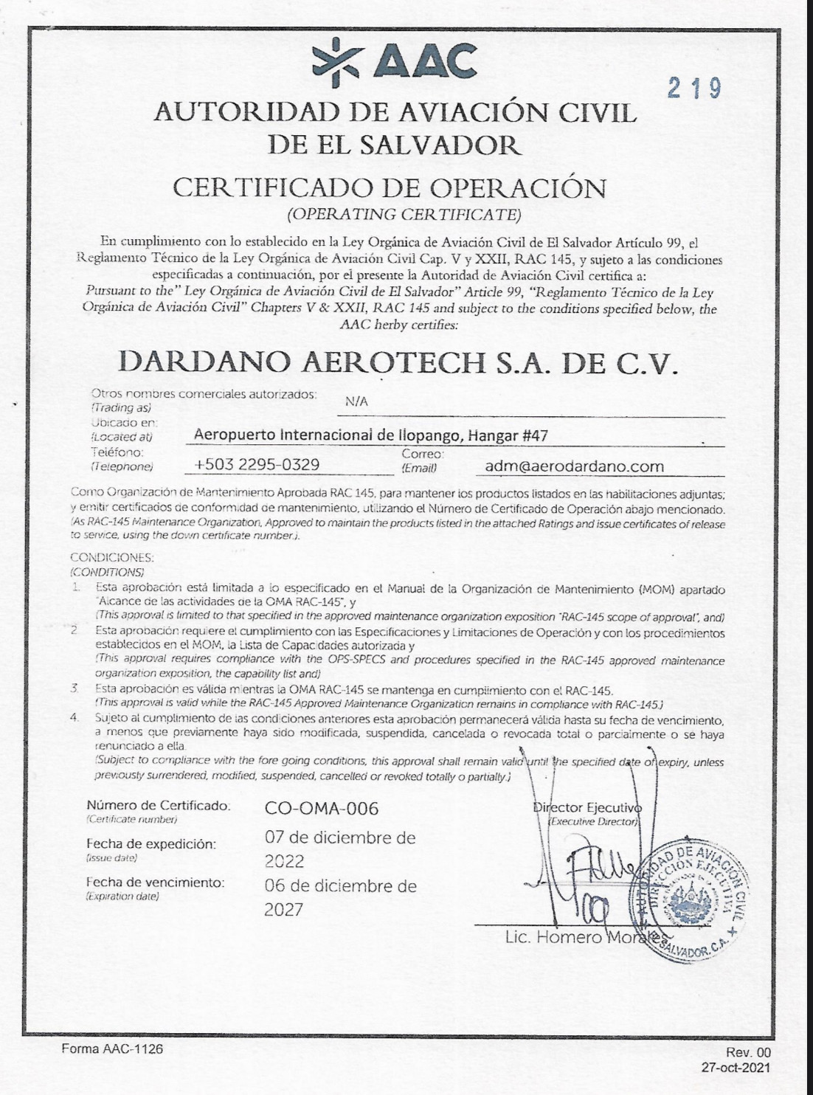

We are certificated by our country AAC
( Aviation Authority) AAC-CO-OMA-006.

