Slide 1
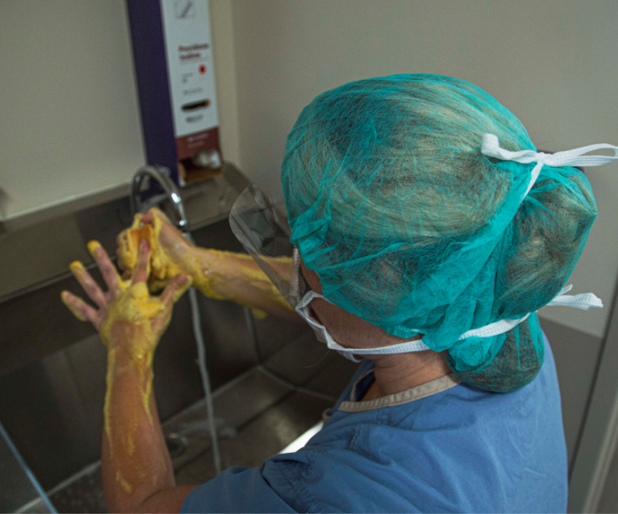

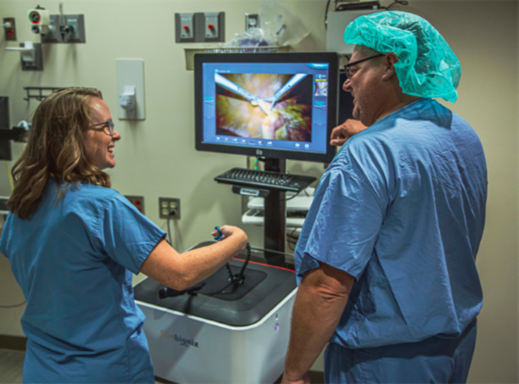
Development of a Perioperative Orientation Program for the Advanced Practice Provider
Lisa Clemens DMSc, MS, PA-C and Cortney Hartman MBA, CST, CRCST, CIS, FAST
Gaps Identified
Sterile Technique
Surgical Skill Proficiency
Sterile Technique: Scrubbing, Gowning, Gloving
Surgical Safety & First Assisting
Surgical Simulations
Code in the OR
Fire in the OR
First Assistant Simulations
Surgical Closure
Laparoscopic Trainer
Surgical Consents & Site Marking
Basic Instruments
Sterile Draping
Surgical Counts
Role of the First Assistant
OR Safety Protocols
Surgical Closure
Key Concepts of Sterile Technique
Surgical Hand Scrub/Rub
Donning Sterile Gown & Gloves
Removing PPE
OR Traffic Patterns
Opening Sterile Packaging
Hands Free Neutral Zone & Sharps Safety
Solution
Results
N=23 (questions 1-3) N=7 (questions 4-7) reported as median

