Slide 1
Joe Crawford’s
Play Calling Guidelines
By: Al Battista

Slide 2
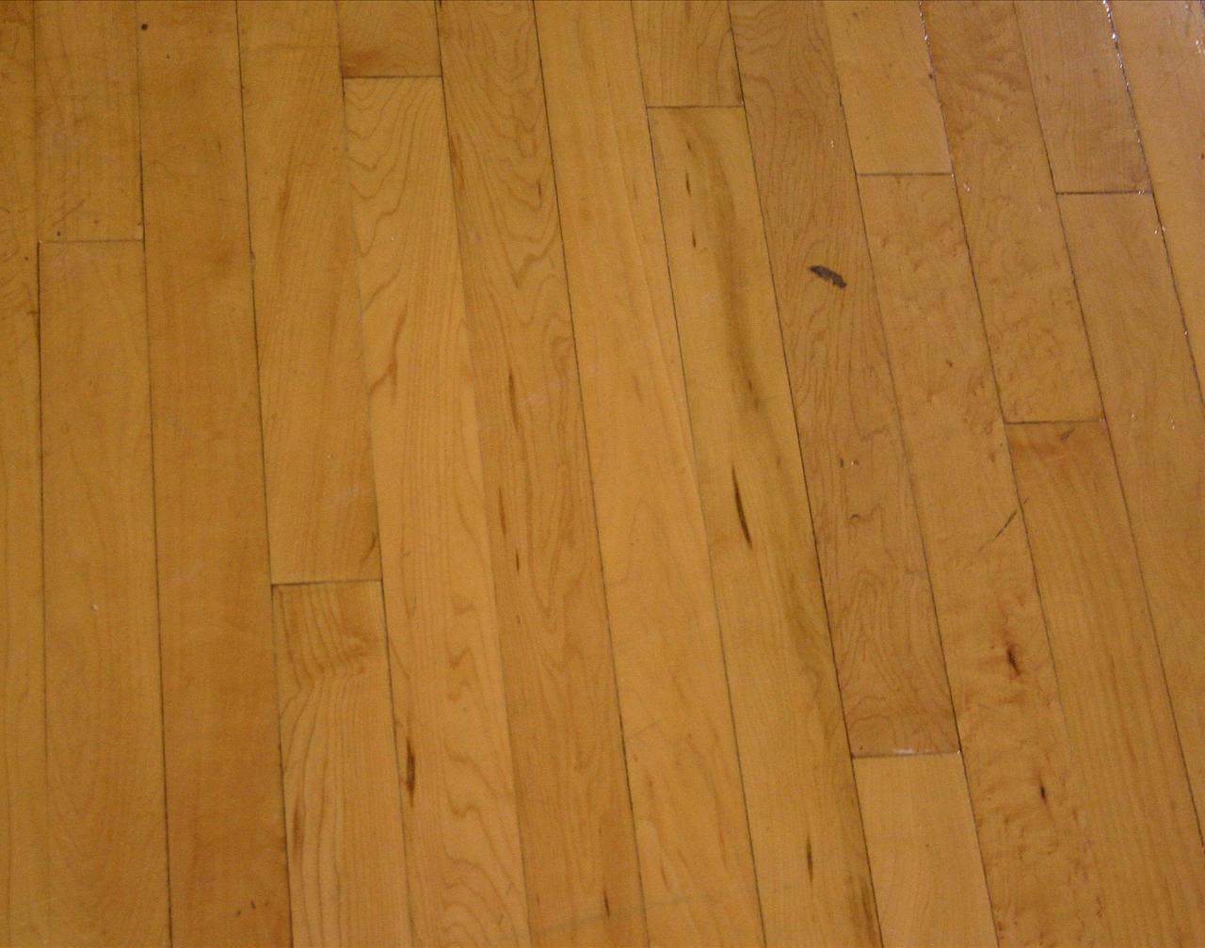
Jump Shots
On jump shots, find the defense and recognize points of contacts. On these plays find the defender's hand{s}. If their hand is below the ball its usually a foul. For example, a hit on the elbow or wrist. If their hand is above the ball its usually legal. This is a guide to help you get plays correct. This is not true all the time, its a guide, it will keep you out of trouble night in and out. Its a plan to officiate jump shooters, lay-ups etc.

Slide 3
Trail Position
In the trail position be careful of adjudicating plays where you don't have an open look and the center {slot} and lead have excellent views. Don't take chances and guess , make sure that you have a good view and you are correct.

Slide 4
Rebounding
Rebound fouls can be very tough to officiate. For example, A-1, A-2 , A-3 and B-1 are all going for the rebound. 90% of the time, Team A is going to obtain the rebound. On these plays if you blow your whistle, make sure the contact is illegal and not marginal. Get the obvious plays that everyone in the audience can see. You cannot miss those plays. Also, adjudicate the plays that are needed for the game. As an official you have to figure out the needed rulings.

Slide 5
Plays to the Basket
When plays are going to the basket you must stay consistent. Remember the principle of verticality, shooters creating contact, shooters being "bumped" from A- B etc. On multiple defender plays to the basket, know what players you are responsible for.

Slide 6
Goaltending
Goaltending is a timing play. The longer the ball is on its way to the basket the better chance of goaltending occurring. The rational for this is there is a better chance of the ball coming down. The quicker the block there is a better chance of the ball going up. Make sure you recognize potential shot blockers in tape breakdowns and also in warm-ups.

Slide 7
Tape Breakdown
Tape breakdown exercise, watch yourself in a position, for example, watch yourself in the lead. Look at plays in the lane where the center{slot} and the trail have whistles on. Identify the player who committed the foul. Ask if this play is your primary? See why they called it? Is it their primary?
You will learn an abundance if you practice this exercise. Do not break down tapes just to validate calls.

Slide 8
Matchups
In today's game you see this match-up more then ever. The match-up is a smaller opponent guarding a bigger opponent or visa versa. When a smaller player guards a bigger player they will tend to hold or flop. If you blow your whistle see the whole play and be patient. When a bigger player is on offense on this scenario, make sure they do not "bully" the smaller player. In other words, recognize the match-up and officiate it.

Slide 9
Blocked Shots
Blocked shots are usually around the basket. This is also true for verticality. When a defender is trailing the play and is bigger then their opponent their is a greater chance of a blocked shot. If a smaller player is trailing the play, they usually go through the shooter. Remember ball and then body is usually a "no call". Body and ball is usually a "foul".

Slide 10
Turnovers
If a player gets their shot blocked or turns the ball over, be aware, they are candidates for committing fouls. They are usually upset at themselves or they thought they were fouled on their play. Its not going to happen every time; but be aware of the scenario. It will enhance your play-calling, your awareness and your "feel" for the game.

Slide 11
Marginal Contact
A-1 is driving to the basket and passes to A-2 who has a wide open lay-up or "3" point shot. Be careful of ruling marginal contact ,if B-1 makes contact with the passer A-1. When you are doing this you are awarding poor defense and remember the contact is marginal and not illegal. Let these plays start/develop/ and finish to the basket. On these plays be patient.

