Slide 1


Establishing and Operating Successful Incident Command

Slide 2
Who am I?
Marc Hill
Degrees and certifications abound
  Bachelors in Social Science
  Masters in Ed Leadership
Over 20 years in public service
  Volunteer, Career, & Public Schools
  Every Rank from FF to Chief
Author of Two Dark Thirty & Read Before Leading
Instructor I & II (Fire and EMS)
FF I & II, DO Pumper & Aerial, & FO I
Haz-Mat Tech, Haz-Mat Commander, Wisconsin North Region TII Lvl A Team
High & Low Angle Rope Team
Swift Water Rescue Team
Wisconsin State Emergency Response Team
NR-Paramedic & Community Medic
CAAS Accreditation Manager

Slide 3
Learning Objectives
Define ICS
Types of Incidents
Key Elements of ICS
Communication Strategies
Questions & Answers

Slide 4
What Is ICS?
Standardized, on-scene, all-hazard incident management concept.
First Established in California’s Firescope System.
Allows users to adopt an integrated organizational structure that can expand and contract.
Has considerable flexibility.
A proven management system.

Slide 5
Incident Command
Establishes leader of the call or scene
  First person on-scene or arrival in unit
Gives radio report of the incident on arrival
  Helps all incoming radio traffic to know what to expect
  Establishes area or location of scene
  Establishes command channel or alternate channels
Establishes command position
  Creates location for all incoming units to assemble
Establishes orders
  Helps incoming units know what they will be doing

Slide 6
Types of Incidents
Planned events
Fire, both structural and wildfire
EMS
Hazardous materials incidents
Search and rescue missions
Natural disasters
Terrorist/WMD Mass Casualty events

Slide 7
Five Key Elements of Incident Command
Establish command early
Perform a thorough size-up
Develop an action plan
Manage resources effectively
Maintain situational awareness

Slide 8
Components of an Effective Size-Up
Incident location and type
Building construction and occupancy
Visible conditions
Immediate life safety concerns
Actions taken and resources needed

Slide 9
Key Components of an Incident Action Plan (IAP)
Incident Objectives: Clear, SMART goals to guide the response.
Operational Period: Defined time frame for the plan.
Organization Assignments: Roles and responsibilities within the ICS.
Situation Overview: Current conditions and forecasts.
Resource Assignments: Specific tasks for personnel and equipment.
Communication Plan: Channels, frequencies, and contact info.
Safety Plan: Hazards, mitigations, and evacuation signals.
Tactical Plans: Step-by-step strategies for objectives.
Medical Plan: Responder care and transport procedures.
Incident Map: Visual layout of the scene.
Contingency Plans: Alternatives if conditions change.
Logistics Support: Resources, food, and equipment management.
Demobilization Plan: Resource release and return to normal.
Documentation: ICS forms and records for accountability.

Slide 10
Some Easy Communication Strategies

Slide 11
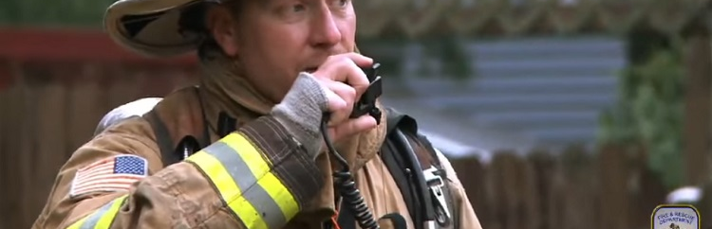
It’s all about Communication!
Clear Radio Procedures
  Stay calm.
  Speak slowly and clearly.
  Repeat if necessary.
  When in doubt keep it short and simple.

Slide 12

13 Initial Arrival Factors
Bystander/witness statements
Access concerns on the property
Building height, size, and stability
Occupancy type
Construction type
Wind direction relative to the building location and configuration
Fire location, size, extent
Civilian and firefighter life safety
Suspected direction of fire and smoke travel within the structure (flow path)
Smoke and fire exposures exterior to the structure
Presence and status of fixed fire protection systems
Firefighter safety building marking systems
Resources available

Slide 13
10-Second Size-Up
What it is: A quick and structured initial report from the first-arriving unit.
Structure:
  Unit identification: "Engine 1 on scene."
  Incident description: "Two-story commercial structure with heavy smoke showing."
  Actions taken: "We are pulling a line for fire attack."
  Command: "Engine 1 establishing Main Street Command."
When to use:
  Upon arrival at an incident.

Slide 14
CAN Report (Conditions, Actions, Needs)
What it is: A concise way to communicate the current situation, what actions are being taken, and what additional resources or support are needed.
Example:
  Conditions: "One-story residential structure, smoke showing from the attic."
  Actions: "Engine 1 is conducting an interior attack."
  Needs: "Request a second engine for water supply."
When to use:
  Progress reports to the Incident Commander.
  Transitioning command.

Slide 15
PACE Model for Problem-Solving Communication
Primary Plan: What you are doing now.
Alternate Plan: Backup strategy.
Contingency Plan: What if conditions worsen.
Emergency Plan: Last resort.
Example: "Primary: Offensive fire attack. Alternate: Exterior lines if interior conditions deteriorate."

Slide 16
Command and Control
360 is Essential
Number of stories on A and C sides
Verify basement type (finished or unfinished) and consider the following:
Type of windows
Likelihood of occupancy
Presence of occupant escape systems
Utilities, including the following:
Electrical service/overhead lines
Propane/fuel oil tanks
Natural gas service (location)
Photovoltaic panels (solar panels)
Pre-existing structural hazards
Hazardous grade changes
Roof type and construction
Presence of fire protection features (hydrants, FDC, fire pump, etc.)

Slide 17
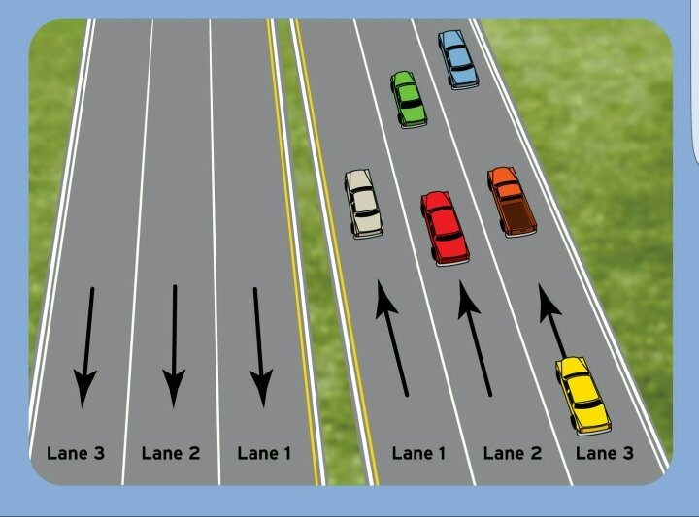
Highway Identification
Lane
Marker
Direction

Slide 18
Let’s Practice

Slide 19
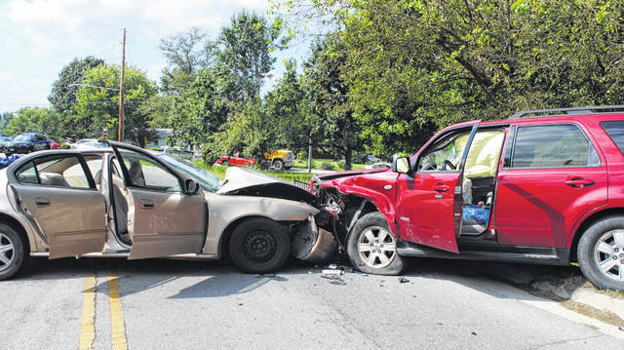

Slide 20
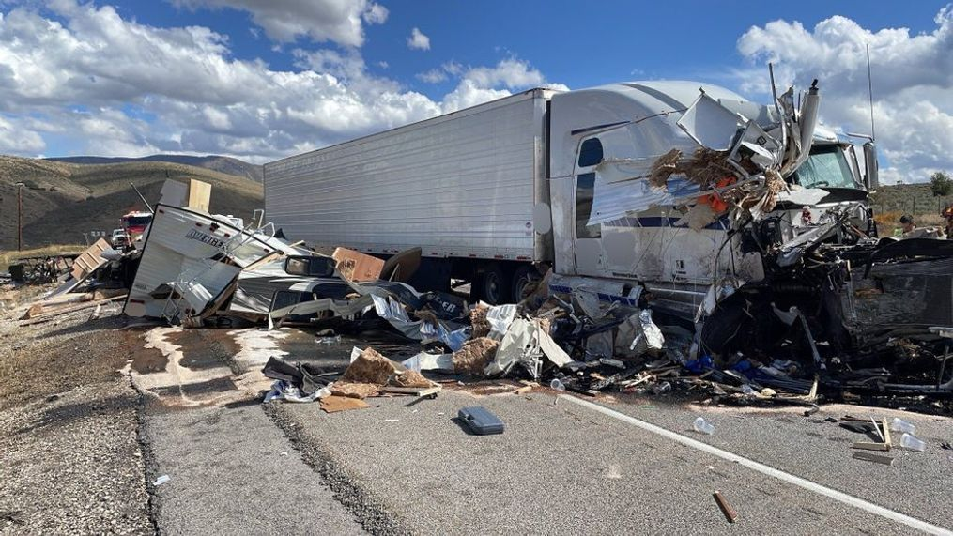

Slide 21
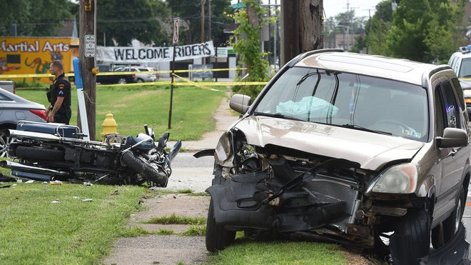

Slide 22
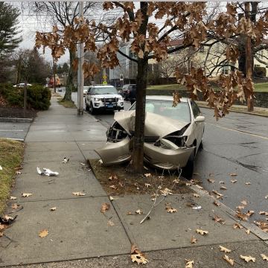

Slide 23
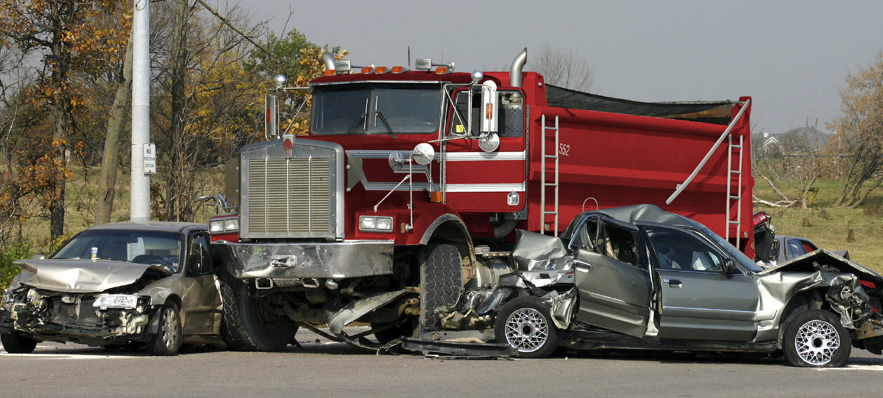

Slide 24
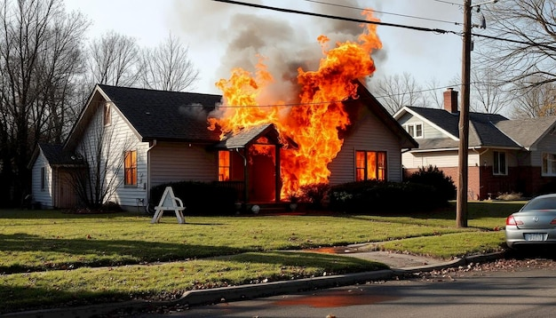

Slide 25
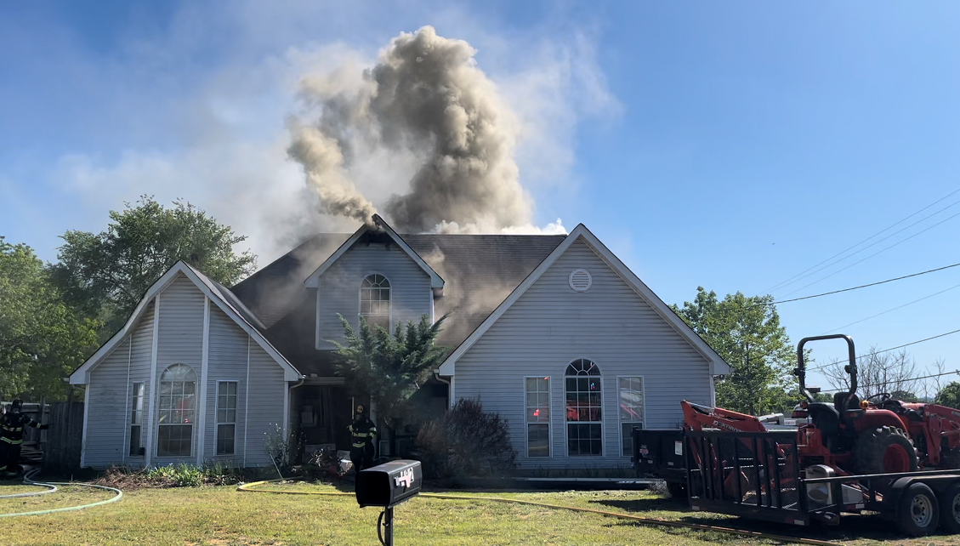

Slide 26
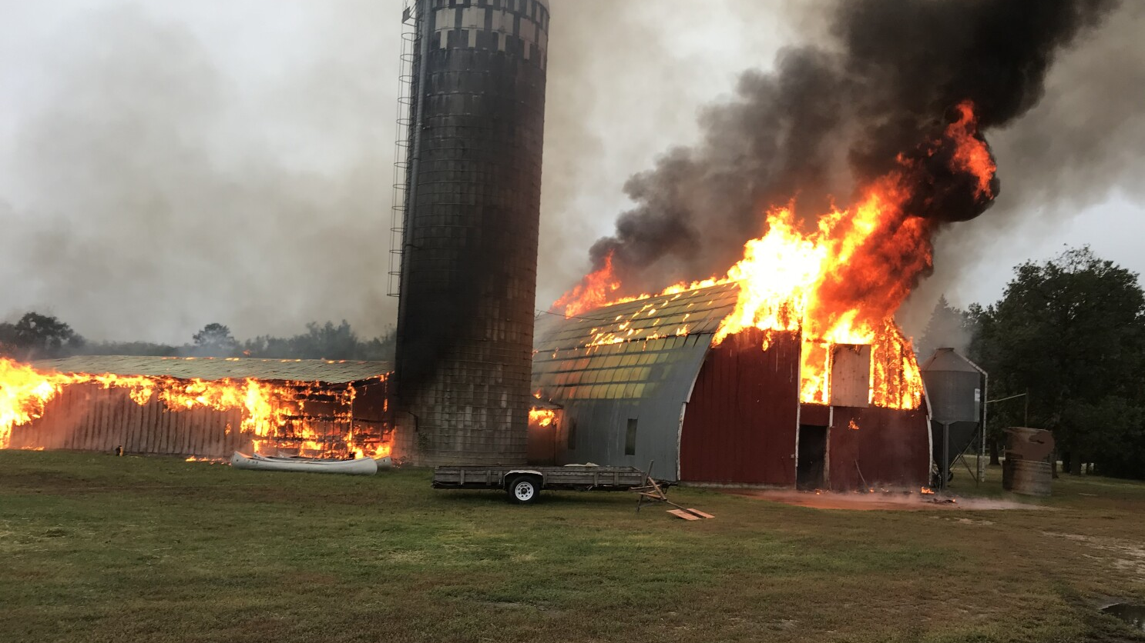

Slide 27
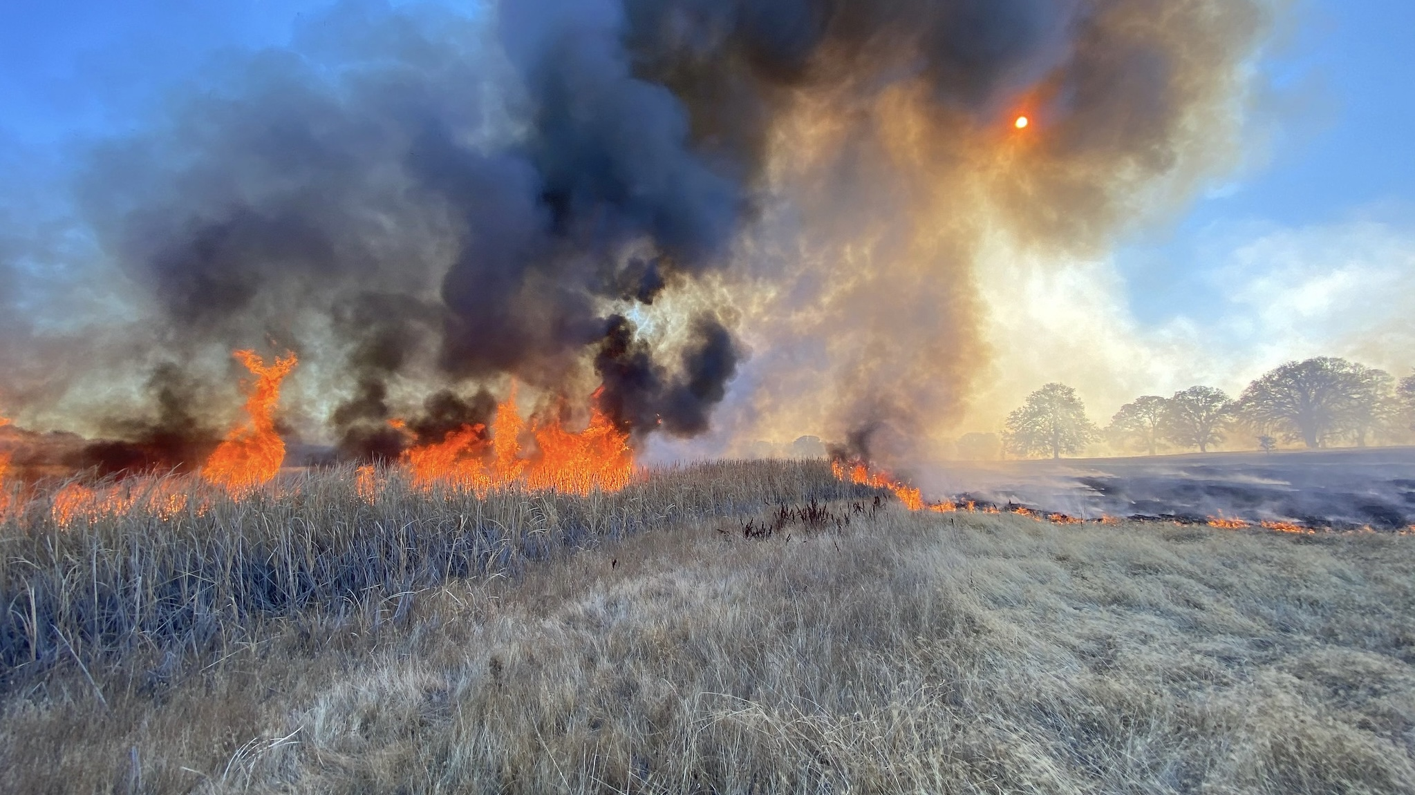

Slide 28
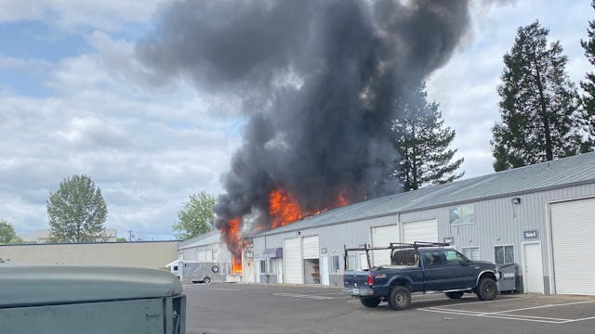

Slide 29
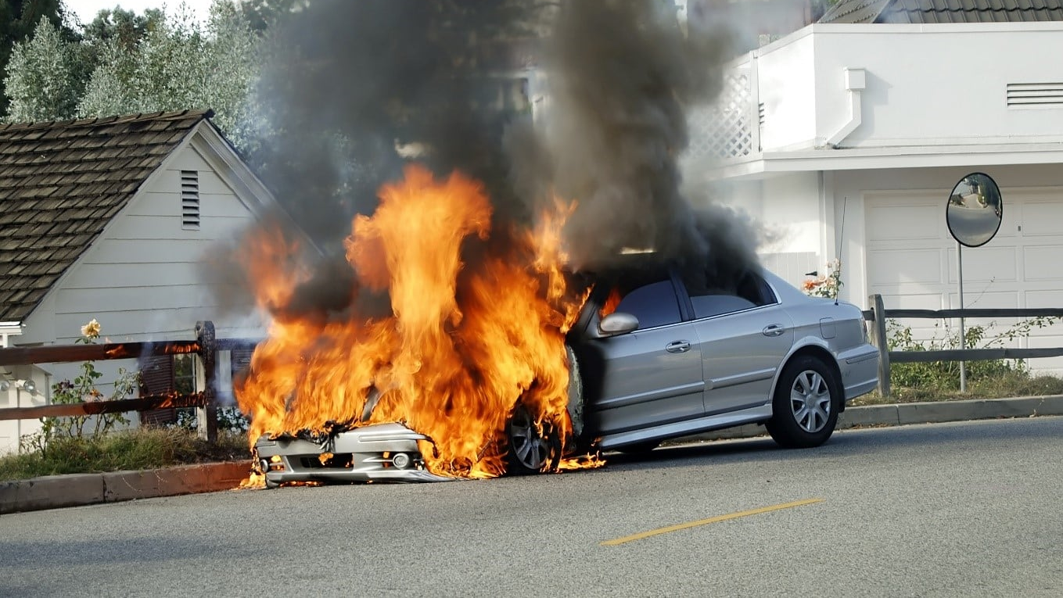

Slide 30
Solutions and Best Practices
Regular ICS training drills
Clear SOPs for local incidents.
Cross-agency collaboration.

Slide 31
Conclusions and Q & A

Slide 32



THANKS FOR HAVING ME
ANY QUESTIONS?
marchill@twodarkthirty.com
Remember to always inspire, teach, and learn!
Please check out my website for more information and free downloads.

