Slide 1




Slide 2
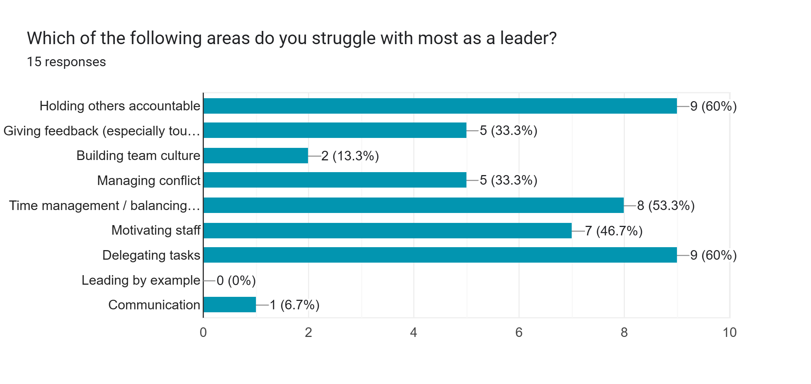

Slide 3
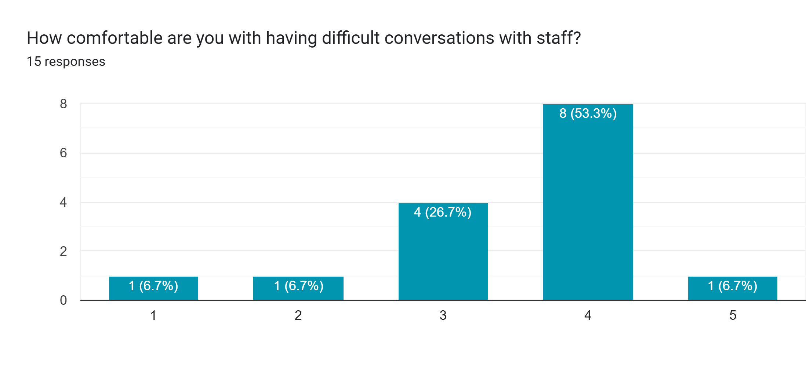
(Linear scale — 1 = Avoid it at all costs, 5 = Very comfortable)

Slide 4
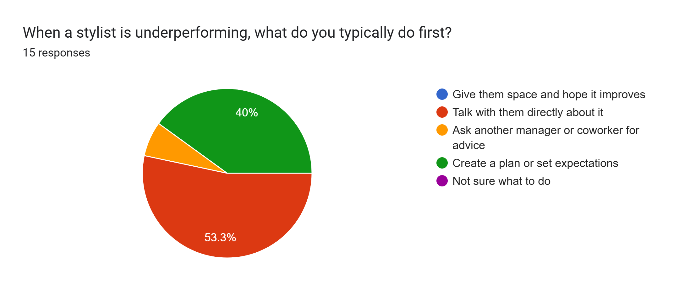

Slide 5
Main Themes From the Survey
Team Motivation & Buy-In
Time Management & Task Overload
Delegation & Accountability
Difficult Conversations & Leadership Confidence
Younger Leaders & Respect
Leading By Example & Emotional Load

Slide 6
“The Mirror Test": Leading Starts With You
We teach people how to treat us—not just by what we say, but what we allow, ignore, or reinforce.
You don’t need to know everything. You need to stand for something.
Respect is earned through consistency, not age.
You don't have to be the smartest person in the room. Just the most accountable.
Practical Takeaway:
  What example are you currently setting—intentionally or not?
  A short daily “mirror test” — Did I show up today the way I’d want my team to?

Slide 7
Create motivation & Inspiration
REWARD THE MOST IMPROVED
CALL OUT THE BEST EFFORTS AND THE TYPE OF ATTITUDE YOU WANT TO SEE
MOTIVATION WILL INCREASE WHEN YOUR CREW SEES IMPROVED RESULTS

Slide 8
Time, Tasks, and the Tyranny of Everything
You’ve got a foot on the floor and a hand in the back office. No wonder you’re sinking.
A simple framework:
🔹 Must Do
🔹 Should Do
🔹 Let Go
Delegation is like coaching, not control.
  Ask: “Who are you robbing of growth by not letting go?”
  “Delegation isn’t dumping. It’s development.”
Practical Tool:
  Provide a sample “task delegation worksheet” or a weekly reflection card:
  ➤ What am I holding on to that someone else could grow from?

Slide 9
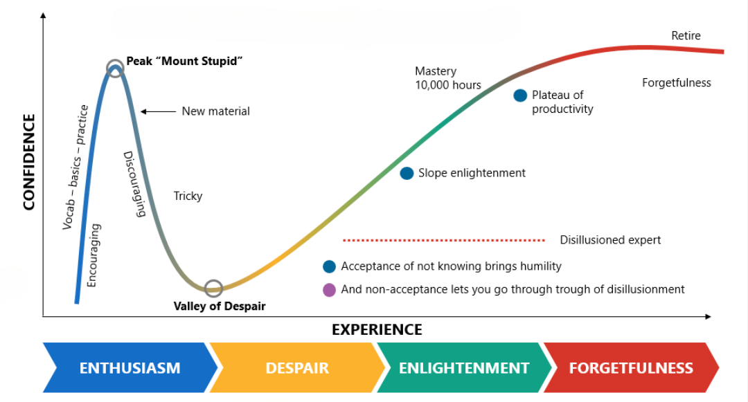
Dunning-Kreger Effect

Slide 10
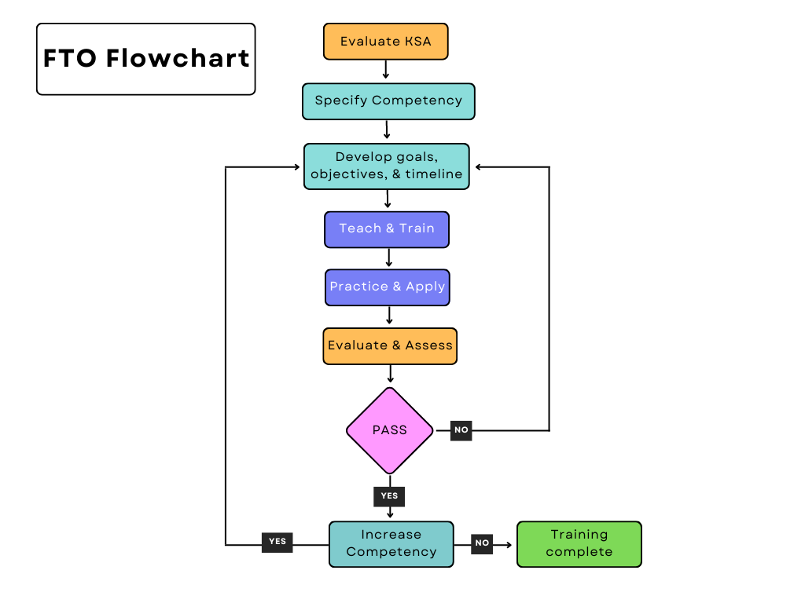

Slide 11
Tough Talks and Team Culture
If it’s hard to say, it’s probably worth saying. The right way.
A simple 3-step framework:
  Clarify the real issue (not the attitude, but the action)
  Be honest, not harsh (clear is kind, vague is cruel)
  Hold the standard even if you’re tired
Use This Language:
  “I respect you too much not to be honest.”
  “I’m not trying to control you. I’m trying to help you grow.”
  “This may not be easy, but it’s important.”

Slide 12
Let’s talk about counseling and feedback
START WITH A QUESTION AND END WITH A QUESTION
ALLOW TIME TO EXPLAIN THEMSELVES
BE SPECIFIC AND TARGETED. RELATE THE ISSUE TO A GOAL.
TIMELY, DON’T WAIT!
PRAISE OVER CRITICISM
CREATE A PLAN TOGETHER FOR ACHIEVEMENT.

Slide 13
Final Close-Out Idea
What’s one thing you’re doing that your team will copy tomorrow—good or bad?

Slide 14

It’s in your power!
A + E = P
(Attitude + Effort = Performance)
Notes:
Attitude + Effort = Performance

Slide 15
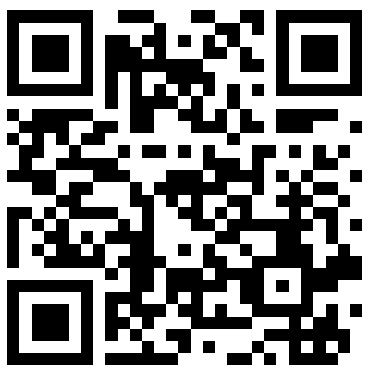

THANKS FOR HAVING ME
ANY QUESTIONS?
MARCHILL@TWODARKTHIRTY.COM
REMEMBER TO ALWAYS INSPIRE, TEACH, LEAD, AND LEARN!
PLEASE CHECK OUT MY WEBSITE FOR MORE INFORMATION AND FREE DOWNLOADS.

