Slide 1


Embracing the F-Word: Failure as a Path to Excellence

Slide 2
Who is marc hill?
Bachelors' degree in Social Science & Masters in Ed Leadership
Over 20 years in public service
  Volunteer, Career, & Public Schools
  Every Rank from FF to Chief
Author of Two Dark Thirty & Read Before Leading
Instructor I & II (Fire and EMS)
FF I & II, DO Pumper & Aerial, & FO I
Haz-Mat Tech, Haz-Mat Commander, Wisconsin North Region TII Lvl A Team
High & Low Angle Rope Team
Swift Water Rescue Team
Wisconsin State Emergency Response Team
NR-Paramedic & Community Medic
CAAS Accreditation Manager

Slide 3
Honest, no BS Truth

Slide 4
You will Fail!
YOU AREN’T PERFECT
YOU DON’T KNOW IT ALL

Slide 5

Is there a difference?
FAILURE PSYCHOLOGICALLY LINKS US TO LOW SELF ESTEEM AND OUR ABILITY TO LEARN.
FAILURE IS PAINFUL, ESPECIALLY WHEN WE HAVE EXPERIENCE & WISDOM.
STOP POINTING FINGERS
AND START LOOKING IN THE MIRROR!

Slide 6

How many of you were Successful the first time you did anything?

Slide 7

Case Studies in failure

Slide 8
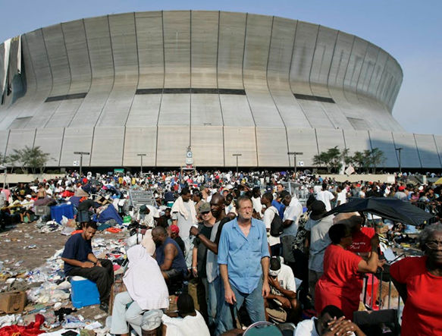
Hurricane Katrina Command Breakdown
Failure: Overlapping federal/state command structures and poor NIMS/ICS implementation delayed response efforts.
Post-Katrina reforms standardized Unified Command protocols across agencies
Departments now conduct cross-agency “disaster chess” simulations
Actionable Takeaway: Run quarterly interagency tabletop exercises with EMS/police using standardized ICS forms

Slide 9
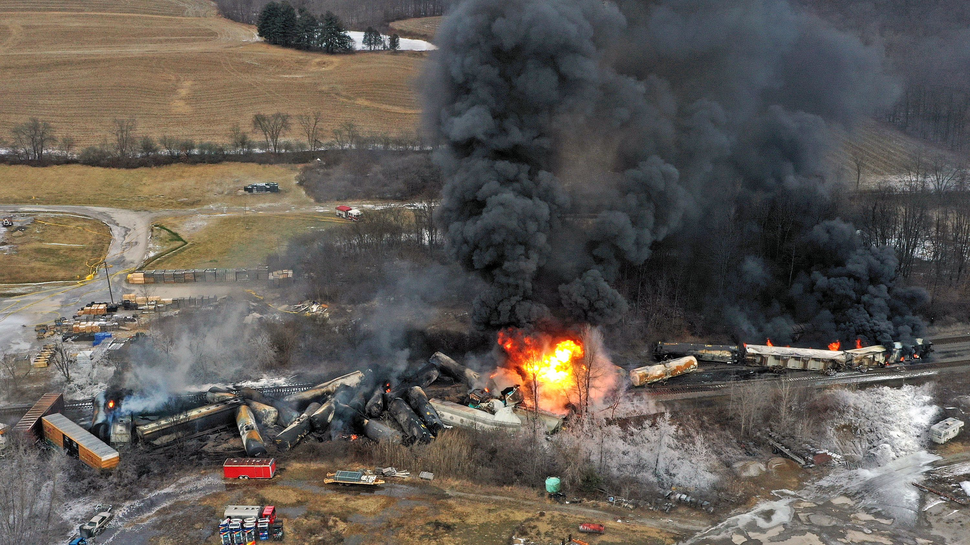
East Palestine Train Derailment
Failure: EPA, CDC, and State Agencies chose to burn off chemical spill.
The entire region will be impacted environmentally for decades causing ground water issues and topsoil concerns.
Advanced Hazmat tools were need to be implemented to verify worry and concerns.
Correct long-term impacts on this scale need to be thought through.

Slide 10
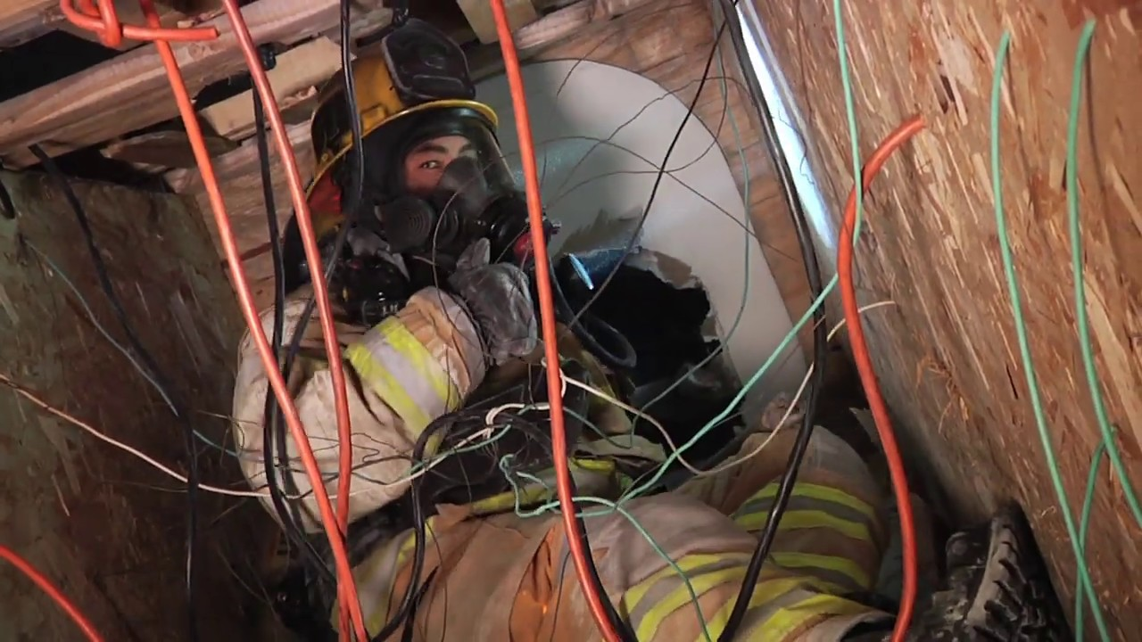
Volunteer Firefighter Dies During SCBA Confidence Training
Failure: No vitals taken prior to incident and no safety officer assigned to the maze during event.
These incidents underscore the importance of rigorous safety protocols, proper supervision, and ongoing evaluation of training procedures in the fire service. They also highlight the need for comprehensive medical screenings and monitoring during physically demanding exercises.

Slide 11
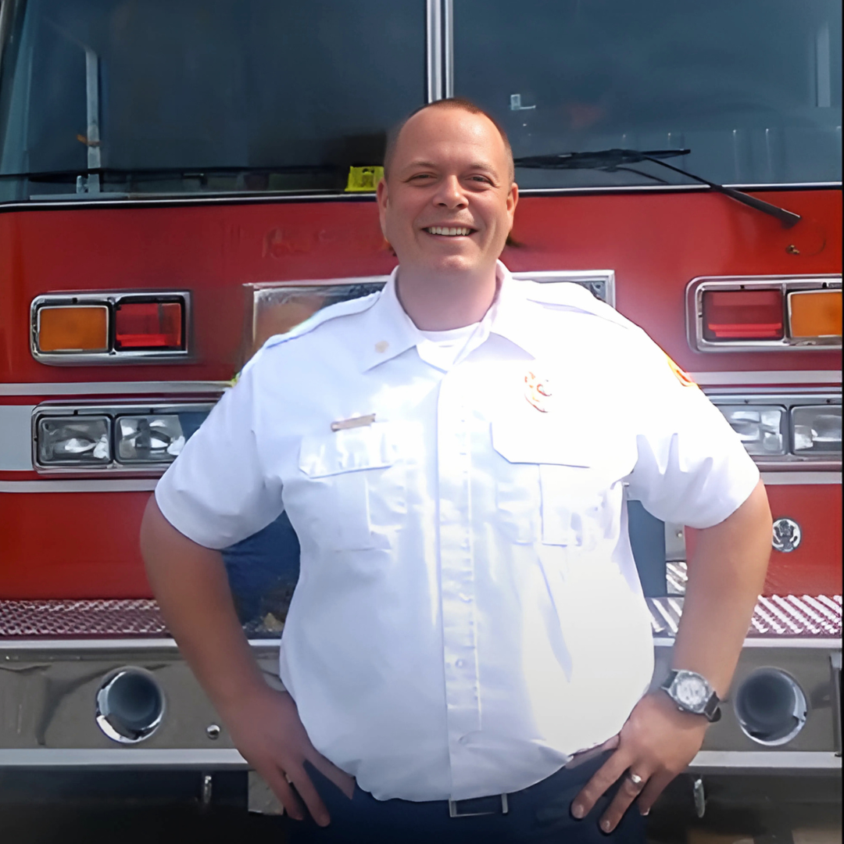
Rothschild Fire/EMS Chief
I was overconfident
I lacked communication skills
I was toxic
I didn’t play politics
I lost sight of why I was there

Slide 12
What are the common takeaways?
COMMUNICATION (LACK OF OR NOT HEARING AND LISTENING)
UNDER OR NOT UTILIZED TOOLS OR TECHNOLOGY
TUNNEL VISION
LACK OF TRAINING/EDUCATION

Slide 13

Think about the last event you were in charge of… how did it go?

Slide 14
Redefining Failure

Slide 15
You’ve got to change
What’s worse paralysis by over analysis or inaction?
Teachable moments are opportunities.
People are scared to act because of the repercussions.

Slide 16
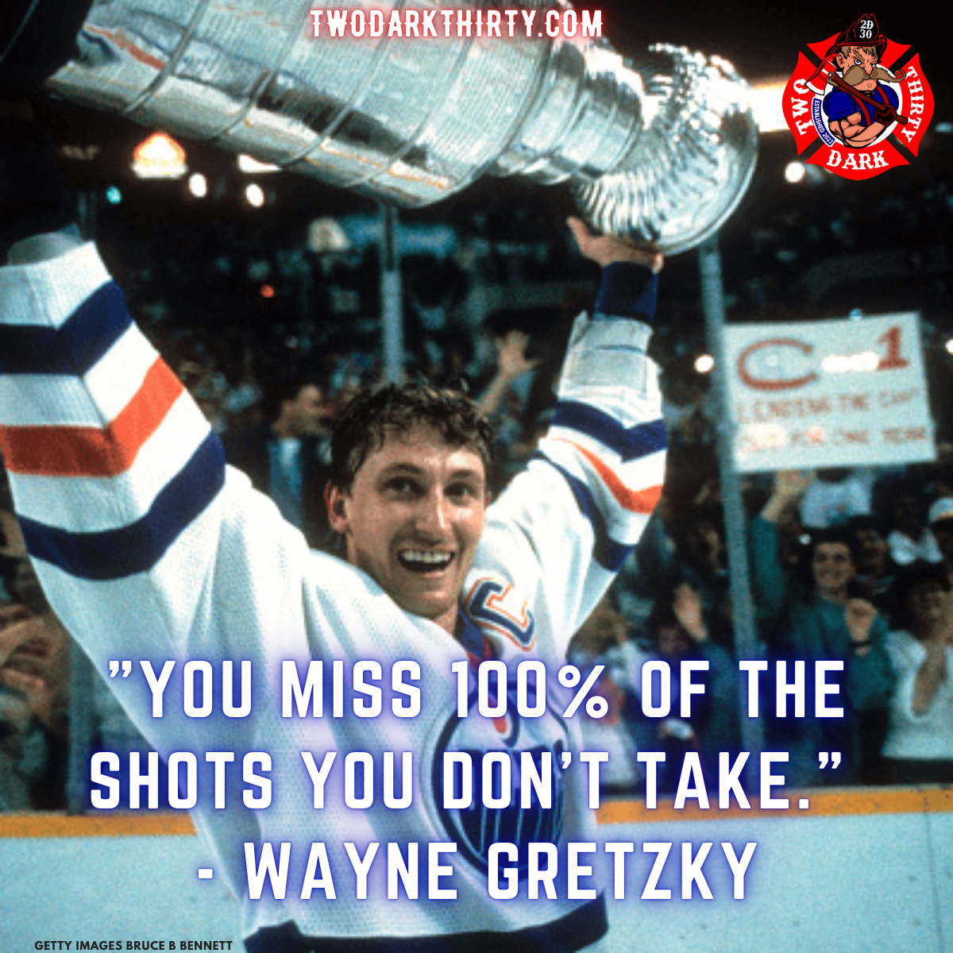
Lead by example
GET OUT
GET OUT FROM BEHIND YOUR DESK.
TALK ABOUT
TALK ABOUT WHEN YOU FAILED AND HOW IT IMPACTED YOU.
COMMUNICATE
COMMUNICATE BUT DO SO WITH TACT!

Slide 17
Failure is good
UNDERSTAND AND ACCEPT THE FAILURE. BE BRAVE!
HAVE THE SKILL TO SHOW OTHERS ITS OK BY TELLING THEM YOU HAVE THEIR BACK.
GET OUTSIDE YOUR COMFORT ZONE.
PUSH YOUR LIMITS

Slide 18
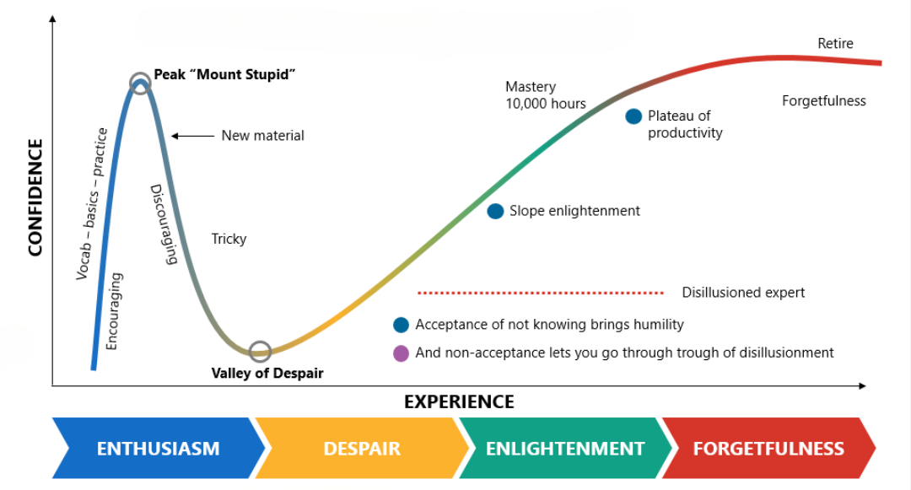
Dunning-Kreger Effect

Slide 19

Take a minute to reflect on your past failures and how important they are to wisdom.

Slide 20
Learning from Failure

Slide 21
Write things down
Near miss calls are an example, every department should have this form. If not make one!
Brings attention to the AAR.
This can be done at any time, especially during a training event.
When you write things down you will remember them.
Use the evaluation form as a teaching tool.

Slide 22
For instructors
ALLOW YOUR STUDENTS TO FAIL
USE THE GROUP TO IDENTIFY IMPROVEMENTS (PEER REVIEW)
BUILD ON THE SUCCESSES AND LEARN TO THINK WITH A POSITIVE GROWTH MINDSET
EVALUATE YOUR LESSONS AND YOUR CONTENT FOR IMPROVEMENTS

Slide 23
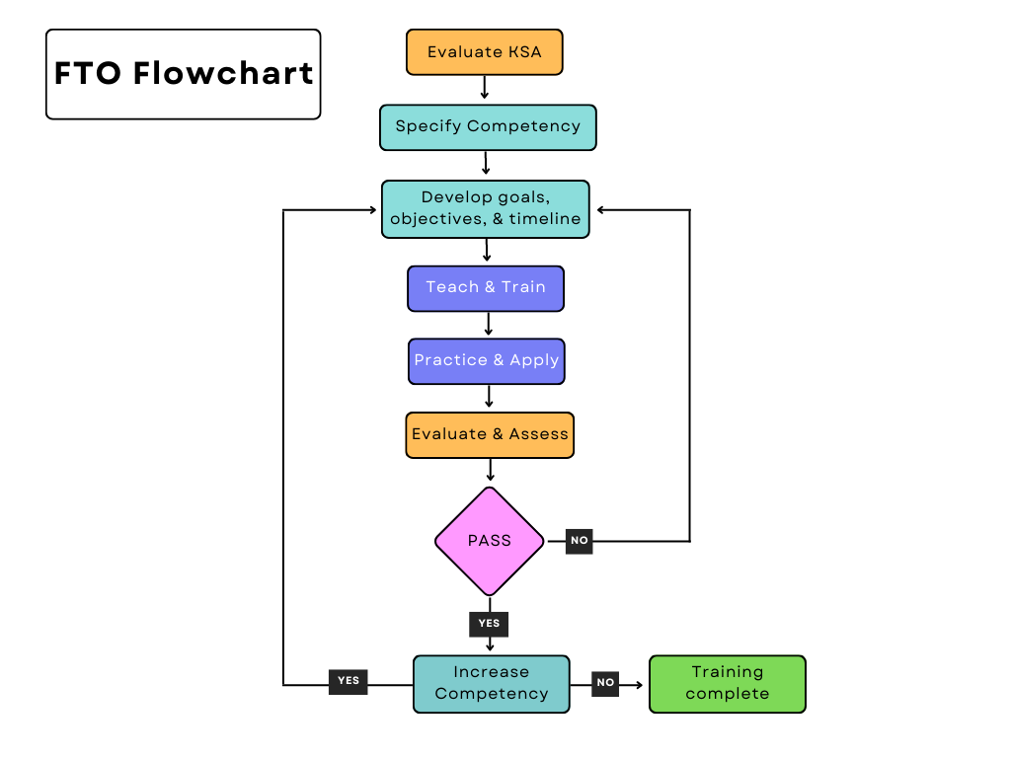

Slide 24

Time is on your side
DON’T BE CRAZY!
1
TAKE THE TIME TO EVALUATE AND REFLECT
2
ADOPT A CYCLICAL APPROACH TO YOUR PROCESS
3

Slide 25
After Action Reviews (AAR)
4 BASIC QUESTIONS
WHAT WAS SUPPOSED TO HAPPEN?
WHAT WENT WELL?
WHAT WENT WRONG?
WHAT CAN WE LEARN AND IMPROVE?

Slide 26
Key Principles of an AAR
FACILITATED DISCUSSION: TYPICALLY LED BY A NEUTRAL PARTY (NOT A DIRECT LEADER OF THE TEAM).
PARTICIPATION FROM ALL LEVELS: EVERYONE INVOLVED IN THE OPERATION HAS INPUT.
FOCUS ON IMPROVEMENT, NOT BLAME: THE GOAL IS LEARNING, NOT PUNISHMENT.
TIMELINESS: CONDUCTED AS SOON AS POSSIBLE AFTER THE EVENT FOR ACCURACY.

Slide 27

Write down your biggest failures or regrets.

Slide 28
Failure-Positive Culture

Slide 29
No this isn’t A hippie Hug fest
This is the basic idea that when you or anyone fails that you don’t come down on the person like a hammer. (Situation Dependent of course)
Take a step back and breathe, let them fail, let them struggle, and allow time for the person to figure it out on their own.
Hold yourself Accountable!

Slide 30
Create motivation
REWARD THE MOST IMPROVED
CALL OUT THE BEST EFFORTS AND THE TYPE OF ATTITUDE YOU WANT TO SEE
MOTIVATION WILL INCREASE WHEN YOUR CREW SEES IMPROVED RESULTS

Slide 31
Understand your role
are you making the mistake vs. you are the leader or teacher allowing the mistake to occur

Slide 32

Do you have a failure positive culture?
How could perspective help retention and recruitment?

Slide 33
Personal Growth

Slide 34
How do you plan to improve?
BOOK CLUBS
CONFERENCES
ONLINE LEARNING AND FREE TRAINING
OUTSIDE SPEAKERS
CREATE COMPETITION AMONG SHIFTS, CREWS, DEPARTMENTS

Slide 35
1% Rule
IT TAKES 10,000 HOURS TO BECOME AN EXPERT.
DON’T EXPECT BIG CHANGE OVERNIGHT.
YOU WILL HAVE GOOD DAYS AND BAD DAYS, THE REALITY IS YOU WANT TO PLAN ON HAVING MORE GOOD THAN BAD.
Notes:
That’s nearly 4 years working every day 8 hours a day at something!

Slide 36
Confidence
When you fail and reevaluate you will learn
That growth will spur new wisdom from the experiences
That wisdom will grow in you as confidence
Confidence is contagious

Slide 37

It’s in your power!
A + E = P
(Attitude + Effort = Performance)
Notes:
Attitude + Effort = Performance

Slide 38


Find ways to learn

Slide 39

What kind of education do you want to seek out?

Slide 40
Leadership Excellence

Slide 41
It starts at the top
LEAD BY EXAMPLE. EXTREME OWNERSHIP
ACTIONS SPEAK LOUDER THAN WORDS
YOU NEVER KNOW UNTIL YOU TRY
DON’T BE AFRAID TO FAIL
ASK AND BE OPEN TO DISCUSSION… COMMUNICATE!

Slide 42
Let’s talk about counseling and feedback
START WITH A QUESTION AND END WITH A QUESTION
ALLOW TIME TO EXPLAIN THEMSELVES
BE SPECIFIC AND TARGETED. RELATE THE ISSUE TO A GOAL.
TIMELY, DON’T WAIT!
PRAISE OVER CRITICISM
CREATE A PLAN TOGETHER FOR ACHIEVEMENT.

Slide 43
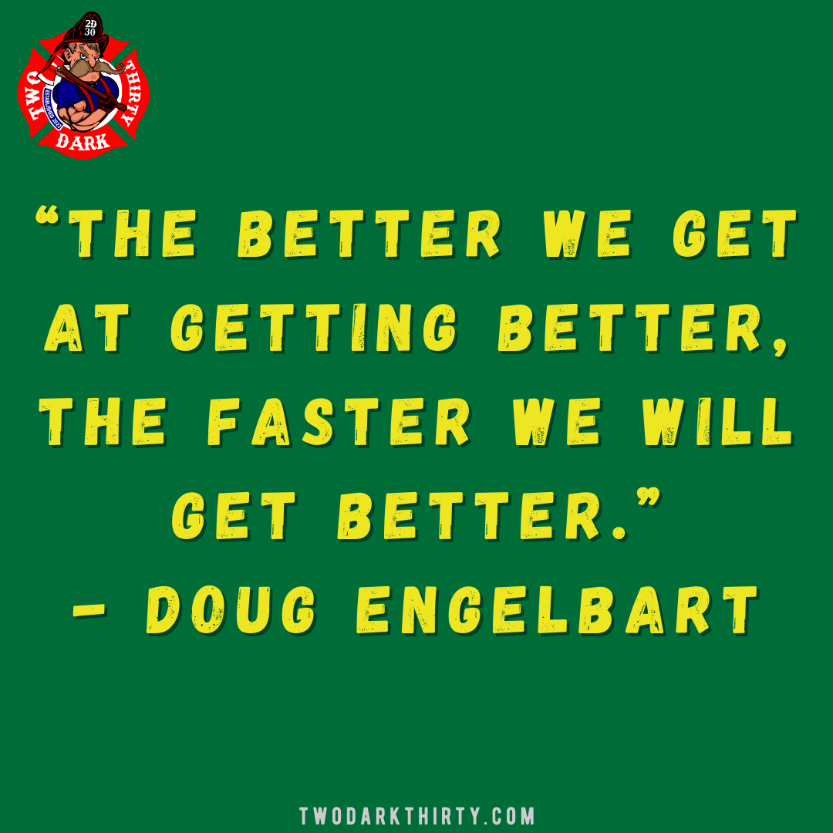

Slide 44
Core principles
HUMILITY & INTEGRITY
EMPATHY
GROWTH MINDSET &
POSITIVE ATTITUDE
FOCUS ON IMPROVEMENT & WHAT YOU CONTROL

Slide 45

What kind of leader do you want to be?

Slide 46
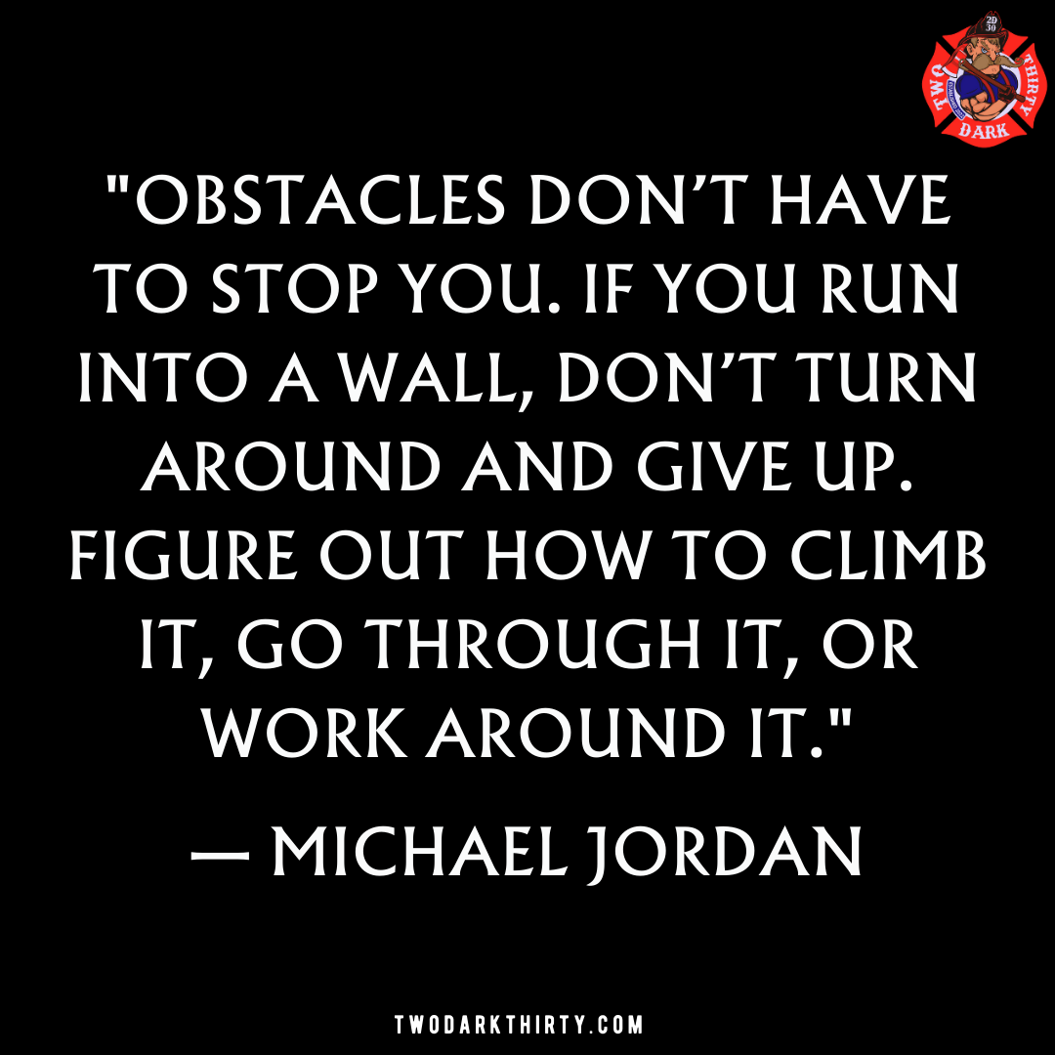

Slide 47

My challenge to you…
START LOOKING AT FAILURE AS AN OPPORTUNITY.

Slide 48
Final questions

Slide 49

20 Leadership Lessons
Accountability
Foundations
Purpose
Patience
Responsibility
Training
Value
Ambition
Ethics
Assistance
Communication
Engagement
Inspiration
Motivation
Teams
Goals
Challenges
Politics
Failure
Balance

Slide 50
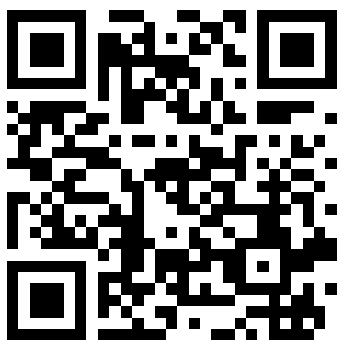


THANKS FOR HAVING ME
ANY QUESTIONS?
MARCHILL@TWODARKTHIRTY.COM
REMEMBER TO ALWAYS INSPIRE, TEACH, LEAD, AND LEARN!
PLEASE CHECK OUT MY WEBSITE FOR MORE INFORMATION AND FREE DOWNLOADS.

