Slide 1



Baraboo Fire & EMS FTO Training

Slide 2
Welcome
Thank you for being here and for taking this important step forward

Slide 3

About me
Taught every grade 6th through 12th
College adult instructor for the past 12 years
Principal, Union President , Coach
MEd in Educational Leadership
Specialized in Curriculum and Learning Systems
Volunteer Firefighter and EMT
Engineer of Special Rescue Ops
Fire Chief
Fulltime Firefighter Paramedic
Haz Mat Technician/ Haz Mat Commander
Instructor I & II for both Fire and EMS

Slide 4
What’s on Tap?
Learning Objectives (LO):
Understand your role and responsibilities as an FTO.
Construct and use quantitative checkoffs and KSA evaluations.
Recognize your audience and understand their expectations.
Analyze how you teach and how to improve.
Organize and take part in feedback and counseling sessions.
The timeline will be roughly 6 hours:
Introductions 9:00
LO 1 9:30-10:00
Break
LO 2 10:05-11:00
Break
LO 3 11:05-11:50
Lunch
LO 4 12:40-1:30
Break
LO 5 1:35-2:30
Wrap-up 2:35-3:00

Slide 5


Slide 6
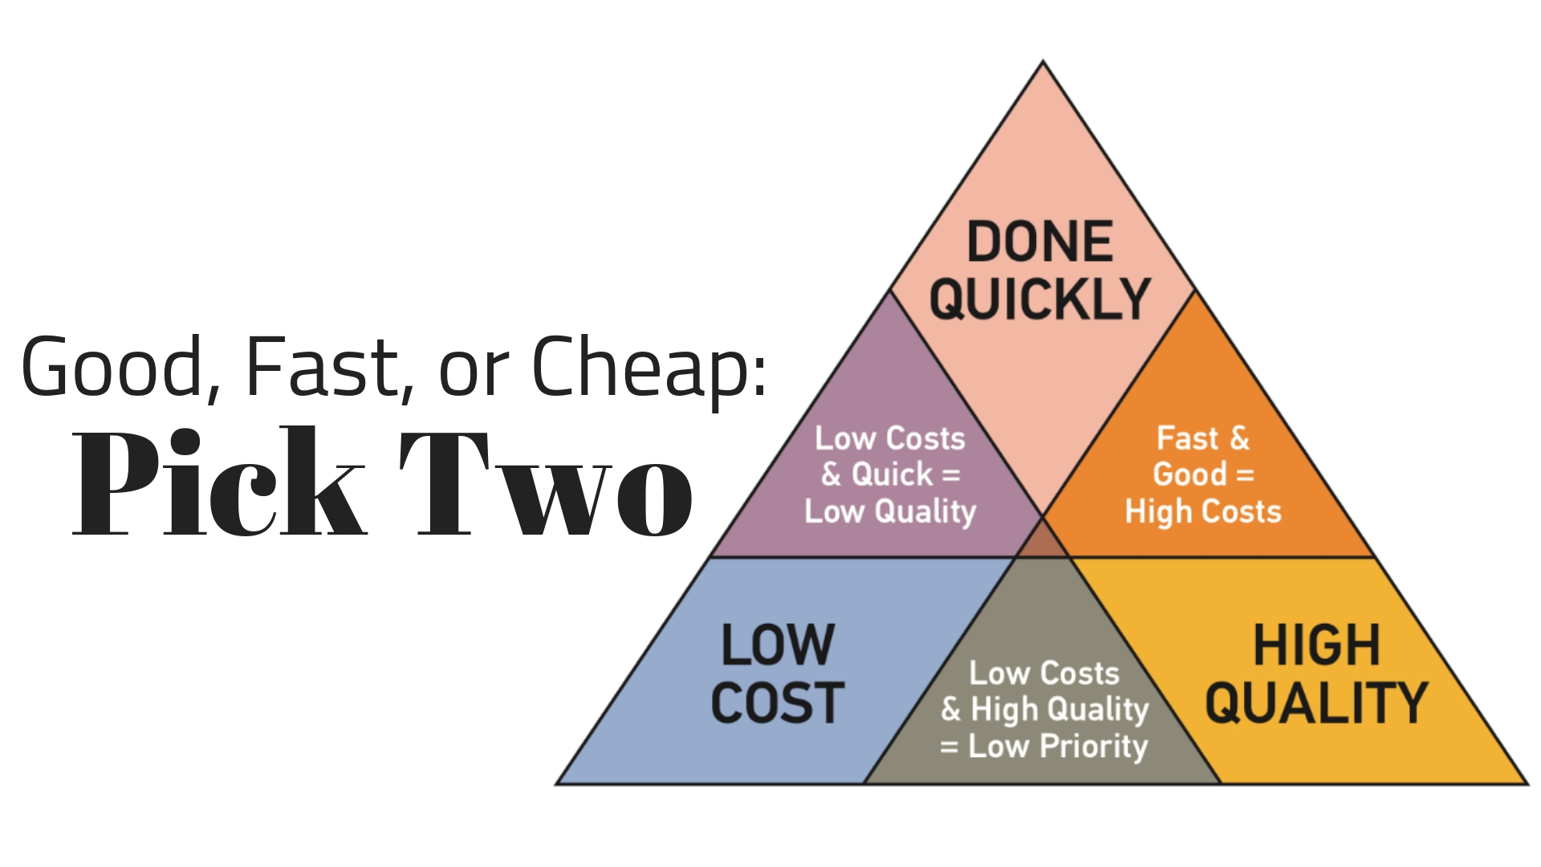

Slide 7
1. Know AND understand your role.
Chapters 3, 6, 7 & 8
9:30-10:00

Slide 8
You are the FTO, not the mentor!
Your role is the teacher and coach. You evaluate and educate.
Use different methods of instruction
Tell a story!
Empower them to act and lead.
Have them teach you!
Celebrate success and have consequences for poor actions

Slide 9
Compare the roles
Mentor
FTO
Friend
Supporter
Role Model
Teacher
Evaluator
Coach

Slide 10


Slide 11
Positive attitudes are contagious
Think Win-Win
Celebrate the positives and the natural abilities in your trainee
Think about how you come off = Enthusiasm
Be someone who inspires not scolds
Remember you should WANT them to succeed, not cheer for their failure.

Slide 12
Be an excellent communicator
Excellent at written and oral
01
Feedback, feedback, feedback
02
Never have evaluation sessions alone
03
Create the feedback circle
04
Sandwich method
05

Slide 13

Questions

Slide 14
2. Quantitative Checkoffs and Evaluation.
Chapters 2 & 3
10:05-11:00

Slide 15
Fundamentals
Sweat the small stuff
Quality vs. quantity
When to apply pressure
Sink or swim

Slide 16
What’s the difference
Quantitative data is numbers-based, countable, or measurable.
Qualitative data is interpretation-based, descriptive, and relating to language

Slide 17

Quantitative Checkoffs
Data and rock solid
Defied and understood
Checkoffs are the basis for the training and education
Daily, Weekly, Monthly, or Quarterly

Slide 18
Quantitative Examples
Numbers based
  Trainee has 60 seconds to accomplish turnout drill
  Trainee has achieved 50 successful IV attempts
  Trainee has completed Protocol review
  Trainee is able to tie rescue harness with webbing
  Trainee can identify all refrigerated medications

Slide 19
Let’s look at your Task Book

Slide 20
Let’s define our KSA
Knowledge
Skills
Abilities
The book or didactic learning
Step-by-step processes
Problem-solving and troubleshooting

Slide 21
What KSA do you want them to attain?
What do you want them to be proficient in?
Do you use SMART goals?
Having a defined endpoint makes it possible to achieve success.
Be motivated and have a clear vision.
Promote buy-in to YOUR system.

Slide 22

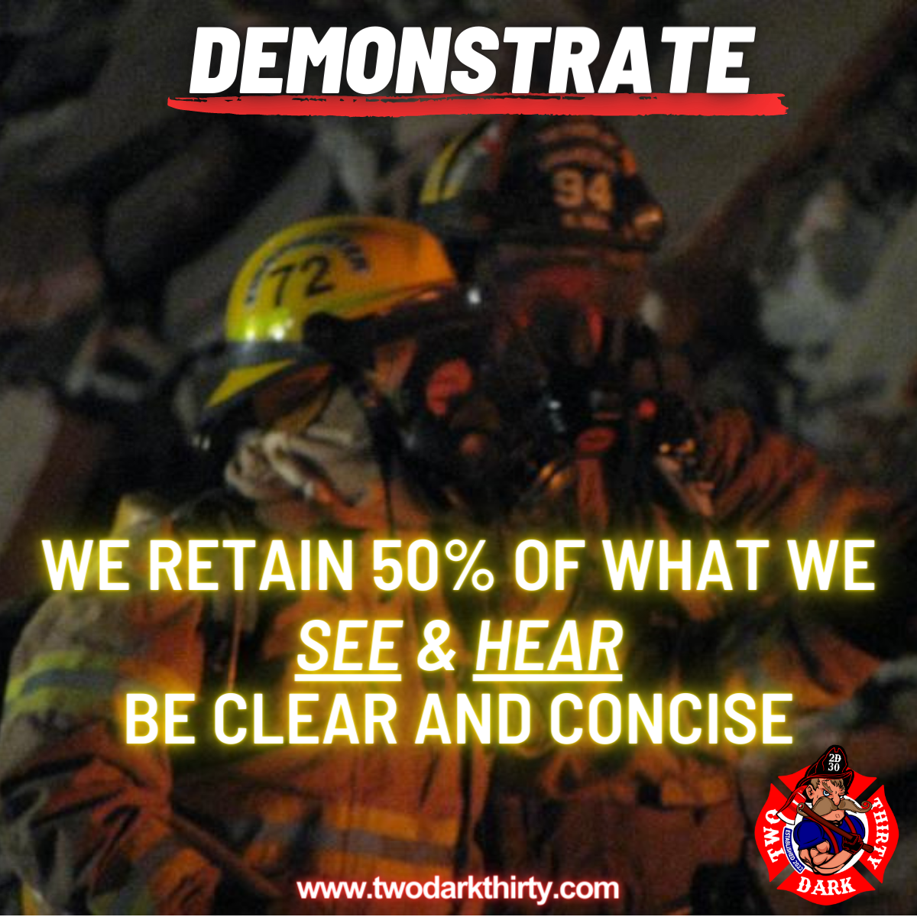

Slide 23
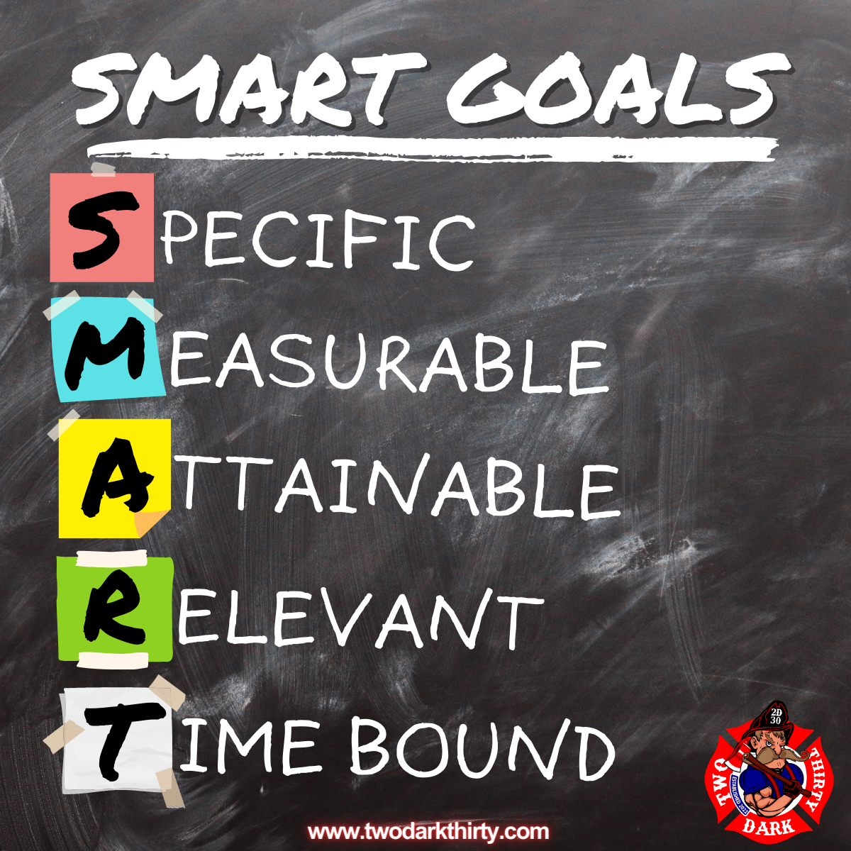
Workbook page 9

Slide 24
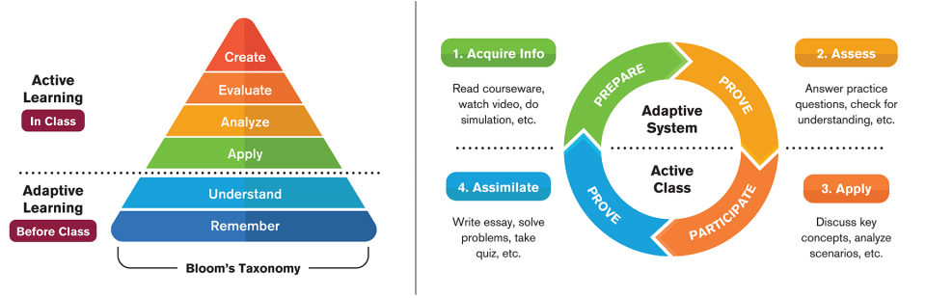
Know when & What to teach

Slide 25
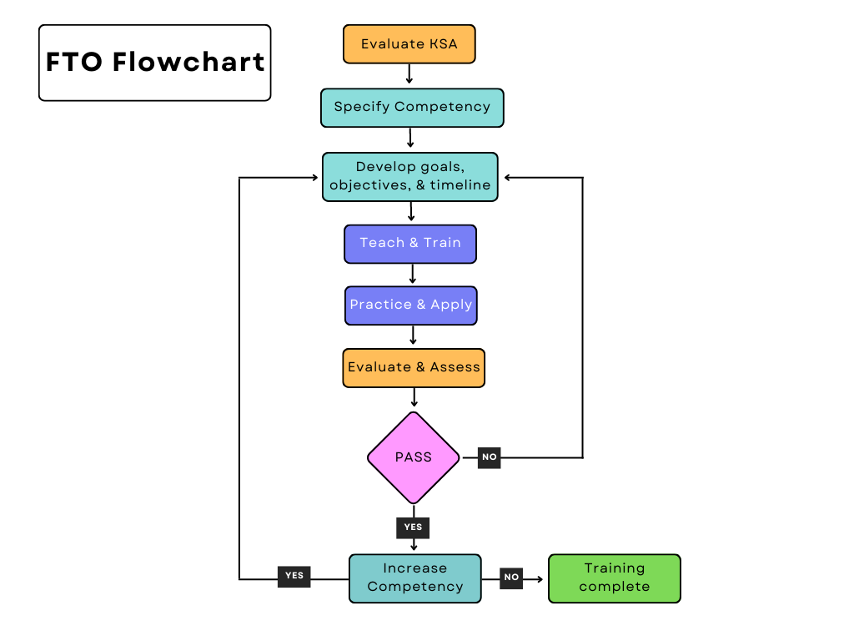
FTO Training Matrix

Slide 26
Questions

Slide 27
3. Recognize your audience
Chapters 4 & 5
11:05-11:50

Slide 28
Understand who you are training
One size doesn’t fit all
Test your trainee
Adaptive learning system (open learning system)

Slide 29
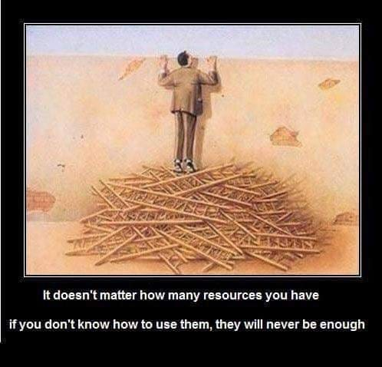

Slide 30
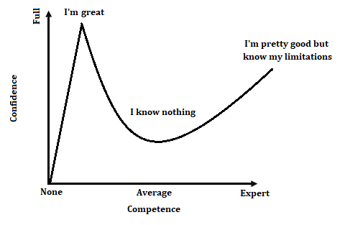
Dunning-Kreger Effect

Slide 31
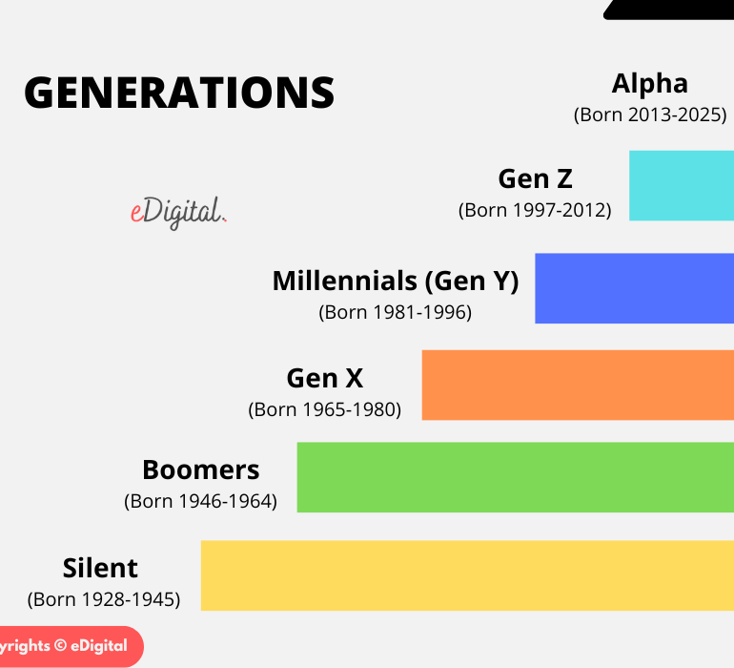
Generational Differences
Millennials, Gen Z, Gen Y
Major Historical Events
Every Generation thinks less of the last
Internet and instant gratification
Parents and working, divorce rates, age of parents
Only children, less competition

Slide 32
What is experience?
3-year 30-year veteran
I did it in class
We’ve been doing it this way for 30 years

Slide 33
How can we adapt?
Set GOALS!
Task Book is the beginning expand and go further
Concentrate on the areas of improvement

Slide 34
Step back
Don’t just do something, stand there.
1
Give the trainee freedom to fail
2
Relax and have fun
3
Realize it is a process and will take time
4

Slide 35
Questions

Slide 36
4. Analyze how to improve
Chapters 2 & 3
12:40-1:30

Slide 37


Slide 38
Go back to your Checkoffs
Identify the lack of KSA
Target the issue and find solutions
Use others to help you, Team effort

Slide 39
Communicate
Ask your trainee where they need to improve
Ask how they learn and what they enjoy
Cater the solution to your problem
Admit that it could be you!

Slide 40
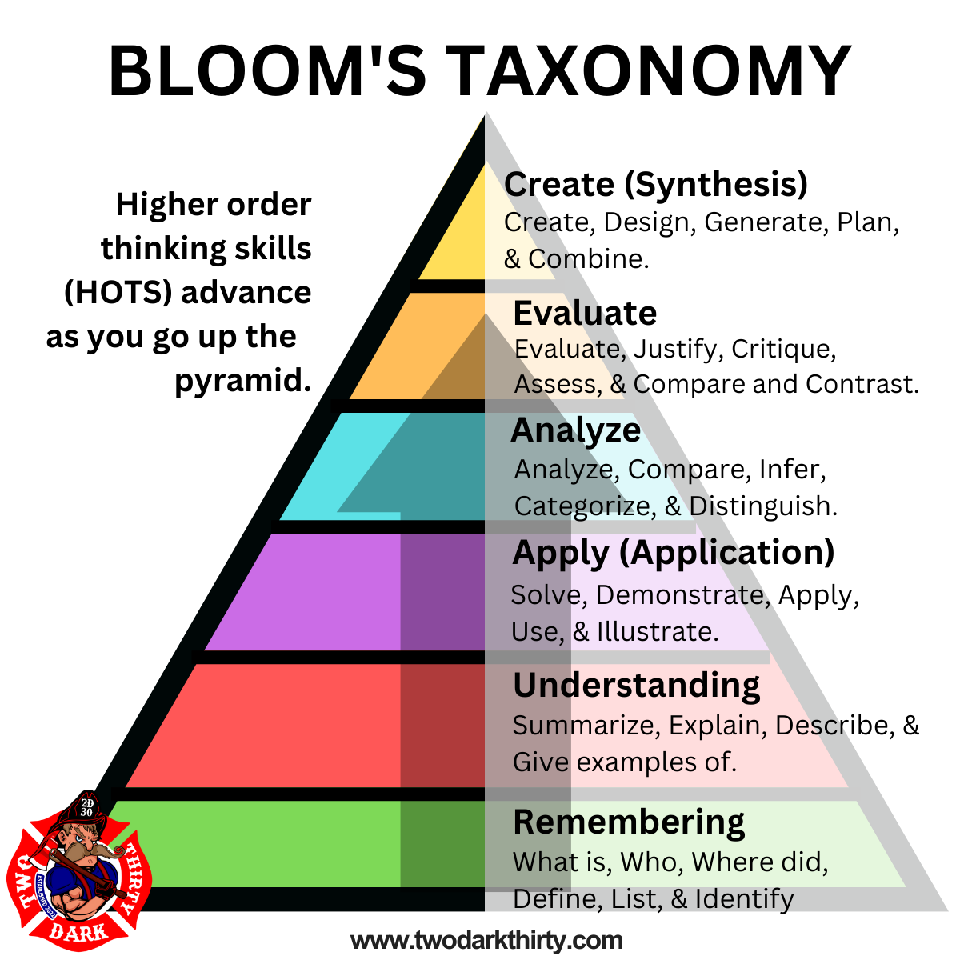
HOTS: Higher order thinking skills

Slide 41
Different Learning Styles
Go back to the Adaptive Model
Think HOTS
Hands-on is great but you need the Didactic first to be able to apply and adapt.

Slide 42
Take a look at your evaluations
If everyone is getting the same thing wrong…
What is the question asking?
Are the possible answers wrong?
Are you evaluating the right things?

Slide 43
Try this out open page 8 in Workbook

Slide 44
Questions

Slide 45
5. Feedback and counseling
Chapters 7, 8 & 9
1:35-2:30

Slide 46
Integrity!
There is no substitute.
Truth and honesty are ALWAYS the best policies
Empathize with your trainee
Meet regularly with your supervisors

Slide 47
Let’s talk about counseling and feedback
Start with a question and end with a question
Allow time to explain themselves
Be specific and targeted. Relate the issue to a goal.
Timely, don’t wait!
Create a plan together for achievement.
Praise over Criticism

Slide 48
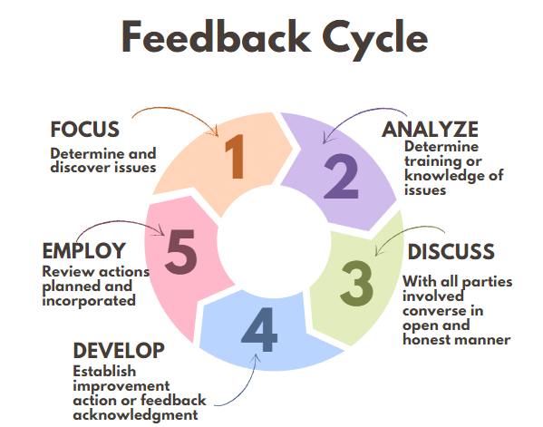
Let’s talk about Feedback

Slide 49
Let’s practice

Slide 50
Sometimes we have to so NO
The hardest thing we do sometimes is have to admit that a certain person is not cut out for this field.
Have documentation
Show that all bridges have been crossed
Improvement plan
Final warning

Slide 51
Questions

Slide 52


Slide 53
So where do we go from here?
Learning Objectives (LO):
Understand your role and responsibilities as an FTO.
Construct and use quantitative checkoffs and KSA evaluations.
Recognize your audience and understand their expectations.
Analyze how you teach and how to improve.
Organize and take part in feedback and counseling sessions.
2:35-3:00

Slide 54

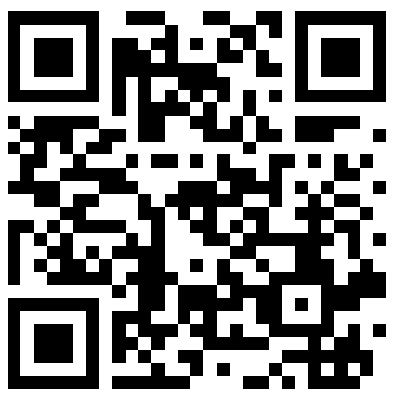
THANKS FOR the opportunity
ANY QUESTIONS?
marchill@twodarkthirty.com
Please check out my website for free information and downloads
www.twodarkthirty.com
@twodarkthirty

