Slide 1

Bridging the generational gap
Successfully teaching and onboarding Millennials and Gen Z

Slide 2
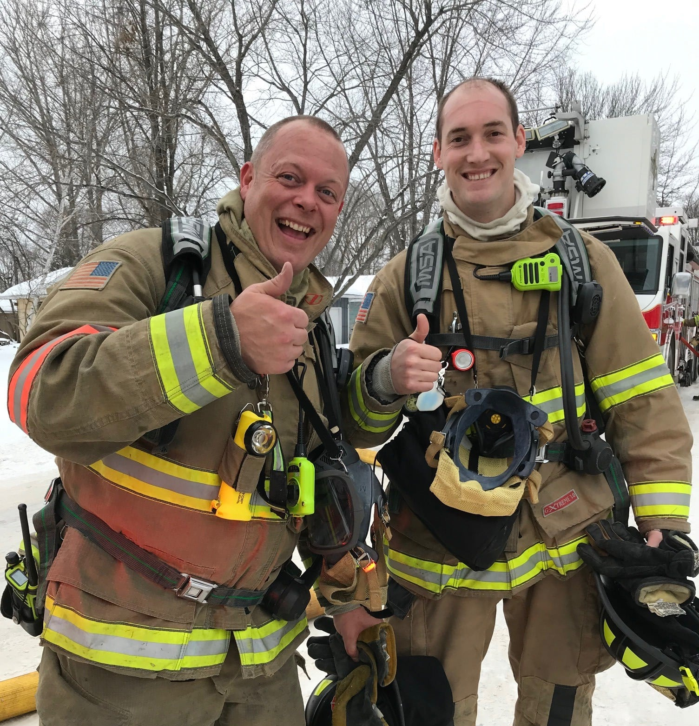
Who am I?
Marc Hill
Degrees and certifications abound
  Bachelors in Social Science
  Masters in Ed Leadership
Over 20 years in public service
  Volunteer, Career, & Public Schools
Author of Two Dark Thirty

Slide 3
Why is this topic important to know?
Support and grow the staff you have
Know your audience
Recruitment and retention
Planning for the future

Slide 4
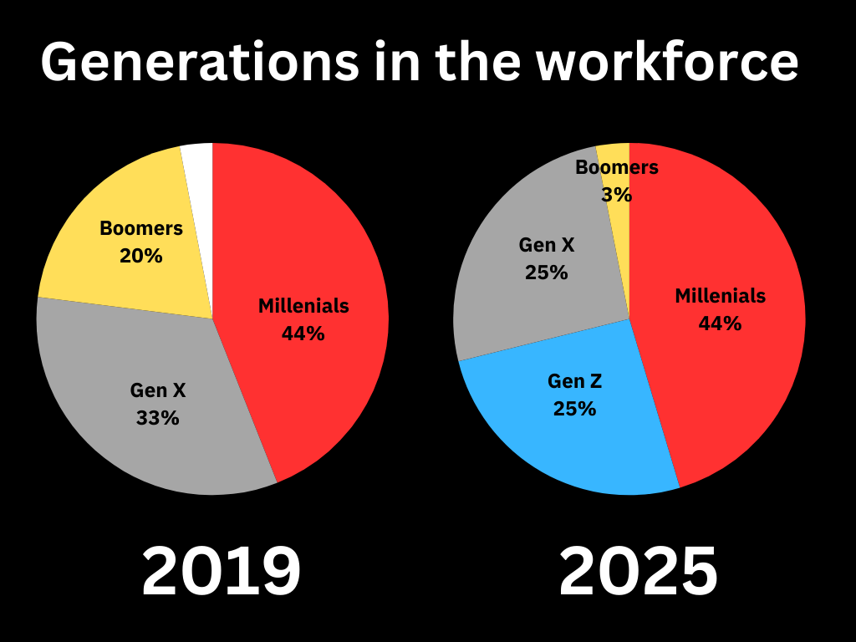

Slide 5
QUICK DOWN AND DIRTY!
What is a Generation and its Characteristics?
How can you Bridge the Generational Gap Effectively?
How can you Employ Each Generation's Uniqueness to Improve the Fire Service?
What does the Future Hold for the Fire Service?
Wrapping it up.

Slide 6
Let’s break all this down…

Slide 7
What is a Generation and its Characteristics?

Slide 8
A generation is…
(1) group of people born around the same time, typically within a 15-20 year span.
(2) Major events and societal changes during a generation's coming-of-age years tend to shape its perspective and attitudes.

Slide 9

Let’s take a trip down memory lane…

Slide 10
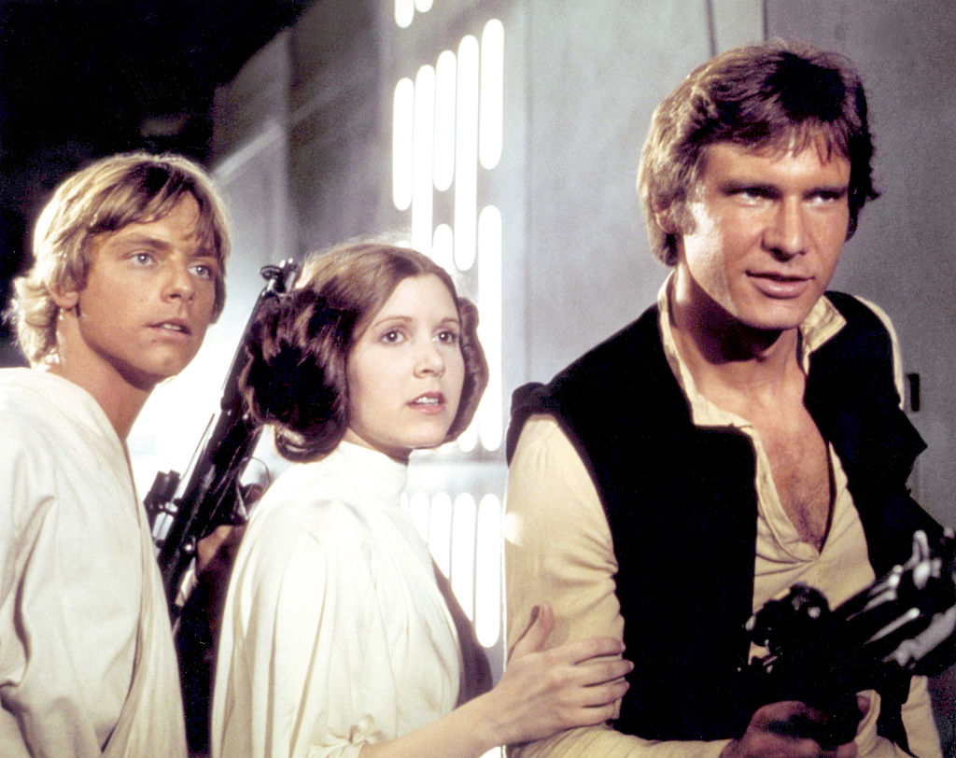
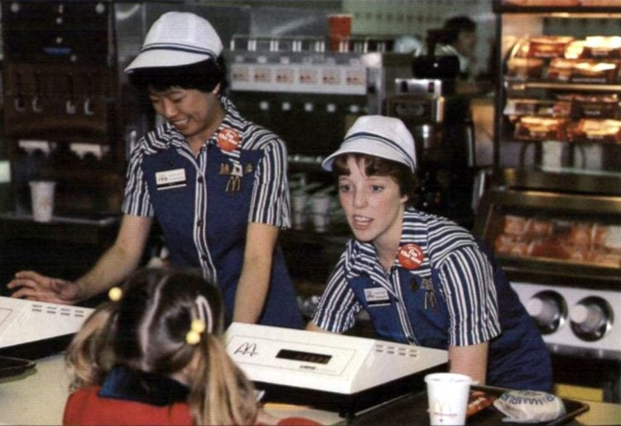
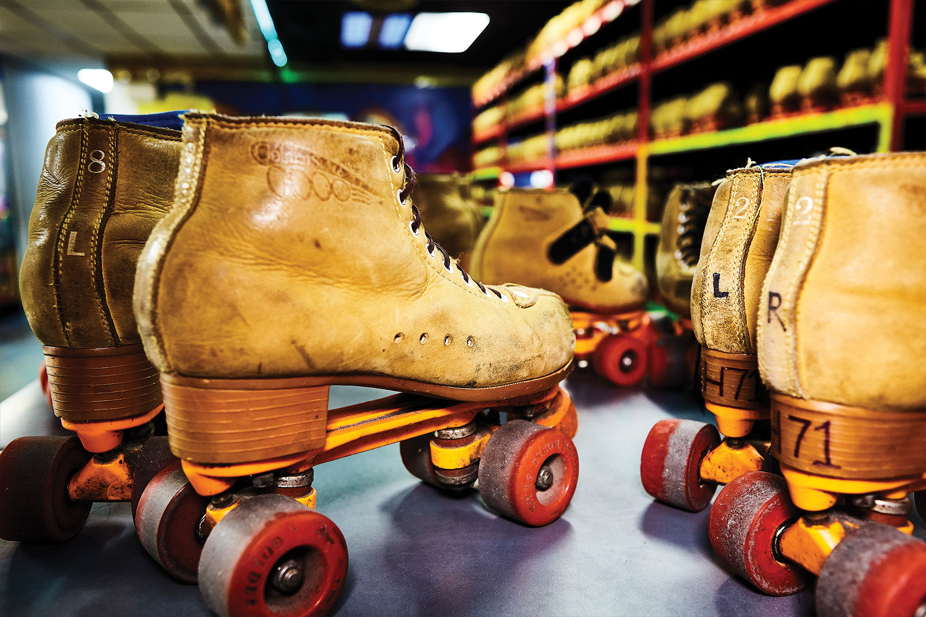
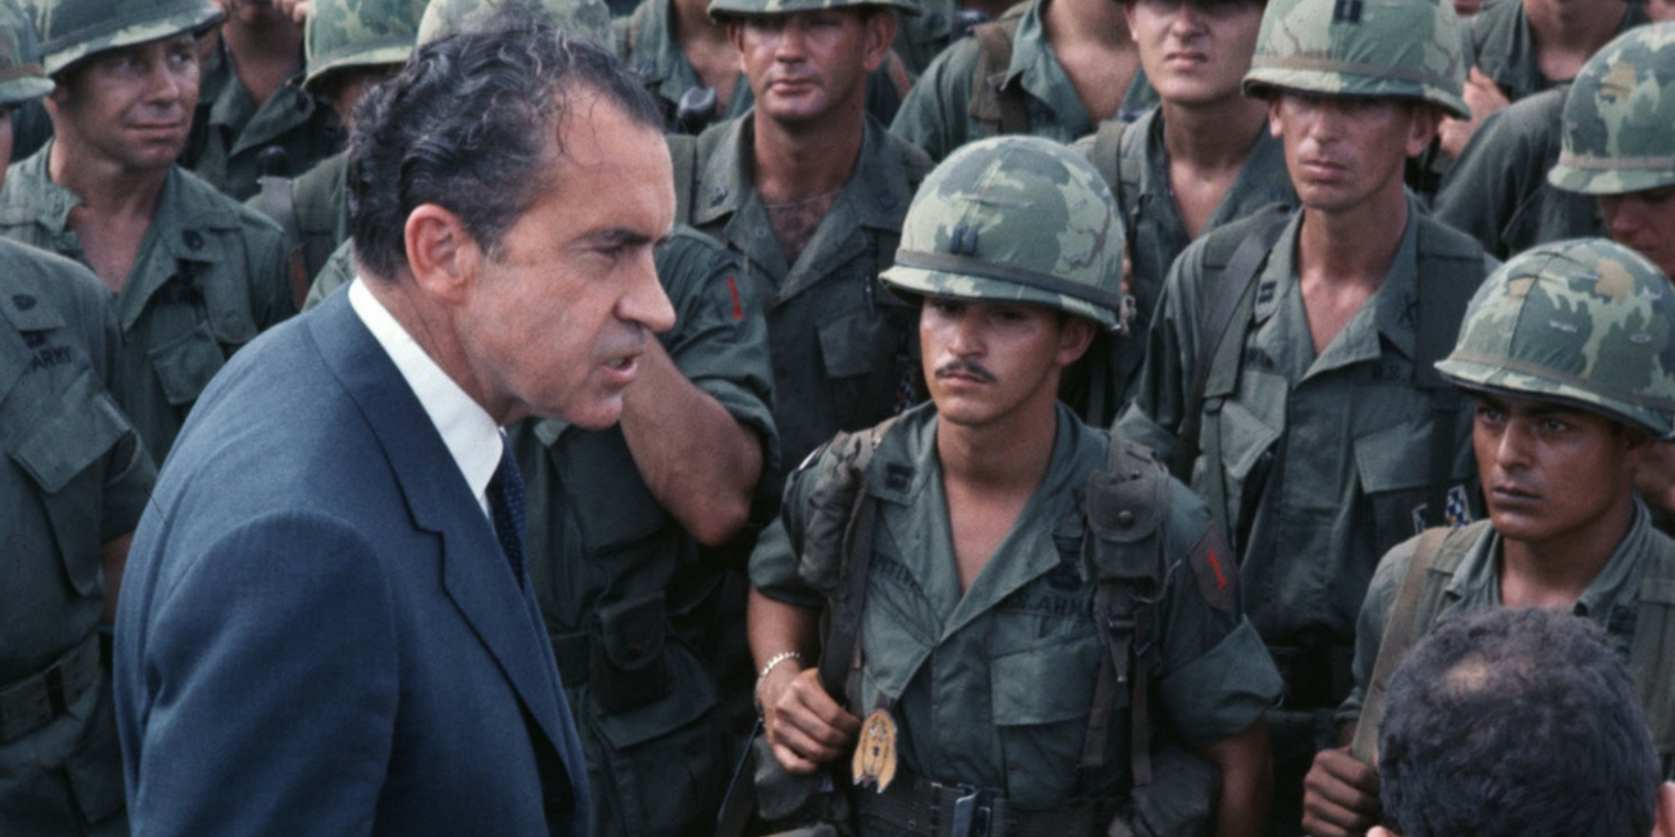

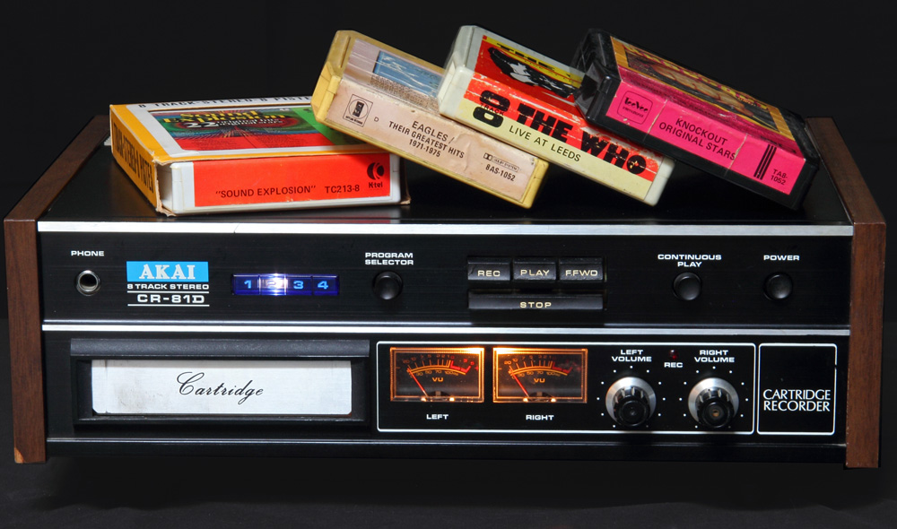
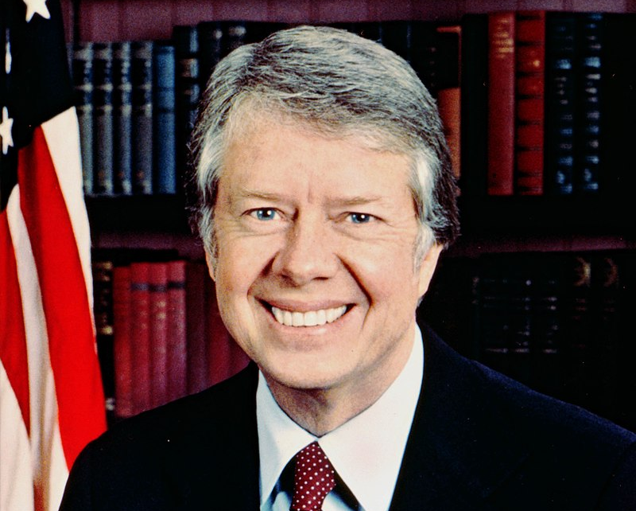
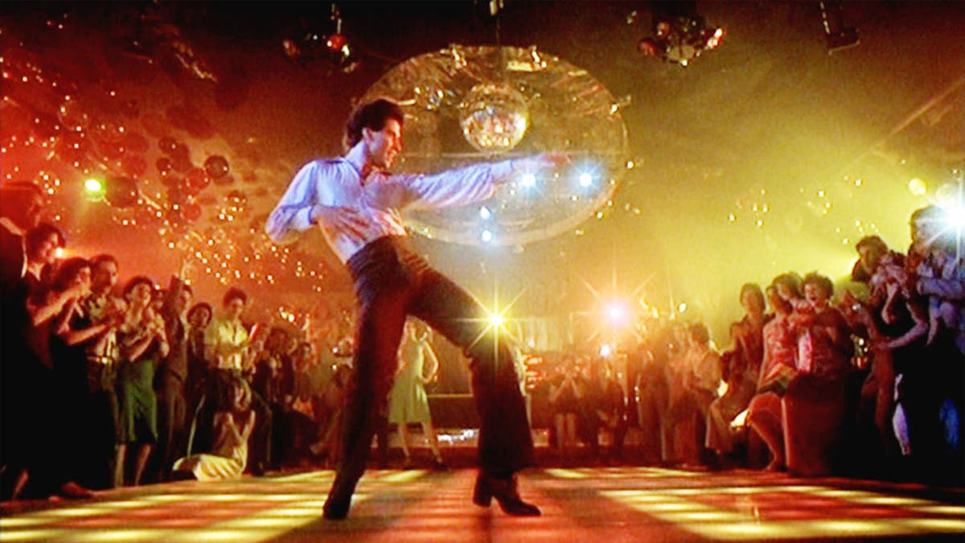
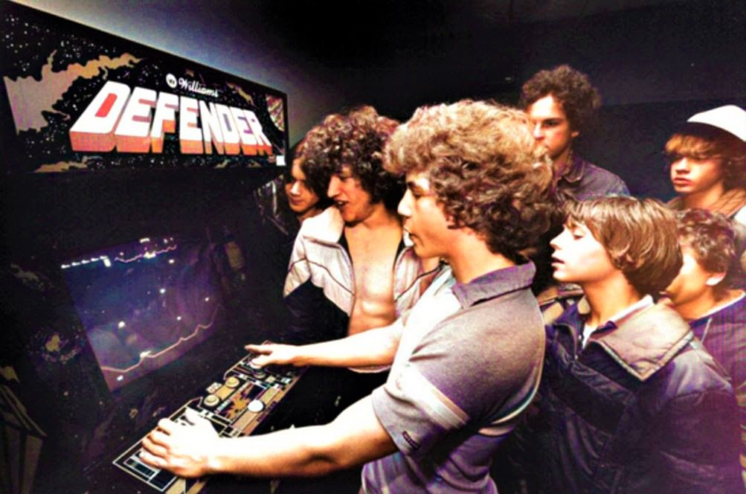
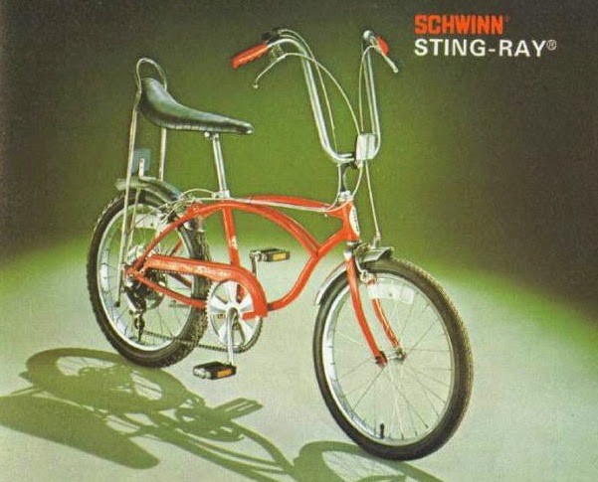
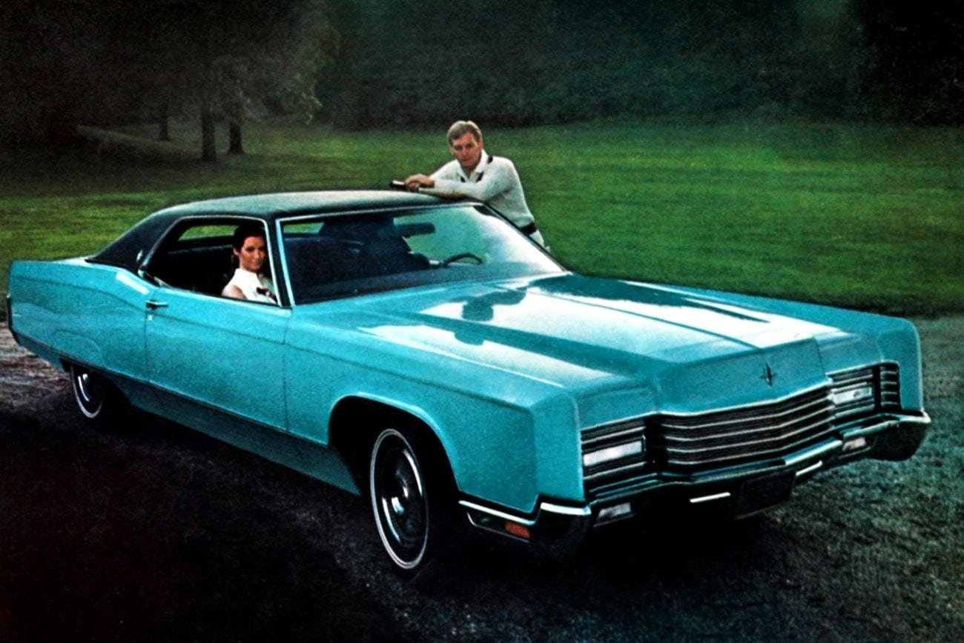

Slide 11
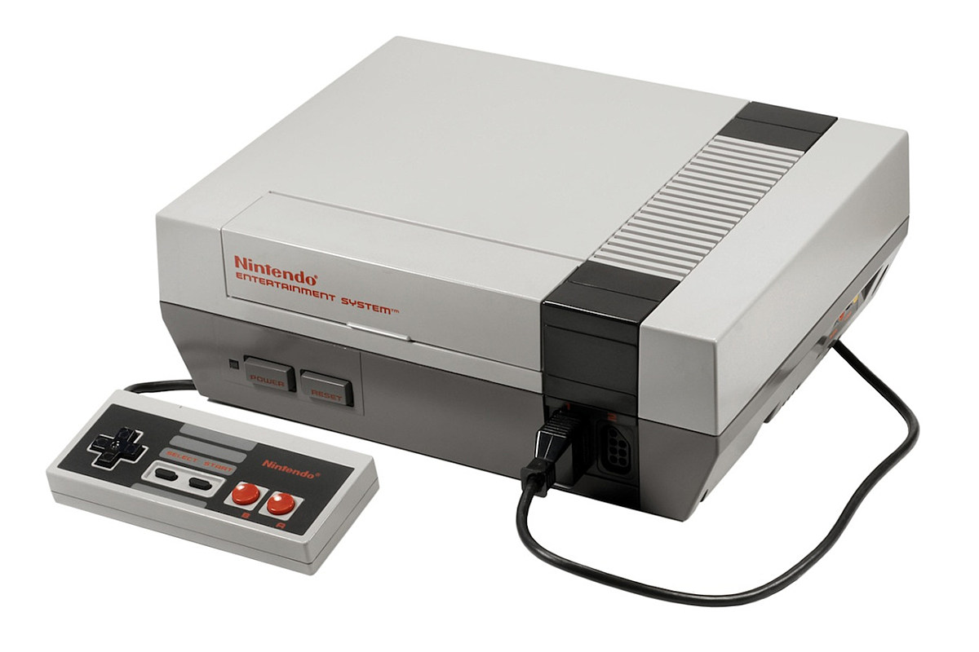
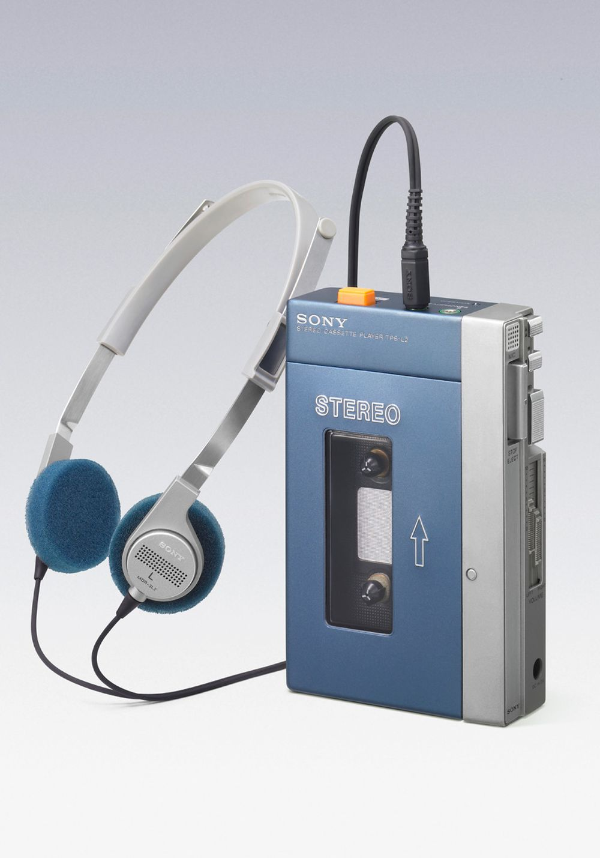
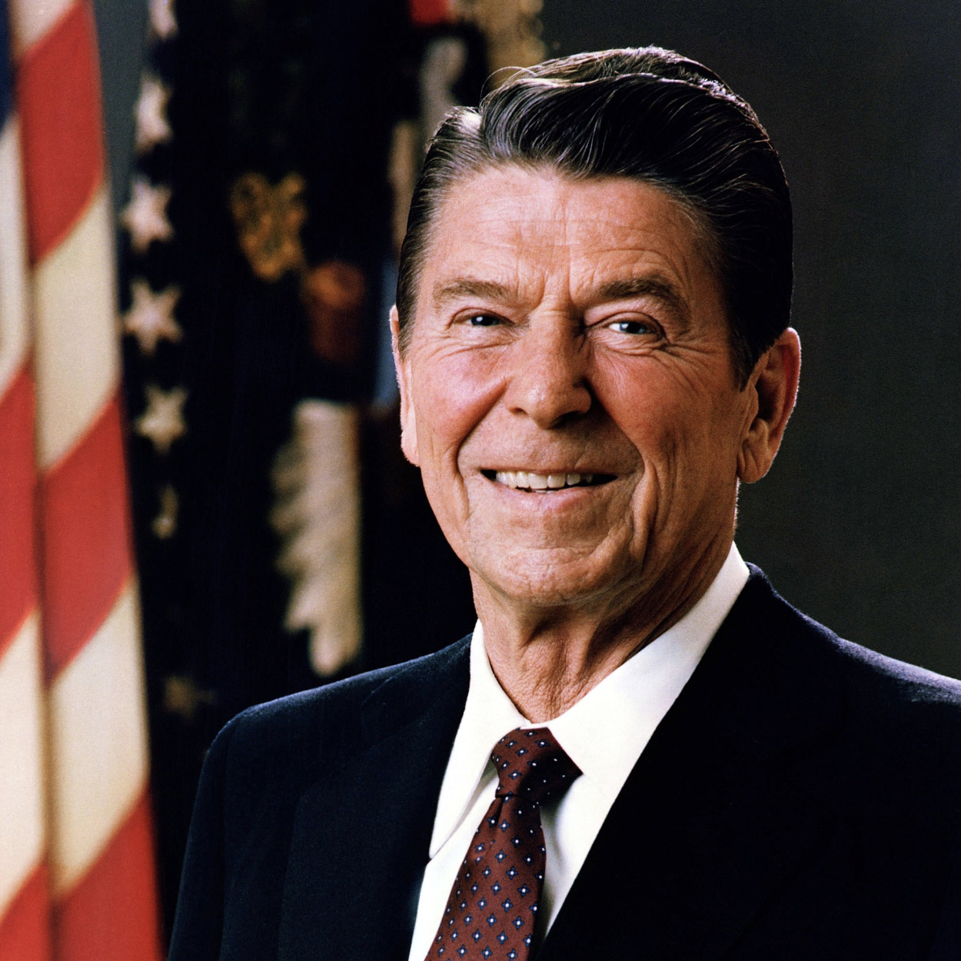
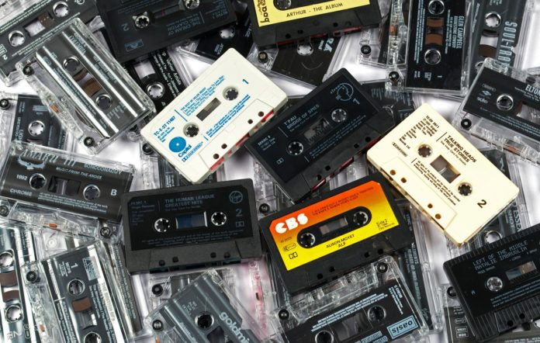
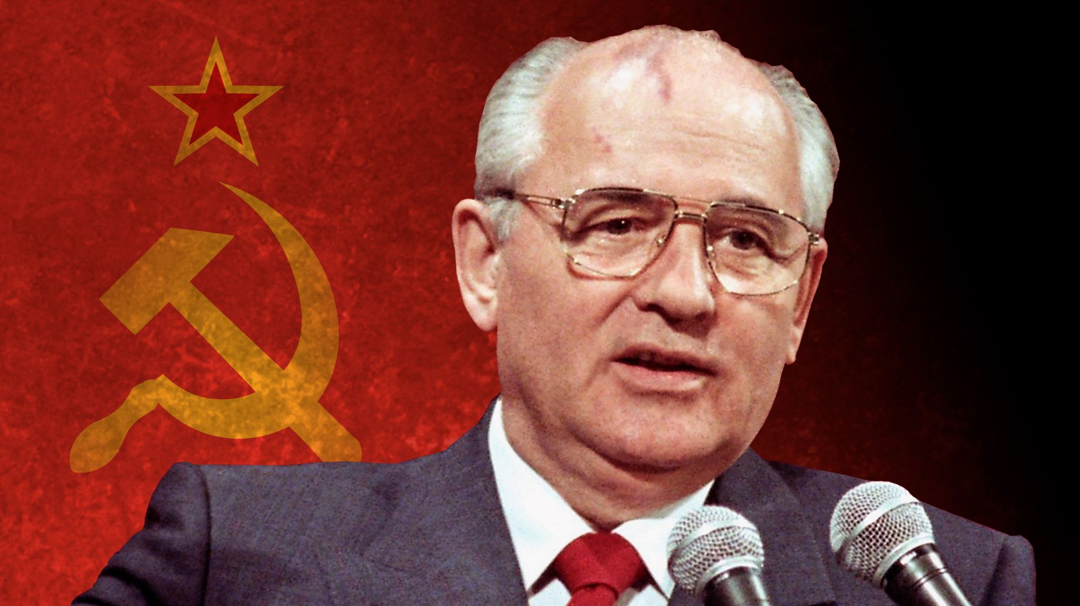
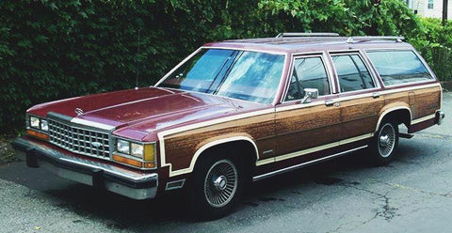

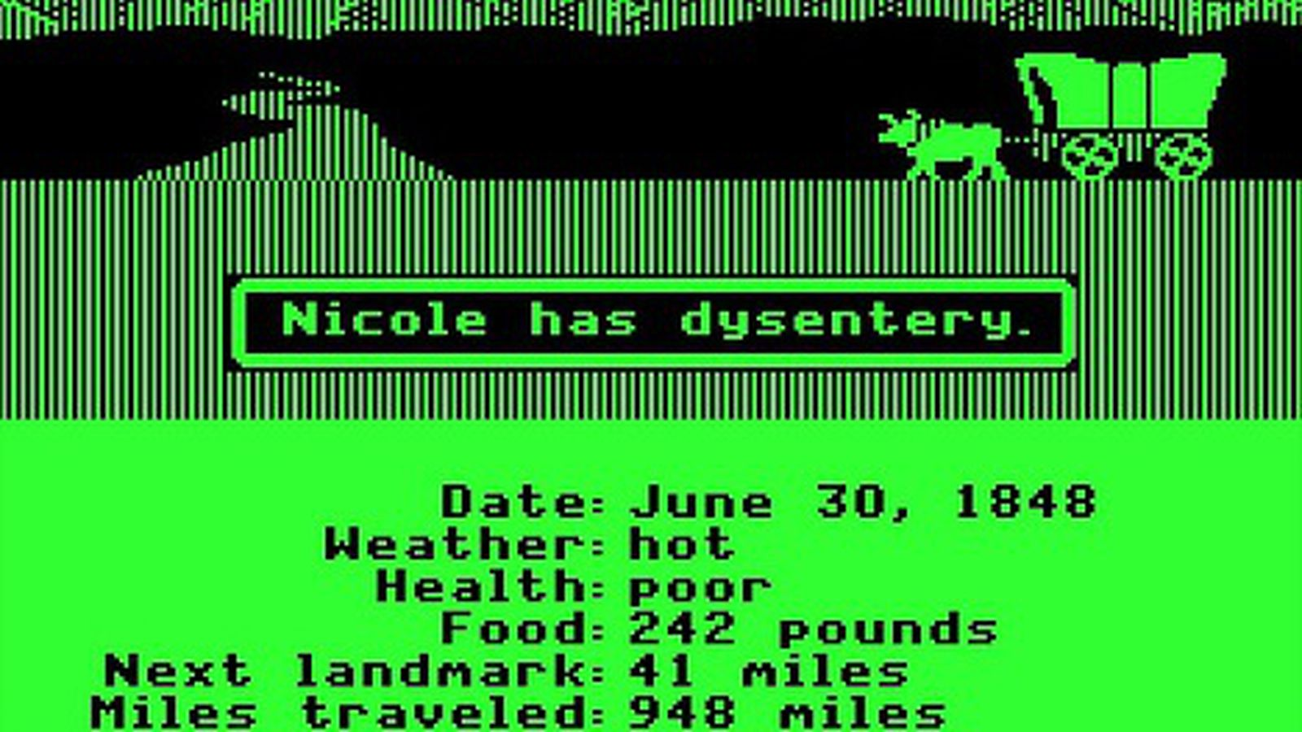
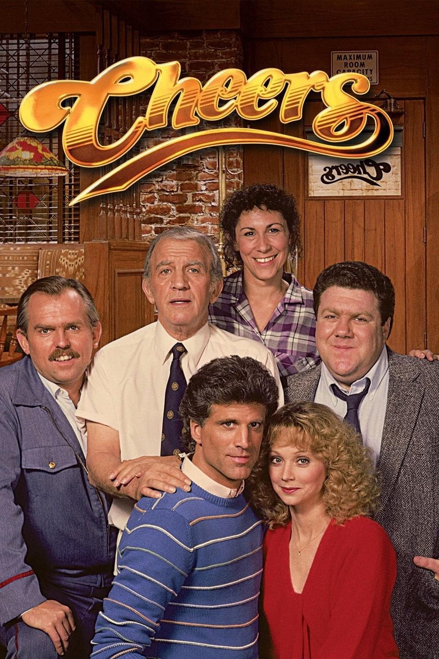
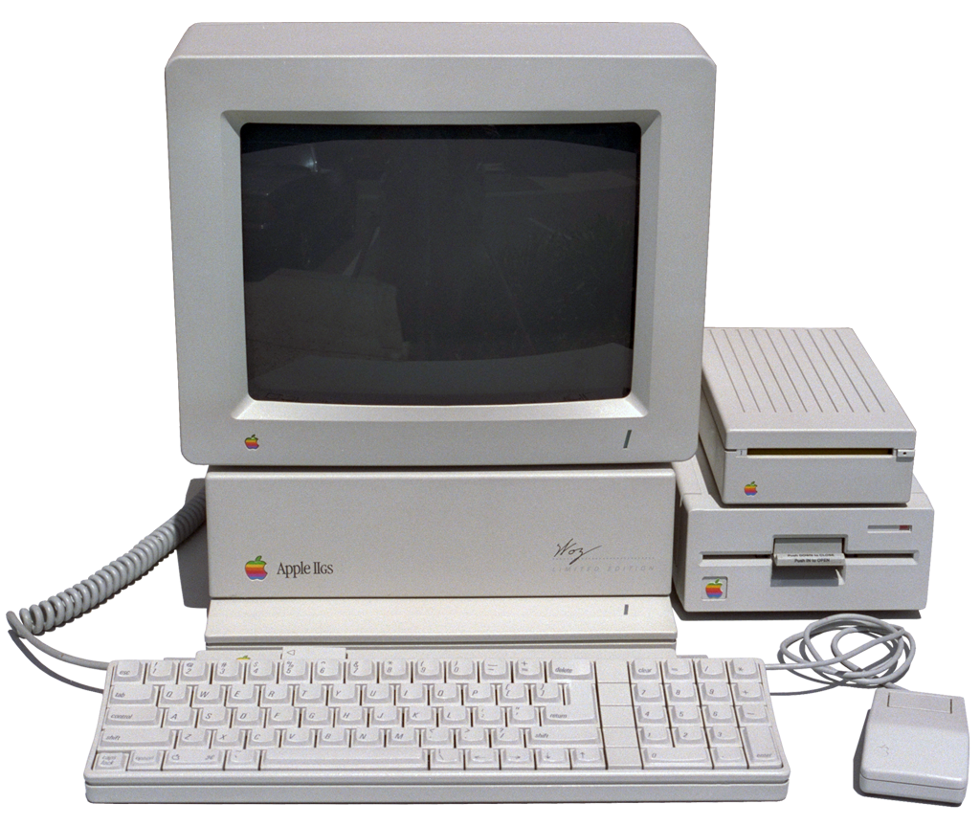


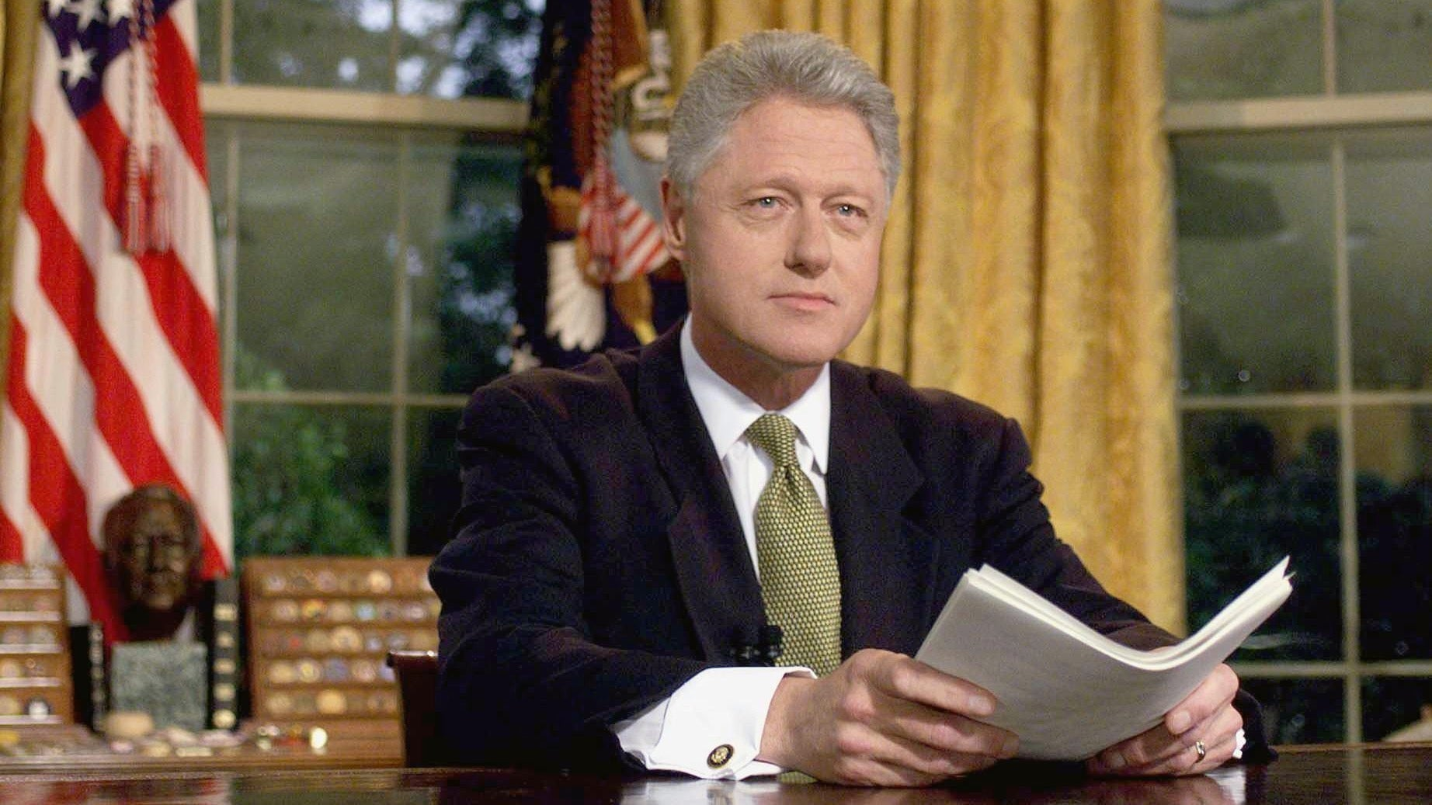

Slide 12
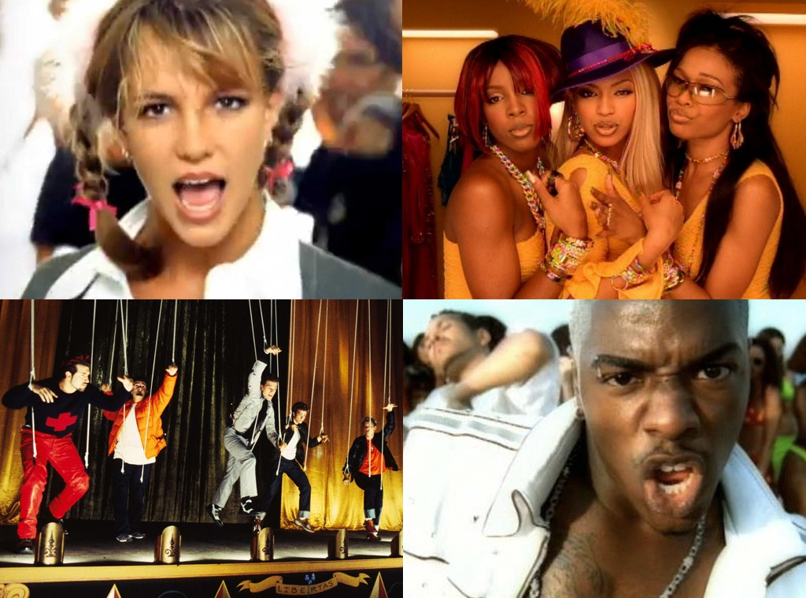
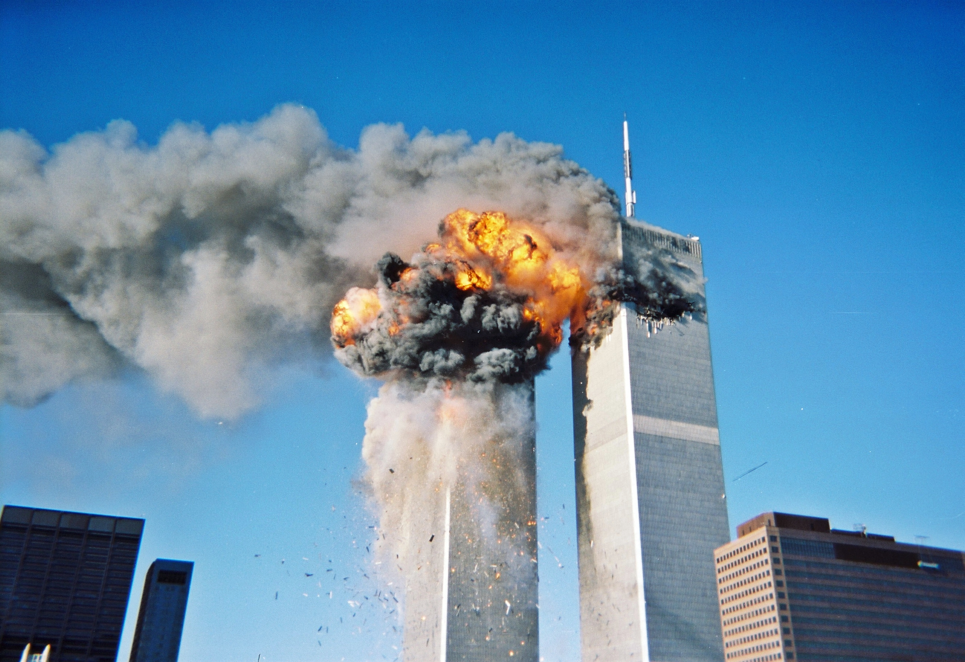
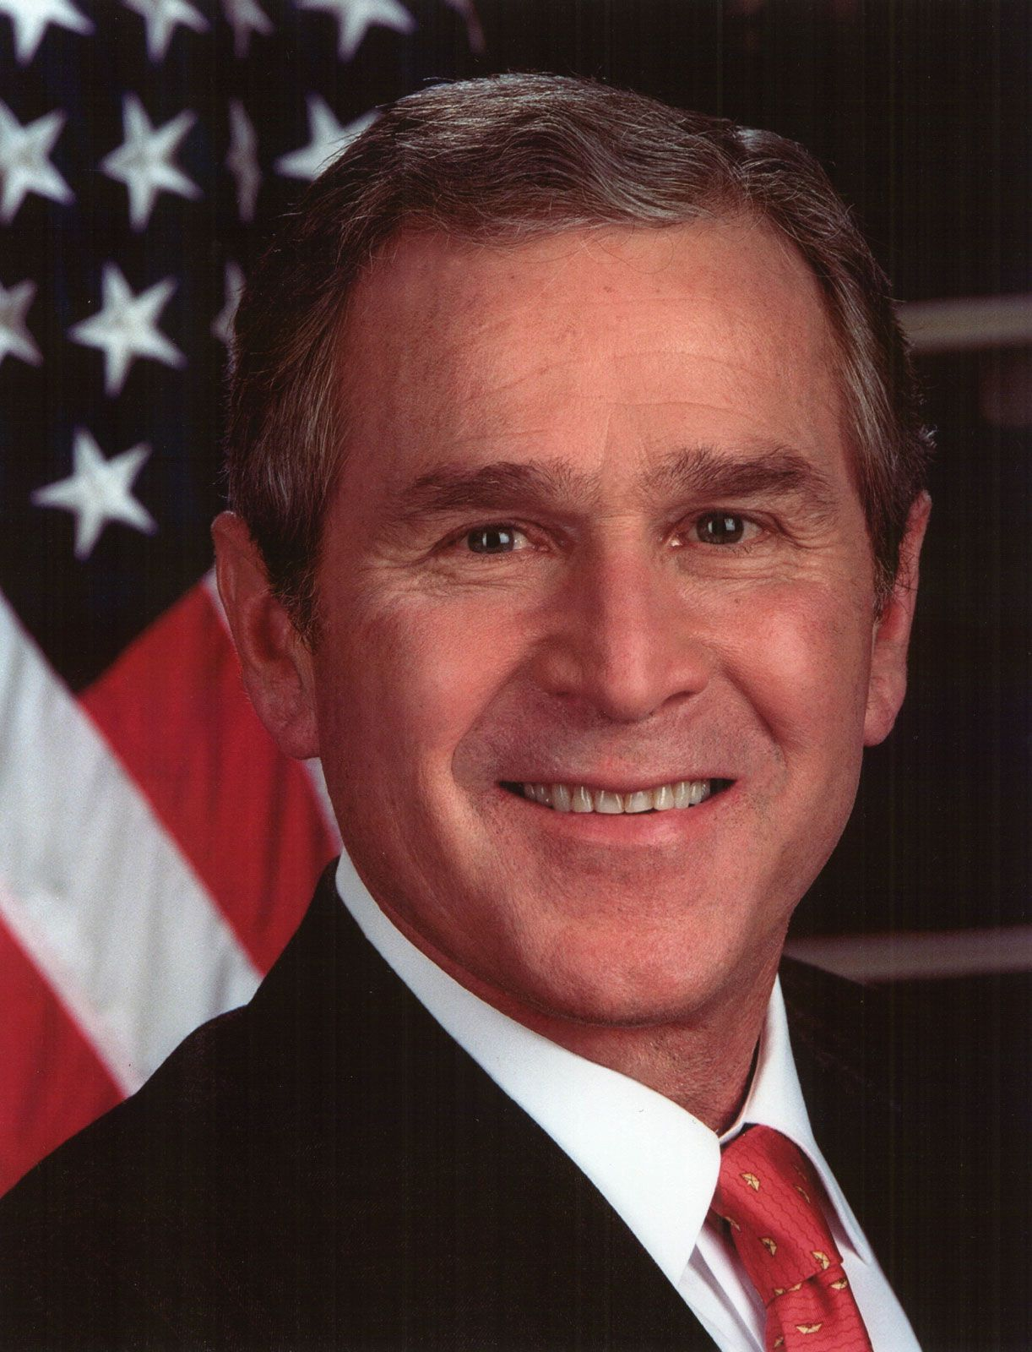

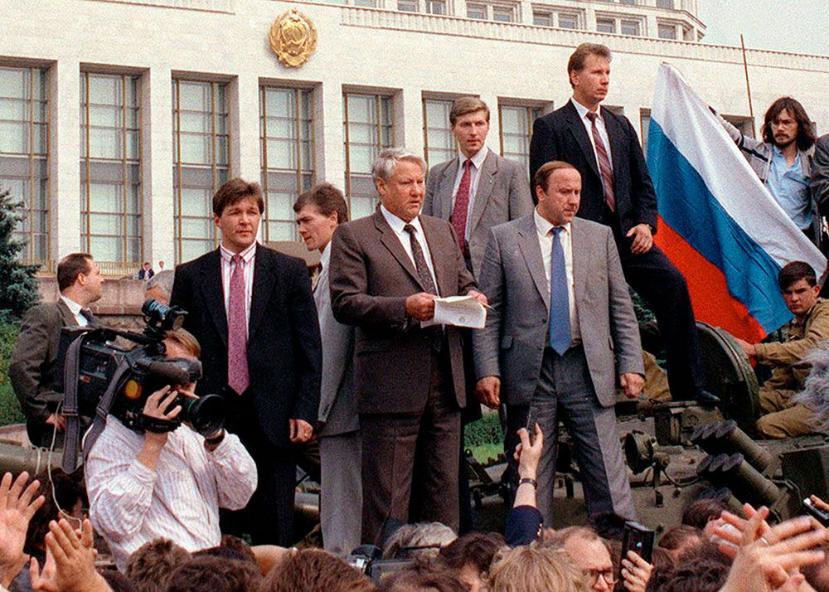
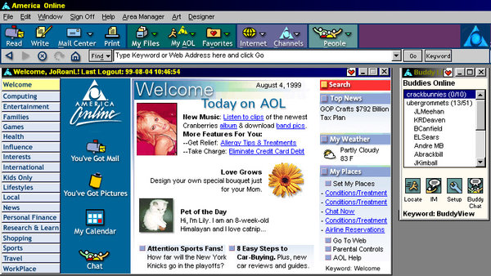
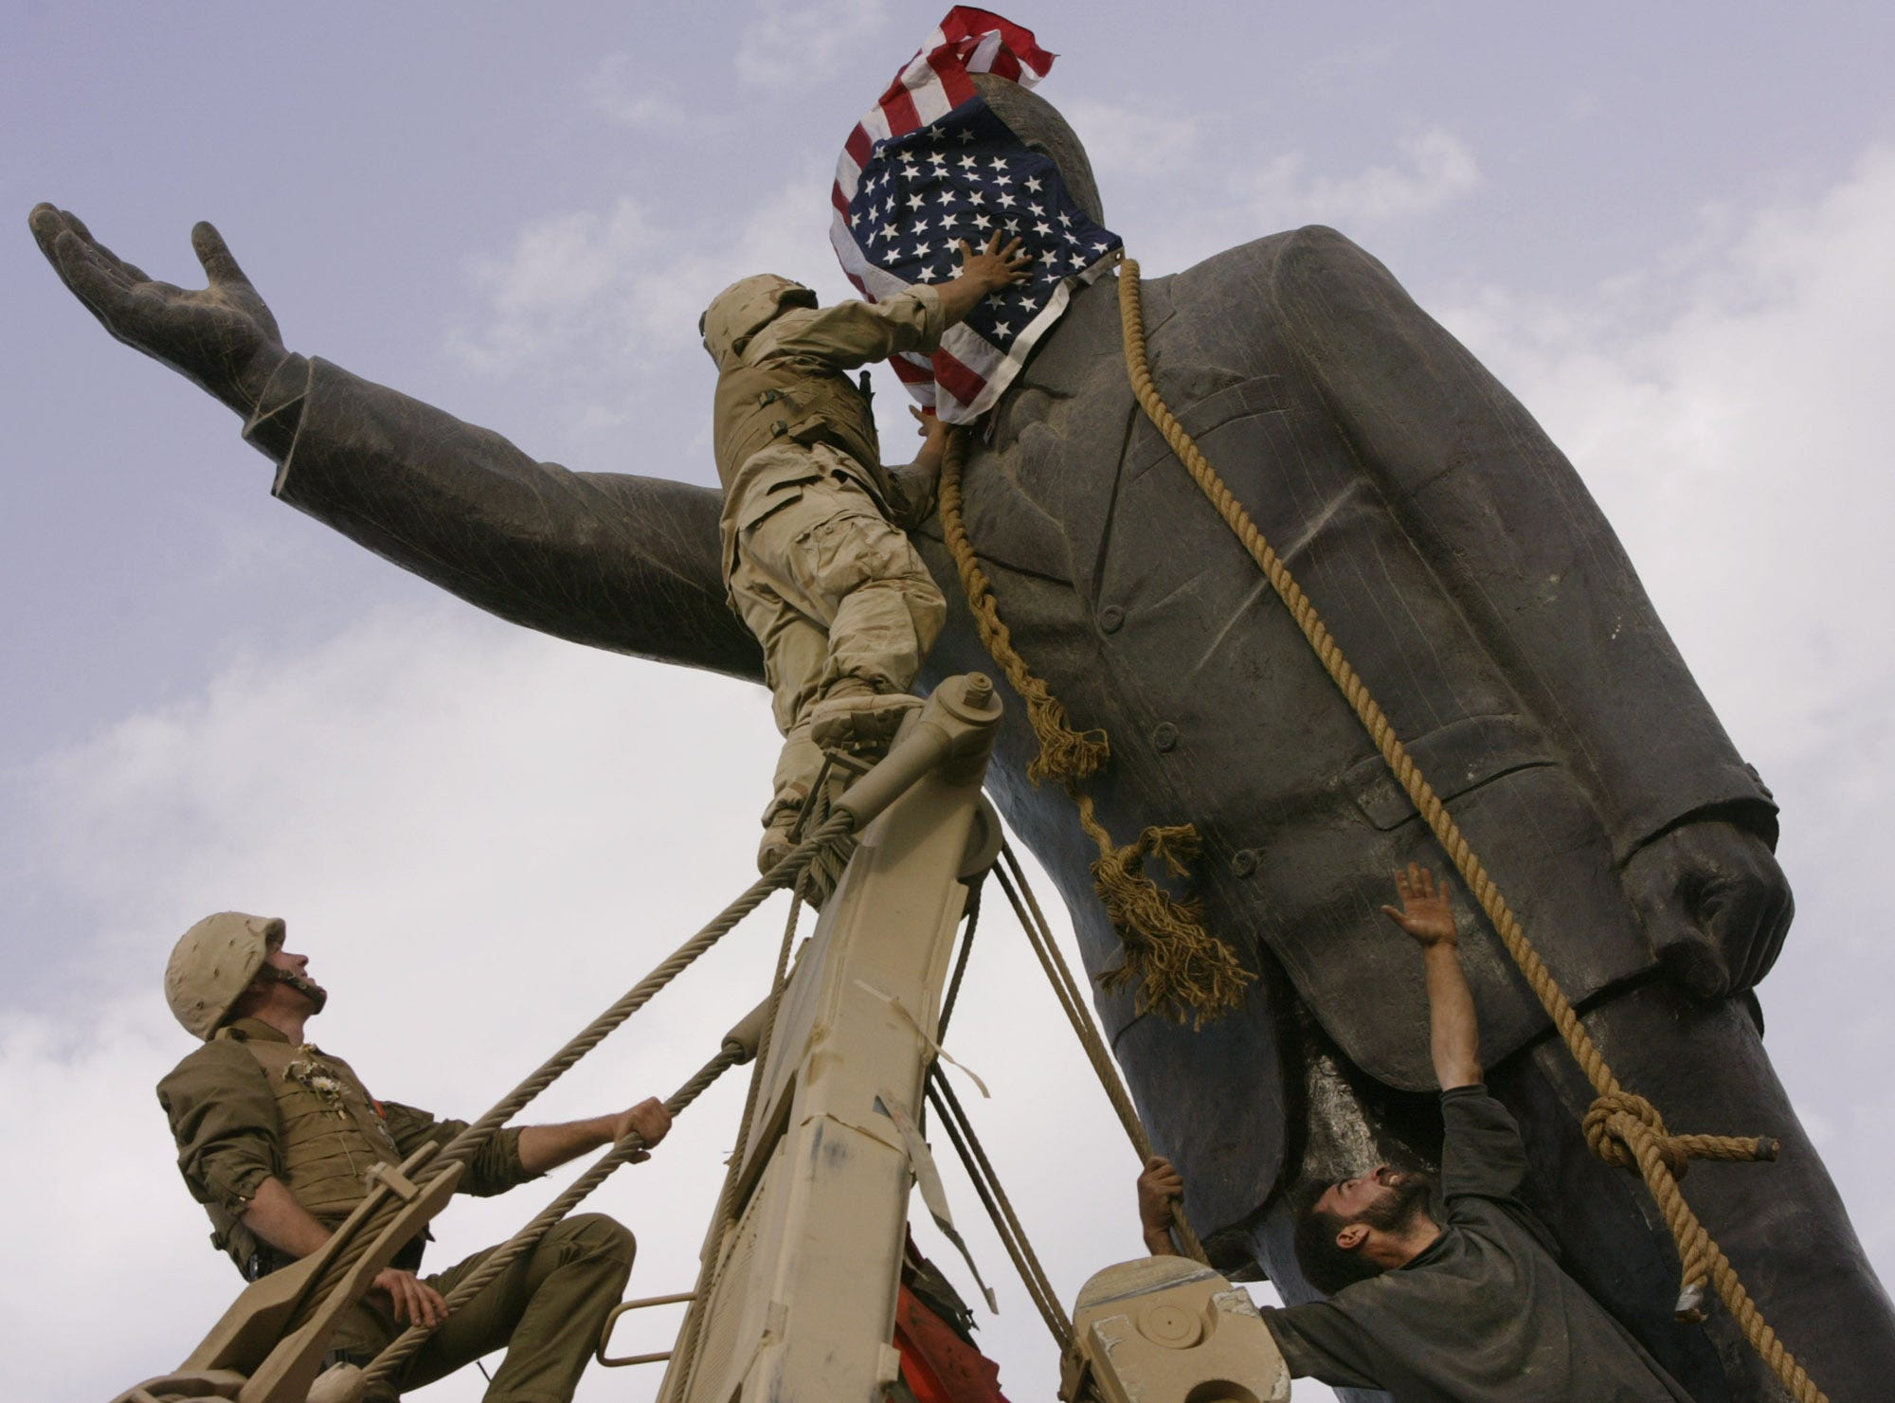
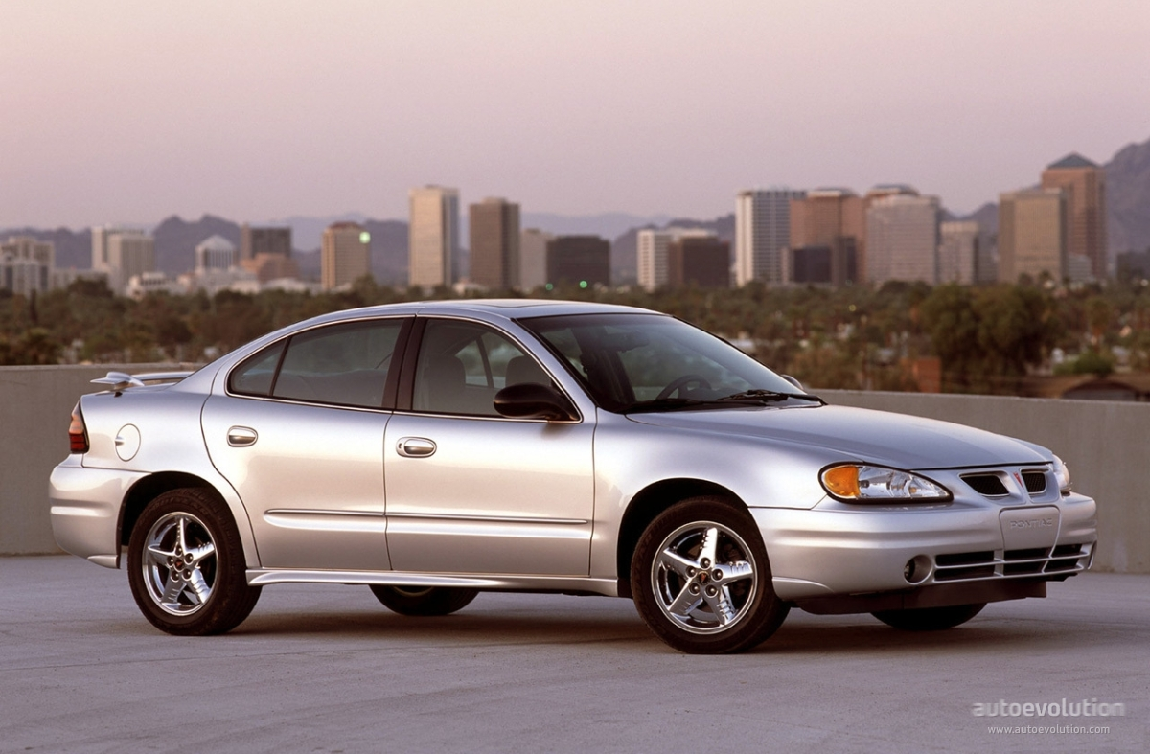
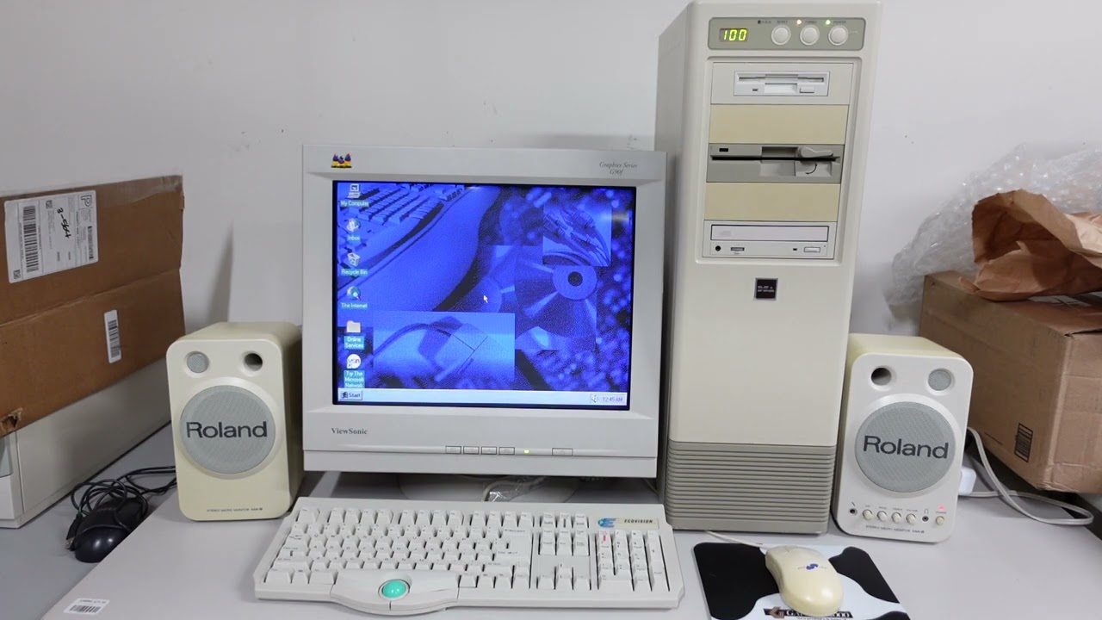
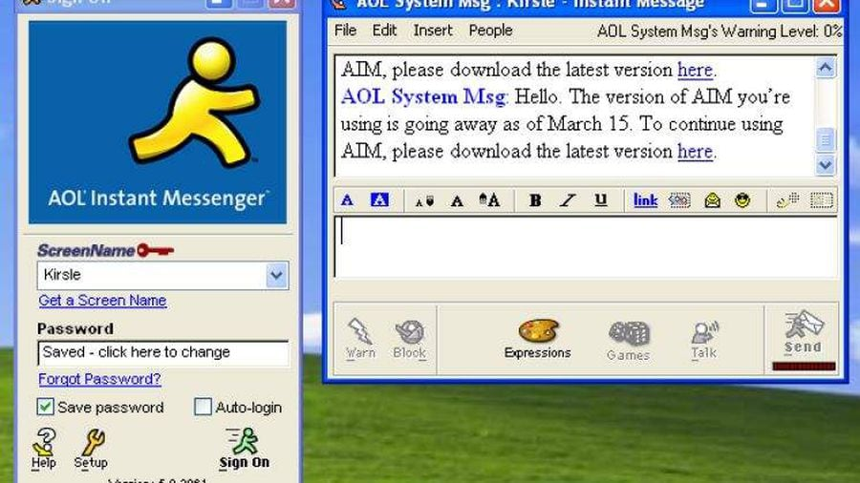

Slide 13
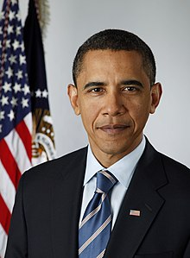
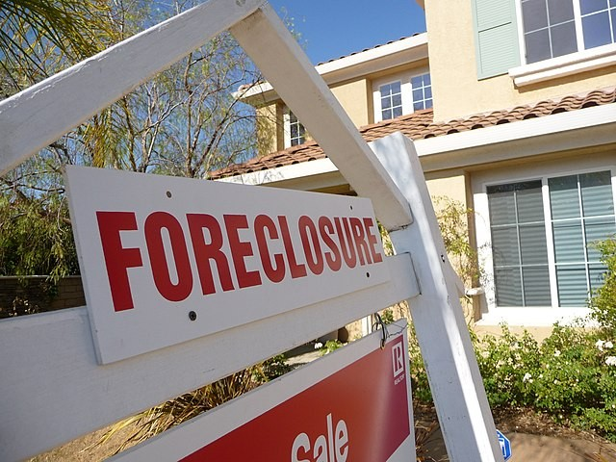



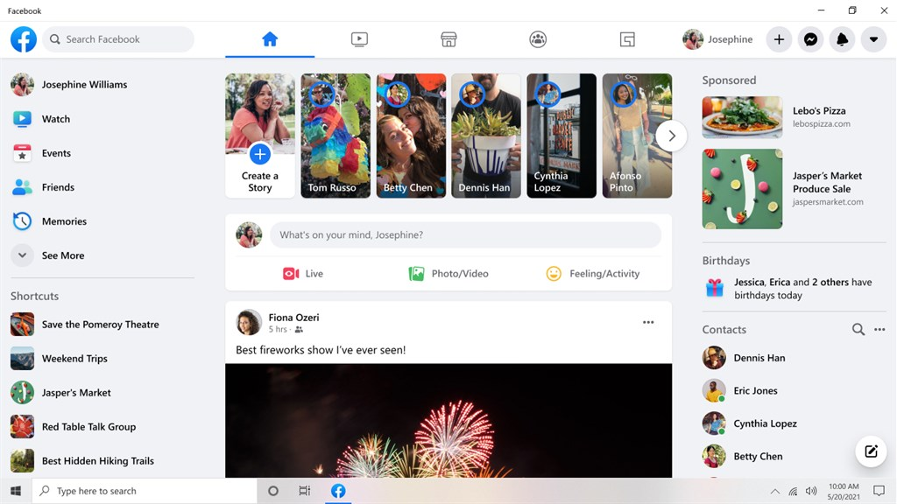





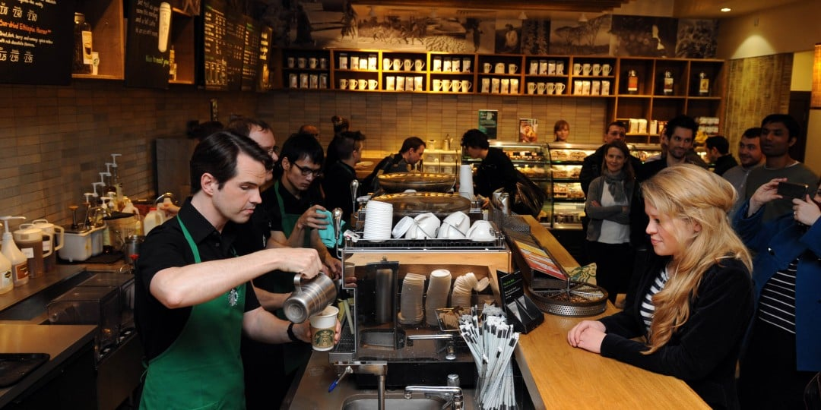
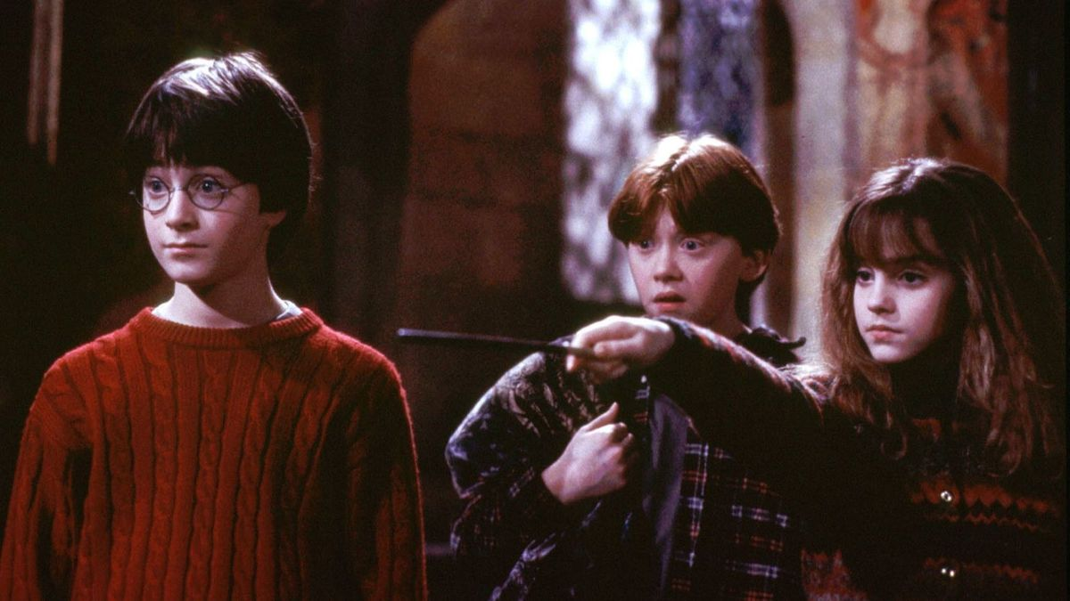

Slide 14
Generation X, 1965-1980
Came of age during more unstable times like the end of Vietnam War, Civil Rights, Women’s Rights, Gas Shortages, the Cold War, and a period of economic recession and downsizing.
They tend to be more pragmatic, self-reliant, and less loyal to institutions than previous generations.

Slide 15
Millennials, or Generation Y, 1981-1996
Grew up with rapid technological advances like the Internet and computers.
Having seen volatile economic conditions, they tend to be civic-minded, and purpose-driven.
Favor flexibility in the workplace.
Millennials tend to be more optimistic than Gen X.

Slide 16
Generation Z 1997 to 2010's
Just entering the workforce.
They are true digitals, even more so than Millennials, as many cannot remember a time before smartphones and social media.
Early research suggests Gen Z tends to be realistic, socially progressive, and highly educated.

Slide 17
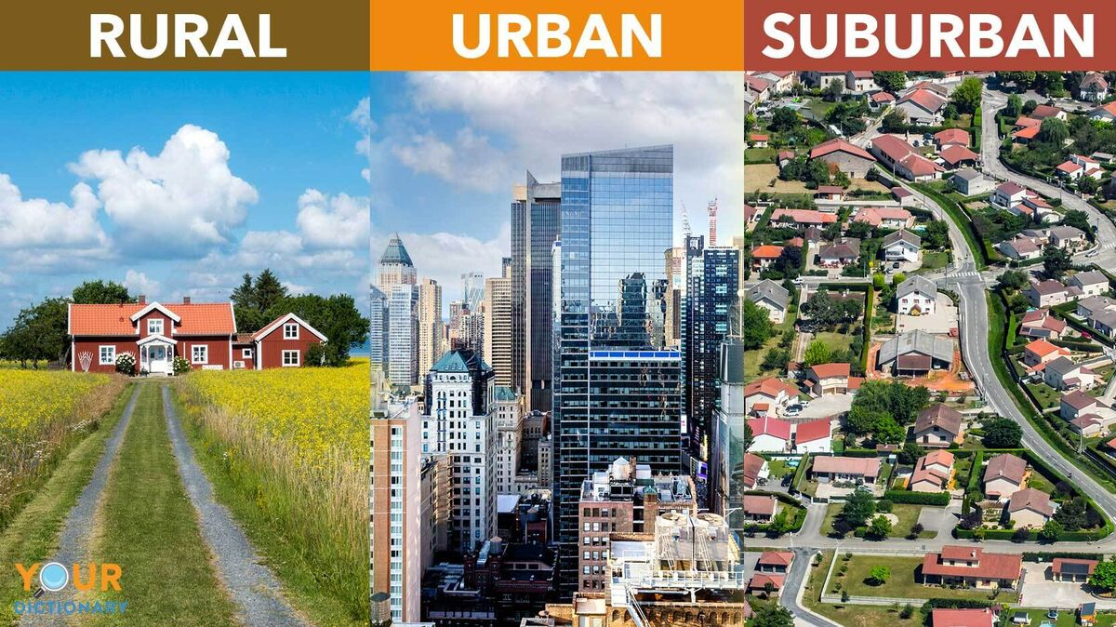
What else causes the differences?
Where you grow up:
  Rural-Countryside
  Urban- Apartments
  Suburban- ranch homes to large McMansions
Family:
  SES or Socio-Economic Status
  Single Parents or Grandparents
  Divorce
  Siblings
  Latchkey vs. no winners

Slide 18
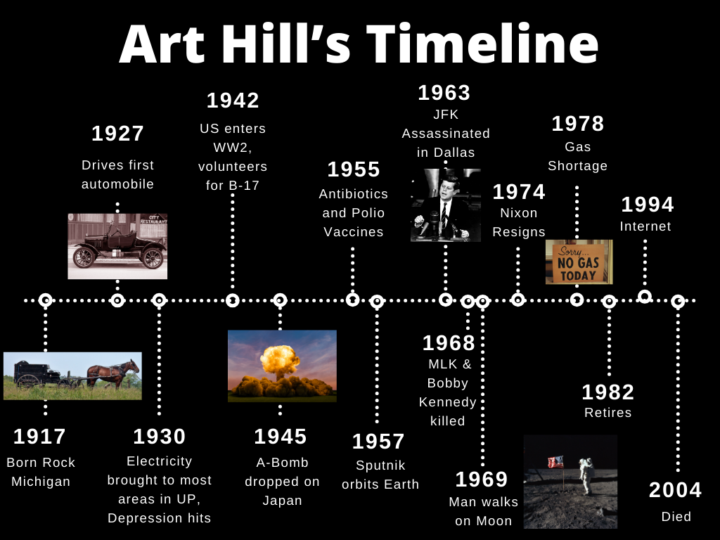

Slide 19
How can you Bridge the Generational Gap Effectively?

Slide 20
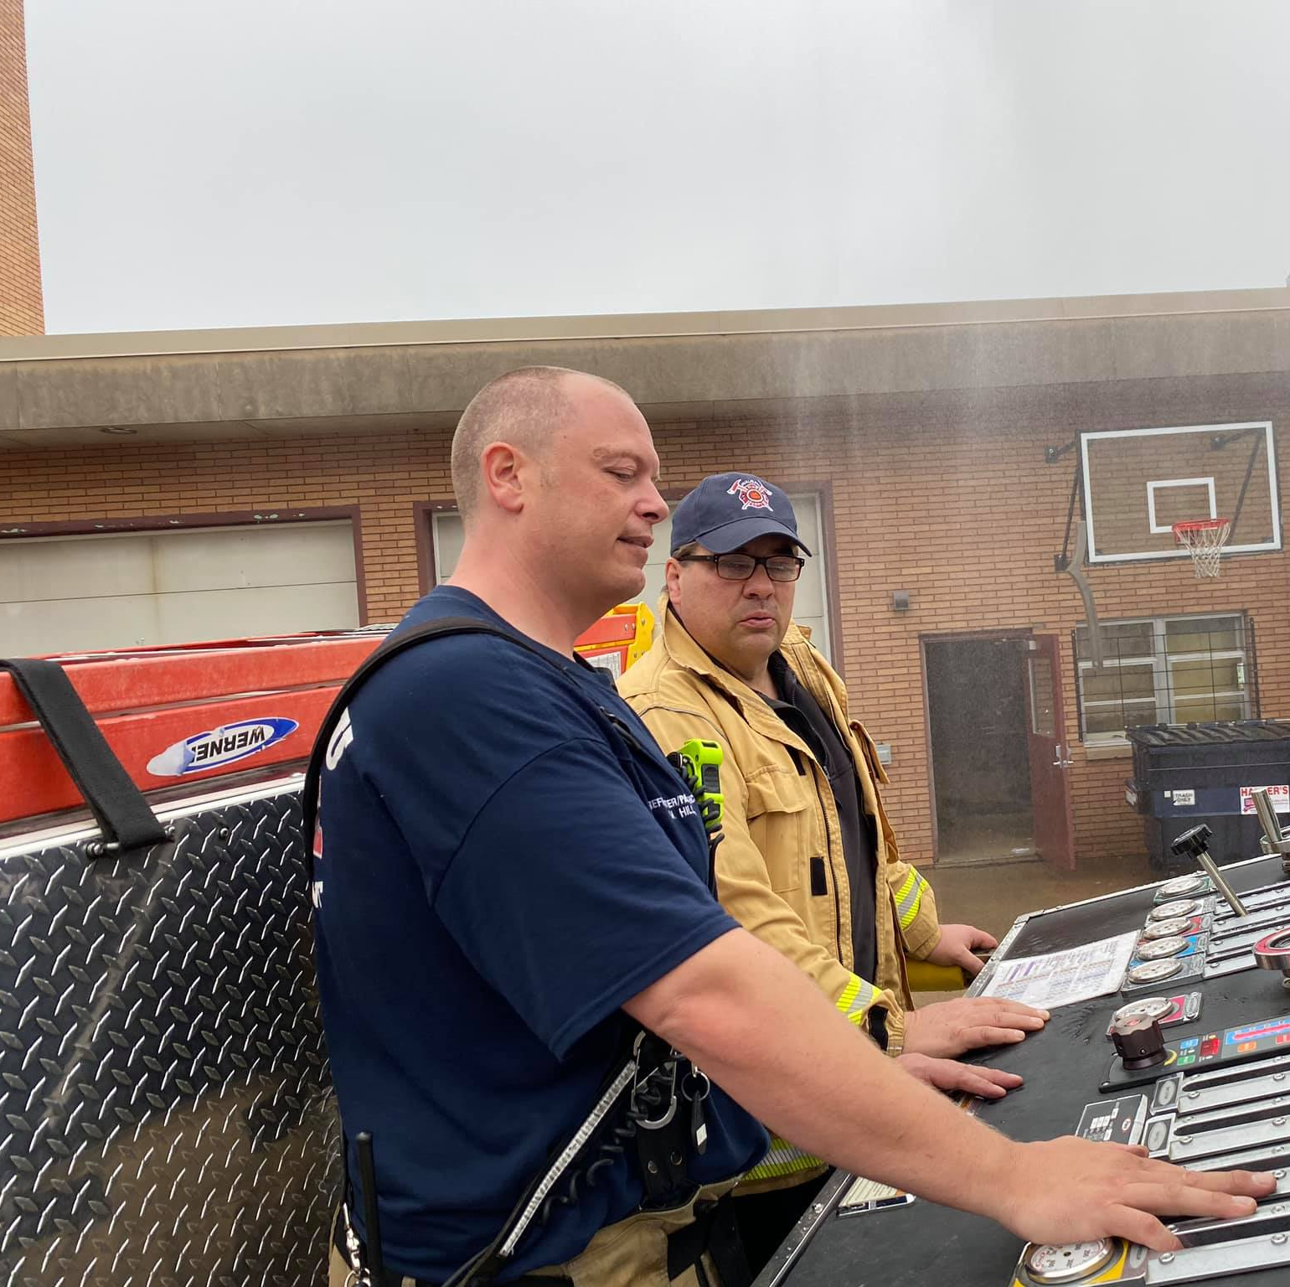
#1 Promote Cross-Generational Mentorships
Pairing seasoned veterans with probationary firefighters enhances morale, training consistency, and knowledge transfer by sharing leadership and life insights in both directions.

Slide 21
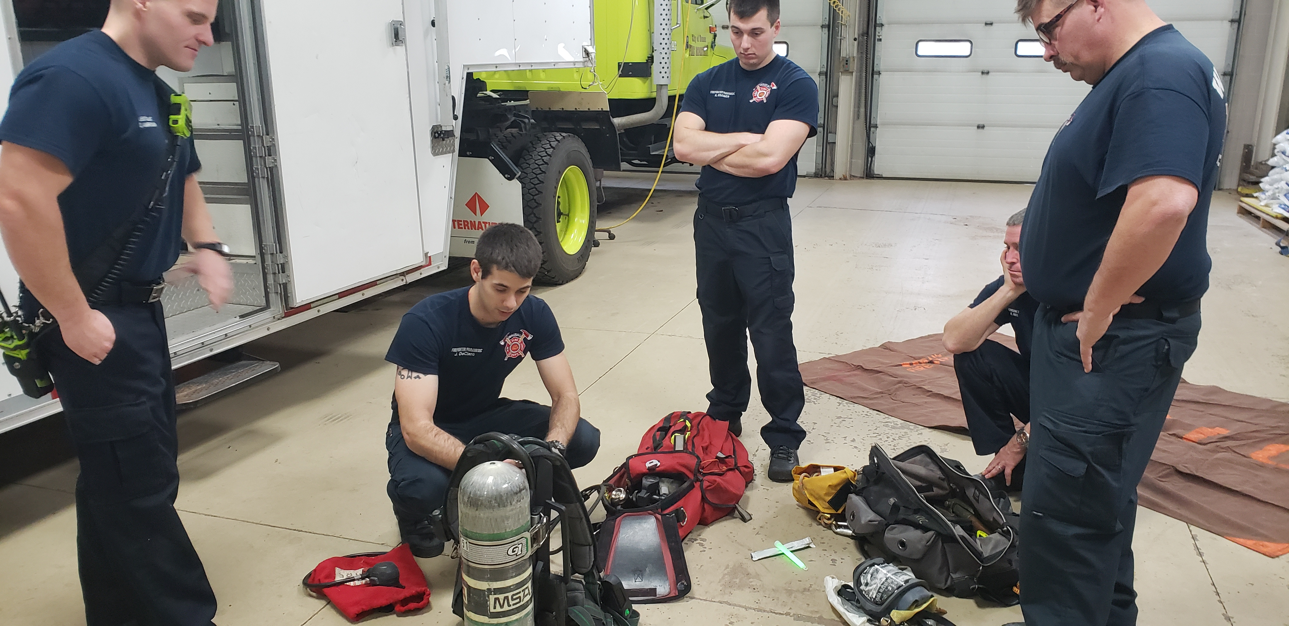
#2 Maintain Approachability and Open Communication
Be open to discussion and keep the door open. If they don’t seek you out then seek them out. Be honest and have integrity.

Slide 22
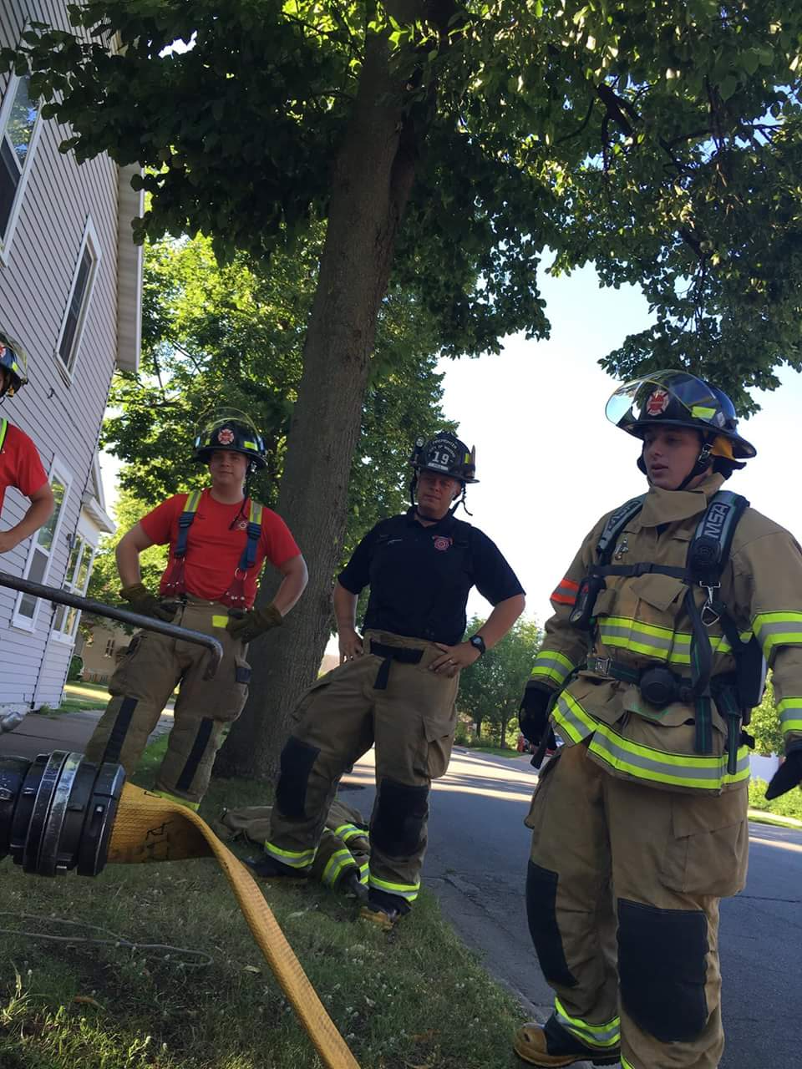
#3 Deliver Feedback with Finesse
Tailoring feedback to generational traits
Criticism is given with acknowledgment of strengths and specific guidance.

Slide 23
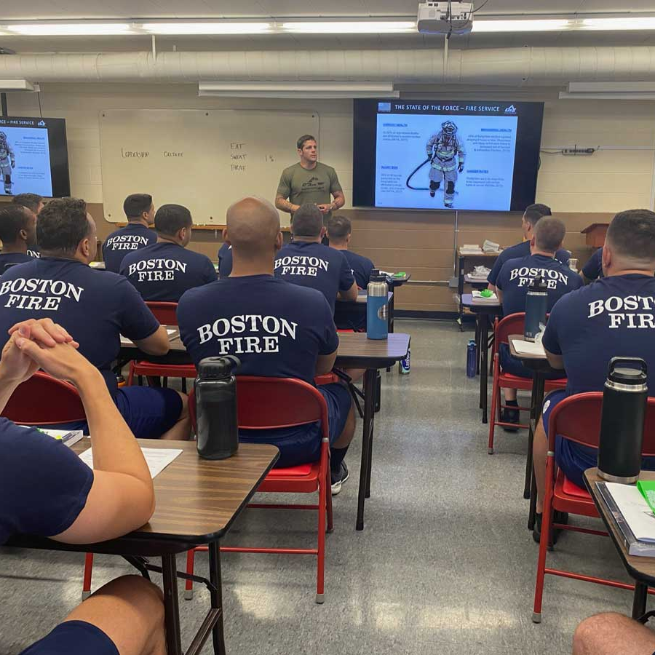
#4 Embrace Flexible Teaching Styles
Use multiple techniques like lectures, visuals, hands-on training, group discussions, and online modules to cater to different learning preferences and connect well across generations.

Slide 24
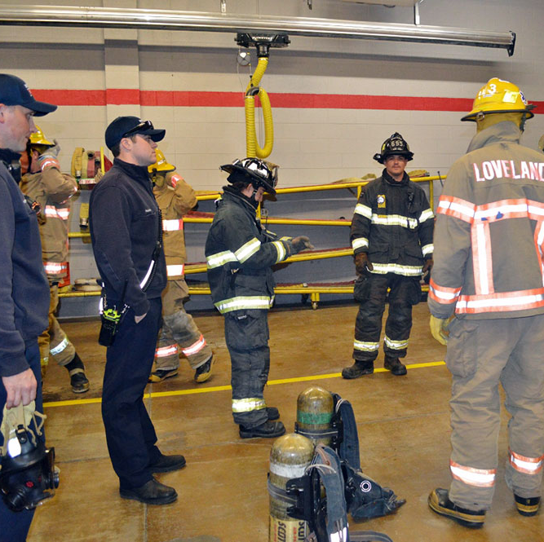
#5 Convey Respect for All Contributions
Prioritize input from all generations by actively seeking insights from everyone in the room.
Encouraging engagement from newcomers on new technologies and wisdom from long-time members.

Slide 25
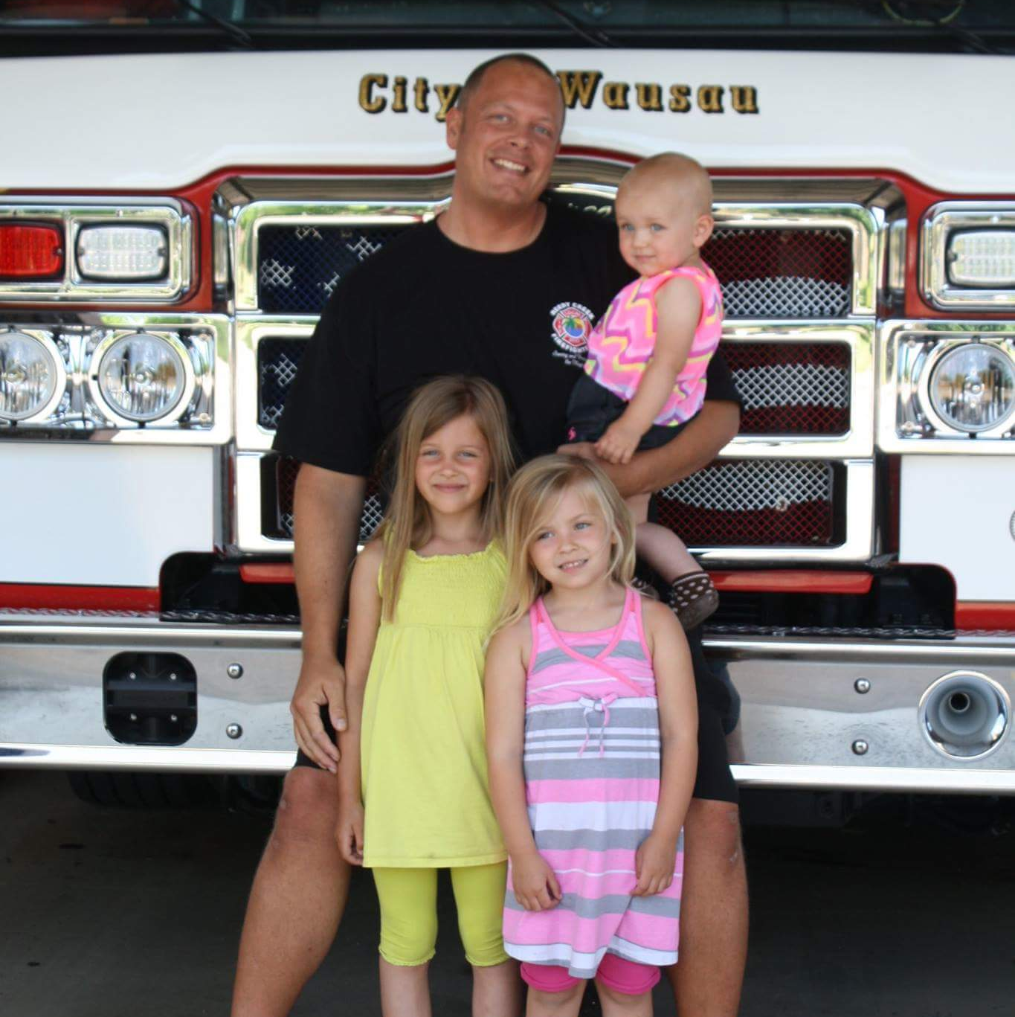
#6 Recognize Life Stage Obligations
Support younger members who are starting families.
Support veteran members who may have parent deaths or long-term care needs.
Outreach groups and committees can help with this.

Slide 26

#7 Spotlight Common Values and Goals
Concentrate on why we are here in the first place.
Does your department have a mission, goals, or values?

Slide 27
How can you Employ Each Generation's Uniqueness to Improve the Fire Service?

Slide 28
Gen X brings:
Adaptability to departmental changes
Self-reliance with little guidance needed
Tech-savvy with a balanced approach to technology

Slide 29
Millennials (Gen Y) bring:
Social Conscience to creatively serve vulnerable populations.
Innovational comfort with emerging technologies.
Multitasking ability enables juggling diverse emergencies and community partnerships.

Slide 30
Gen Z contributes:
Hyper-Connectedness: proficient in leveraging technology for networking and information gathering.
Inclusiveness: accepting of diversity and expects fair treatment for all.
Pragmatism: develops risk analysis and solution-focused thinking due to financial and job insecurities during youth.

Slide 31
It starts at the top
Lead by example. Extreme Ownership
Actions speak louder than words
You never know until you try
Don’t be afraid to fail
Ask and be open to discussion… COMMUNICATE!

Slide 32
You must understand your staff
Value and meaning
Personal improvement and advancement
Options to raise in leadership
Purpose-driven impact in the community

Slide 33
Old habits won't open new doors

Slide 34
Key Concepts
Patience
  They don’t know what they don’t know
  Family and upbringing are their foundations
Have a conversation and know the individual
  Communicate, communicate, communicate!
The old way won’t work anymore. You must adapt and change.

Slide 35
What does the Future Hold for the Fire Service?

Slide 36
Limitless potential!
I've observed positive traits in Gen Z trainees indicating leadership potential
Mission-driven self-starters
Comfort with change and unpredictability
Socially and environmentally conscientious
Technology will play a bigger role

Slide 37
Adapt and change…
Technology will be a large part of the Future Deployment Models

Slide 38
So where do we go from here?

Slide 39
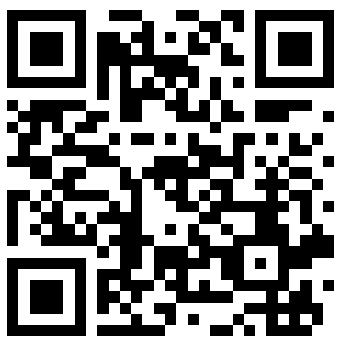

THANKS FOR COMING
ANY QUESTIONS?
marchill@twodarkthirty.com
Remember to always inspire, teach, and learn!
Please check out my website for more information and free downloads.
Coupon code: WSESI24 for 10% off
www.twodarkthirty.com

