Slide 1
EVALUATING THE EVALUATOR
OR HOW I STOPPED WORRYING AND LEARNED TO LOVE CRITICISM

Slide 2
DOWN AND DIRTY!
What curriculum are you following?
Analyze your schedule and planning
Verify your course evaluations and assignments
How do you evaluate your data?
Who are your students?

Slide 3
Let’s break all this down…

Slide 4
1. What curriculum are you following?

Slide 5
Curriculum is…
(1) the courses offered by an educational institution.
(2) a set of courses constituting an area of specialization.

Slide 6
Is this a WTCS course or an agency course?

Slide 7
Do we know how to find those resources?
WTCS website
DHS EMS website
Textbook

Slide 8
Are you qualified to teach?

Slide 9
2. Analyze your schedule and planning

Slide 10
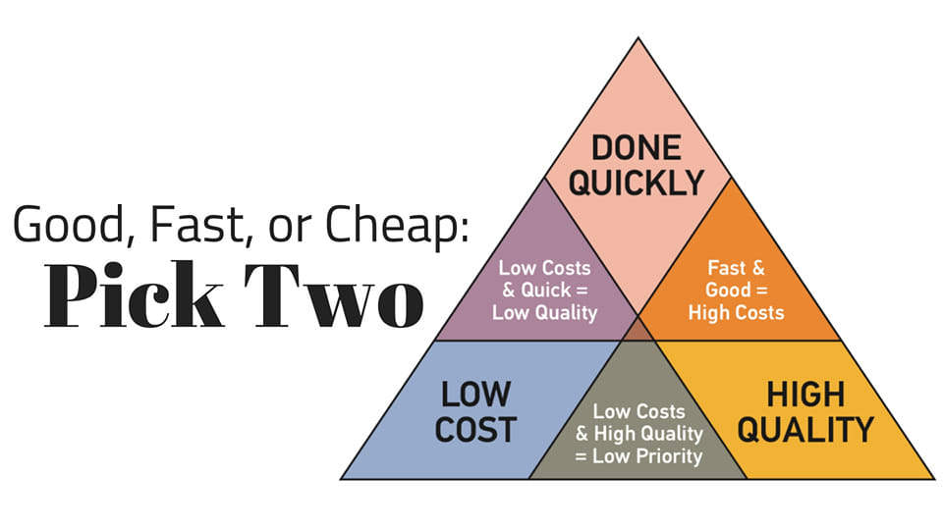

Slide 11
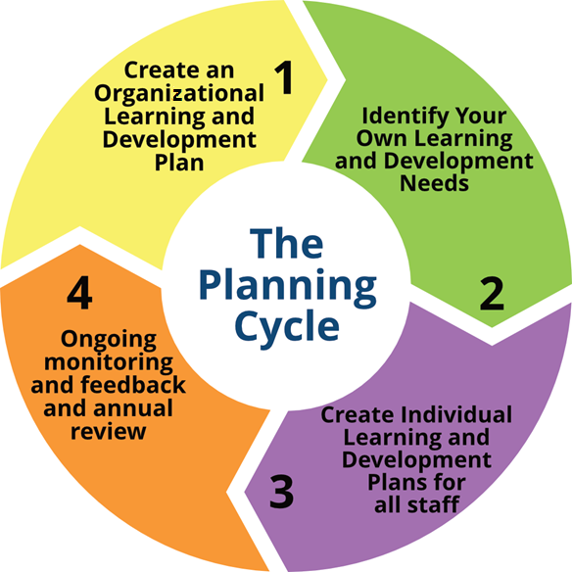

Slide 12
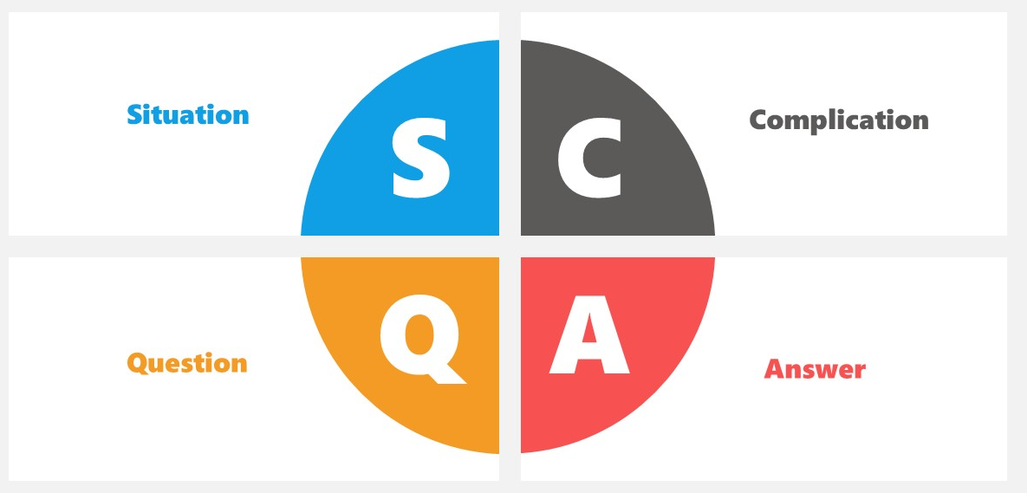

Slide 13
Is there enough time for all the didactic?
Is the right amount of information available?
Is it easy to understand?
Does it require more context?
Are you making the course fun, inspiring, and engaging?

Slide 14
Start with the end…
Begin at the end.
Ask your students how or why types of learning they enjoy.

Slide 15
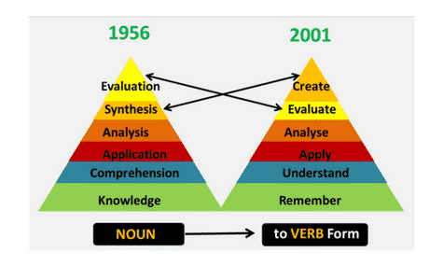
Are you using Bloom and Maslow?
Does the course involve higher-order thinking skills (HOTS)?
Challenging
Empowering
Using
Groups
Competition
Bloom’s Taxonomy

Slide 16
Adaptive Learning Systems (ALS or OLS)

Slide 19
Lesson Plans

Slide 20
Evaluate your time in class
How do you spend it?
Is there a routine?
Is there clear expectations?
Is there a set syllabus or schedule?

Slide 21
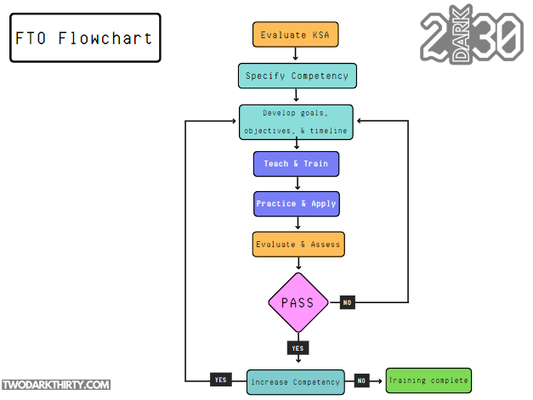
Is there a designed plan or progress to follow?

Slide 22
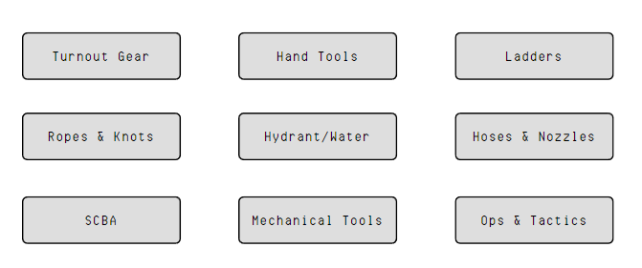
Curriculum Mapping
Let’s put things in the right order

Slide 23
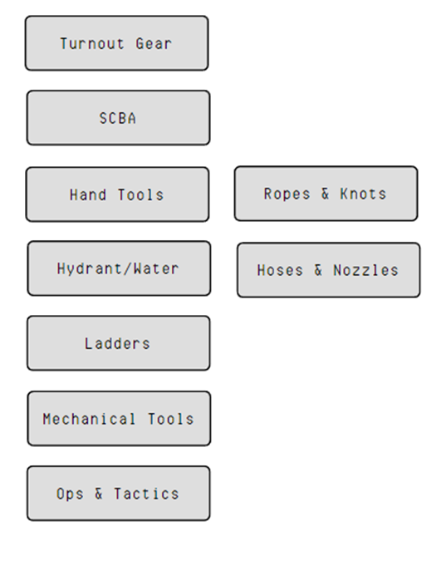

Slide 24
What do you use in class?
Consumables?
Tools and equipment
Aids or assistants?
Locations or structures

Slide 25
Future Technology… today
https://flaimsystems.com/products/trainer

Slide 26
3. Verify your course evaluations and assignments

Slide 27
What types of assessments do you use?
Diagnostic
Formative
Summative

Slide 28
What types of assignments do you use?
Is there a rubric?
Who does the grading?
Turn around time.
Resurrection points?

Slide 29
Rubrics

Slide 30
How do you show proficiency?
Pure evaluation?
Portfolio process?
Do you have the end in mind at the beginning?
Is there confirmation bias?

Slide 31
4. How do you evaluate your data?

Slide 32
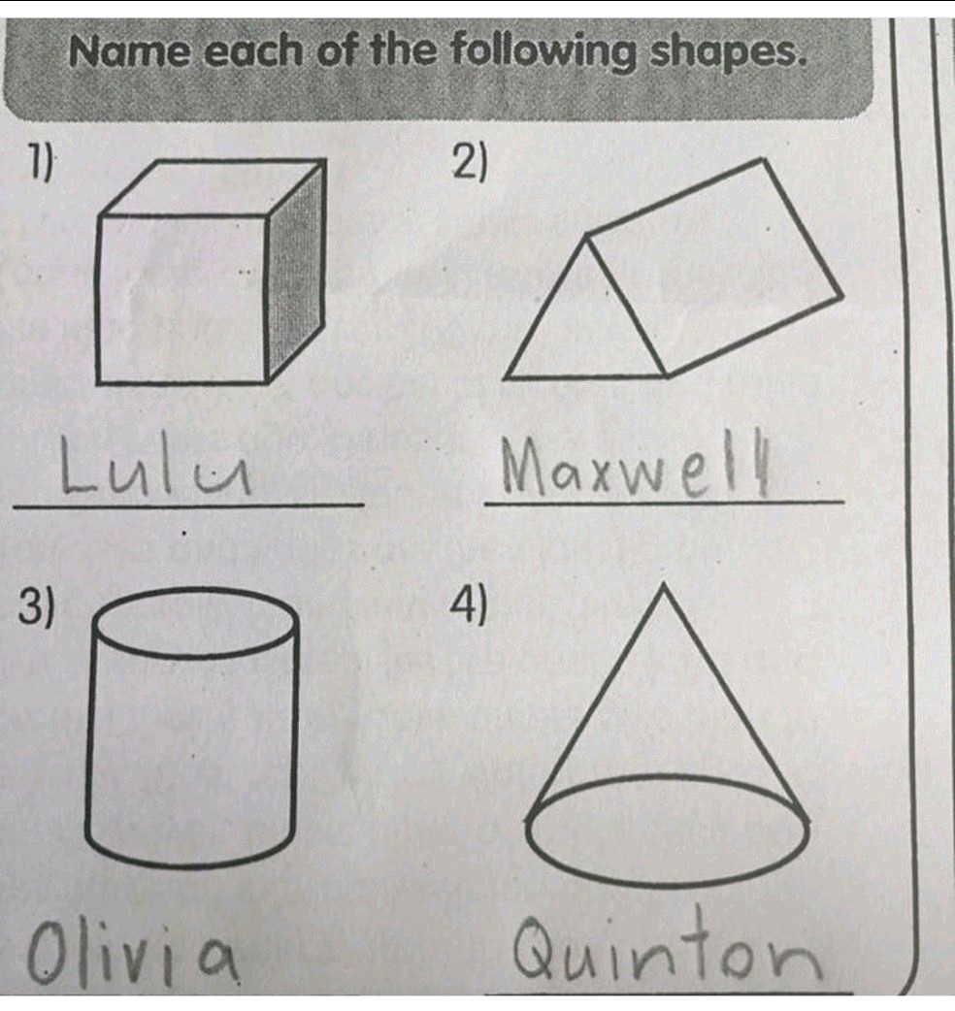

Slide 33
Evaluate your evaluations
Is the number of questions adequate?
Is the question clear and the answers concise?
Is there a varied type of question?
Multiple Choice
Short answer
Matching
Fill in the blank
Where did you get the evaluation from?
How old is it?

Slide 34
Higher Order Thinking Skills (HOTS)
1. What do you think could have happened next?
2. Do you know of another instance where...?
3. What would you change in the story?
4. From the information given, develop a set of instructions about ...?
5. What do you see as possible outcomes? Why?
6. Why did ..... changes occur?
7. What was the turning point? Why?
8. What was the problem with...?
9. How would you have handled...?
10. What are the pros and cons of ...?
11. If you had access to all resources, how would you deal with...?
12. What are the alternatives?

Slide 35
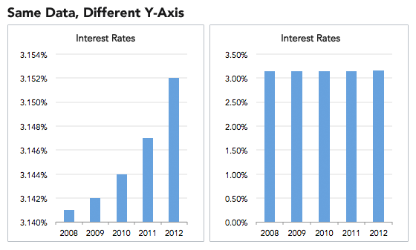
I Love Statistics… not really.

Slide 36
Do you look for student feedback?

Slide 37
Vicious Cycle

Slide 39
Self Assessments

Slide 40
5. Who are your students?

Slide 41
Understand your audience
What experience do they come in with?
Why are they there?
Communicate at THEIR level.

Slide 42
So where do we go from here?

Slide 43
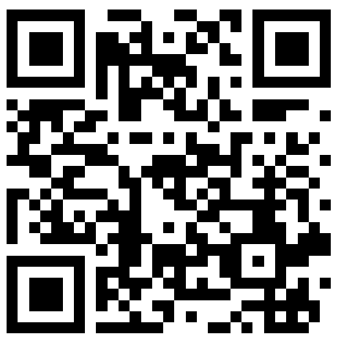
THANKS FOR COMING
ANY QUESTIONS?
marc@twodarkthirty.com
Remember to always inspire, teach, and learn!
Please check out my website for more information and free downloads.
www.twodarkthirty.com

