Slide 1

Unlocking the power of NFPA 1700
Wisconsin Society of Emergency Service Instructors

Slide 2
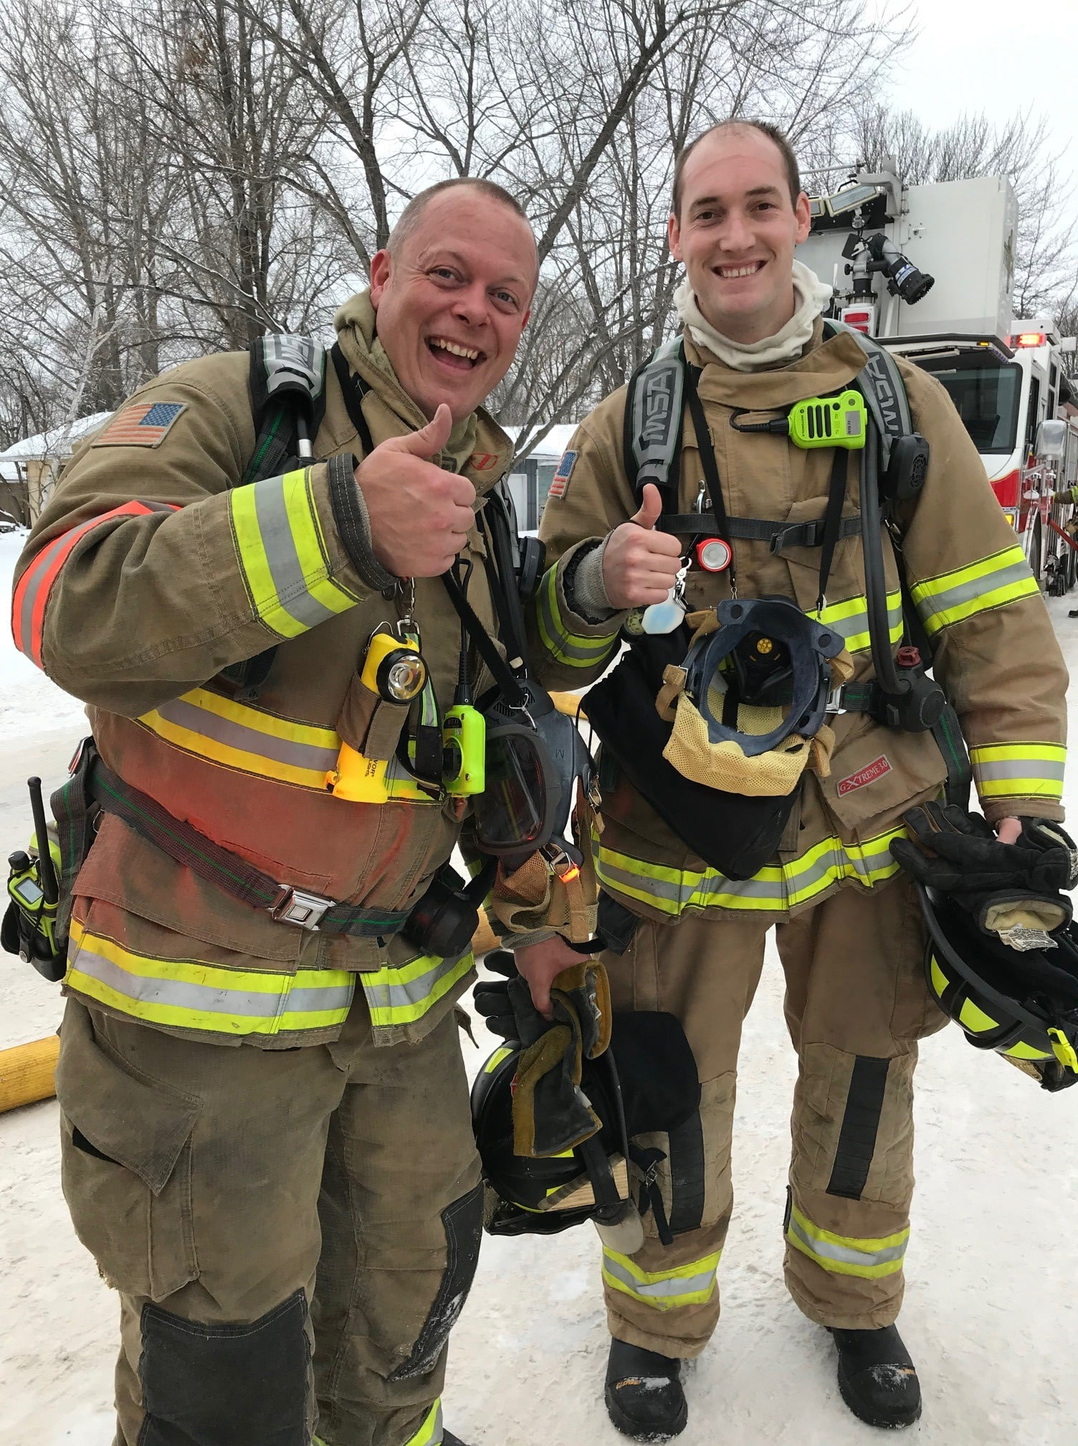
Who am I?
Marc Hill
Degrees and certifications abound
  Bachelors in Social Science
  Masters in Ed Leadership
Over 20 years in public service
  Volunteer, Career, & Public Schools
Author of Two Dark Thirty

Slide 3
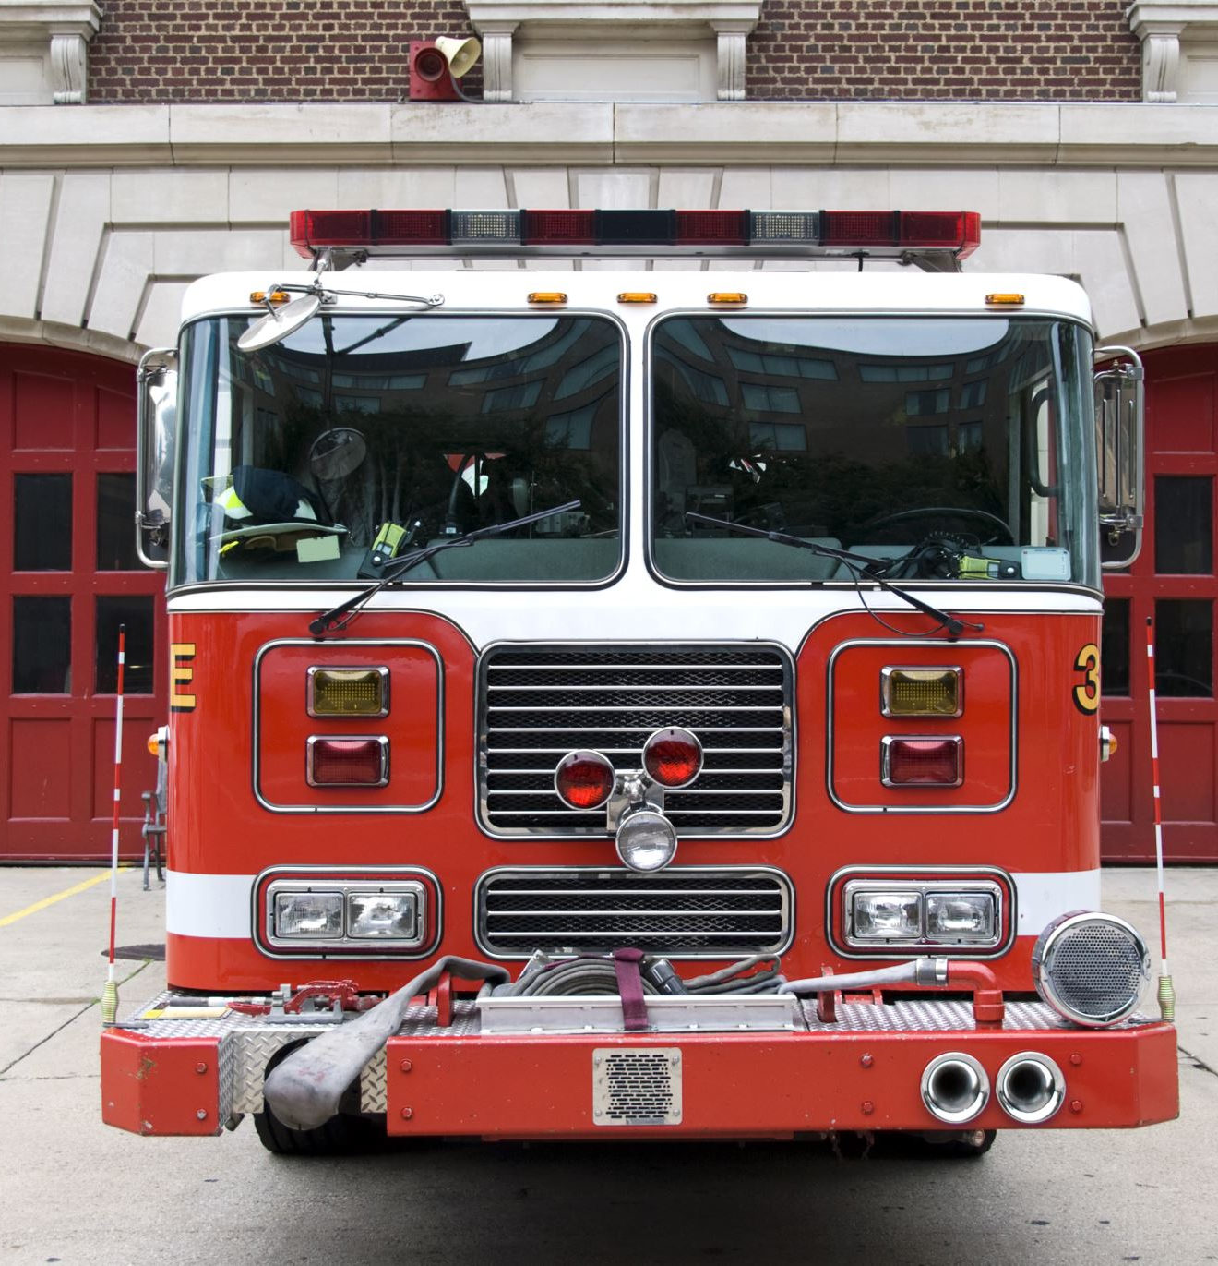
Why bother knowing NFPA 1700?
New homes reach flashover 300% faster than legacy dwellings - in as little as 3-5 minutes.
Modern furnishings can release up to 2x more heat energy per pound versus traditional materials.
Today's lightweight engineered lumber burns faster and fails quicker than dimensional lumber.
Firefighters and civilian lives matter!

Slide 4
What are we going to talk about?
What is NFPA 1700?
Today’s Fire Environment
Firefighting strategies
Contamination Reduction
Education and Training

Slide 5
What is NFPA 1700?

Slide 6
Who was involved?
Originated from a 2014 proposal by retired Kansas City Fire Chief Richard “Smokey” Dyer to develop a guide connecting fire dynamics research with structural firefighting best practices
Endorsed by major fire service organizations including the International Association of Fire Chiefs (IAFC) and the National Institute for Occupational Safety and Health (NIOSH)

Slide 7
Science
Six years, this team pored over modern fire experiments from NIST to UL and investigations to shape a strategy grounded in quantifiable data versus unchallenged tradition
Consensus-based guide represents the gold standard for safe, effective fireground operations

Slide 8
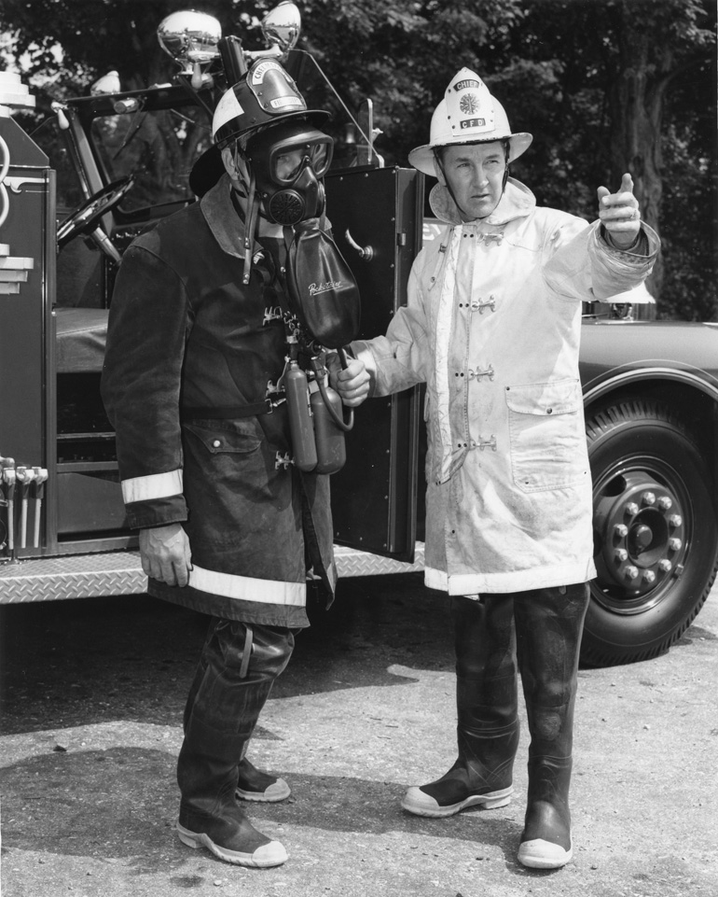
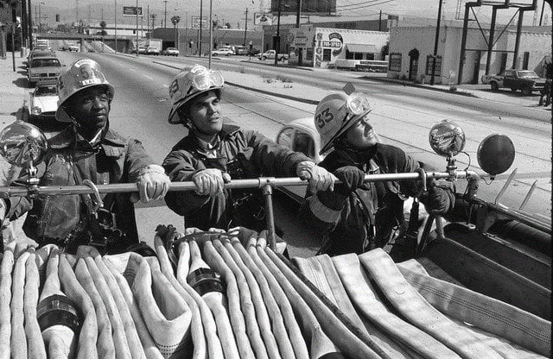
A lot has changed in 50 years

Slide 9
Changes in construction
New and unknown hazards (technology)
Faster fire propagation
Shorter time to flashover
Rapid changes in fire dynamics
Shorter escape times
Shorter time to collapse
New exposure problems

Slide 10
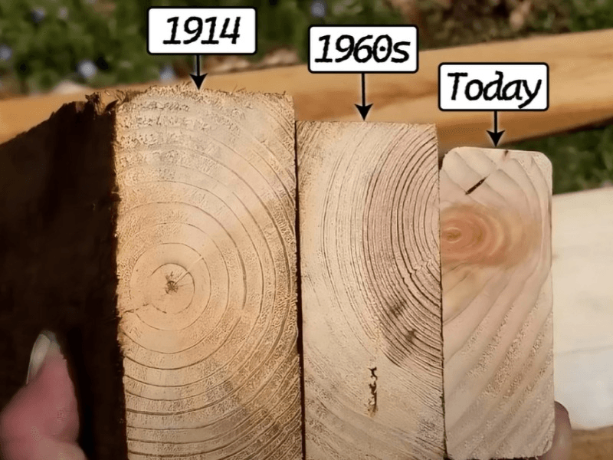
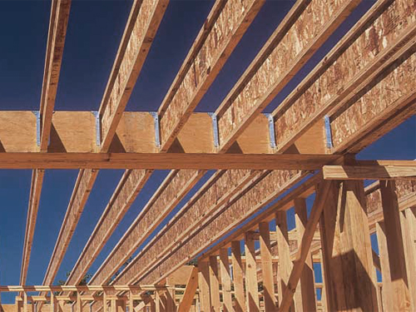

Slide 11
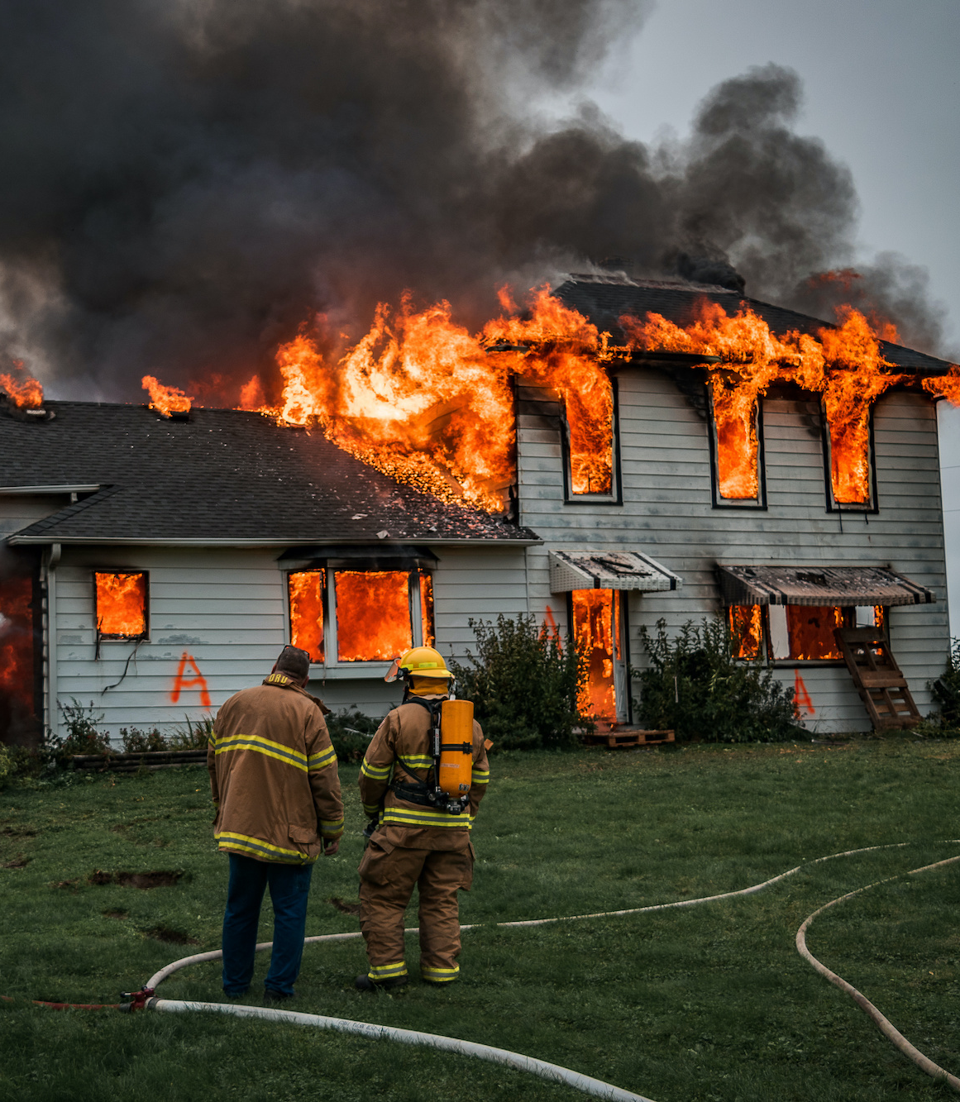
Have you adapted your training plan to address these changes?
Changes in fuel loads and construction methods have had an impact on the fire environment
The value of a proper 360 size-up
The importance of having tactical options such as:
  Door control
  Coordinated ventilation and suppression together
  Exterior fire control prior to entry

Slide 12
Making choices
How often do you make decisions on the fireground based on your knowledge of fire science or fire dynamics?
When was the last time you updated your understanding of how it impacts modern firefighting operations?

Slide 13
Change is constant
Change isn't going to slow down.
The current trend is that more homes will have solar panels on the roof and battery-powered vehicles in the garage.
New technologies in building design and construction methods are always evolving.

Slide 14
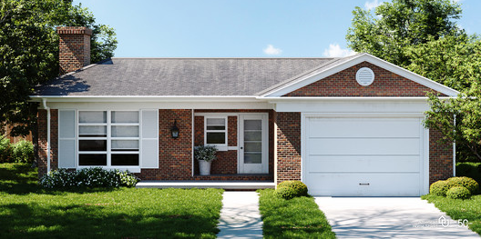

Supersize me
In 1973, the average size of a single-family home was 1600 sq. ft.
By 2008, the average size had increased to 2,500 sq. ft.

Slide 15
Today's Fire Environment
Things burn faster, time is shorter, and hazards are different.

Slide 16
Larger Homes
An increase in the construction of larger two-story homes.
This means more open home geometries such as:
  taller ceilings
  open floor plans
  two-story foyers
  great rooms
Void spaces
Lightweight construction

Slide 17
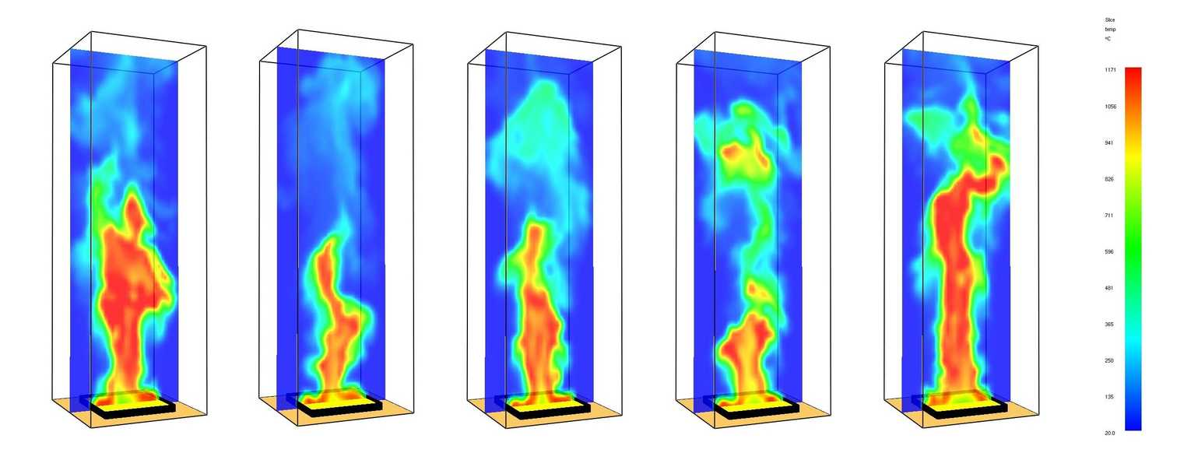
Fire Dynamics
Dimensional lumber
Legacy vs. synthetic materials
Time to flashover
Heat rates
Wind direction, ventilation, and flow patterns

Slide 18
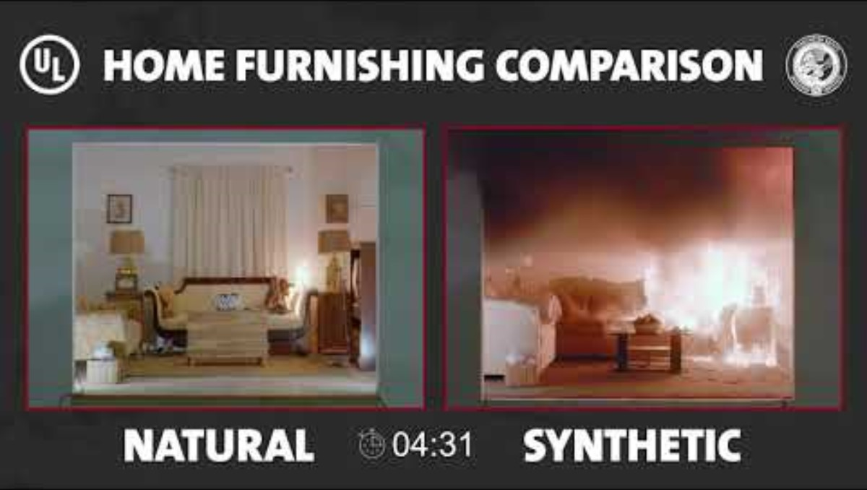

Slide 19
Firefighting strategies

Slide 20
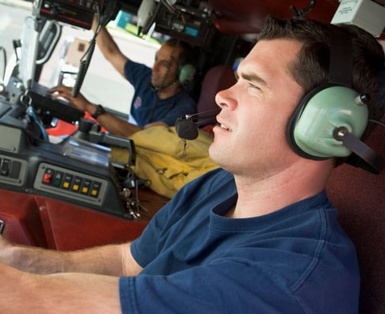
13 Initial Arrival Factors
Bystander/witness statements
Access concerns on the property
Building height, size, and stability
Occupancy type
Construction type
Wind direction relative to the building location and configuration
Fire location, size, extent
Civilian and firefighter life safety
Suspected direction of fire and smoke travel within the structure (flow path)
Smoke and fire exposures exterior to the structure
Presence and status of fixed fire protection systems
Firefighter safety building marking systems
Resources available

Slide 21
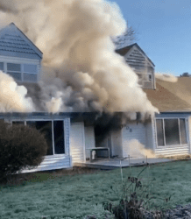
Command and Control
360 is essential
Number of stories on A and C sides
Verify basement type (finished or unfinished) and consider the following:
  Type of windows
  Likelihood of occupancy
Presence of occupant escape systems
Utilities, including the following:
  Electrical service/overhead lines
  Propane/fuel oil tanks
  Natural gas service (location)
  Photovoltaic panels (solar panels)
Pre-existing structural hazards
Hazardous grade changes
Roof type and construction
Presence of fire protection features (hydrants, FDC, fire pump, etc.)

Slide 22
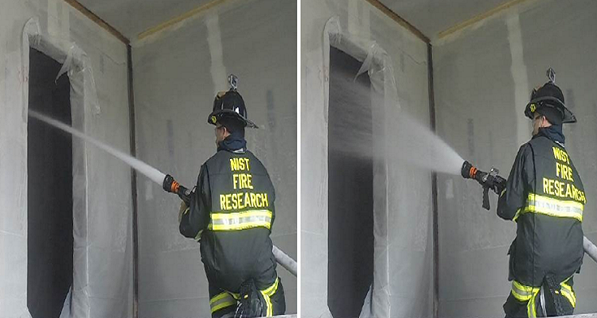
Risk Management
Risk vs. reward
Offensive or Defensive
Water tactics
big vs. little
straight vs. fog
Tactics can change SLICERS vs. RECEVO VS
Determine your priorities
Life Safety 1st

Slide 23
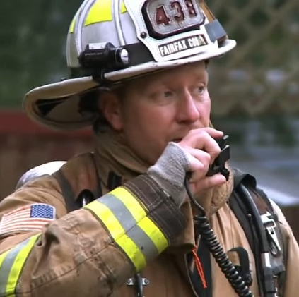
Communicate
Within crews and with command
Work together and coordinate
Outline objectives
Accountability

Slide 24
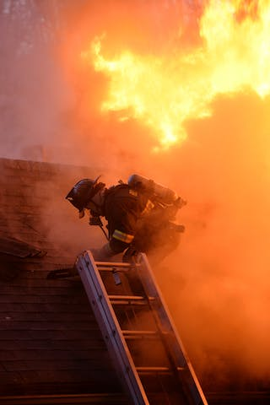
Ventilation studies
Non-vented
Horizontal
Vertical
Hydro
Positive Pressure
Negative Pressure
Door/Window control

Slide 25
Contamination Reduction
Minimizing exposure to products of combustion

Slide 26
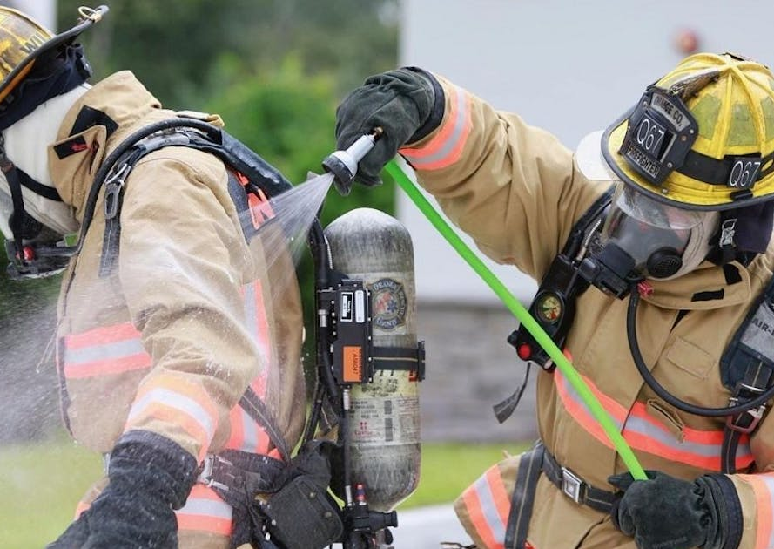
Reducing Exposure to Contaminants
Do you have a decon SOG?
  Brush off
  Water off
  Soap & water
Exposure control
  Overhaul with PPE & SCBA!

Slide 27
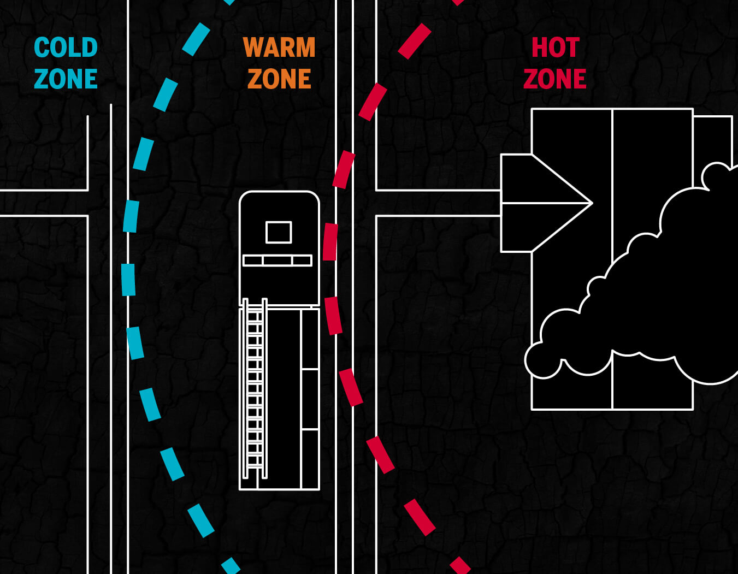
Reinforce Knowledge
Use Hazmat zones we’re all familiar with
  Hot, warm, cold
  Use your meters

Slide 28
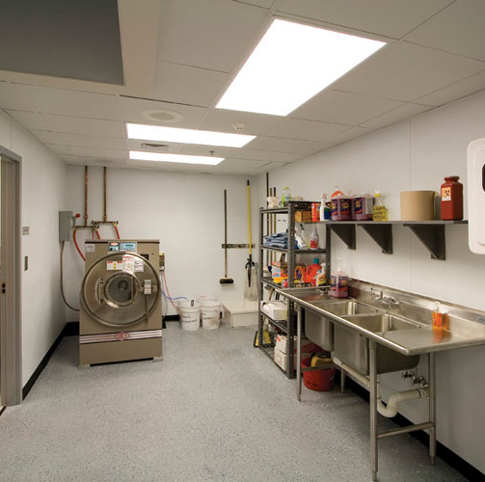
Back at the Station
PPE bagged on scene
Multiple sets for each FF
Showers
Rehab firefighters
Tools and Apparatus wash
Again, think about exposure control

Slide 29
Training and Education

Slide 30
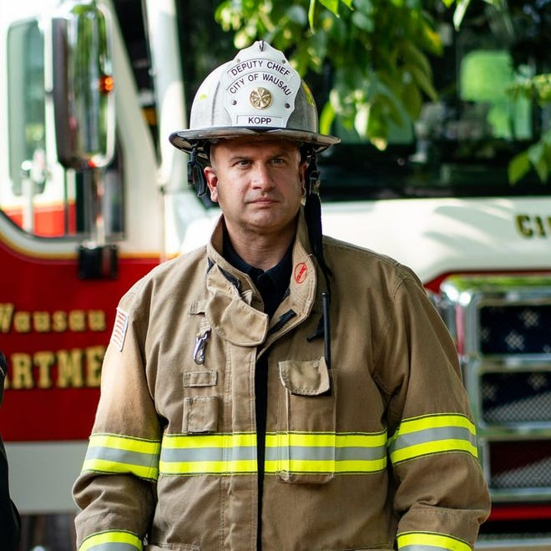
It starts at the top
NFPA 1700 training is free!
Command staff knowledge
Current members wisdom
Probational staff awareness

Slide 31

How to implement?
Review SOGs and Protocols
Involve inspections and public education
Little things make a difference
Start small and work up
Bad habits die hard

Slide 32
When was the last time?
You looked at NFPA 1001, 1002, 1021, or 1710?
Reviewed and refreshed Firefighter 1 & 2 skills?
  Remember DSPS only requires a 60-hour initial course
Do you have mandated training hour requirements?
  Is the training scheduled and organized?
ISO recommends:
  192 hours of training per year.
  Four 3-hour multi-company drills.
  40 hours of fitness per member.

Slide 33
Where do we go from here?

Slide 34


THANKS FOR COMING
ANY QUESTIONS?
marchill@twodarkthirty.com
Remember to always inspire, teach, and learn!
Please check out my website for more information and free downloads.
Coupon code: WSESI24 for 10% off
www.twodarkthirty.com

