Slide 1
SUCCESSFUL STRATEGIES FOR THE FTO
OR HOW I STOPPED WORRYING AND LEARNED TO LOVE TEACHING

Slide 2
DOWN AND DIRTY!
Start with the end.
Know AND understand your role.
Be honest and open.
Realize what you are evaluating AND why.
Recognize your audience.
Patience

Slide 3
Let’s break all this down…

Slide 4
1. Start with the end in mind

Slide 5
Is your program organized?
Start small put first things first.
Are there steppingstones?
Pathway maps
Have defined targets and evaluation points
End with a sharpened saw
Fit for duty

Slide 6
Have a vision for where you want to go

Slide 7
Create a Routine
Routines give understanding and they create an understood environment for learning.
1
Schedules will help create a set time for repetitions, reviewing, and remediation.
2

Slide 8
Program information is clear
All forms used for the program should be clear and understood by all parties.
Forms and documentation should be used for tracking
Supervisor and ALL parties involved should be aware information collection
Understand the legal importance

Slide 9
Legally speaking
This is a life-or-death business
If something happens on-scene EVERYONE will come looking
Make sure you have all your ducks in a row and document, document, document!
EEOC concerns & accomidations

Slide 11
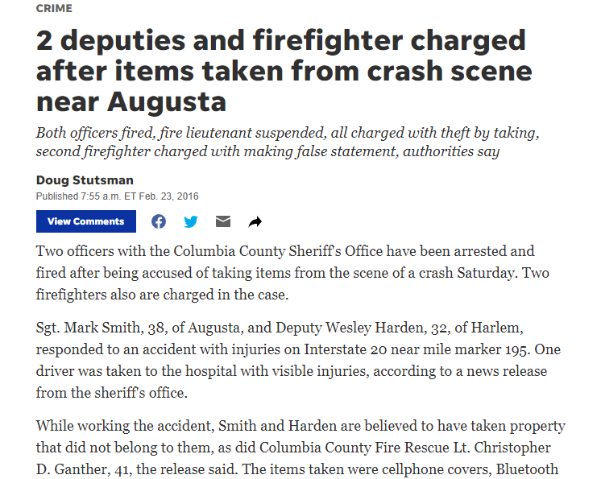

Slide 12
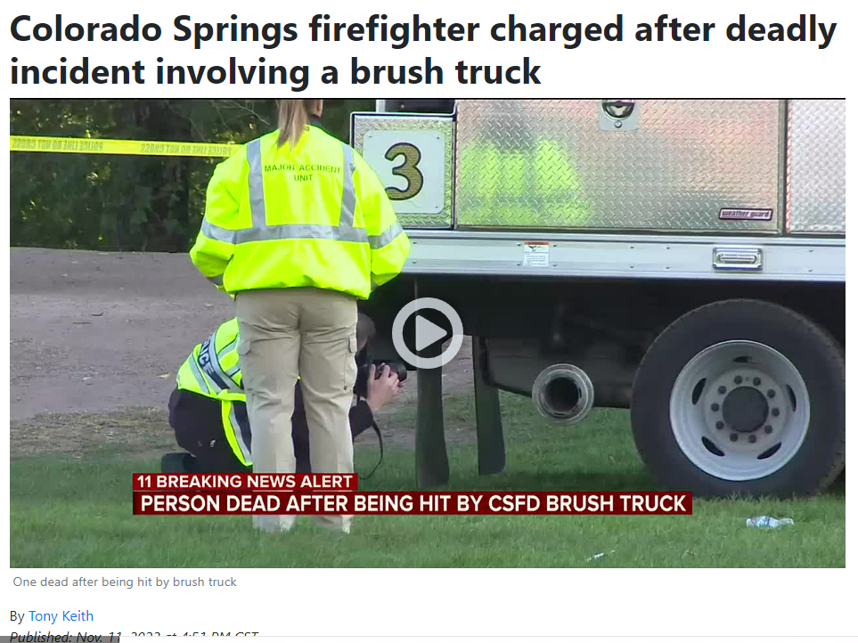

Slide 13
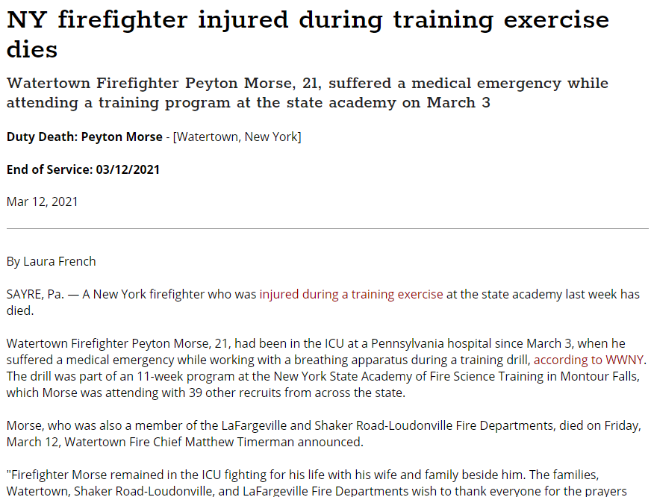

Slide 16
2. Know AND understand your role.

Slide 17
You are the FTO not the mentor!
Your role is the teacher and coach. You evaluate and educate.
Use different methods of instruction
Tell a story!
Empower them to act and lead.
Have them teach you!
Celebrate success and have consequences for poor actions

Slide 18
Compare the roles
Mentor
FTO
Friend
Supporter and motivator
Role Model
Teacher
Evaluator
Coach

Slide 19
Positive attitudes are contagious
Think Win-Win
Celebrate the positives and the natural abilities in your trainee
Think about how you come off
Be someone who inspires not scolds
Remember you should WANT them to succeed, not cheer for their failure.

Slide 20
Keep a professional distance
Remember
Remember you are an evaluator and not a friend.
Becoming
Becoming too buddy-buddy can cause issues with evaluations, understanding, expectations, and integrity.
Help
Help when you can but let the trainee fail if needed.

Slide 21
Be an excellent communicator
Excellent at written and oral
Feedback, feedback, feedback
Never have evaluation sessions alone
Have the feedback circle created
Sandwich method

Slide 22
3. Be honest and open

Slide 23
Integrity!
There is no substitute.
Truth and honesty are ALWAYS the best policies
Empathize with your trainee
Meet regularly with your supervisors

Slide 24
Let’s talk about counseling and feedback
Start
Start with a question and end with a question
Allow
Allow time to explain themselves
Be
Be specific and targeted. Relate the issue to a goal.
Don’t wait
Timely, don’t wait!
Create
Create a plan together for achievement.

Slide 25
Let’s talk about Feedback

Slide 26
Higher Order Thinking Skills (HOTS)
1. What do you think could have happened next?
2. Do you know of another instance where...?
3. What would you change in the story?
4. From the information given, develop a set of instructions about ...?
5. What do you see as possible outcomes? Why?
6. Why did ..... changes occur?
7. What was the turning point? Why?
8. What was the problem with...?
9. How would you have handled...?
10. What are the pros and cons of ...?
11. If you had access to all resources, how would you deal with...?
12. What are the alternatives?

Slide 27
Have the hard conversations
Talk about
Talk about what will be expected of the trainee
Be
Be honest with issues like stress, insomnia
Have
Have the death talk

Slide 28
GRIEVING
G- Gather the family or other members present.
R - Seek out resources to help with grief, such as religious, family, and friends.
I – Identify yourself and name the deceased by name.
E – Educate the family or friends to the brief events and information that you do know.
V – Be clear and verify that the patient has died or is dead.
(_) – Space is just that, giving a moment to let the news set in.
I – Inquire or ask if there are any questions.
N – Nuts and bolts… offer the members to say goodbye to the body.
G – Give them contact information or resources to assist.

Slide 29
4. Realize what you are evaluating AND why.

Slide 30
Fundamentals
Sweat the small stuff
Quality vs. quantity
When to apply pressure
Sink or swim

Slide 31
What KSAs do you want them to attain?
What do you want them to be proficient in?
Do you use SMART goals?
Having a defined endpoint makes it possible to achieve success.
Be motivated and have a clear vision.
Promote buy-in to YOUR system.

Slide 32
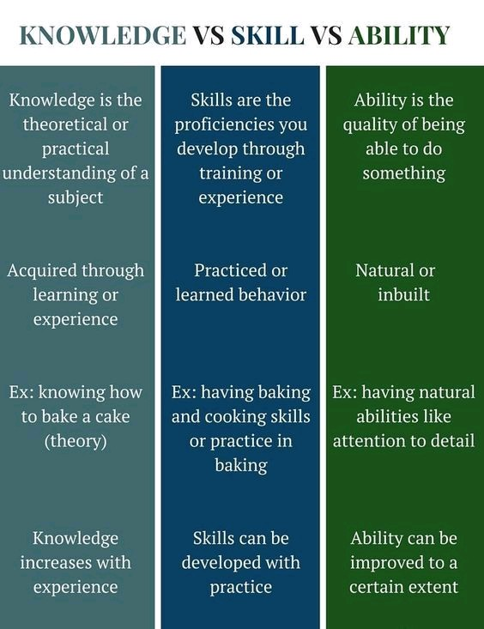

Slide 33
Let’s define our KSAs
Knowledge
Skills
Abilities
The book or didactic learning
Step-by-step processes
Problem-solving and troubleshooting

Slide 34
FTO Training Matrix

Slide 35
5. Recognize your audience

Slide 36
Understand who you are training
One size doesn’t fit all
Test your trainee
Adaptive learning system (open learning system)

Slide 37
Adaptive Learning Systems (ALS or OLS)

Slide 38
6. Patience

Slide 39
Dunning-Kreger Effect

Slide 40
Step back
Don’t just do something, stand there.
Give the trainee freedom to fail
Relax and have fun
Realize it is a process and will take time

Slide 41
So where do we go from here?

Slide 42
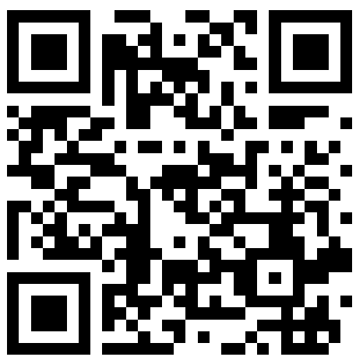
THANKS FOR COMING
ANY QUESTIONS?
marc@twodarkthirty.com
Remember to always inspire, teach, and learn!
Please check out my website for information and downloads
www.twodarkthirty.com

