Slide 1


Winning Strategies for the Field Training Officer
OR HOW I STOPPED WORRYING AND LEARNED TO LOVE TEACHING

Slide 2
About me
Volunteer Firefighter and EMT
Engineer of Special Rescue Ops
Fire Chief
Fulltime Firefighter Paramedic
Haz Mat Technician
Paper and certs abound
Taught every grade 6th through 12th
College adult instructor for the past 12 years
Principal
MEd in Educational Leadership
Specialized in Curriculum and Learning Systems

Slide 3
Big Questions
Why are we here?
Why are we doing this?
What's our MO?
What gets us out of bed in the morning?

Slide 4
DOWN AND DIRTY!
Strategy 1. Start with the end.
Strategy 2. Know AND understand your role.
Strategy 3. Be honest and open.
Strategy 4. Realize what you are evaluating AND why.
Strategy 5. Recognize your audience.
Strategy 6. Patience

Slide 5
Let’s break all this down…

Slide 6
1. Start with the end in mind
Dr. Stephen Covey

Slide 7
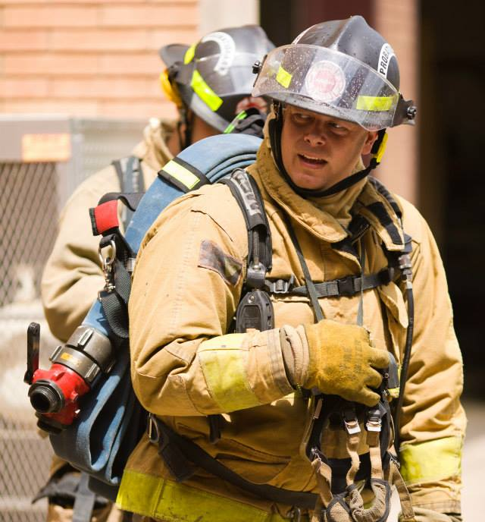
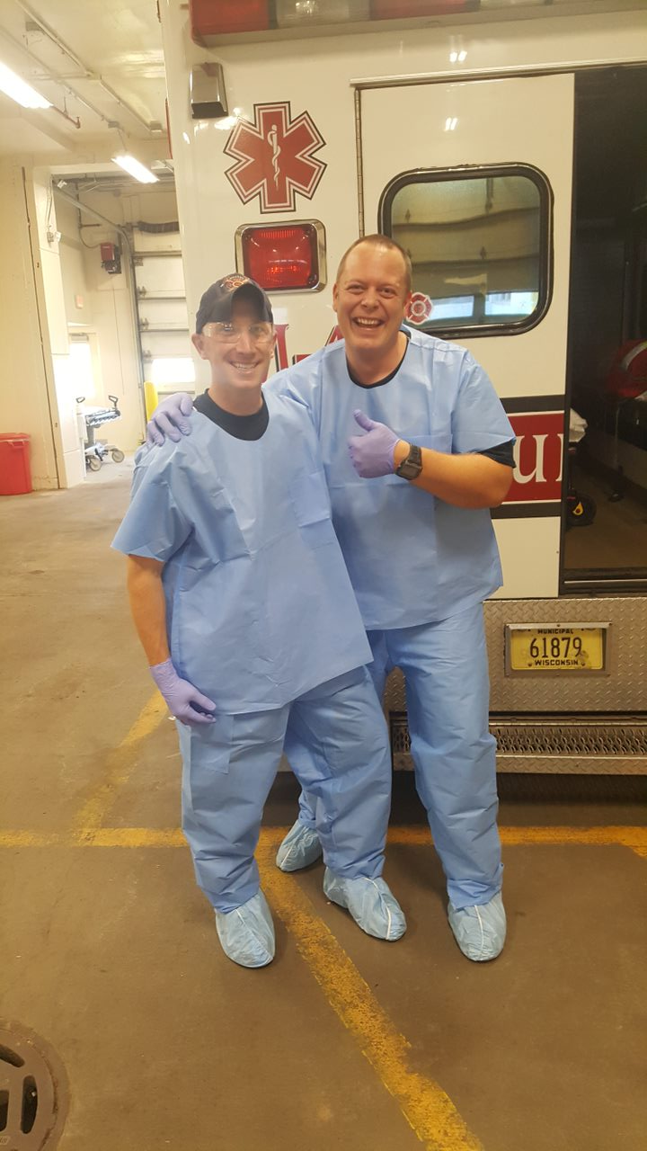

Slide 8
Is your program organized?
Start small put first things first.
Are there steppingstones?
Pathway maps
Have defined targets and evaluation points
End with a sharpened saw
Fit for duty

Slide 9
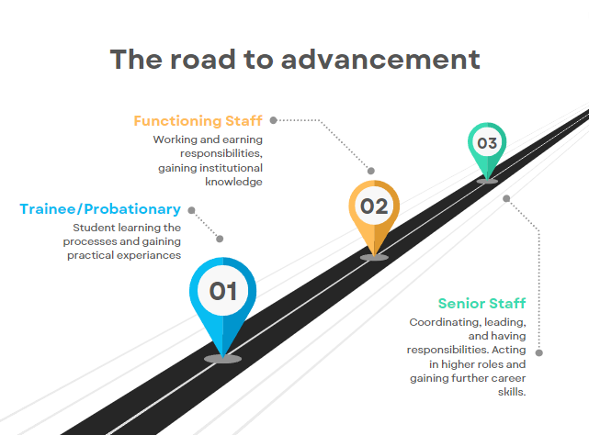
Have a vision for where you want to go

Slide 10
Create a Routine & Schedule
Routines give understanding and they create an understood environment for learning.
Schedules will help create a set time for repetitions, reviewing, and remediation.

Slide 11
Program information is clear
All forms used for the program should be clear and understood by all parties.
Forms and documentation should be used for tracking
Supervisor and ALL parties involved should be aware information collection
Understand the legal importance

Slide 12
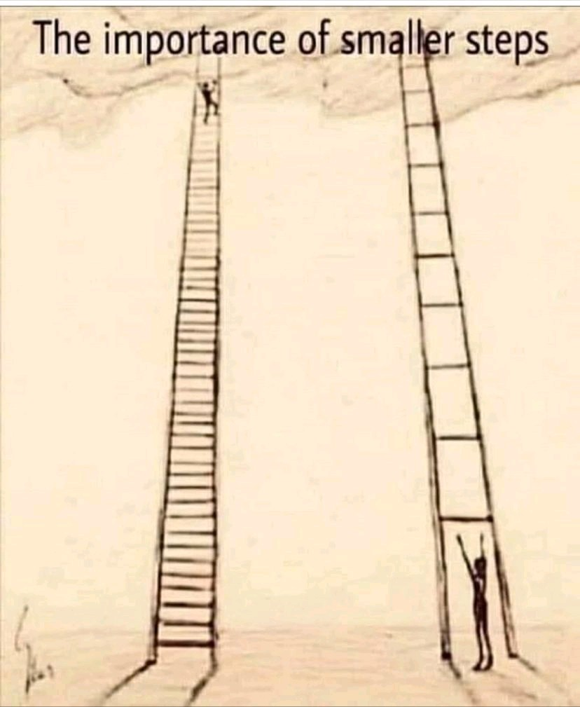

Slide 13

Legally speaking
This is a life-or-death business
If something happens EVERYONE will come looking
Make sure you have all your ducks in a row and document, document, document!
EEOC concerns & accommodations

Slide 14

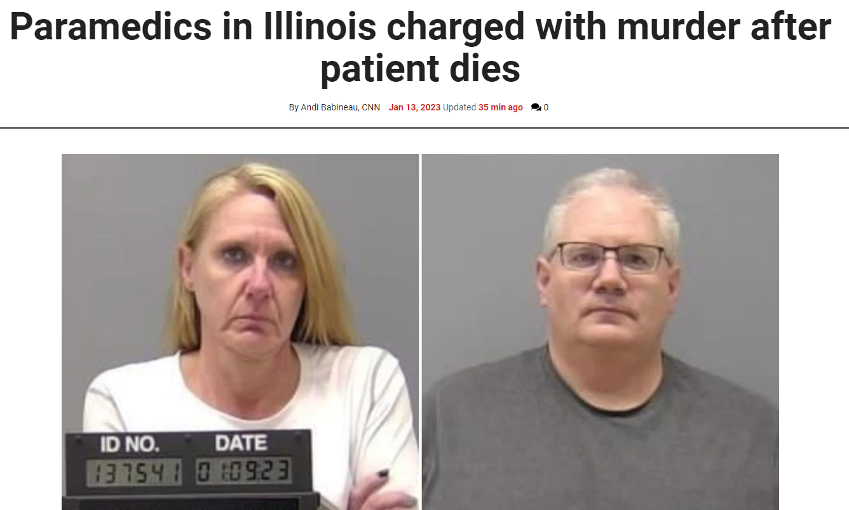

Slide 15
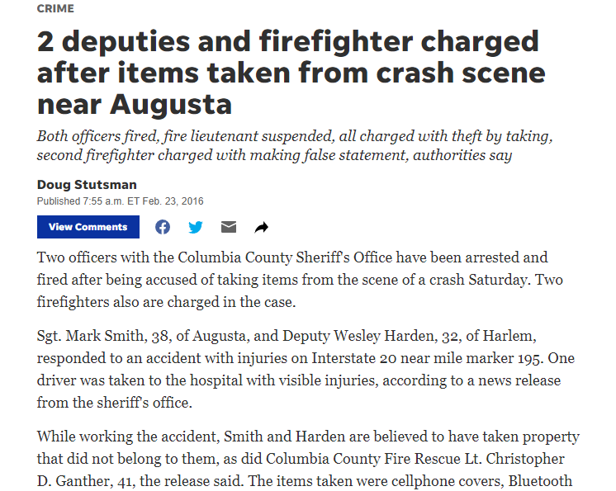

Slide 16
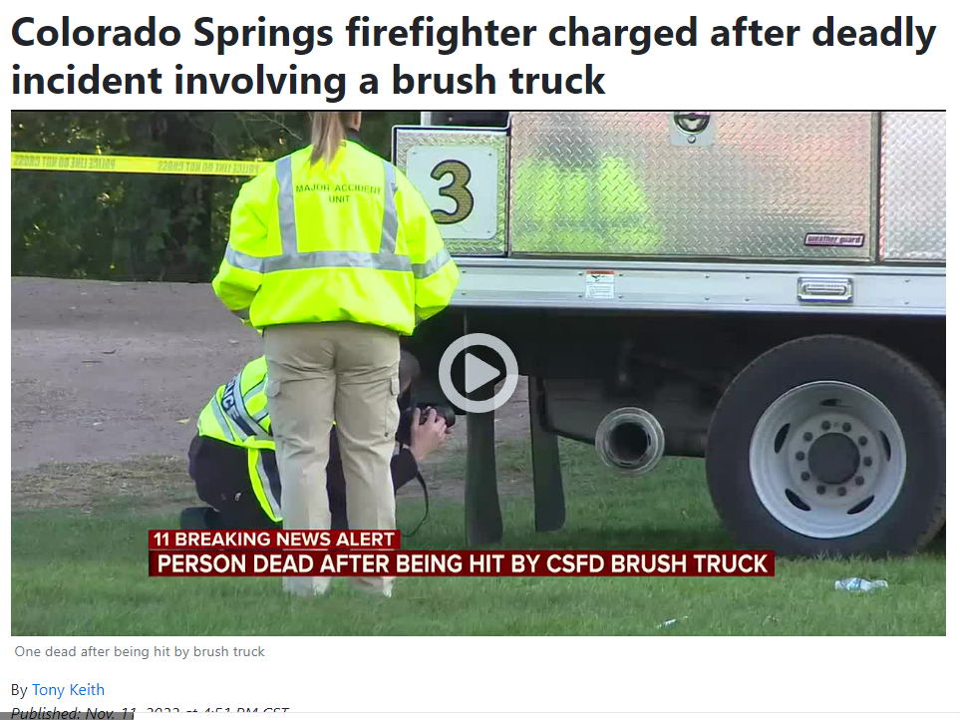

Slide 17
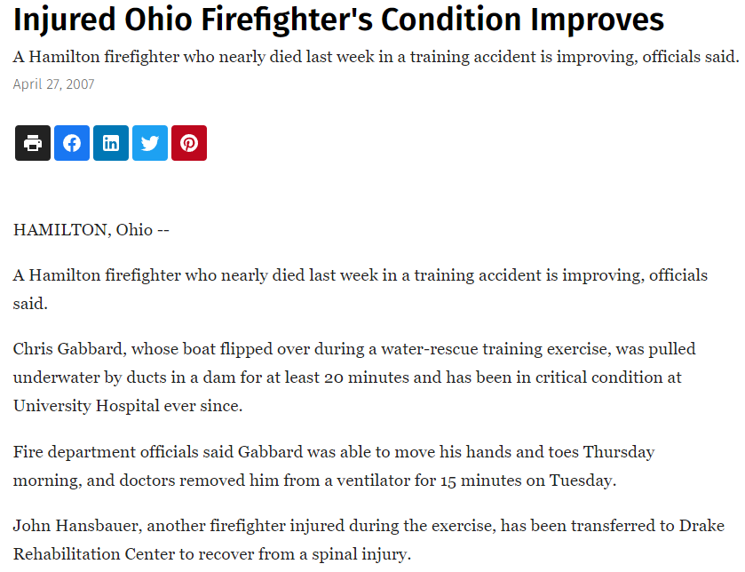

Slide 18
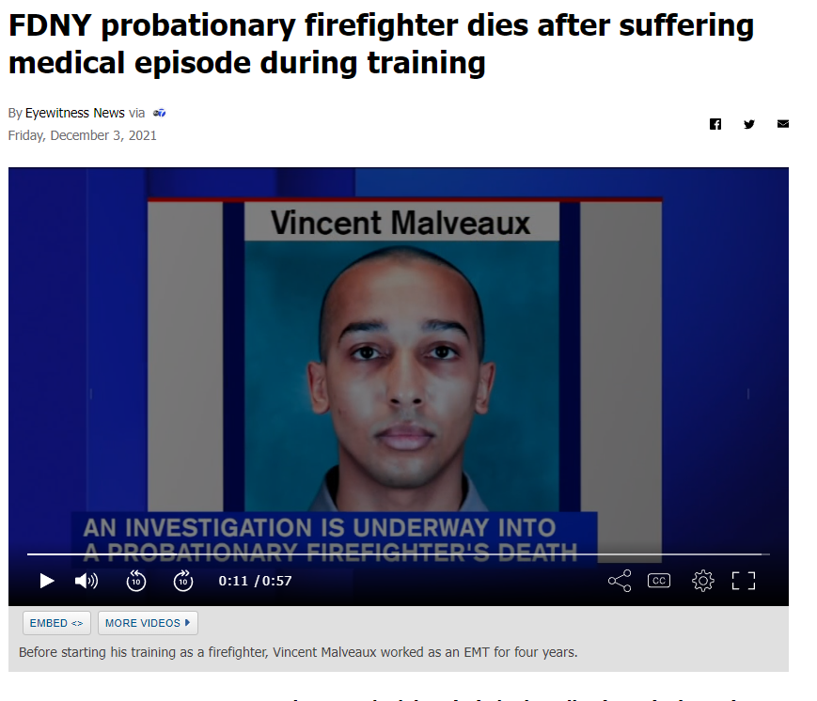

Slide 19
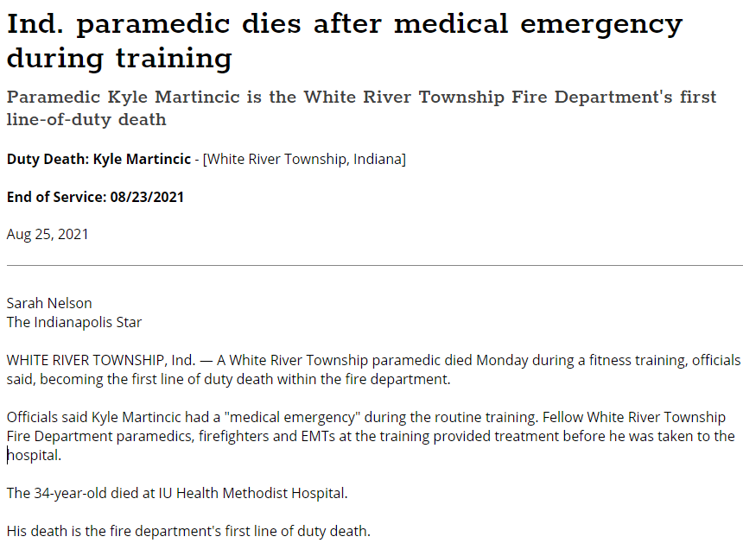

Slide 20
2. Know AND understand your role.

Slide 21
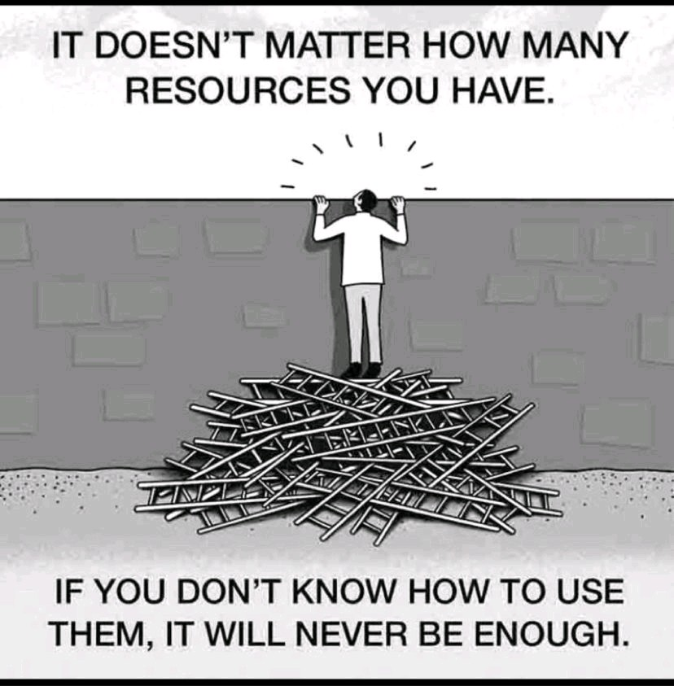

Slide 22
You are the FTO, not the mentor!
Your role is the teacher and coach. You evaluate and educate.
Use different methods of instruction
Tell a story!
Empower them to act and lead.
Have them teach you!
Celebrate success and have consequences for poor actions

Slide 23
Compare the roles
Mentor
FTO
Friend
Supporter
Role Model
Teacher
Evaluator
Coach

Slide 24
Positive attitudes are contagious
Think Win-Win
Celebrate the positives and the natural abilities in your trainee
Think about how you come off
Be someone who inspires not scolds
Remember you should WANT them to succeed, not cheer for their failure.

Slide 25
Be an excellent communicator
Excellent at written and oral
Feedback, feedback, feedback
Never have evaluation sessions alone
Create the feedback circle
Sandwich method

Slide 26
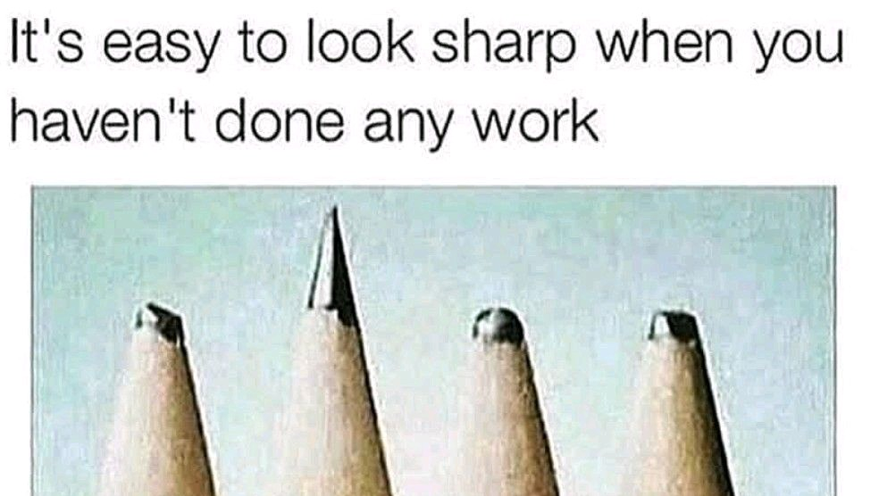

Slide 27
3. Be honest and open

Slide 28
Integrity!
There is no substitute.
Truth and honesty are ALWAYS the best policies
Empathize with your trainee
Meet regularly with your supervisors

Slide 29
Let’s talk about counseling and feedback
Start with a question and end with a question
Allow time to explain themselves
Be specific and targeted. Relate the issue to a goal.
Timely, don’t wait!
Praise over Criticism
Create a plan together for achievement.

Slide 30
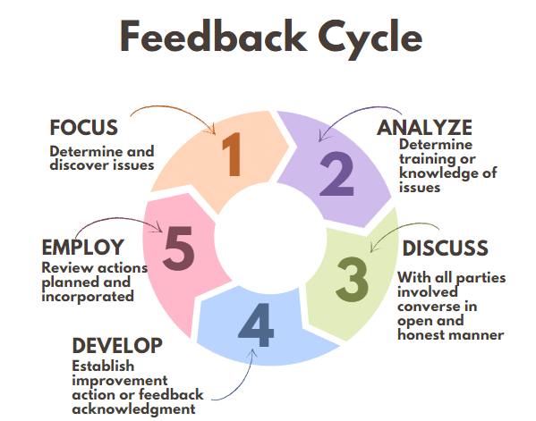
Feedback Loops

Slide 31
Sometimes we have to so NO
The hardest thing we do sometimes is have to admit that a certain person is not cut out for this field.
Have documentation
Show that all bridges have been crossed
Improvement plan
Final warning

Slide 32
Higher Order Thinking Skills (HOTS)
1. What do you think could have happened next?
2. Do you know of another instance where...?
3. What would you change in the story?
4. From the information given, develop a set of instructions about ...?
5. What do you see as possible outcomes? Why?
6. Why did ..... changes occur?
7. What was the turning point? Why?
8. What was the problem with...?
9. How would you have handled...?
10. What are the pros and cons of ...?
11. If you had access to all resources, how would you deal with...?
12. What are the alternatives?

Slide 33
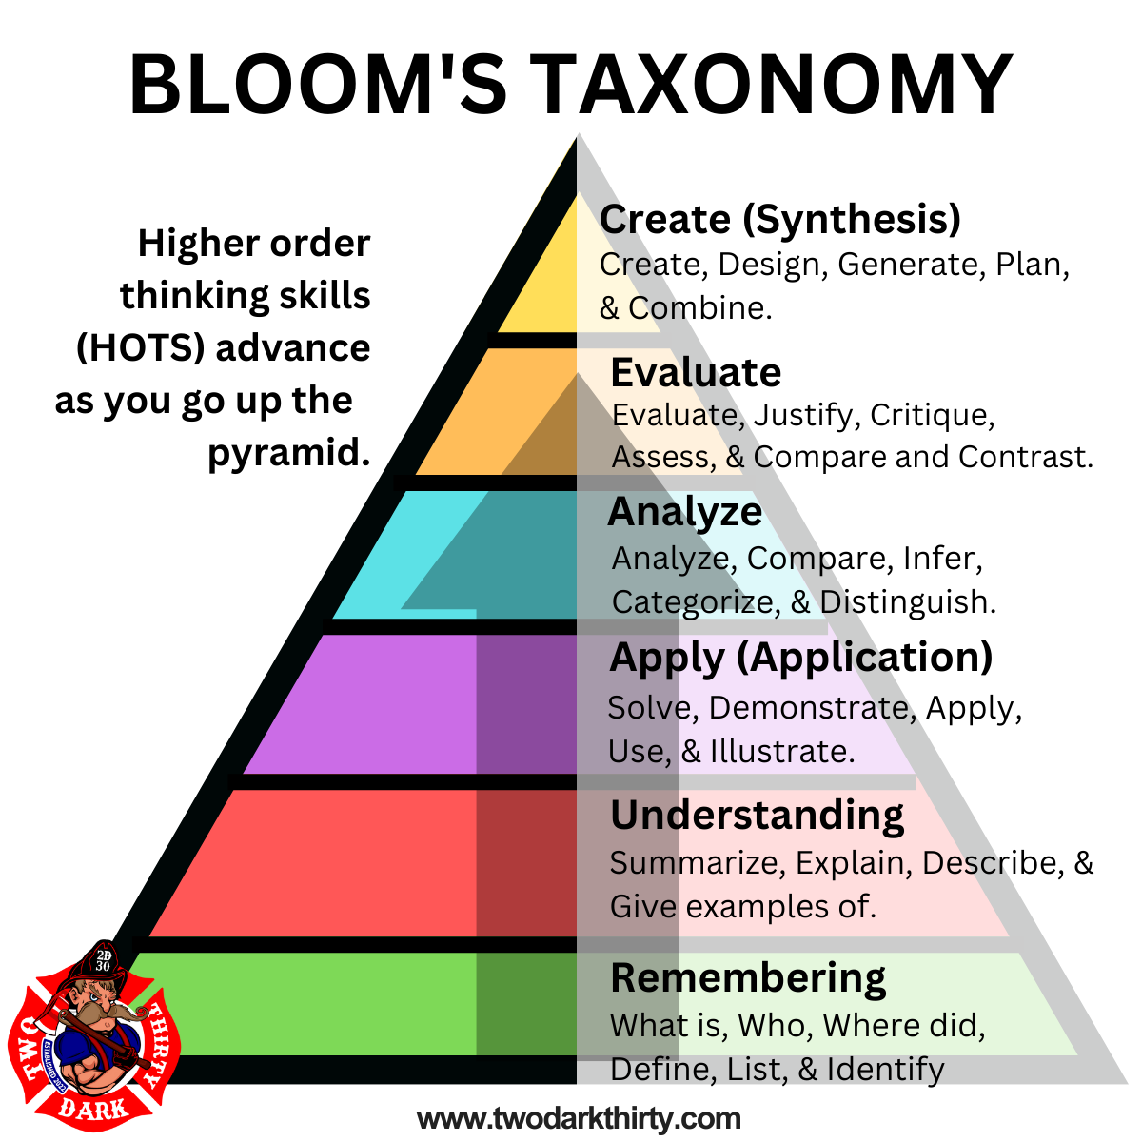

Slide 34
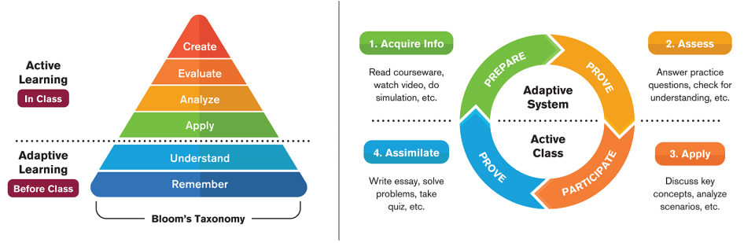
Understand when to teach & What

Slide 35
Have the hard conversations
Talk about
what will be expected of the trainee
Be
honest with issues like stress, insomnia
Have
the death talk

Slide 36
GRIEVING
G- Gather the family or other members present.
R - Seek out resources to help with grief, such as religious, family, and friends.
I – Identify yourself and name the deceased by name.
E – Educate the family or friends to the brief events and information that you do know.
V – Be clear and verify that the patient has died or is dead.
(_) – Space is just that, giving a moment to let the news set in.
I – Inquire or ask if there are any questions.
N – Nuts and bolts… offer the members to say goodbye to the body.
G – Give them contact information or resources to assist.

Slide 37
4. Realize what you are evaluating AND why.

Slide 38
Fundamentals
Sweat the small stuff
Quality vs. quantity
When to apply pressure
Sink or swim

Slide 39
Let’s define our KSAs
Knowledge
Skills
Abilities
The book or didactic learning
Step-by-step processes
Problem-solving and troubleshooting

Slide 40
What KSAs do you want them to attain?
What do you want them to be proficient in?
Do you use SMART goals?
Having a defined endpoint makes it possible to achieve success.
Be motivated and have a clear vision.
Promote buy-in to YOUR system.

Slide 41
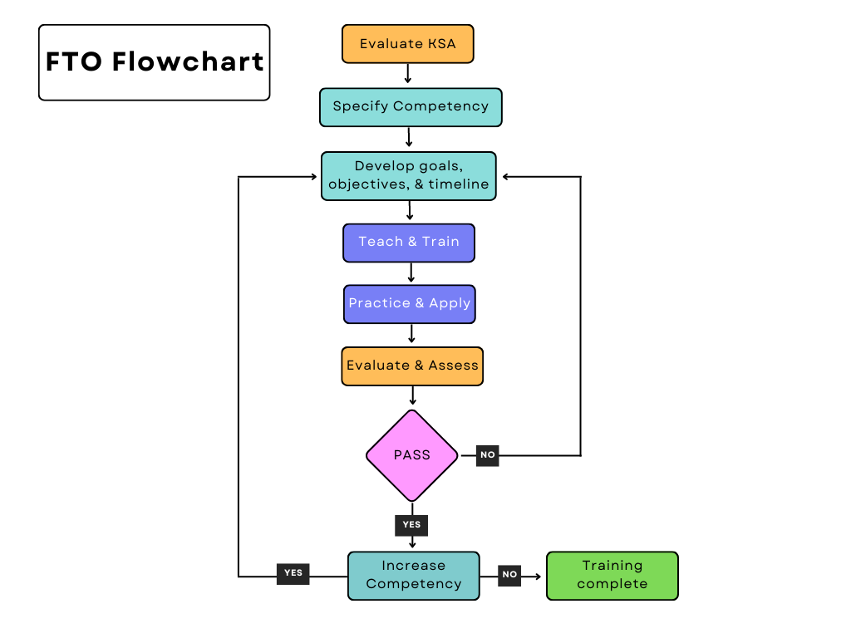
FTO Training Matrix

Slide 42
5. Recognize your audience

Slide 43
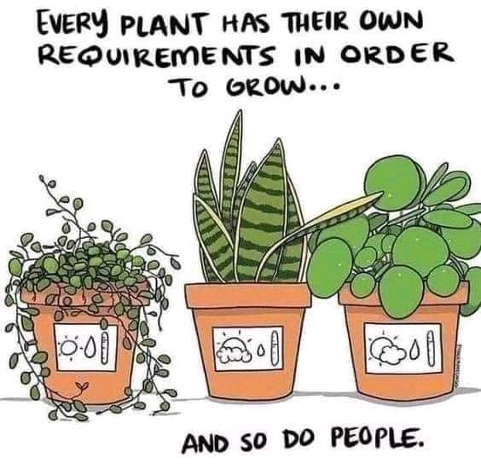

Slide 44
Understand who you are training
One size doesn’t fit all
Test your trainee
Adaptive learning system (open learning system)

Slide 45
Generational Differences
Millennials, Gen z, Gen Y
  Technology
  Divorce Rates
  Latch Key
  Participation Awards
  Social Promotion
  Internet and Social Media
  Instant Gratification
  Long Game

Slide 46

Culture Wars and Socio-Economic Status (SES)
What upbringing can tell you
Neighborhoods
Class distinction
Family and Relationships
Female vs. Male

Slide 47
6. Patience

Slide 48
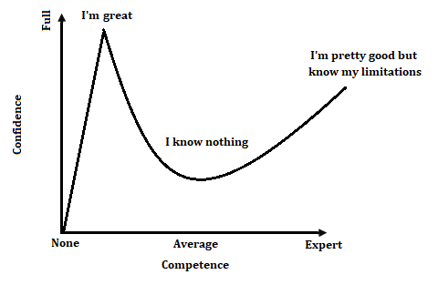
Dunning-Kreger Effect

Slide 49
Step back
Don’t just do something, stand there.
1
Give the trainee freedom to fail
2
Relax and have fun
3
Realize it is a process and will take time
4

Slide 50
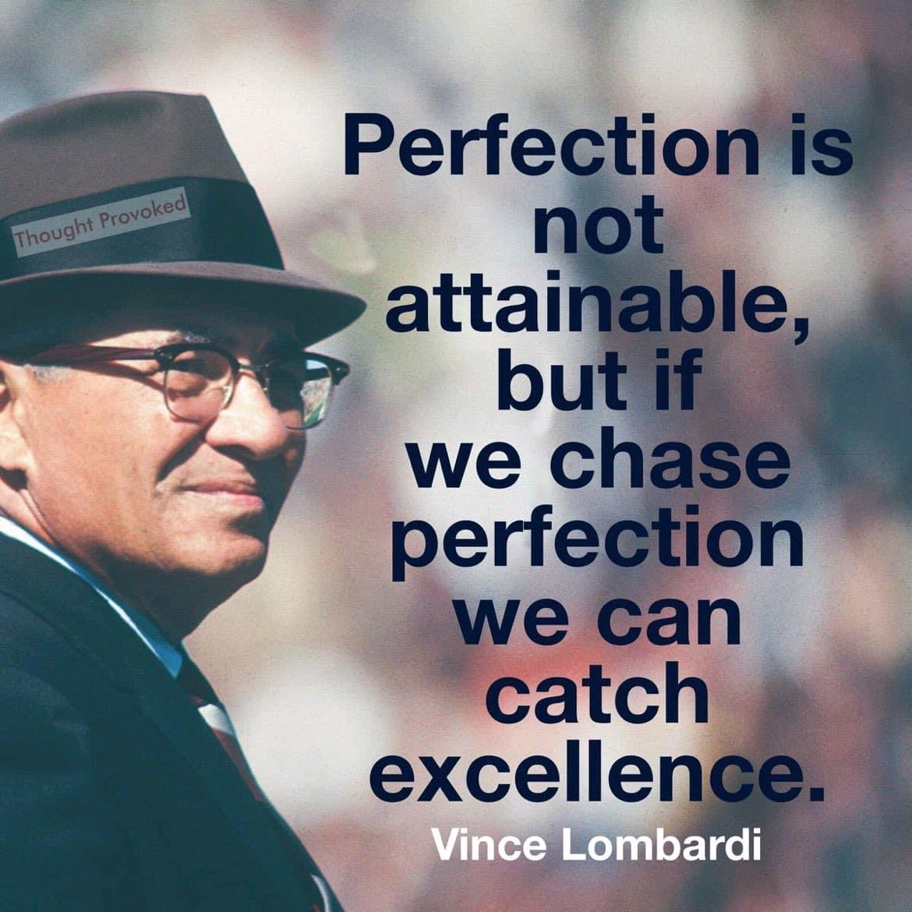

Slide 51
So where do we go from here?

Slide 52

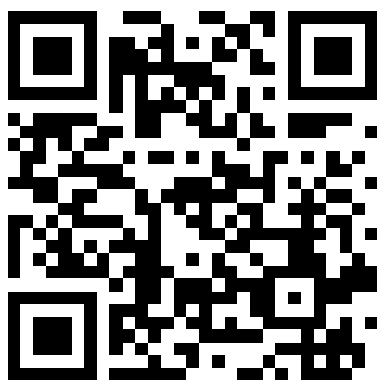
THANKS FOR COMING
ANY QUESTIONS?
marchill@twodarkthirty.com
Please check out my website for information and downloads
www.twodarkthirty.com
OHIO25 for a special 25% discount

