Slide 1
RodPumpTracker.com
Relevant Data.
Real Time Results.

Slide 2
About RPT
RPT is a web-based program - No software installation or maintenance - Continual, live data collaboration between stores - Access and enter data from any location
RPT offers a wide range of data entry, tracking, and analysis - Track and chart a well’s entire history at the push of a button - Quickly pinpoint failure rates, cost trends and more - Build and save customized reports and charts for future use
Email capabilities to stay connected and share data

Slide 3
Benefits of RPT
Save time and money through our ability to analyze and track failure rates, repetitive component failures, metallurgical interventions, etc.
Diagnose cost and failure trends to extend pump life
“What gets measured gets improved”

Slide 4
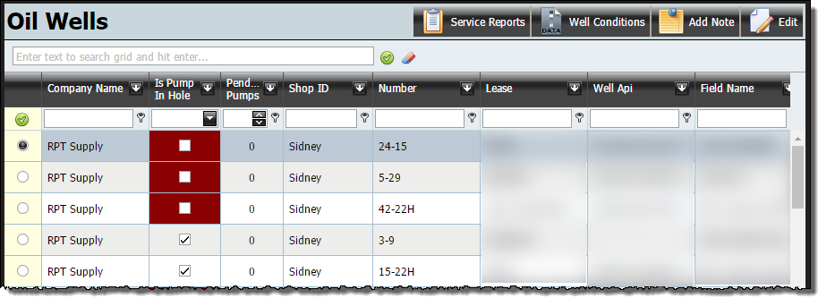
Oil Well Information
Track and search any oil well’s history
Pull up Service Reports to search past components, photos, notes and more
View, print or email any Service Report
Easily search and filter through results to find specific data or oil wells

Slide 5
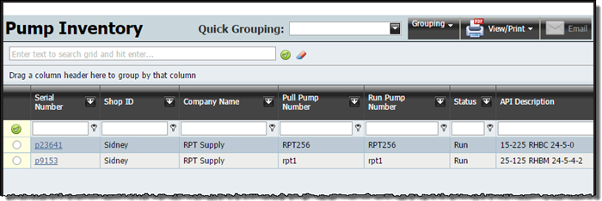
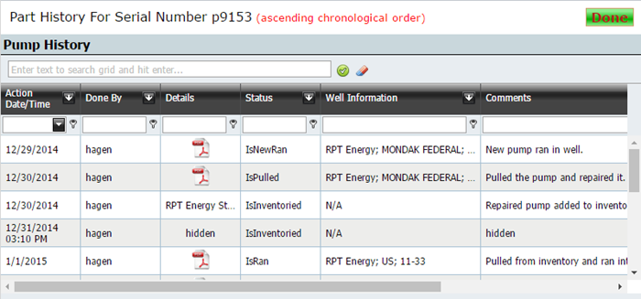
Pump & Part Inventory
Two levels of tracking pumps and parts - Use, track and view inventoried items and their full history

Slide 6
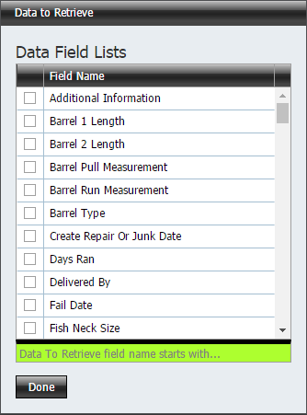
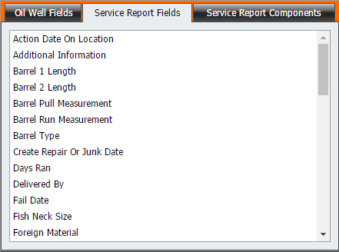
Analysis Section
Create and run custom analysis reports - Reports can be saved to be run weekly, monthly, etc. - Narrow or broaden analysis results as needed - Choose from many report criteria options - Create as many analysis reports as needed
“Data is what drives decisions”

Slide 7
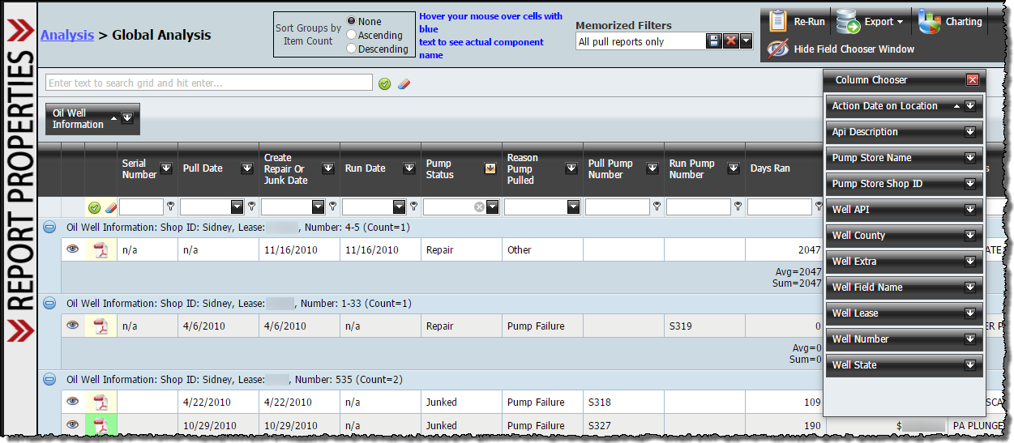
Analysis Grid System
RPT’s grid system allows you to search, filter, group, sort and simplify your data
Easy to use drag-and-drop layout
Organize and add/remove field columns in the order you choose
View Service Reports, photos and notes for any well
Save useful filters for a later date with our Memorized Filters box
Export main grid and/or component details
Create data charts from your grid results

Slide 8
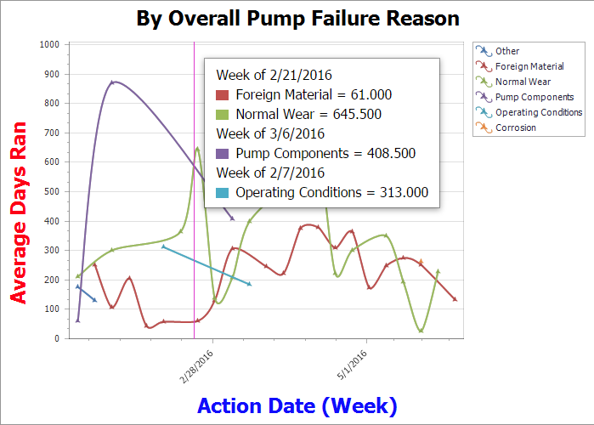
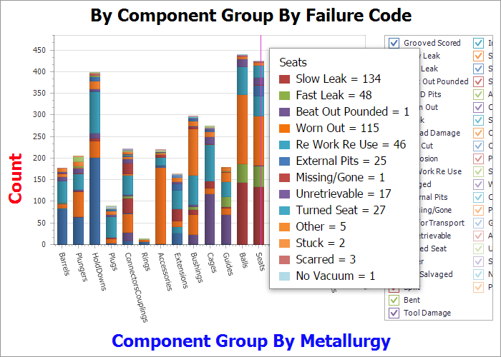
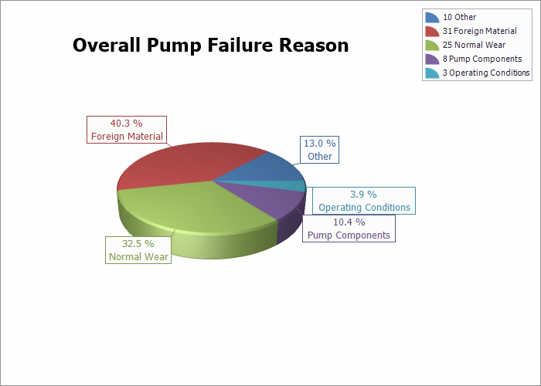
Charting Data
Chart trends, analyze failures and track data
Choose from a number of bar, spline, pie and line charts
Pin and save charts for later reference
Charts will automatically re-render when data is modified or filtered
Easily export, email or print charts

Slide 9
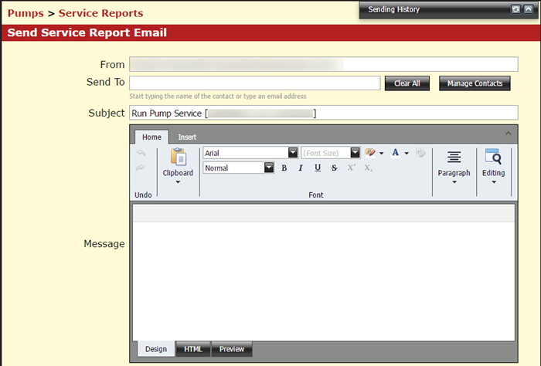
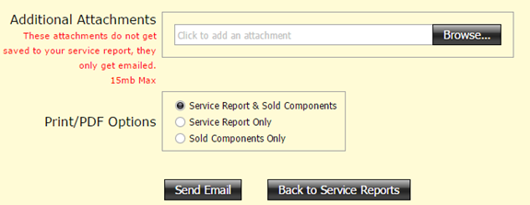
Email Capabilities
RPT’s live, continually updated site makes it easy to connect and share with others
Manage your contacts and send emails, snapshots, charts and well information
Keep a record of past emails through our Sending History

Slide 10
Contact Us
RodPumpTracker
Email: Sales@rptindustries.com
Tel: +701 214 5665
Fax: +701 355 7667
www.rptindustries.com

