Slide 1
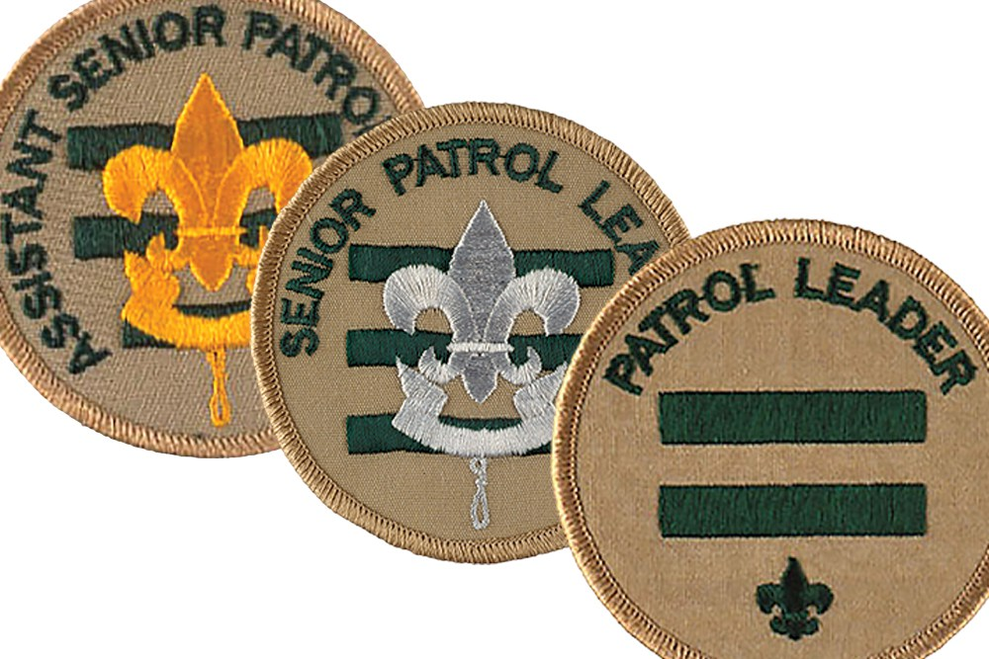
Troop 225
Positions of Responsibility
2017-2018

Slide 2
Jr. Asst. Scoutmaster Reports to Scoutmaster
Chain of Communications
2 out of the 3 weekly meetings/month
2 PLC meetings in the fall (Sept, Oct, Nov, Dec)
2 PLC meetings in the spring.(Jan, Feb, Mar, Apr, May)
3 Trips a year(1 Fall, 1 Spring, 1 Choice)
Lead PLC with guidance from Scoutmaster
Coordinate PLC objectives with Committee & Scoutmaster.
Assist patrol leaders (including SPL, ASPL)in their duties and ensure regular attendance is being kept, set a good example for the troop by wearing required uniform and behaving in a manner that personifies the Scout Oath and Law.
Work to promote the success of individual advancement. Sign-off on Trail to 1st Class and others as directed by Scoutmaster.
Communicate concerns, issues and recommendations to PLC & Scoutmaster.
Organize Court of Honor ceremonies for the Troop.
Other duties as assigned by the Scoutmaster.
MUST be 16 years old, have previous leadership experience within the Troop of Patrol Leader or higher. Preference given to Eagle Scouts. Is selected by the Scoutmaster. PLC may make recommendations.
Troop Committee
Scoutmaster
Asst. Scoutmaster
Jr Asst. Scoutmaster
PLC

Slide 3
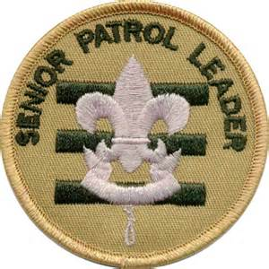
Senior Patrol Leader member of Patrol Leader Council
Chain of Communications
Troop Committee
Scoutmaster
2 out of the 3 weekly meetings/month
2 PLC meetings in the fall (Sept, Oct, Nov, Dec)
2 PLC meetings in the spring.(Jan, Feb, Mar, Apr, May)
3 Trips a year(1 Fall, 1 Spring, 1 Choice)
Lead Troop meetings and PLC meetings with guidance from Scoutmaster
Organize Scouts & Plan Activities for Trips with PLC. Ensure a Patrol Leader is designated for every activity/trip
Assist patrol leaders in their duties and ensure regular attendance is being kept, set a good example for the troop by wearing required uniform and behaving in a manner that personifies the Scout Oath and Law
Work to promote the success of individual patrols.
Communicate concerns, issues and recommendations to PLC & Scoutmaster.
Record PLC meeting agenda and notes on forum
Must have prior leadership experience with the Troop of at least Patrol Leader.
Jr Asst. Scoutmaster
Patrol Leader Council
Patrol Leaders
Senior Patrol Leader
Scout Leadership Core
Patrol Members

Slide 4
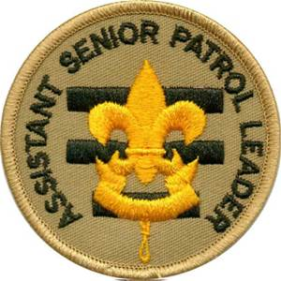
Assistant Senior Patrol Leaders member of Patrol Leader Council
Chain of Communications
Scoutmaster
Assist the SPL to lead the weekly troop meetings.
Assume the SPL responsibilities if the SPL cannot attend a troop meeting or PLC meeting.
Must attend 2 out of the 3 weekly meetings/month
Must attend 2 PLC meetings in the fall (Sept, Oct, Nov, Dec)
Must attend 2 PLC meetings in the spring.(Jan, Feb, Mar, Apr, May)
ASPL will review with each Patrol Leader to ensure that they are actively involving all scouts in trip activities.
Assist Guide in Training Patrol Leaders
Takes on Guide and Instructor roles in absence of these positions.
Communicates issues, concerns & recommendations to PLC
Patrol Leader Council
Senior Patrol Leader
Asst. Senior Patrol Leaders
Scout Leadership Core
Patrol Leaders
Patrol Members

Slide 5
Order of Arrow Rep Member of Leadership Core & PLC
Chain of Communication
Scoutmaster
Must attend 7 of 10 monthly Tri-County Chapter meetings (Sept-Aug)
Must attend 1 of 3 OA Lodge weekends/year (Sept- Aug)
Must participate in at least 1;
Chapter Service project(s)
Chapter Fellowship
Chapter Committee Activities
Provide OA updates and information at Troop Meetings
Arrange an election for potential new OA members each Feb or March with The Scoutmaster, Chapter Chief and Chapter Advisor.
Must attend 2 PLC meetings in the fall (Sept, Oct, Nov, Dec)
Must attend 2 PLC meetings in the spring.(Jan, Feb, Mar, Apr, May)
Must attend 2 out of the 3 weekly meetings/month
These positions must be requested and approved by Scoutmaster. They are not chosen or elected.
PLC
Scout Leadership Core
Instructor
Order of Arrow
Representative
Guide
Patrol Members

Slide 6
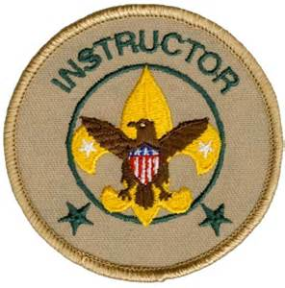
Instructor Member of Leadership Core & PLC
Chain of Communication
Scoutmaster
Must be proficient in scout skills required for outdoor activities
Must have complete understanding of rank advancement(s)
Must teach any combination of the above during 2 different meetings or troop activity. Dates must be pre-approved by Scoutmaster.
Must attend “Brownsea Weekend”
Must attend 2 PLC meetings in the fall (Sept, Oct, Nov, Dec)
Must attend 2 out of the 3 weekly meetings/month
Must attend 2 PLC meetings in the spring.(Jan, Feb, Mar, Apr, May)
These positions must be requested and approved by Scoutmaster. They are not chosen or elected.
PLC
Scout Leadership Core
Instructor
Order of Arrow
Representative
Guide
Patrol Members

Slide 7
Guide Member of Leadership Core & PLC
Chain of Communication
Scoutmaster
Trains and mentors new Patrol Leaders
Ensures Patrol Leaders are communicating with patrol members.
Ensures Patrol Members are advancing in rank with Instructor’s assistance.
Must be Life or Eagle Scout Rank
2 out of the 3 weekly meetings/month
2 PLC meetings in the fall (Sept, Oct, Nov, Dec)
2 PLC meetings in the spring.(Jan, Feb, Mar, Apr, May)
These positions must be requested and approved by Scoutmaster. They are not chosen or elected.
PLC
Scout Leadership Core
Instructor
Order of Arrow
Representative
Guide
Patrol Members

Slide 8
Patrol Leader member of Patrol Leader Council
Chain of Communication
Patrol Leader Council
2 out of the 3 weekly meetings/month
2 PLC meetings in the fall (Sept, Oct, Nov, Dec)
2 PLC meetings in the spring.(Jan, Feb, Mar, Apr, May)
Assist Scribe in maintaining accurate weekly attendance records for your patrol
Communicate news and updates to scouts in your patrol
Set a good example for the troop by wearing required uniform and behaving in a manner that personifies the Scout Oath and Law
Help patrol members be successful scouts and advance in rank
Report Patrol member concerns and ideas to PLC
Patrol Leader
Patrol Members

Slide 9
Positions of responsibility within a Patrol
Chaplain’s Aide
Historian
Librarian
Photographer (wears Historian patch)
Quartermaster
Scribe
Webmaster
Asst. Patrol Leader(does not count for advancement)

Slide 10
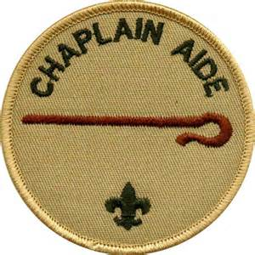
Chaplain’s Aide
Chain of Communication
Church
Lead the troop in a prayer before a meal during at least one fall and one spring camping trip.
Lead the troop in a prayer before at least one COH's during the course of the year.
Ensure the troops religious needs are met and religious holidays observed and recognized on troop calendar, promote the BSA religious emblem program
Organize Troop members for Scout Sunday in conjunction with our host Church or another local Church – 2 deep leadership required. Scoutmaster approval and notification of event.
Chaplain's Aide
Scoutmaster & PLC
Patrol Members
Minimums for those in advancing rank in 4 months or less
1 fall or spring meal prayer
1 COH prayer
Religious emblems in fall or Scout Sunday in Spring

Slide 11
Historian
Chain of Communication
Scoutmaster
Complete a minimum of one project of historical significance to the troop prior to rank advancement or 1 year, whichever comes first.
Ideas must be pre-approved by Scoutmaster (sample projects are: interview past Eagle scouts from the troop, collect and display troop memorabilia)
Gather accurate data from Scouts, families and leadership as needed.
Present completed project at a Court Of Honor or Troop meeting.
Historian
Troop Members

Slide 12
Librarian
Chain of Communication
Scoutmaster & SPL
Maintain record of inventory in troop library
“Check out” borrowed materials to individual scouts.
Provide an Inventory to SPL & Scoutmaster in Sept and May each year of all booklets, notify of any needing replacement or lost and booklets still checked out to individual scouts.
Alphabetize booklets. The Librarian shall follow up with lenders to ensure that the booklets are returned in usable format.
The Librarian shall also inventory the troop's library at the beginning of the year to ensure that upcoming MB's to be taught are included, and coordinate with troop leaders if any are missing.
Librarian
Scouts
Minimums for those in advancing rank in 4 months or less
1 fall or spring complete inventory
Provide borrowed materials list
Confirm booklets available for next 6 months of upcoming MBs

Slide 13
Photographer
Chain of Communication
Scoutmaster & Webmaster
Attend 1 Fall & 1 Spring trip and take photographs
Attend 2 Court of Honors and take photos
Provide Scoutmaster & Webmaster with digital files for posting on website
The photographer will be responsible for taking photographs during troop outings, at COH's, and during weekly meetings
The photographer should attempt to make sure that all scouts are photographed at least twice during the year
Take photographs of MB counselors at least once during each MB session.
Obtain photos from other members for any trips not attended
Photographer
Troop Membership
Minimums for those in advancing rank in 4 months or less
1 fall or spring trip
1 COH
MB Counselors either fall or spring

Slide 14
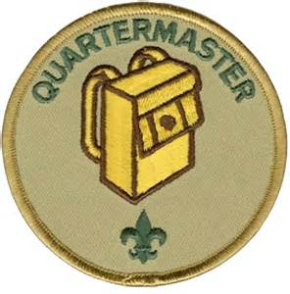
Quartermaster
Chain of Communication
Scoutmaster & Quartermaster
Organize at least 2 clean-up dates(1 fall, 1 spring) after camping trips with Scoutmaster and Adult Quartermaster approval.
Attends at least one Bergey Barn clean-up in the fall and one in the Spring to clean & organize equipment.
Coordinate with other quartermasters for a minimum of 4 clean-ups a year.
Keep equipment in good repair and communicate any needed replacements.
Ensure the patrol box(es) has a complete set of camping equipment, and that the equipment is clean and usable for the upcoming trip.
Set up the camping stove during trips and train younger scouts in the proper method of stove setup and equipment usage.
Quartermaster
Scouts
Minimums for those in advancing rank in 4 months or less
Organize 1 clean-up
Attend 1 clean-up
Set-up Equipment on 1 trip

Slide 15
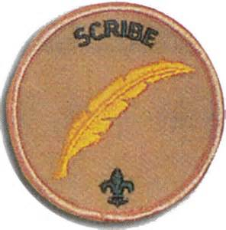
Scribe
Chain of Communication
Contributes at least two times to 2 Scout newsletters (there are 4 newsletters, one at each Court of Honor).
The scribe is also expected to take attendance during the weekly troop meetings, and will record the attendance on the troop forums.
The scribe will also work with the Troop Leaders to prepare Thank You letters to all donors for major fundraising events such as the Turkey Shoot.
Scoutmaster &
Troop Leadership
Scribe
Scouts
Minimums for those in advancing rank in 4 months or less
1 article in a COH Newsletters
Record attendance for 4 months
Thank you letter(s) or get an article promoting Troop 225 in a local paper or attend a PLC meeting acting as Secretary

Slide 16
Webmaster
Chain of Communication
Scoutmaster
Responsible for maintenance of the troop website and forums-ensuring that posted information is accurate
Notifies Scoutmaster of missing sign-ups or data
Uploads photos received from Photographer & Scoutmaster
Makes recommendations for changes to website
Trains new Scouts on how to post to the forums.
Works with Scoutmaster to get new scouts sign-ons
Webmaster
Scouts
Minimums for those in advancing rank in 4 months or less
Uploads photos from 1 trip or activity
Gives 1 update on status of website to Scoutmaster

Slide 17
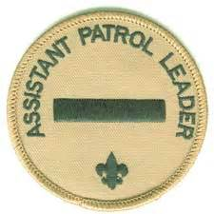
Assistant Patrol Leader
Chain of Communication
PLC
Assumes Patrol Leader duties in absence of Patrol Leader
1 out of the 3 weekly meetings/month
1 PLC meetings in the fall (Sept, Oct, Nov, Dec)
1 PLC meetings in the spring.(Jan, Feb, Mar, Apr, May)
BSA does NOT consider this a qualified leadership position.
Patrol Leader
Asst. Patrol Leader
Scouts

Slide 18
Scout Responsibility
Positions are considered to be held from Sept to May plus any days June to Aug (Summer camp, Assacorkin) where duties are actively being fulfilled for the Troop.
To fulfill all duties as listed .
Keep track of and be able to demonstrate how he fulfilled those duties.
Attend 1 meeting a month plus 1 trip Sept-Dec & 1 Trip
Jan-May
Wear Class A to all activities and events, unless instructed to wear Class B
Provide service in addition to Rank required service hours benefiting their community (approval form on website) in an amount equal to the Rank he is working on. Rank service hours must be BSA/Troop sponsored.

