Slide 1

Campus Culture -
Creating Safer Spaces
“It could happen to anyone. What I wish I knew but didn’t, until it was too late.”

Slide 2



About me
Ahuva Gamliel, ND, AP
BA Psychobiology UC Santa Cruz, Student Service Award Recipient, 1996
Fellowship at Cornell University, 1997
Gap year in USVI – Miss Hawaiian Tropic of the Virgin Islands, 1998 Attended UVI
Naturopathic Doctor / Acupuncturist Bastyr U ‘2004
Cruise ship Acupuncturist, 2004-2006
Professor of Alternative Medicine Everglades Univ
Private Practice x 20+ years
Published autobiography & meditations on Amazon
Master’s Athlete - tennis, track & field, 5K, sprint triathlons. Pan American Games
Love the beach, outdoors, travel, dance, and sports.

Slide 3

Intention
“I want to empower individuals by having the knowledge
to make informed decisions that they won't regret.
Knowledge is power, but action is everything!”
Silence is consent.
You’re either part of the problem,
Or part of the solution…

Slide 4

My Story

Slide 5

An American is sexually assaulted every 68 seconds
Approximately 463,634 individuals aged 12 or older are victims of rape or sexual assault each year in the U.S.
Reference RAINN
Notes:
Unpleasant topic but necessary because if you stay naïve about it, it could hurt you and I want to do everything I can so that more people don’t get hurt.

Slide 6

Lifetime Risk
1 in 5 women 20% have experienced completed or attempted rape during their lifetime.
Reference
National statistics indicate that and 1 in 33 or ~ 3% of men¹ will be victims of sexual assault in their lifetime (1 in 71 of rape) and 1 in 6 males were sexually abused before the age of 18². These statistics should be considered conservative, as we know that a majority of all acts of sexual violence are not disclosed or reported.
Reference Rutgers University
https://malesurvivor.org/

Slide 7

Age of First Victimization
79.6% of female victims experienced their first rape before age 25; 42.2% before age 18.
27.8% of male victims experienced their first rape at age 10 or younger.
Ref: National Sexual Violence Resource Center
Adolescents: Among adolescents, the prevalence of date rape ranges from 3% - 23% for girls & 2% - 4% for boys.

Slide 8

Prevalence
College-Aged Women: Studies indicate that approximately 13% - 27% of college-aged women have experienced date or acquaintance rape.
Reference

Slide 9
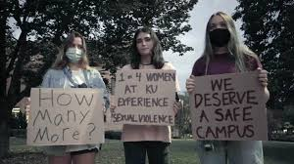
Campus Sexual Assault
Among undergraduate women at major U.S. universities, nearly 1 in 4 report experiencing sexual assault or misconduct.
Ref: National Sexual Violence Resource Center
1 in 16 men are sexually assaulted while in college.

Slide 10

Reporting and Legal Outcomes
Only about 21.4% of rapes and sexual assaults were reported to police in 2022.
Of every 1,000 perpetrators, only 25 are incarcerated. (2.5%) Reference

Slide 11
Risk Factors
Demographic Factors: Younger age at first date, early sexual activity, earlier age of menarche, and a history of prior sexual victimization increase vulnerability to date rape. Ref: UpToDate
Psychosocial Factors: Acceptance of rape myths and violence toward women are associated with higher risk. Ref: UpToDate
Substance Use: Alcohol is the most commonly used substance in date rape incidents, surpassing the use of "date rape" drugs. Ref: HRF

Slide 12

Prevention Strategies
Education Programs: Programs focusing on changing rape-related attitudes, myths, and victim-blaming have been implemented, but their effectiveness varies. oatext.com
Bystander Intervention: Initiatives like the Green Dot program have shown success in reducing sexual violence through training students to intervene in high-risk situations. Green Dot seeks to shift social norms towards compassion, connection, and care, creating a culture that doesn't tolerate violence. Teen Vogue
Self-Defense Training: Specialized training programs for college women have been effective in reducing the risk of rape by teaching risk assessment and self-defense techniques. Time

Slide 13

David Lisak's Study
Title: Repeat Rape and Multiple Offending Among Undetected Rapists
Author: David Lisak & Paul M. Miller (2002)
Journal: Violence and Victims
Key Findings: 6.4% of college men admitted to behavior that met legal definitions of rape or attempted rape.
https://pubmed.ncbi.nlm.nih.gov/11991158/

Slide 14

AAU Campus Climate Survey (2019)
Title: Association of American Universities Campus Climate Survey on Sexual Assault and Misconduct
Key Findings: 13% of undergrad women reported nonconsensual sexual contact
Association of American Universities PDF

Slide 15

Tjaden & Thoennes (2000) – National Institute of Justice
Title: Prevalence, Incidence, and Consequences of Violence Against Women
Published by: National Institute of Justice and CDC
Key Findings: Lifetime prevalence of rape among women: ~18% & Most assaults committed by someone the victim knows

Slide 16

Statewide Rape Rate
In 2023, Florida reported a rape rate of 10.1 per 100,000 population.

Slide 17

Miami-Dade County
In 2024, Miami recorded 102 cases of forcible rape, down from 121 in 2023. Miami Police

Slide 18
Underreporting and Challenges
Many incidents of sexual violence go unreported, often due to fear, stigma, or distrust in the justice system.
The actual prevalence of rape and sexual assault is likely much higher than reported figures suggest.

Slide 19

High Profile Cases
Bill Cosby- 1 M bail, served 3 years
Harvey Weinstein sentenced to 23 years in prison in March 2020 in NY. In February 2023, +16 years in CA for other convictions.
USA Girls’ Olympic Gymnastics Team doctor - 60 years in federal prison for child pornography charges + 40 to 175 years & 40 to 125 years in Michigan state prison for numerous sexual assault charges.
Chris Brown – Plead guilty to the felony charge of assault & received a sentence that included 5 years of probation, community labor, rehab & domestic violence counseling. He served 108 days of a 131-day sentence for a probation violation.
Epstein & Maxwell – faced 45 years ; 20 years in prison
Hip-hop mogul Sean "Diddy" Combs (AKA Puff Daddy)is on trial in New York for sex trafficking and racketeering charges. Prosecutors allege that over two decades, Combs exploited his celebrity status to sexually abuse women, orchestrating drug-fueled events and using violence to maintain control. Combs denies all allegations, claiming all activities were consensual.
Motown legend, Smokey Robinson, 85, is facing a $50 million lawsuit filed by four former female employees. The plaintiffs allege that Robinson sexually assaulted them repeatedly between 2007 and 2024, often luring them into rooms without surveillance cameras. His wife, Frances Robinson, is also named in the suit for allegedly enabling the abuse and contributing to a hostile work environment. Robinson's attorney has strongly denied the allegations, calling them "vile" and "false."

Slide 20

Celebrities
Lady Gaga – Raped at 19 by a music producer; spoke publicly in The Hunting Ground documentary and on Oprah.
Tori Amos – Raped at knifepoint when she was 21; detailed her trauma in songs and interviews.
Demi Lovato – Disclosed being raped as a teenager by someone she knew.
Rihanna – Said in interviews she was a survivor of domestic abuse and alluded to deeper trauma.
Viola Davis – Has shared surviving childhood sexual assault in the context of discussing trauma and resilience.
Gabrielle Union – Raped at gunpoint at age 19 during a robbery at the shoe store where she worked.
Alyssa Milano – One of the earliest celebrity voices in the #MeToo movement; disclosed being raped in her twenties.
Tyra Banks – Has spoken about surviving emotional and sexual trauma, though not all details are public.
Oprah Winfrey – Disclosed being raped as a child by a cousin and later abused by other relatives.
Maya Angelou – Wrote about being raped at age 8 in her memoir I Know Why the Caged Bird Sings.
Being raped can have profound, long-lasting effects on a person’s life—psychologically, emotionally, physically, and socially.
Survivors may experience impacts that vary in intensity and duration, but the trauma is often deep and complex.

Slide 21

As of November 2025 :
2,783 pending cases in the
Uber driver sex abuse MDL

Slide 22
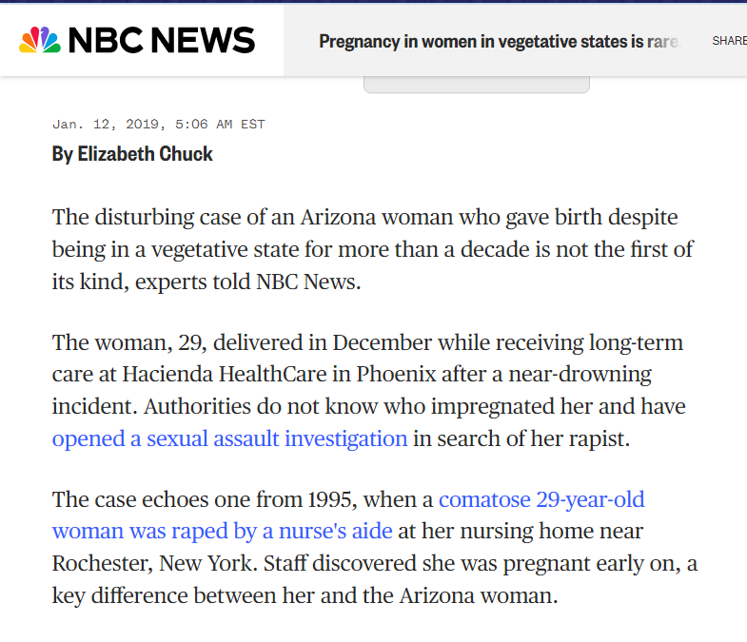
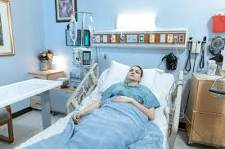

Slide 23


https://www.cnn.com/interactive/2017/02/health/nursing-home-sex-abuse-investigation/

Slide 24
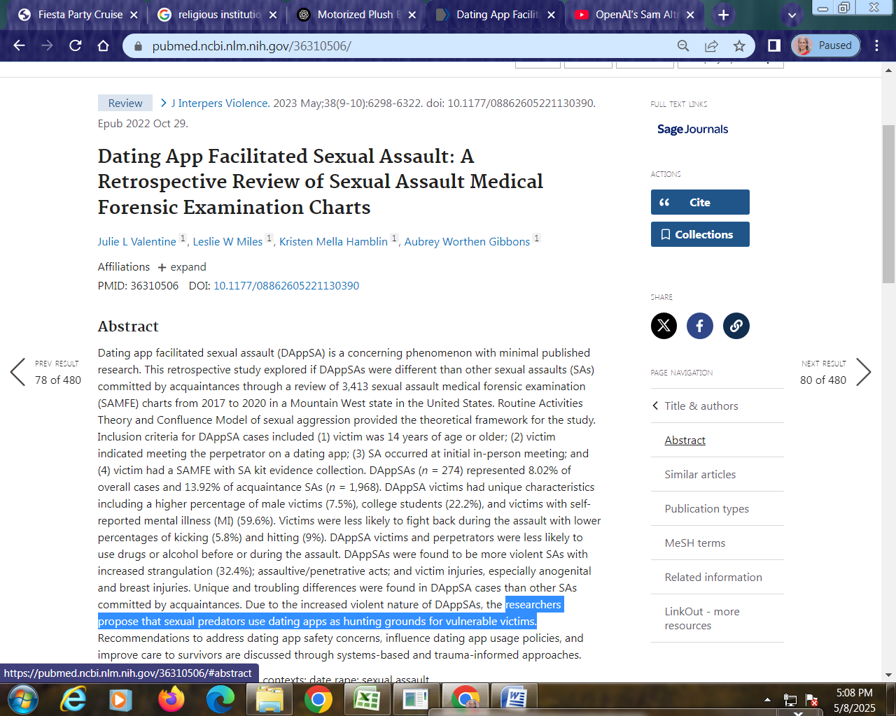

Slide 25
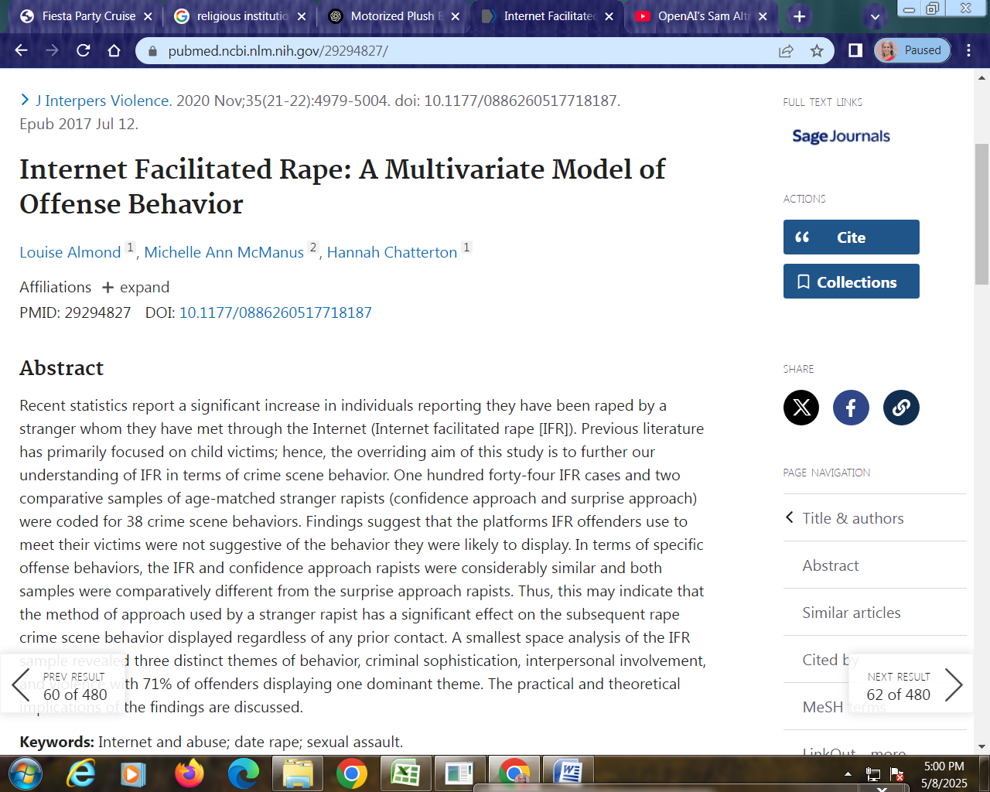


Slide 26

Psychological Impact
Mental Health: Victims of (date) rape are more likely to suffer from post-traumatic stress disorder (PTSD) and other psychological issues (such as anxiety, depression, isolation, trust issues) compared to the general population. Ref: HRF
Notes:
Protective mechanism gaining weight

Slide 27

Common Health Consequences
Flashbacks, nightmares, hyper-vigilance, emotional numbness
Suicidal thoughts
Fear of being alone or in public
Sexual Dysfunction
Loss of desire, fear of intimacy, physical pain during sex
Guilt or Self-Blame
Often irrational but deeply internalized ("I should have prevented it")
Dissociation
Feeling disconnected from one's body or reality (a trauma coping mechanism)
Gaining weight as a protective mechanism

Slide 28

If the Survivor Is a Child or Teen
Developmental disruptions in trust, identity, and self-esteem.
Higher risk of re-victimization or risky behaviors later.
Difficulty forming healthy adult relationships.

Slide 29
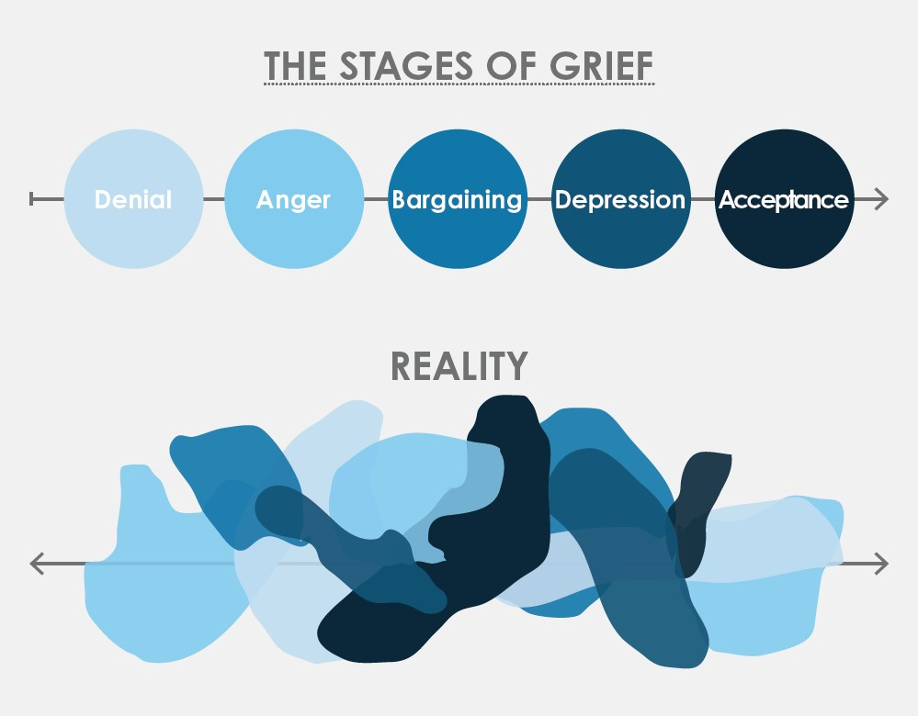
Long-Term Effects
Survivors may carry the impact for years or decades, even with therapy.
Many report transformative resilience, but healing is not linear.
Triggers (smells, sounds, locations) can reactivate trauma unexpectedly.

Slide 30
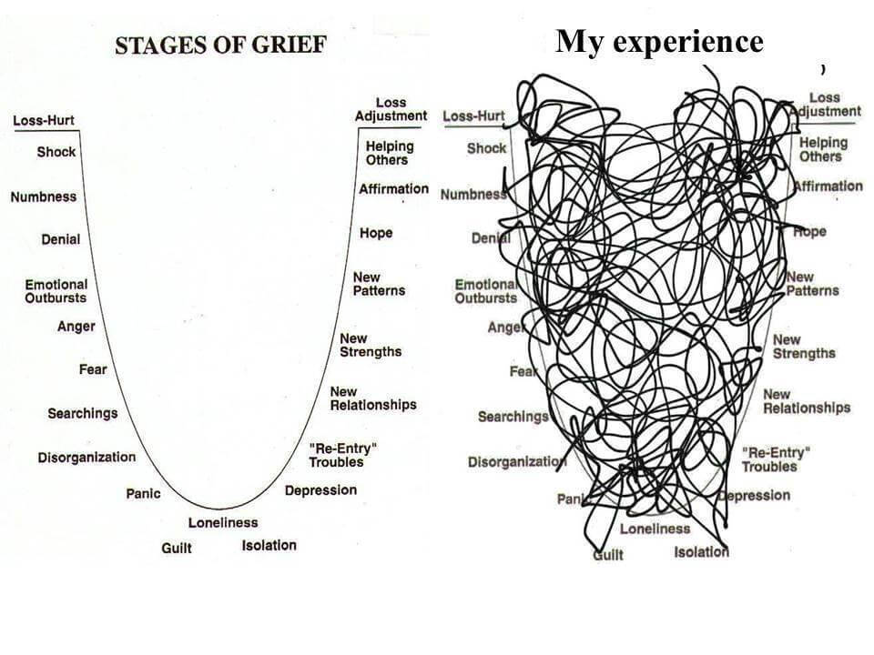

Slide 31

Survivors Say...
“It felt like a part of me was stolen.”
“Even after years of therapy, certain situations still bring it all back.”
“I’m strong now—but I carry the scars, seen and unseen.”
“My body & will were violated.”

Slide 32
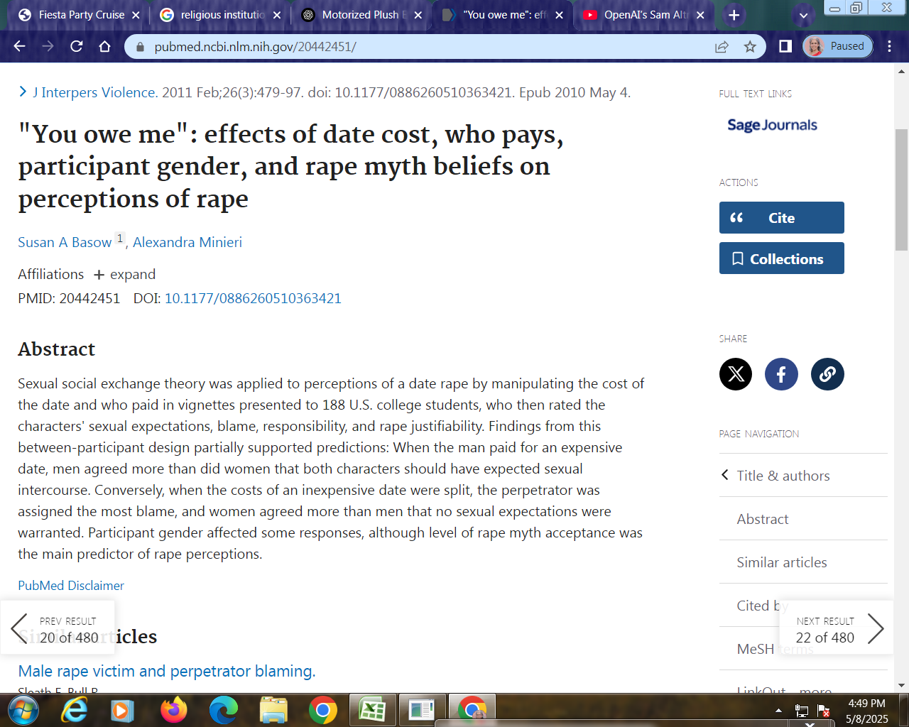

Slide 33

Entitlement and Misogynistic Attitudes
Belief that they are owed sex because of money spent, attention given, or expectations of dating.
Objectification of women; seeing them as conquests or prizes.
Endorsing traditional gender roles that justify male dominance.
Manipulative, selfish, bully, narcissist.
Patronizing, condescending, mean.

Slide 34
Use of Substances to Facilitate Control
Often involves alcohol or drugs to reduce a victim’s ability to consent.
Some intentionally get themselves and the victim intoxicated to justify or excuse their behavior.

Slide 35
Manipulative Behavior
Coercion, guilt-tripping, or persistence after a clear “no.”
Misinterprets or deliberately ignores nonverbal or verbal resistance.

Slide 36
Minimization and Denial
Believes “it wasn’t really rape” if there was some prior relationship or if the person didn’t resist “enough.”
May believe that consent is implied if someone agrees to a date or comes home with them.

Slide 37
Repeat Offenders
Studies (e.g., by Dr. David Lisak) have shown that many date rapists are serial offenders
These individuals often have a pattern of targeting vulnerable people.

Slide 38
Not all perpetrators exhibit all of these traits
Anyone, regardless of appearance, social status, or background, can commit this crime.
Most date rapes are committed by someone the victim knows and may trust.

Slide 39
Warning Signs of Predatory Behavior
Whether you're watching out for your own safety, a friend’s, or looking to educate others, these behaviors can be red flags:
  Manipulative Language: Says things like “Don’t you trust me?” or “Come on, we’ve gone this far.”
  Disrespect for Consent: Assumes that any intimacy (flirting, kissing, a date) equals permission for sex.

Slide 40

Date Rape Drugs
Dark web and unregulated websites often sell date rape drugs disguised as sleep aids: These markets are hard to track and often ship internationally in plain packaging.
  Some perpetrators steal or misuse legitimate prescriptions.
  In some cases, drugs are diverted from friends, family, or colleagues in medical fields.
  Some are home-made.
  Others bought from drug dealers.

Slide 41
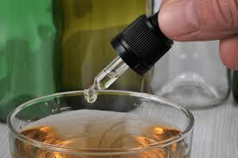
Important Notes
Date rape drugs are usually tasteless, odorless, & fast-acting.
They are often slipped into drinks in crowded or dimly lit places—bars, clubs, parties.
Access to these drugs is illegal or tightly controlled in most countries, so any possession or use is already criminal.
Currently, there isn't a consumer-available test capable of detecting over 100 different date rape drugs directly in a drink. Most on-the-spot detection tools, such as test strips, straws, or nail polish, are designed to identify a limited number of common substances.

Slide 42
How to Talk About Consent and Prevention
Whether you're talking to friends, teens, or adults, these approaches help make conversations effective and supportive:
Use Clear, Everyday Language: “Consent means you both actively want to do something—not just going along with it.”
“You can change your mind at any time. That’s normal and should be respected.”
“If someone is drunk, high, or unsure, that’s not consent.” “You can’t assume anything based on what someone wears, says, or does.”

Slide 43

Challenge Myths Without Shaming
Gently correct ideas like “they were asking for it” or “real rape is done by strangers.”
“Actually, most sexual assaults happen between people who know each other.”

Slide 44
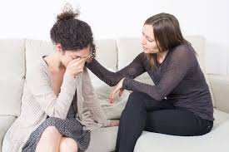
Listen without judgment
Believe them. Don’t question what they wore, drank, or did (it wasn’t their fault!).
Offer resources (hotlines, campus safety, local advocacy centers).
Let them make their own choices about what to do next—reclaiming control is crucial.

Slide 45

Date Rape Detecting Devices
Drink Safe Coasters – Apply a drop of your drink to test areas; color changes may indicate drugs.
SipChip – A small disk that tests for multiple drugs in wine, beer, or cocktails.
Undercover Colors Test Strips – Detect 2 possible DRDs with just a drop.
Pros: Small, discreet, fast.
Cons: Limited to certain drugs; false negatives/positives can happen.

Slide 46
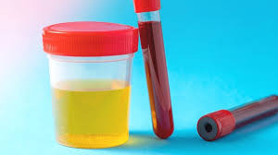
Forensic lab testing
Urine tests – Can detect many drugs within hours to a day.
Blood tests – Often more accurate.
Hair tests – May detect drug use days or weeks later, though less useful in the short term.
Pros: High accuracy.
Cons: Must be administered quickly (especially for short-acting drugs).

Slide 47
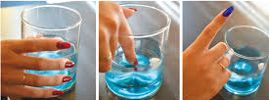
Wearable or Smart Tech (Emerging)
These are newer, often in development or early rollout stages, examples:
Nail polish testers (e.g., the concept by Undercover Colors): changes color when dipped in a tainted drink.
Smartphone-connected sensors Small devices that analyze a drink and send results to your phone.
Pros: Discreet, high-tech appeal.
Cons: Limited availability; may not cover all drugs yet.

Slide 48

Important Notes
Certain drugs are often out of the bloodstream within 12–24 hours — act quickly if you suspect exposure!
No method is 100% foolproof, so prevention, awareness, and trust are just as vital.
If you suspect a drink was tampered with, do NOT drink it—and if someone feels suddenly drunk, drowsy, or disoriented, get help immediately!

Slide 49
Free Date Rape Drug Detection Cards
The City of Miami Beach offers free date-rape prevention test cards, particularly during high-traffic periods like Spring Break. These cards can detect common date-rape drugs by turning blue when exposed to contaminated beverages.
They available in the lobby
Miami Beach Police Department
  1100 Washington Ave, MB

Slide 50
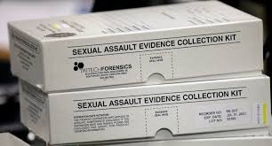
Free and Confidential Sexual Assault Services:
The Roxcy Bolton Rape Treatment Center (RTC), part of Jackson Memorial Hospital, provides comprehensive care for victims of sexual assault. Their services include:
24/7 crisis intervention including FREE rape test kit
Medical examinations and forensic evidence collection
Testing and prevention for pregnancy & sexually transmitted infections
Short-term counseling and support groups
Assistance with law enforcement and legal processes
Jackson Memorial Hospital
1611 NW 12th Avenue, Miami, FL 33136
24/7 Helpline: 305-585-RAPE (7273)

Slide 51
What I Wish I knew!
Evidence collection is most effective within 72–120 hours (3–5 days) after the assault, but support is still available afterward.
Free forensic exams (rape kits) — no need to file a police report to receive one
You do not need to press charges to receive a rape kit in Florida.
You can bring a support person with you if you'd like. You will not be forced to talk to police unless you want to; it's your choice.
The nurse will explain every step of the process and ask for your written consent.
Medical Care: Treatment for injuries, STI prevention, and emergency contraception (Plan B) is offered.
HIV/STI screening may be done if desired.

Slide 52
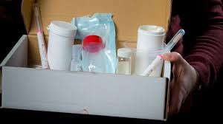
Follow-Up and Support
You'll receive a medical exam summary and referrals for counseling or legal help.
If evidence is collected but no report is made, it may be stored for a time in case you decide later to report.
The center will help with follow-up appointments, legal aid, and emotional support.
Jackson Memorial Hospital
1611 NW 12th Avenue, Miami, FL 33136
24/7 Helpline: 305-585-RAPE (7273)

Slide 53
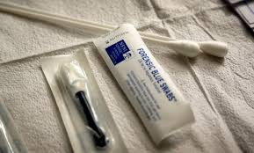
Forensic part of the exam may include
Swabs from the mouth, genitals, anus, or other areas (only if you consent).
Documentation of injuries (photos with consent).
Time required: 2 to 4 hours, depending on circumstances and your needs.

Slide 54

Important Tips
Try not to bathe, brush your teeth, eat, or change clothes before the exam if possible — but come in no matter what. Evidence can often still be collected.
Bring a change of clothes your clothing may be kept as evidence.
All services are free and confidential, regardless of immigration status, income, or insurance.

Slide 55

MUJER, Inc. – One-Stop Domestic Violence & Sexual Assault Center
Serving South Miami-Dade, MUJER offers:
24/7 sexual assault helpline
Individual therapy and safety planning
Legal and immigration assistance through partner organizations
Emergency financial aid and care coordination
Address: 28905 S. Dixie Highway, Homestead, FL 33030
Helpline: 305-247-1388

Slide 56
Additional Support Resources
Florida Council Against Sexual Violence: Offers legal services and a statewide information line at
1-888-956-7273.
Miami Dade College's Sexual Violence Prevention: Provides resources and referrals for those affected by sexual violence offers online chat support
Helps with legal and medical questions, emotional support, and referrals 1-844-762-8483 not a crisis line but a rich resource hub for learning and advocacy.

Slide 57
Miami-Dade County Coordinated Victims Assistance Center (CVAC)
CVAC offers a centralized location for:
Crisis counseling and emotional support
Assistance with restraining orders and legal advocacy
Referrals to shelters and other support services Victim Advocate.com
Address: 2400 S. Dixie Hwy, Miami, FL 33133
Phone: 305-285-5900

Slide 58

Child help National Child Abuse Hotline
Hotline: 1-800-4-A-CHILD (1-800-422-4453)
Website: www.childhelp.org
24/7 support for survivors of child sexual abuse
Assistance for both children and adults reporting abuse

Slide 59
RAINN (Rape, Abuse & Incest National Network)
Hotline: 1-800-656-HOPE (4673)
Website: www.rainn.org
Available 24/7
Free and confidential
Connects callers to local rape crisis centers
Offers online chat support
Helps with legal and medical questions, emotional support, and referrals

Slide 60

PREVENTION
EDUCATION
PROTECTION
SELF DEFENSE
MINDFULNESS
CAUTIOUSNESS

Slide 61

In the United States
Rape is a felony offense in all 50 states. Punishments typically include:
Up to life in prison if victim is under 18 U.S. Code § 2241 (aggravated sexual abuse). Federal Law (if on federal property or involving interstate elements)
Mandatory registration as a sex offender, often for life, with public disclosure.

Slide 62

Punishments vary widely
UK Up to life imprisonment, typically 4–19 years for first-time offenders depending on severity.
Canada Up to life imprisonment; minimum sentences may apply in aggravated cases.
India 7 years to life imprisonment, with harsher penalties for gang rape or repeat offenders.
Sweden/Germany Several years in prison, up to life for aggravated cases.
Notes:
Consequences: cause and effect

Slide 63
Some countries have mandatory minimum sentences
The statute of limitations can affect whether charges can be brought (though many jurisdictions have removed limits for rape cases).
Consent laws and definitions of rape differ by jurisdiction (e.g., some include marital rape; others do not).
In Florida, rape is legally referred to as sexual battery under Florida Statutes § 794.011. Penalties are severe and vary based on the age of the victim, use of force, and whether a weapon was involved.

Slide 64
Basic Sexual Battery
(Adult Victim, No Aggravating Factors)
2nd Degree Felony
Punishment: Up to 15 years in prison, 15 years probation, and $10,000 fine
Aggravated Sexual Battery (With Force/Threat, Weapon/Injury, Victim is a minor)
1st-Degree Felony
Punishment: Up to 30 years to life in prison

Slide 65

Sexual Battery on a Victim Under 18
Victim age 12–17
  Offender over 18 1st-degree felony, up to life imprisonment
  Offender under 18 still a serious felony, sentencing may differ
Victim under 12 (by adult)
  Life felony
  Mandatory life imprisonment
  No parole

Slide 66
Enhanced Penalties for Aggravating Circumstances
Use of a deadly weapon
Causing serious bodily injury
If committed along with another crime (e.g., robbery)
If the victim is mentally incapacitated, under-age or under duress
Note: In Florida a spouse can be charged with rape.

Slide 67

Other Consequences
Mandatory lifetime sex offender registration
Possible civil lawsuits by the victim
Loss of professional licenses and restrictions on housing, employment, and internet access

Slide 68

Rearrest for Reoffense
Around 40–50% of convicted rapists are rearrested for any crime within 5–10 years after release.
Most studies show 5–24% reoffend with another sexual offense.
A well-known U.S. Department of Justice study (2003) tracking 9,691 sex offenders over 3 years found:
  Reconviction and re-imprisonment: 24% were reconvicted for a new offense, and 38.6% were returned to prison for either a new sentence or a parole violation.
  46% were rearrested for any new crime
Some longitudinal studies suggest sex crime recidivism rises to up to 25% over 15–20 years, especially among:
  Offenders with multiple victims
  Those who began offending at a young age
  Offenders who target strangers or children

Slide 69
Key Considerations
Underreporting Sexual violence is often not reported, meaning actual re-offense rates may be higher.
Recidivism ≠ detection Many re-offenses are never prosecuted.
Risk assessment tools (like Static-99R) are used to estimate likelihood based on offender history, age, and behavior.

Slide 70
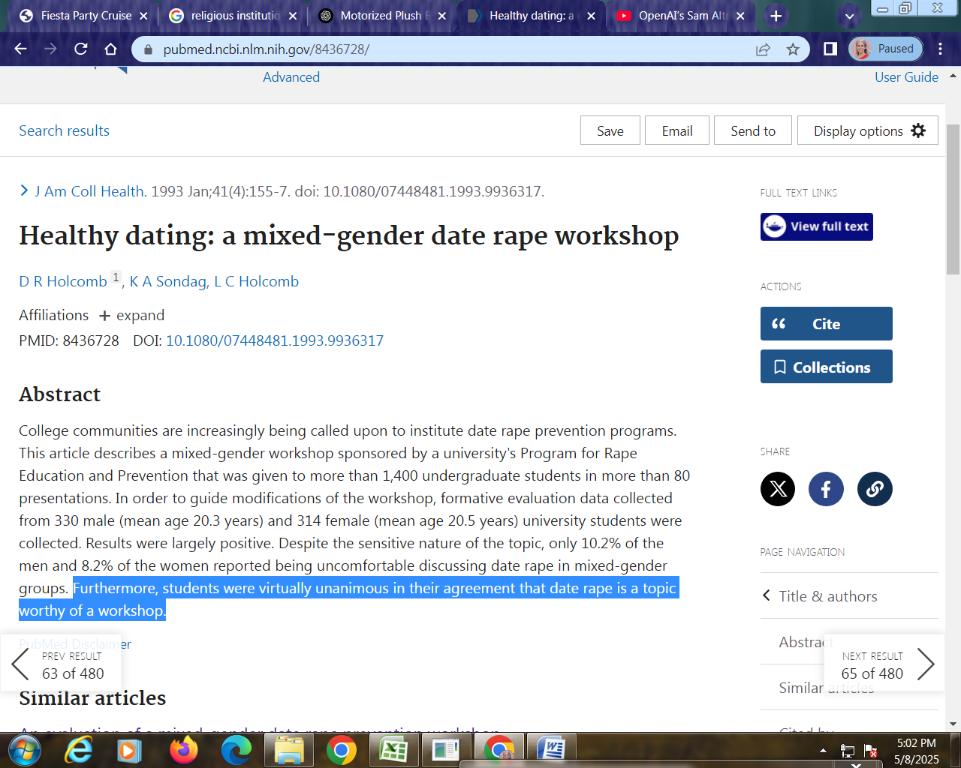

Slide 71
HEALING
TELL SOMEONE
GET TESTED
CONSIDER REPORTING TO POLICE
GET HELP
  Therapy, energy work, reiki, body talk, acupuncture, etc
SELF HELP
  art, music, writing, self expression, sports, etc
GET CLOSURE
MOVE ON
HELP OTHERS

Slide 72
Recommendations
An ounce of prevention is worth a pound of cure.
Be aware, be vigilant, be safe, be careful!
If it happens to you, tell someone you trust right away.
You are not alone & you did NOT do anything wrong to deserve it.
If you’re not sure if it happened (because you suspect you were drugged) get a date rape kit done ASAP before the evidence is gone.
Deciding to make a police report is a personal decision and doing the right thing requires careful consideration of all the circumstances. Make a pros and cons list and decide what is right for you in each case. Consider potential future victims.
Take care of yourself. Take time to deal with and process your emotions so that it’s not detrimentally impacting future relationships and to minimize long term effects.
Once you are in a good place, help others who have been through it too.

Slide 73
Sharing is caring
Download a FREE copy of this presentation to share it with friends, family and your community (fraternity, sports team, religious organization etc). https://mibaso.org/heal-the-world
Together we can make a huge impact to bring the statistics down and make the world a better, safer, and healthier place for future generations!
Email MibasoHolisticHealth@gmail.com to book a talk
Or call / text (786)537-0771
THANK YOU for your referrals to other schools or organizations who can benefit from this information!
  PS I hope you NEVER need to use these resources!

