Slide 1



Energy Tools
+971 56 257 4316

Slide 2
About SP Power Energy Tools
Brief History of Orgon energy and Orgonites
The composition of metals, minerals and crystals in each tool, compressed in epoxy, creates what is called an Orgon Energy Field. Orgon Energy is also known as Life Force, Chi or Zero Point energy.
Wilhelm Reich in the 1940s built orgon accumulators, from discovering a technology whereby layering organic and inorganic matter, created a piezoelectric effect, a positive energetic charge, that healed cancer patients and served as an effective cloud buster. Faraday Cages today, evolved from this principle.
In the early 1990s, Karl Hans Welz took Reich’s work a step further, and discovered that these materials in finer molecules, when cast in epoxy resin, could transmute negative, toxic energy into powerful Chi energy. Hence, coined the term Orgonite, giving birth to a variety of energy tools which can be worn or placed in living / work spaces, plants, gardens, around pets, babies and children, and could purify water.
Energetic, health, healing and spiritual benefits
The life force field created by an Orgonite or Orgon Generator, transmutes negative energies & frequencies in the environment into positive. Orgon energy also amplifies one’s energetic field to achieve bio-harmony. The energy field encapsulates everything within a certain distance, depending on the size of the generator. A small pendant can cover an 8 meter radius and will have a positive impact on all living matter.
Orgonites create a shield of protection against Electro Magnetic Frequencies (EMFs), radiation emitted from 4/5G Wi-Fi, cellular networks, mobile / smart devices, microwaves, and other electrical / computing equipment, when worn or placed in the habitat.
Water is purified if placed under, in or above dispensers / bottles. Placing under pillows, or on bedside, fosters better sleep, helps overcome insomnia and can facilitate astral travels, if desired.
DNA needs photons (light) to activate and thrive. Orgon energy activates DNA and promotes cellular repair, while detoxifying, gateway to cure and prevent disease.
Orgonites repel negative energy and entities (both physical and non-physical), and improve physical, emotional and mental states of being.
Orgonites are effective tools to facilitate meditation, reiki, and to make crystal grids.
They keep the meridians in the body clear and activated to prevent energy blocks, and allow optimal flow of energy.

Slide 3
About SP Power Energy Tools
Treskelion Coils
The copper Treskelion coil embellishment, is the length of a Royal Cubit, measurement unit of the ancient Egyptian pyramids.
Treskelions were used by Nikola Tesla in his free energy work, and have been found in ancient archeological sites all over the world.
Coils further amplify the piezoelectric effect of the orgonite and energetic properties of the healing crystals contained within, similar to a turbo booster in a car.
The Treskelion symbol is often denoted to the inter-relationship between the physical, spiritual and celestial realms, hence facilitating connection with Source, and clearing reception for divine guidance.
Crystals and Minerals
Healing properties of the crystals, calibrate with ones own auric field, infusing it with their strong attributes, promoting health, love, abundance, success, confidence, spiritual awareness, heightened intuition, ascension, connection to Source Creator and communication with higher realms. Look up the crystals used in SPower tools and how they individually and collectively beneficial.
Solfeggio Frequencies
Solfeggio Frequencies refer to specific tones of sound that help with and promote various aspects of body and mind health, reputed to date back to ancient history. The main Solfeggio frequencies are: 432hz, 528 hz, 396 hz, 639 hz, 741 hz, 852 hz and 963 hz.
Physician and researcher, Dr. Joseph Puleo, rediscovered Solfeggio frequencies in the 1970s, bringing their benefits back into public awareness. In his research, he used mathematical numeral reduction to identify six measurable tones that bring the body back into balance and aid in healing. These frequencies were believed to profoundly affect the conscious and subconscious mind in order to stimulate healing and promote vitality. In 1988, biochemist Dr. Glen Rein confirmed through comprehensive experiments, that these frequencies have a positive impact on human DNA.
Solfeggio frequencies resonate in harmony with the low frequency of the Schumann resonance of 8hz, which is the frequency at which the Earth vibrates and is found to be perfectly synchronized with the higher brain function of humans. Through scientific tuning, the frequencies are derived by beginning at 8Hz and working up the musical scale octave by octave until the C note is vibrating at the 256 Hz frequency and the A note is vibrating at 432 Hz.
N.B. To fully understand the power of SPower energy, healing and manifestation tools, in-depth information on Orgone Energy, Treskelion coils, Solfeggio Frequencies, healing properties and health benefits of Crystals & Minerals used, is widely available on the internet.

Slide 4
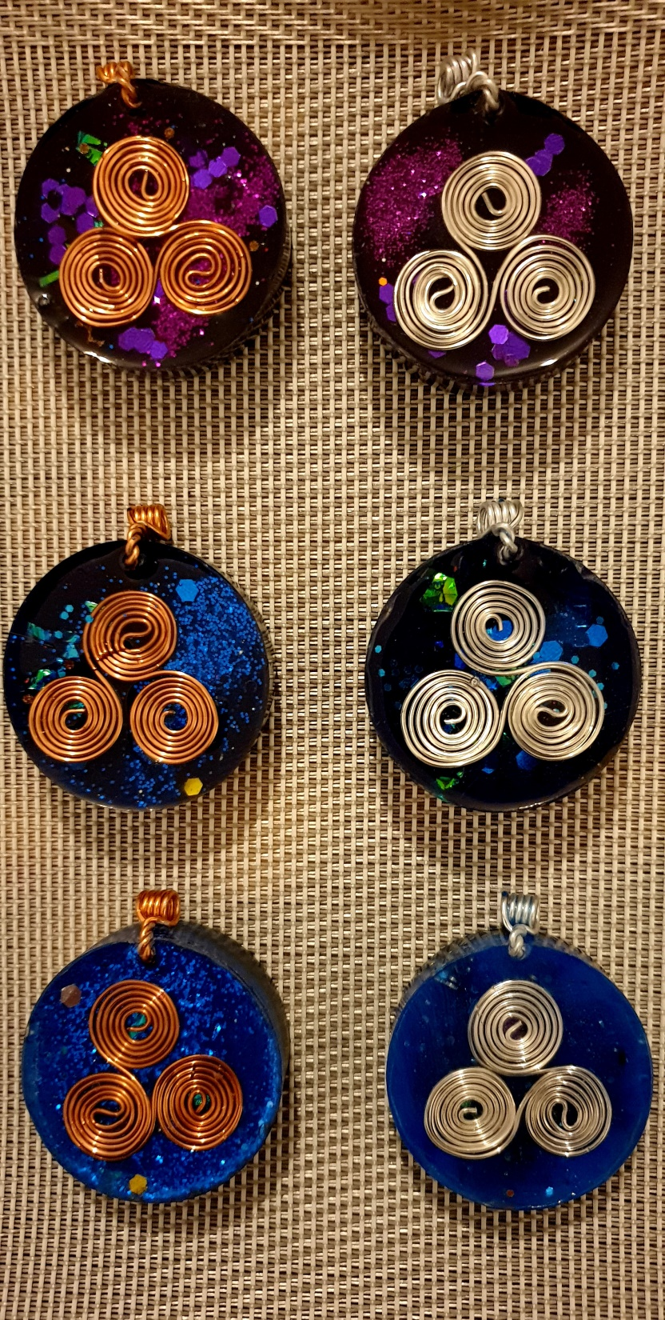
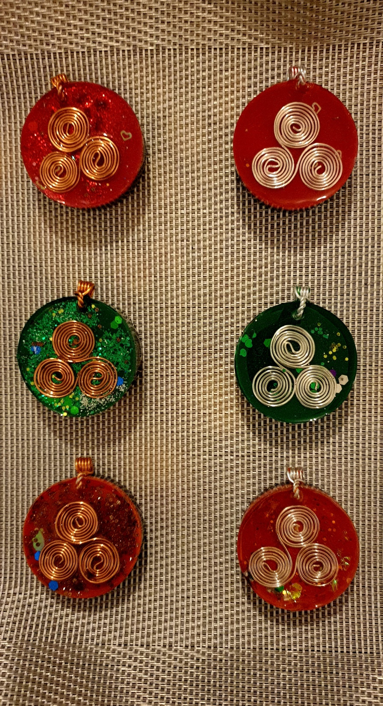
Orgon Energy Pendants
Purple
Navy
Blue
Red
Green
Orange
PC
PS
RC
RS
Diameter = 4 cm
NC
GC
GS
NS
OC
OS
BC
BS

Slide 5
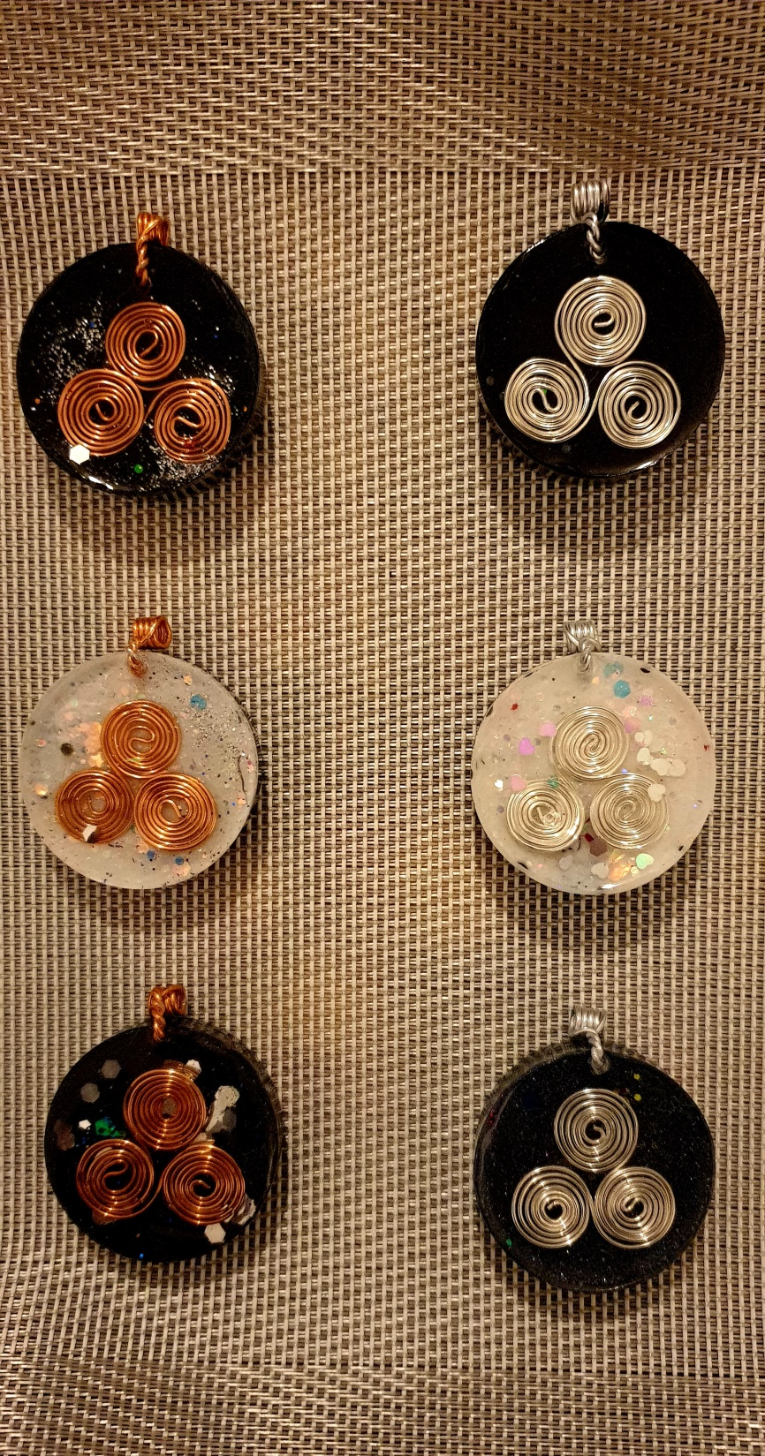
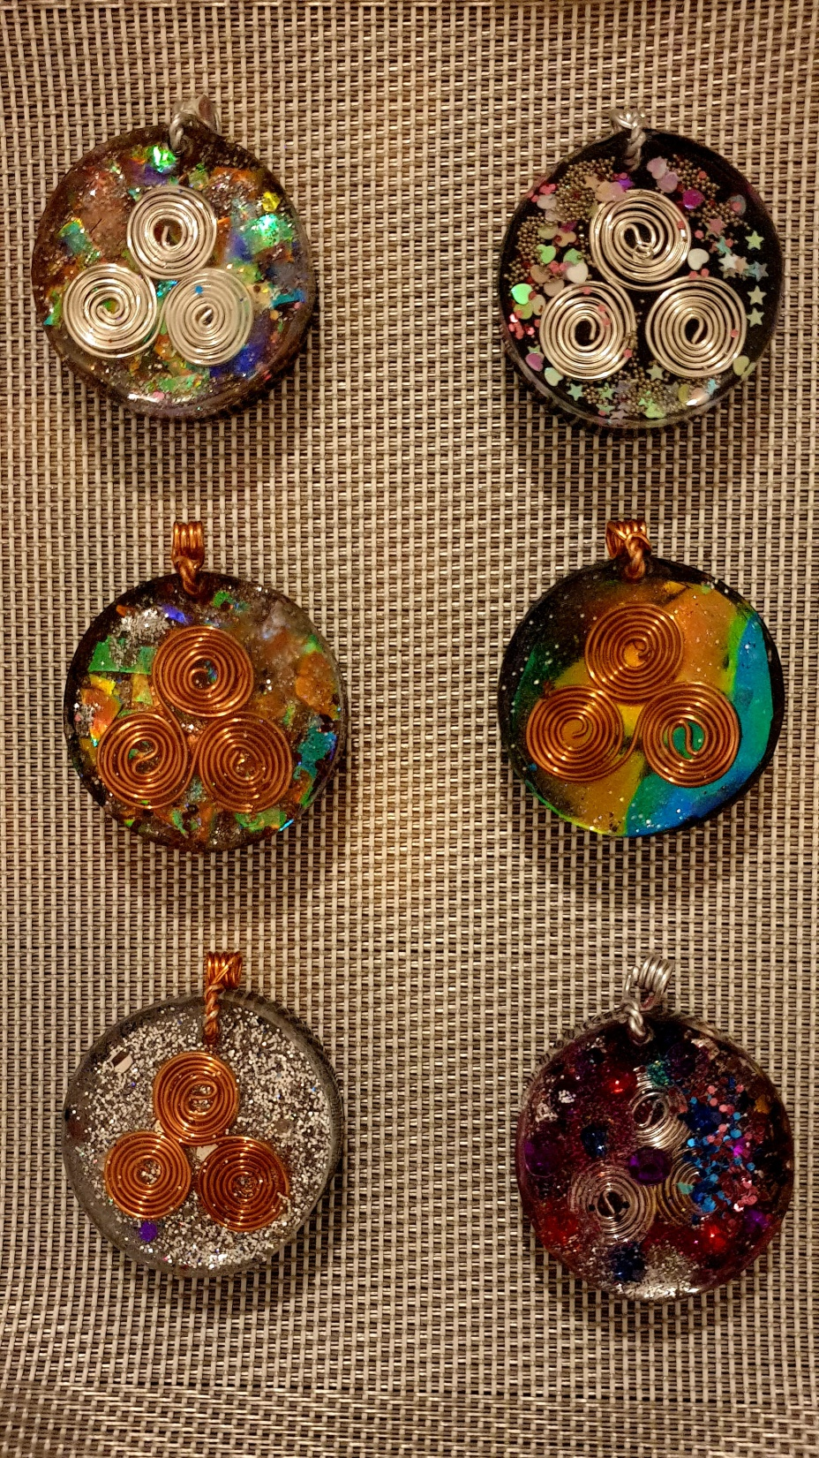
Orgon Energy Pendants
Black
White
Grey
C1S
C2S
BC
BS
Diameter = 4 cm
Cosmic Collection
C3C
C4C
WC
WS
YC
YS
C5C
C6S

Slide 6

Crystals, metals and minerals, contained within SPower Energy Tools
Infused with Solfeggio Frequencies
Crystals:
Clear quartz
Rose quartz
Amethyst
Green aventurine
Citrine
Himalayan rock
Minerals:
Shungite
Activated charcoal
Volcano dust
Magnesium sulfate
Sandalwood
Calamine
Fullers Earth
Metals:
Copper
Stainless steel
Aluminum
Zinc oxide
Iron oxide
All of the ingredients above, are infused together and encased in a non-toxic epoxy base, safe for the human body and if in contact with food and beverages.
Price per pendant: $150 US
All SPower Energy Tools are handmade with love and care, in the United Arab Emirates
To place an order, please send a message on Whatsapp +971 56 257 4316
** Free shipping worldwide **
Shipping can take anywhere between a few days to two weeks, depending on country and region.
Payments to be made via PayPal or bank transfer. Details to be provided at time of placing an order.
COD option not available. Sales are final and non-refundable.

