Slide 1
Lesson 1:
What is Energy?

Slide 2
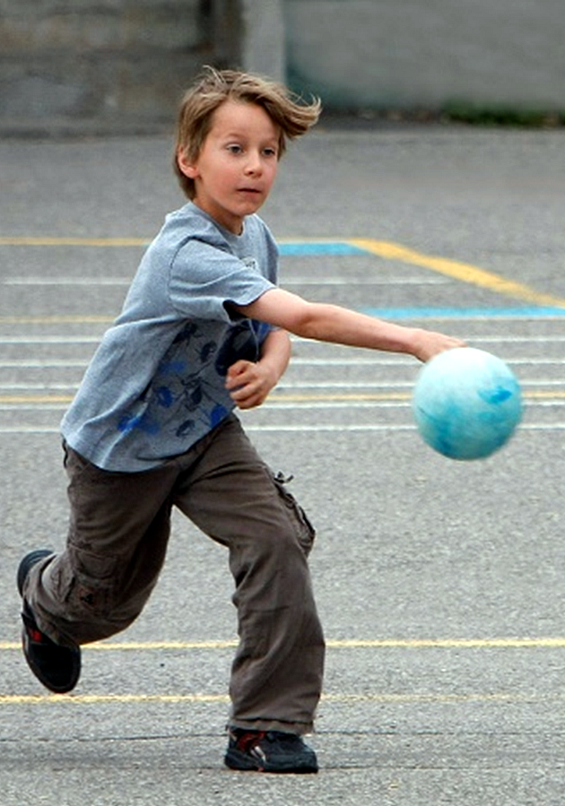
Energy is the ability to do work. It is the capacity or ability to cause a physical change.

Slide 3
There are two major types of energy:
1. Potential Energy
- energy that is stored in an object; energy that an object has because of its position relative to other objects
- energy that is doing work; the energy that an object has because of its motion
2. Kinetic Energy

Slide 4
Discovery Education Video:
Potential and Kinetic Energy
Potential energy is stored energy, or energy of position. Kinetic energy is energy of motion. A book that has been lifted from the floor and placed on a table has stored potential energy due to gravity. A falling book, however, has kinetic energy, and the force of its impact with the ground will release energy. Likewise, the first hill of a rollercoaster should be the highest, so that the most potential energy is stored before the ride drops and potential energy is converted to kinetic energy. A battery has chemical potential energy, and its chemical energy is stored until it is connected to a circuit, where its chemical energy can be changed to electrical energy.

Slide 5
Discovery Education Video:
Potential and Kinetic Energy
Potential energy is stored energy. It is the energy of position. Kinetic energy is the energy of motion.

Slide 6
Energy can exist in several forms.
Electrical Energy
Heat Energy
Light Energy
Sound Energy
Mechanical Energy
Magnetic Energy

Slide 7
The Law of Conservation of Matter and Energy tells us that matter and energy cannot be created or destroyed.
But they can change forms!

Slide 8
Key Questions:
1) What is energy? 2) What are the two types of energy? How are these types of energy different?
3) What is the Law of Conservation of Matter and Energy? What does it tell us about the different forms of energy.

