Slide 1
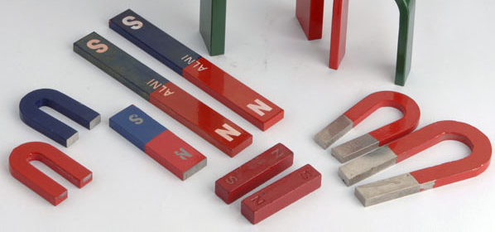
Lesson 1:
What is a Magnet?

Slide 2
Magnets
K | W | L
What do I already know about magnets? | What do I want to learn about magnets? | What did I learn about magnets? (after the unit)

Slide 3
The two major forces in the universe are gravitational and
electromagnetic.
A force is just a push or pull on an object.

Slide 4
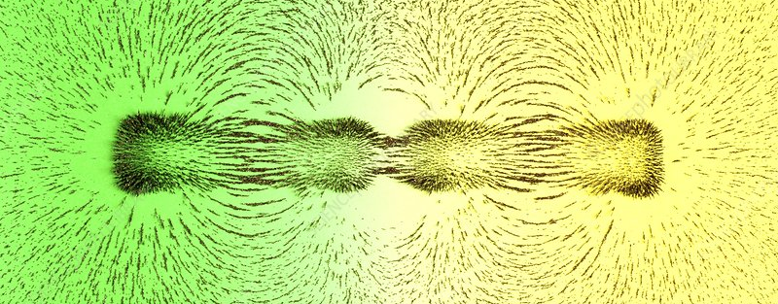
“Sticking” vs. “Attracting”
Magnets do not stick to other objects like tape or glue does. They attract other objects with a pulling force.

Slide 5
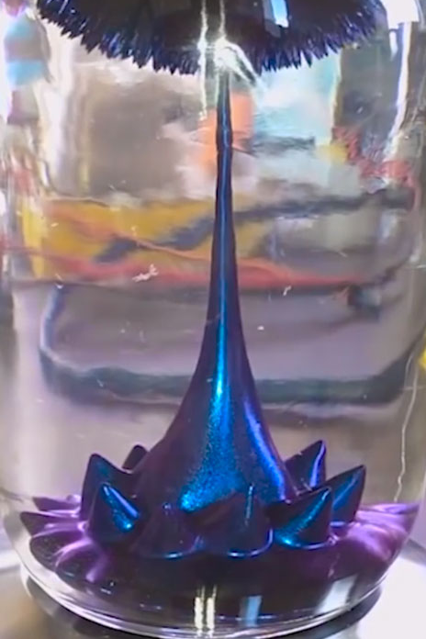
Many people believe that magnets attract metals, but this only partially true.
Of the many different types of metals, only a few are attracted by magnets.

Slide 6
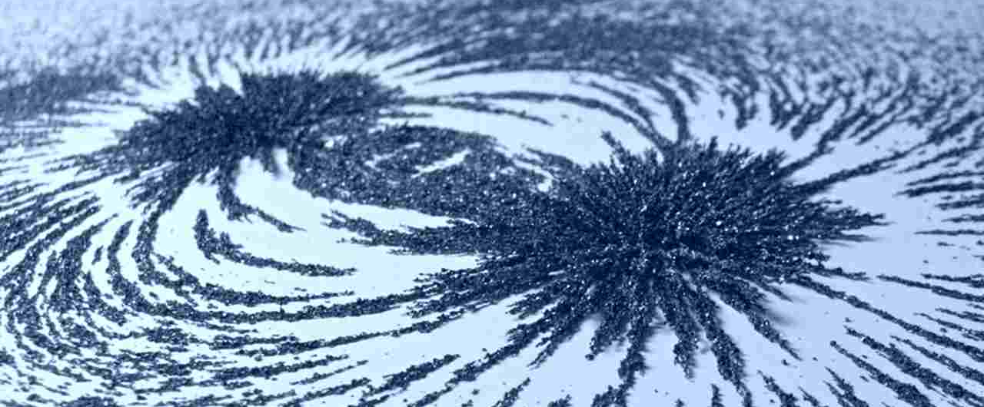
Characteristics of Magnets
An object that produces a magnetic field
Pulls on other ferromagnetic materials
Attracts or repels other magnets

Slide 7
Key Questions
1. What characteristics can we use to identify a magnet?
2. What does it mean for a magnet to attract an object?
3. Is it accurate to say that magnets attract metals? Why or why not?

