Slide 1
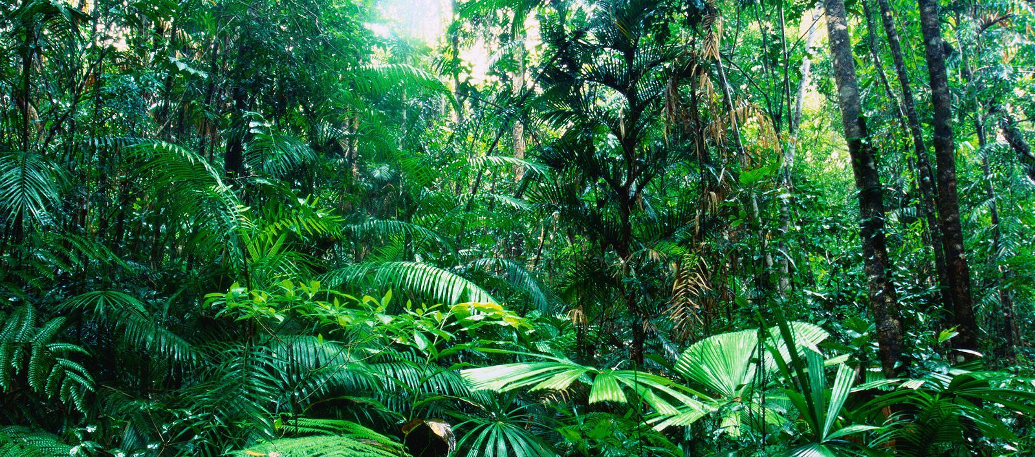
Lesson 1:
Ecosystems and Biomes

Slide 2
K | W | L
What do I already know about ecosystems? | What do I want to learn about ecosystems? | What did I learn about ecosystems? (after the unit)
Complete the Ecosystems KWL chart in your science journal. The K and W portions should be completed now, and the L portion should be completed at the end of the unit.

Slide 3
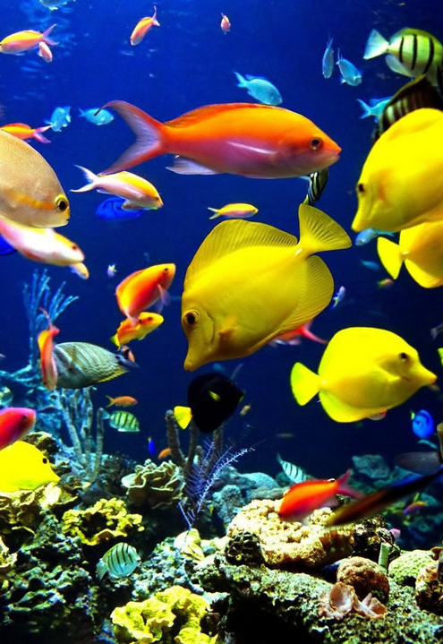
An ecosystem is a community of organisms interacting with their environment.
Organisms are living things and the environment is made up of non-living things.

Slide 4
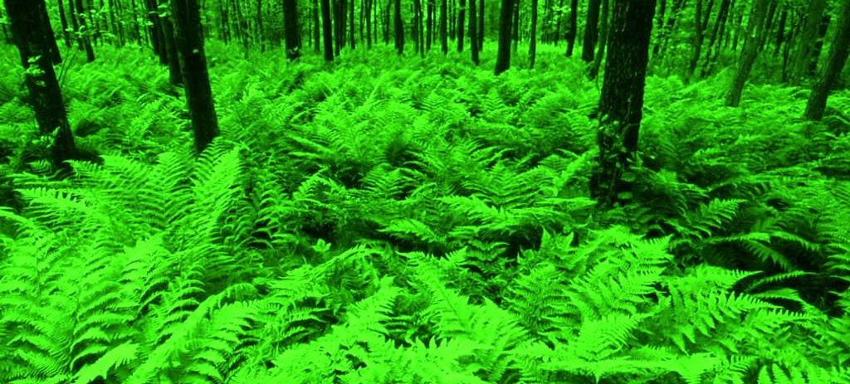
The interaction between these biotic (living) factors and abiotic (non-living) factors make up the characteristics of an ecosystem.

Slide 5
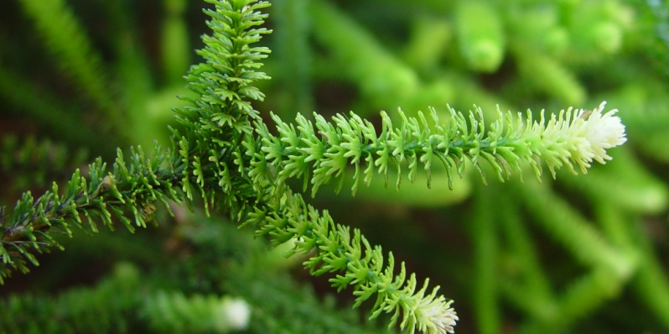
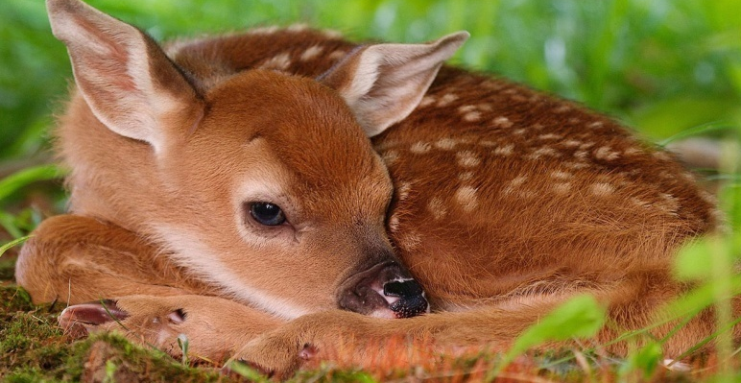
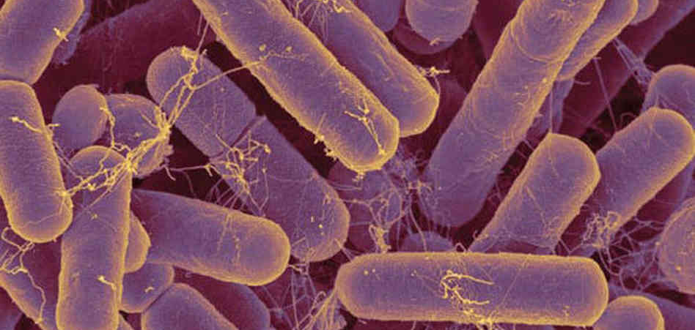
Types of Biotic Factors:
Plants
Animals
Microbes

Slide 6
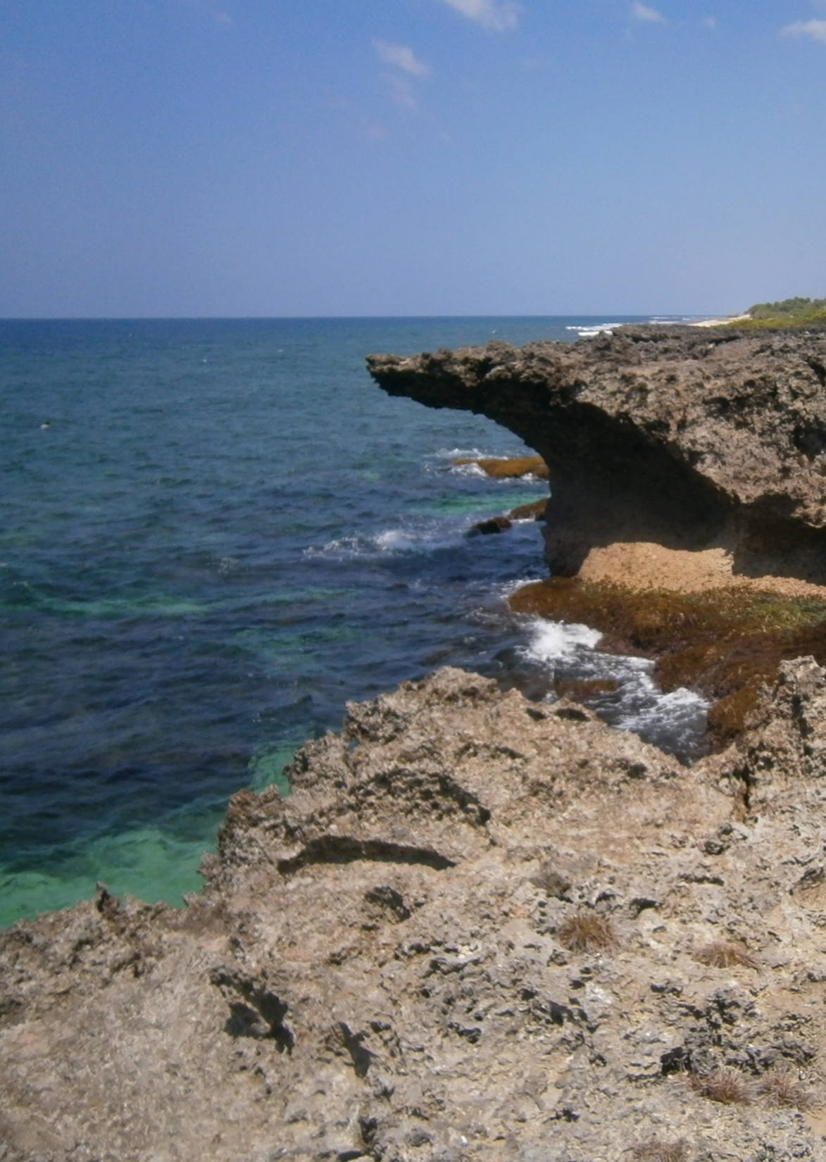
Types of Abiotic Factors:
Air
Water
Soil
Rocks
Sunlight
Weather

Slide 7
Discovery Education Video:
Real World Science: Ecosystems and Biomes
This program takes students on a journey to different types of biomes around the globe, from tropical rain forests, to mountains, deserts and the ocean. Live-action footage and colorful graphics teach students about different regions and climates, explain what an ecosystem is, and examine the impact living organisms and their environments have on each other. A terrarium project shows students how they can build their own living ecosystem.

Slide 8
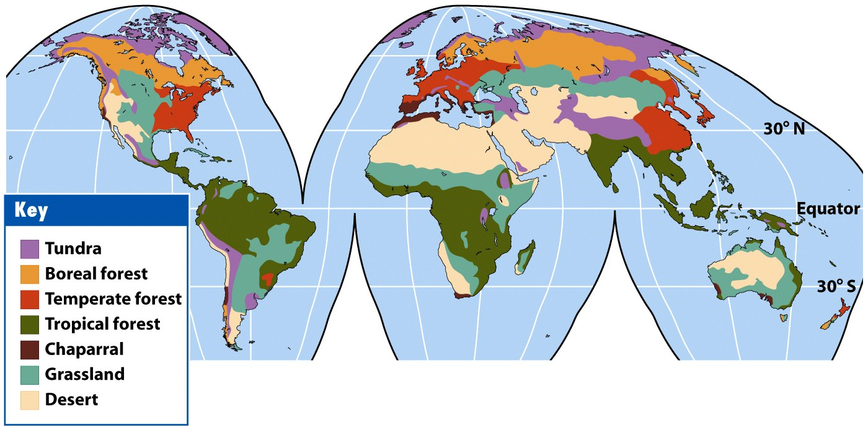
A biome is a major regional or global living community characterized by the dominant organisms and climate. Our planet has seven major biomes.

Slide 9
Arctic Tundra Biome

Slide 10
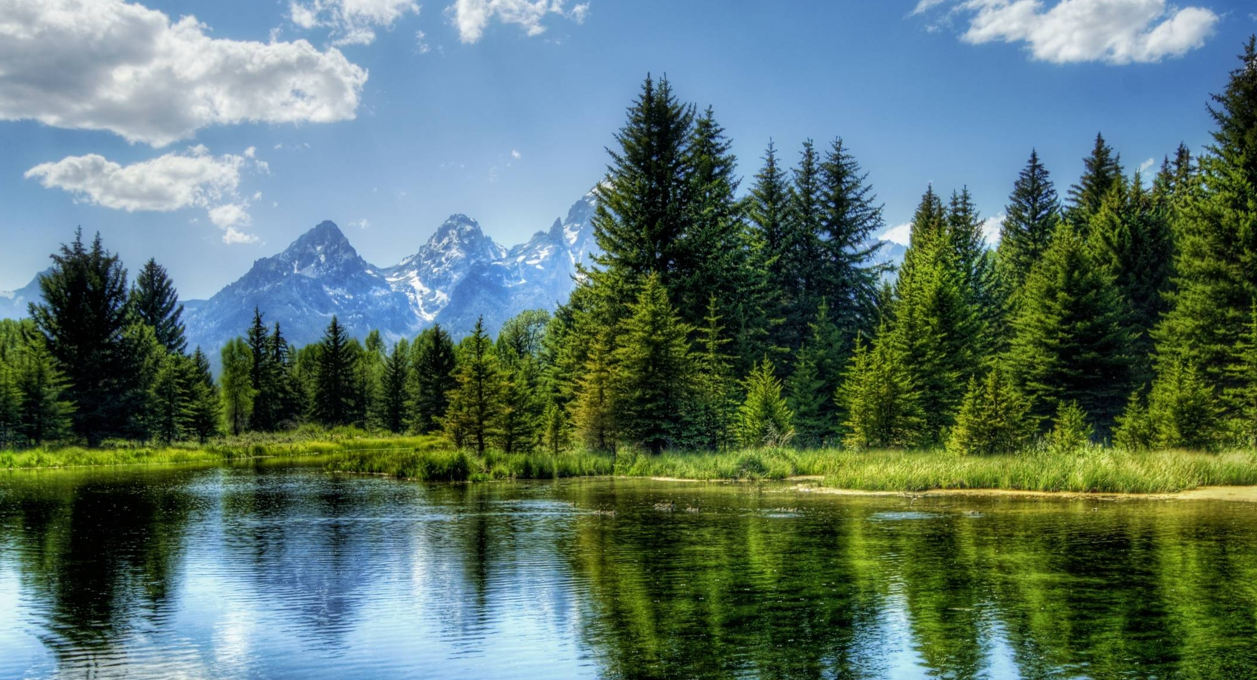
Coniferous Forest Biome

Slide 11
Grassland Biome

Slide 12
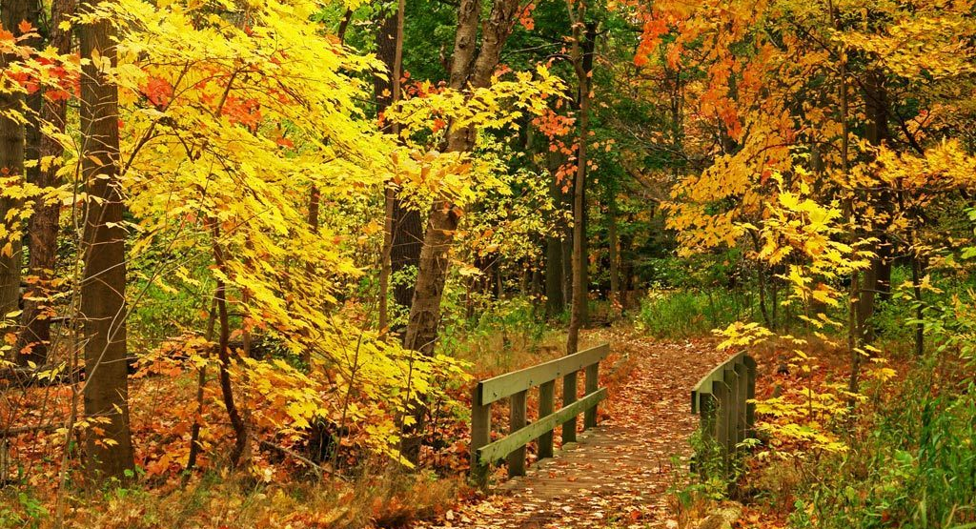
Deciduous Forest Biome

Slide 13
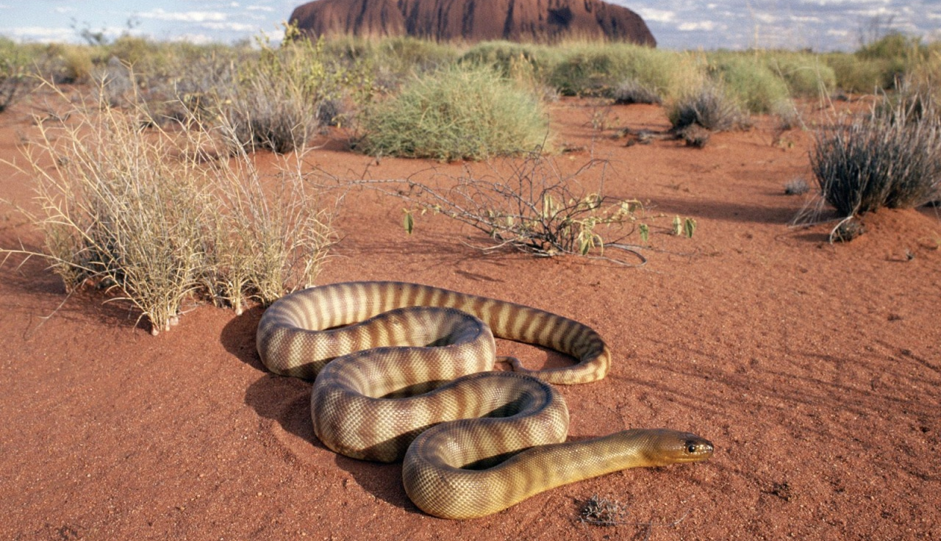
Desert Biome

Slide 14
Tropical Rainforest Biome

Slide 15
Aquatic Biome

Slide 16
Ecosystems and Biomes: Key Questions
What is an ecosystem?
How are ecosystems and a biomes similar? How are they different?
What are biotic and abiotic factors? Give examples of each.
What are the seven major biomes on Earth?

