Slide 1
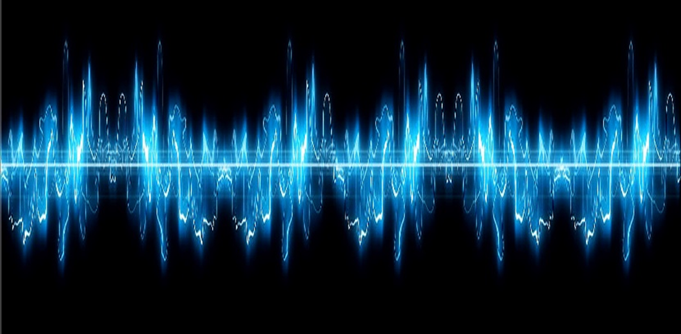
Lesson 2:
Sound Energy

Slide 2
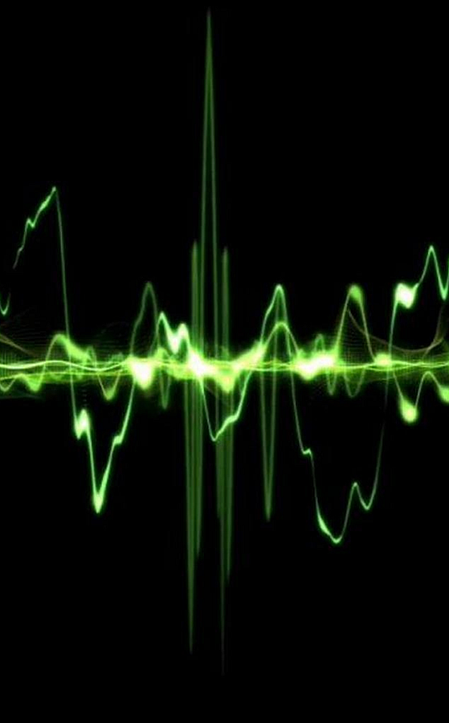
What is sound?
Sound is the movement of energy by vibrations through substances in the form of waves.

Slide 3
Discovery Education Video:
Sound Waves

Slide 4
Sound waves must travel through a medium.
This medium can be solid, liquid, or gas.

Slide 5
Wavelength and Frequency
Wavelength is the measurement of a wave from crest to crest or from trough to trough.
Frequency describes how often the particles of a medium vibrate when sound waves pass through the medium.

Slide 6
Smaller wavelength = higher frequency
Longer wavelength = lower frequency

Slide 7
Frequency is measured in Hertz.
1Hz = 1 Vibration per Second
Humans can hear sounds in the range of 20Hz to 20,000Hz.
Many animals can hear sounds with much higher frequencies.

Slide 8
Frequency determines the pitch of a sound.
Pitch determines how we hear the sound.
“Find the Musical Note”

Slide 9
Amplitude
Amplitude is the height of a wave. It measures to the crest or trough of a wave.
Amplitude determines how loud a sound is.

Slide 10
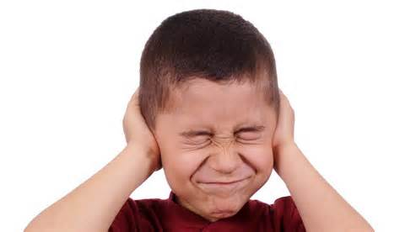
Larger Amplitude = Louder Sound

Slide 11
Sound Energy: Key Questions
What is sound? How does it travel?
Does the medium have an effect on sound? Explain.
What factors of sound waves affect what we hear? Explain.

