Slide 1
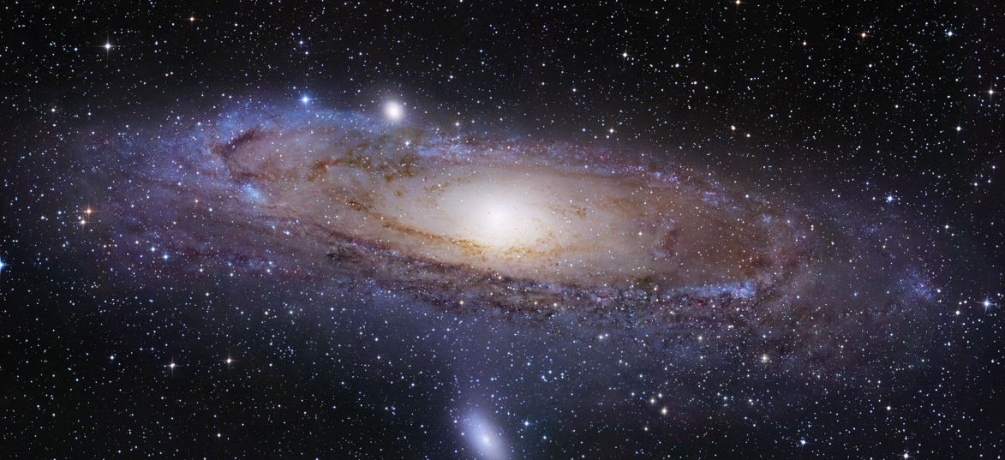
Lesson 2:
Earth’s Movement Around the Sun

Slide 2
In addition to day and night, earth also goes through cycles of seasons.
Changes between spring, summer, fall, and winter occur due to the movement of Earth.

Slide 3
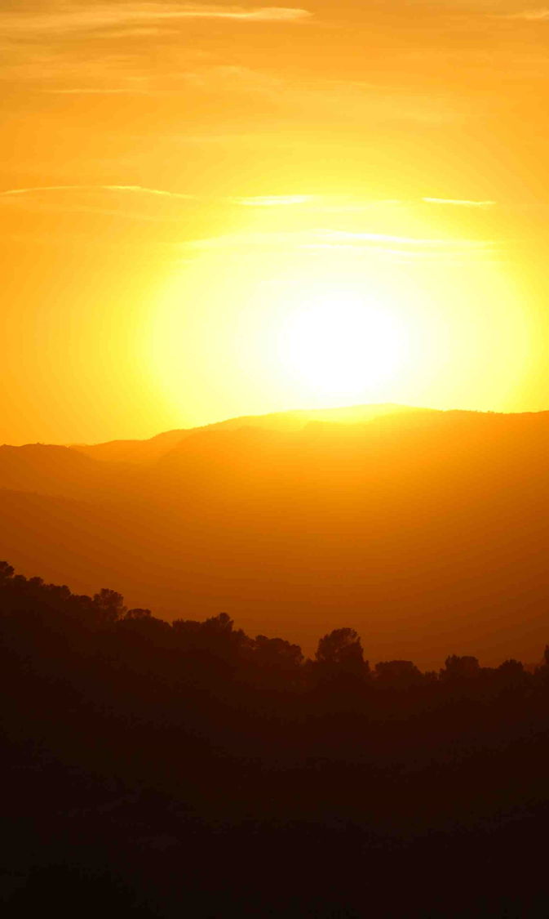
Earth’s Movement Around the Sun
Discovery Education Video:
Explains how the Earth and Moon revolve around the Sun. The program also shows how the Earth tilts on an axis.

Slide 4
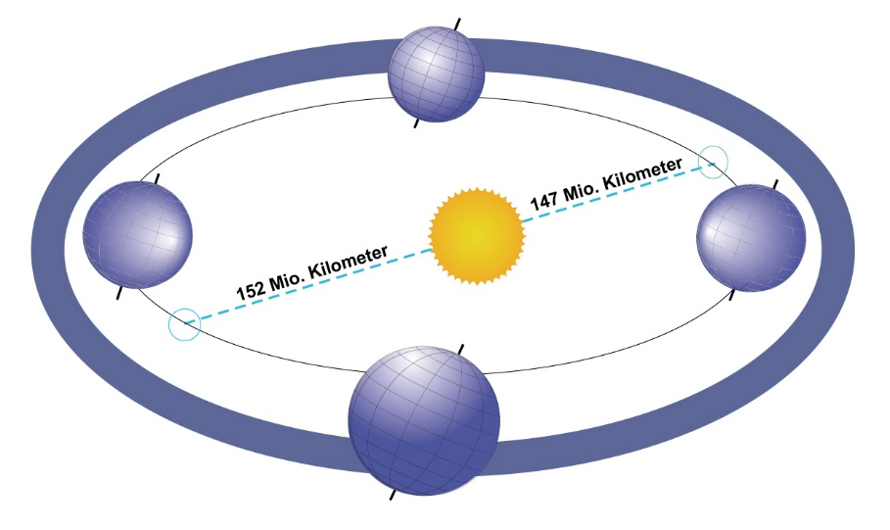
In addition to rotating on its axis, Earth moves in an elliptical orbit around the sun.
This movement of the Earth around the sun is called a revolution.

Slide 5
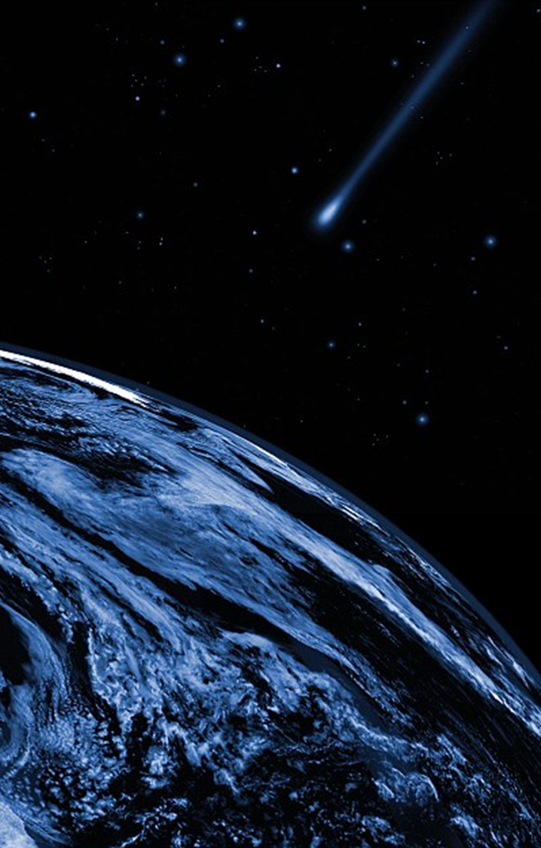
This is why we have a 365 day year.
It takes about 365 days for the earth to make one revolution around the sun.

Slide 6
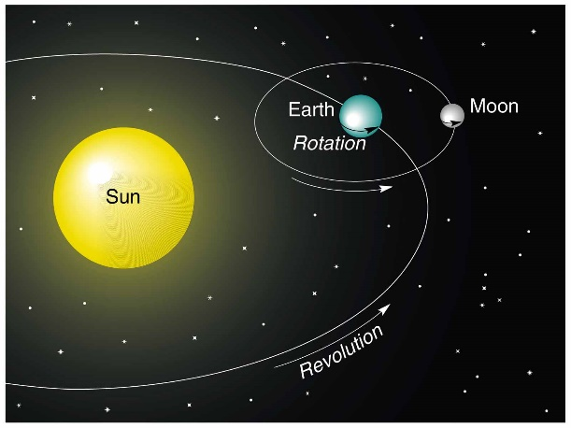
Even though we don’t feel the earth’s movement, it is constantly rotating on its axis as it revolves around the sun.

Slide 7
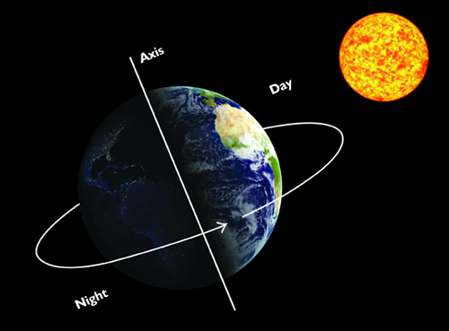
Because of the tilt of Earth’s axis, Earth’s northern and southern hemispheres can be angled either toward or away from the sun.

Slide 8
When the northern hemisphere is angled toward the sun, we will have summer. When it is angled away from the sun, we will have winter.
The season in the southern hemisphere will always be opposite of the northern.

Slide 9
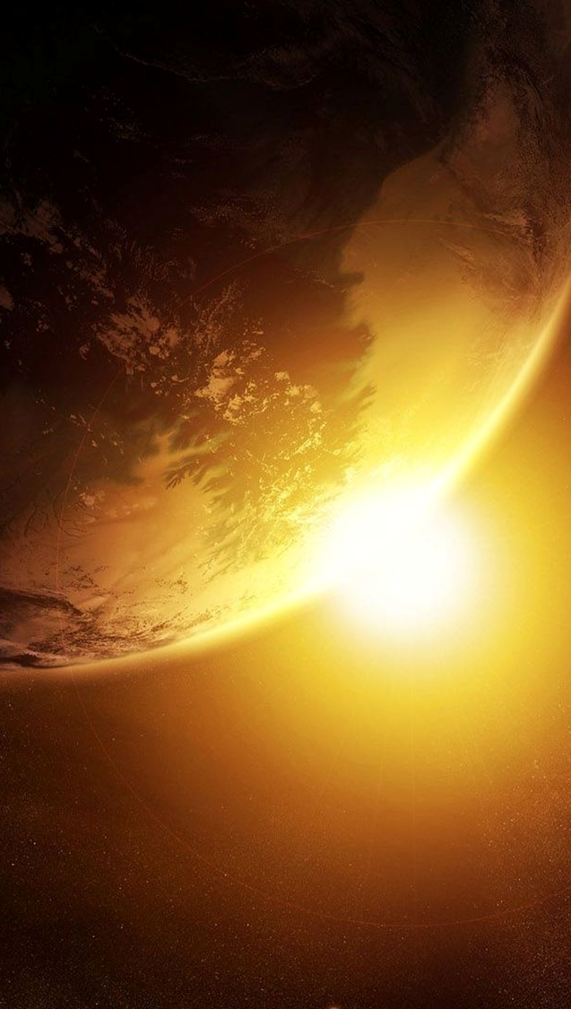
Space Science: Our Revolving Earth and Moon
Discovery Education Video:
This series explores the basics of astronomy and presents an overview of the events occurring in our universe. This program describes the relationship between Earth and its only natural satellite, the Moon.

Slide 10
The Four Seasons
Discovery Education Video:
Details Earth's movement around the sun to better understand why some places on Earth experience four different seasons.

Slide 11
Earth’s Movement Around the Sun: Key Questions
What is the difference between a rotation and a revolution?
How does the tilt of the earth’s axis affect life on Earth?
How are seasons in the southern hemisphere similar to seasons in the northern hemisphere? How are they different?

