Slide 1
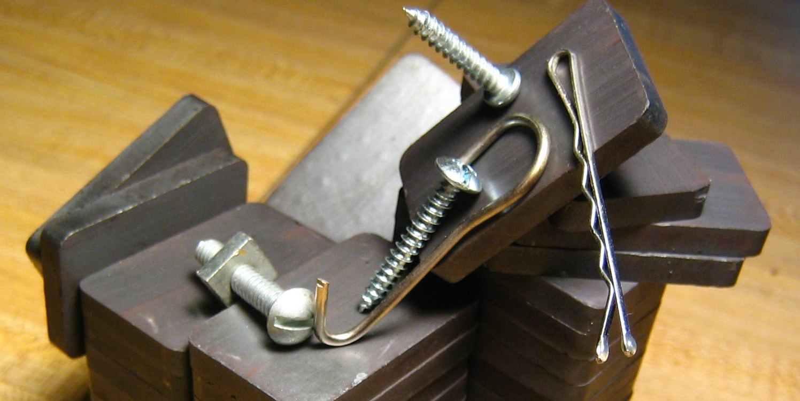
Lesson 2:
Ferromagnetic Substances

Slide 2
Characteristics of Magnets
An object that produces a magnetic field
Pulls on other ferromagnetic materials
Attracts or repels other magnets

Slide 3
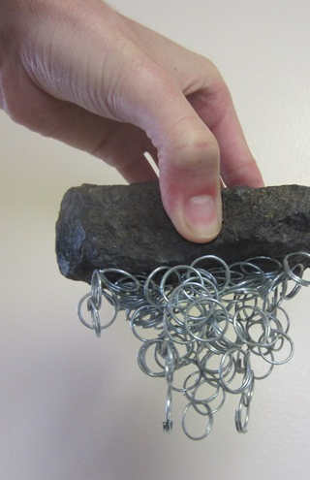
A ferromagnetic substance is a substance that is attracted to a magnet.
This attraction can be observed by a pulling force from the magnet on the ferromagnetic object.

Slide 4
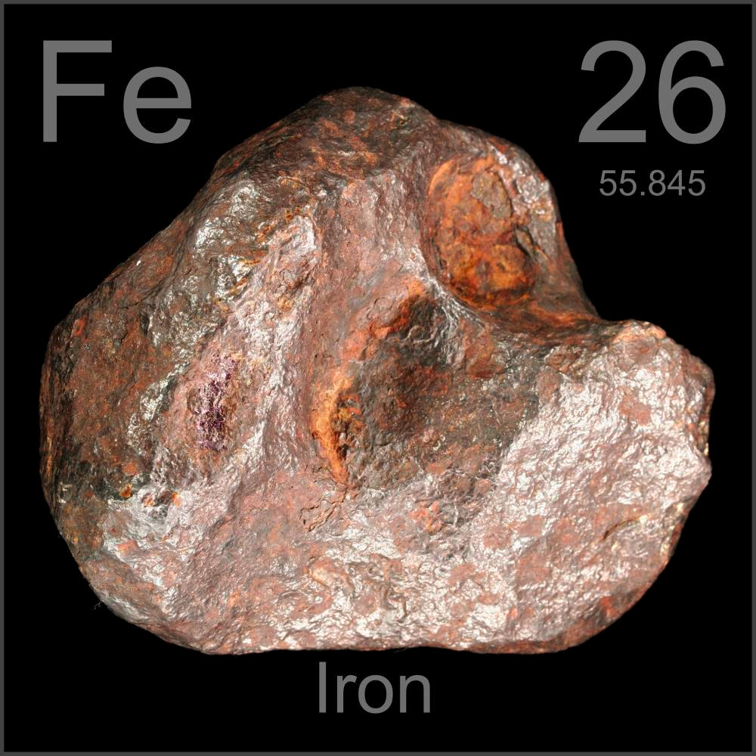
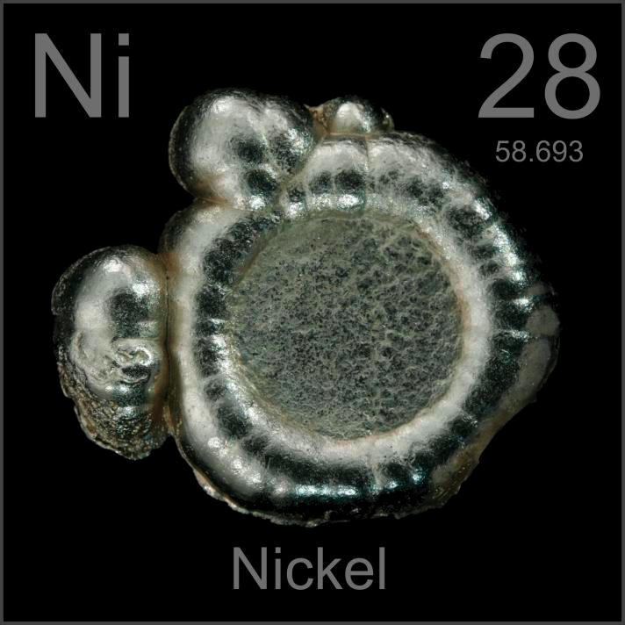
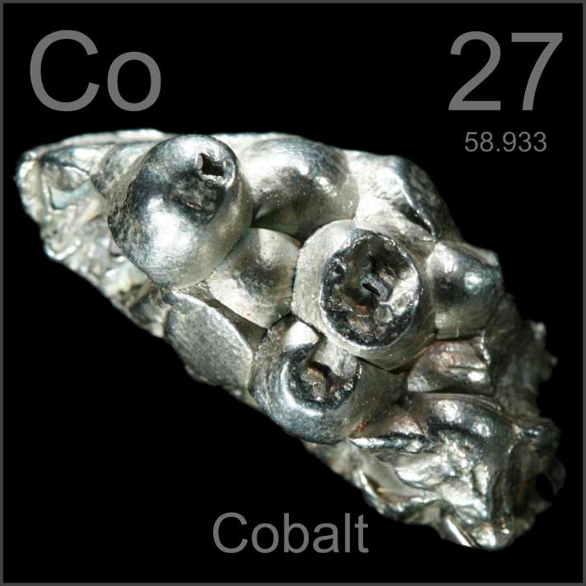
There are three common ferromagnetic elements. Any object or substance that can be pulled by a magnet contains one or more of these elements:
1. Iron (Fe) 2. Nickel (Ni) 3. Cobalt (Co)

Slide 5
Ferromagnetic materials can be combined with other elements to create alloys – mixtures of a metal with another metal or nonmetal.
Common ferromagnetic alloys include steel (iron and carbon) and permalloy (iron and nickel).

Slide 6
A magnet can be used to test the ferromagnetic properties of a substance.
Using a magnet, we can also separate ferromagnetic and non-ferromagnetic substances from a mixture.

Slide 7
Ferromagnetic Substances: Key Questions
What is a ferromagnetic substance?
Are all metals ferromagnetic? Explain how you can test the ferromagnetic properties of an object.
Based on your observations, what are some common uses of ferromagnetic materials?

