Slide 1
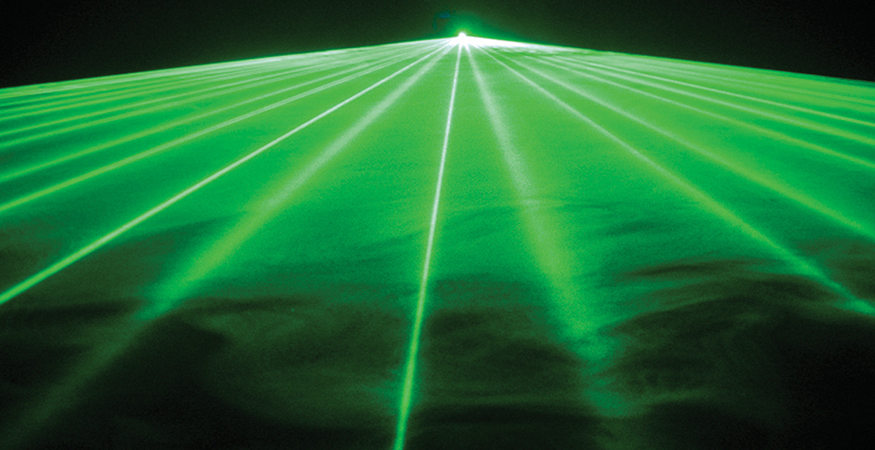
Lesson 3:
Light Energy

Slide 2
Discovery Education Video:
Light: A Visible Form of Energy
Light is energy and travels as waves.

Slide 3
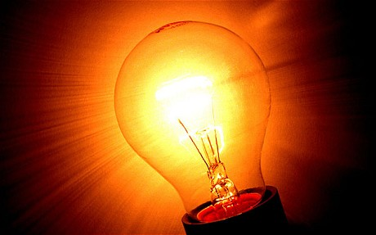
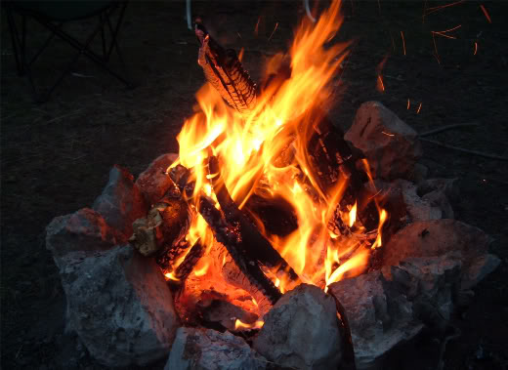
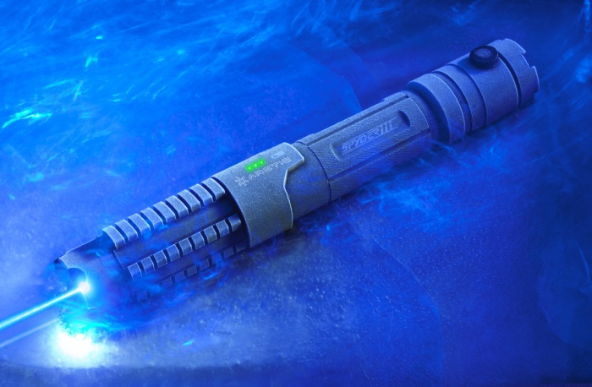
What is light?
Light is made up of waves of electromagnetic energy.
It is the visible portion of the electromagnetic spectrum, or electromagnetic waves that we can see.

Slide 4
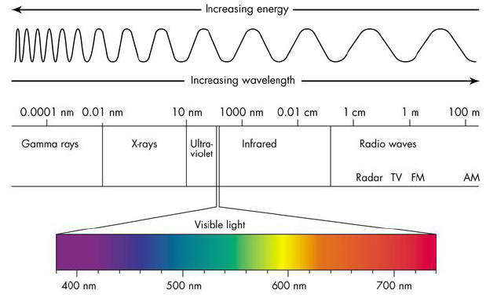
The Electromagnetic Spectrum
Visible light is only a very small part of the electromagnetic spectrum.

Slide 5
Discovery Education Video:
The Electromagnetic Spectrum
Light is a small part of the electromagnetic spectrum. Waves at the beginning of the spectrum have long wavelength and low frequency. Each group of waves and how they are used is discussed in some detail.

Slide 6
How does light travel?
Light travels as a wave in a straight line.
The speed of light is 186,000 miles per second (mps).

Slide 7
Light can be affected when it hits an object.

Slide 8
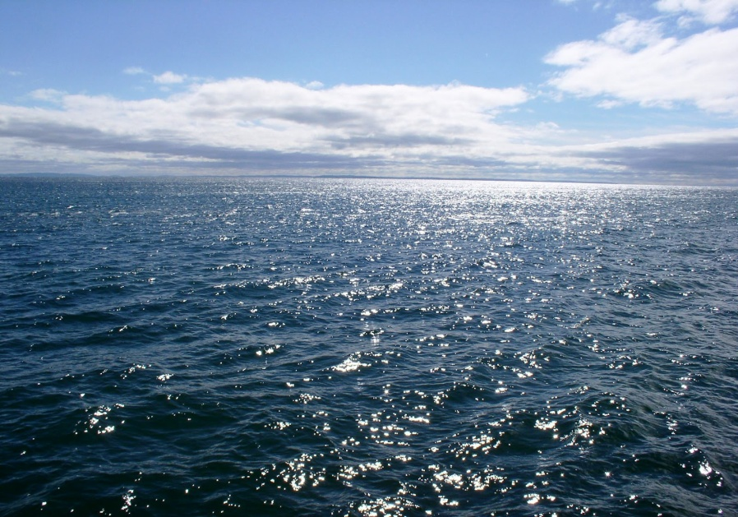
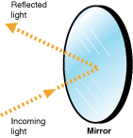
Reflection
When light strikes a reflective surface, it will bounce back in the opposite direction.

Slide 9
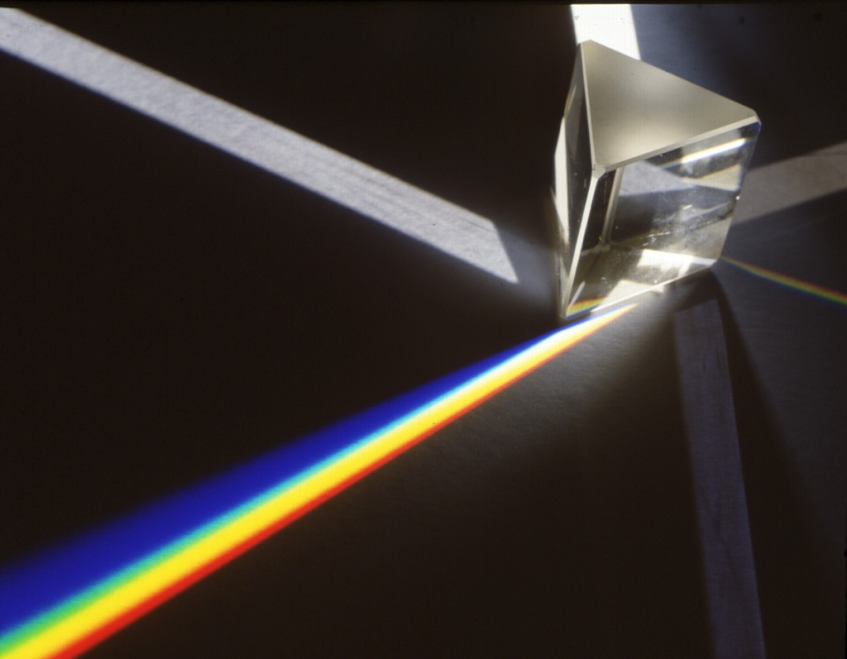
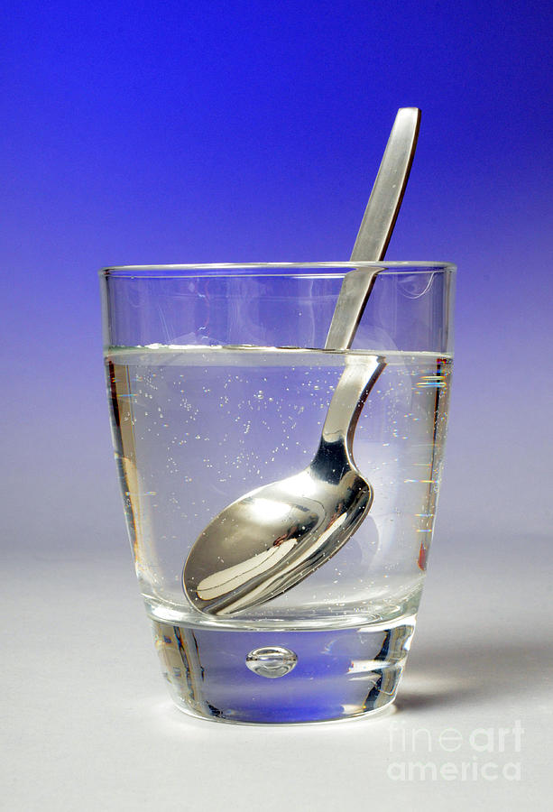
Refraction
When light refracts, the light bends as it passes through a material.

Slide 10
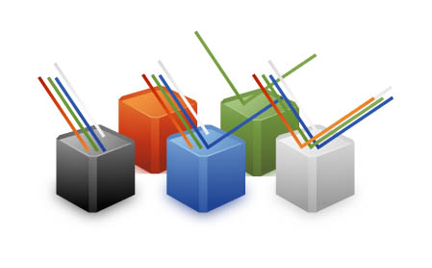
Absorption
When light is absorbed, it cannot be seen after it strikes an object.
An object can absorb one or more colors of light.

Slide 11
Discovery Education Video:
Light, Lenses, and Lasers
This program supports physics and physical science units on waves and their characteristic properties. It explains that light is the visible part of the electromagnetic spectrum, which consists of a variety of waves from radio waves to cosmic rays. It also explores the use of concave and convex lenses and the concepts of diffraction and polarization.

Slide 12
Light Energy: Key Questions
How is light energy similar to sound energy? How is it different?
What is the electromagnetic spectrum? What portion of the electromagnetic spectrum are we able to see?
What happens to light when it strikes an object?

