Slide 1
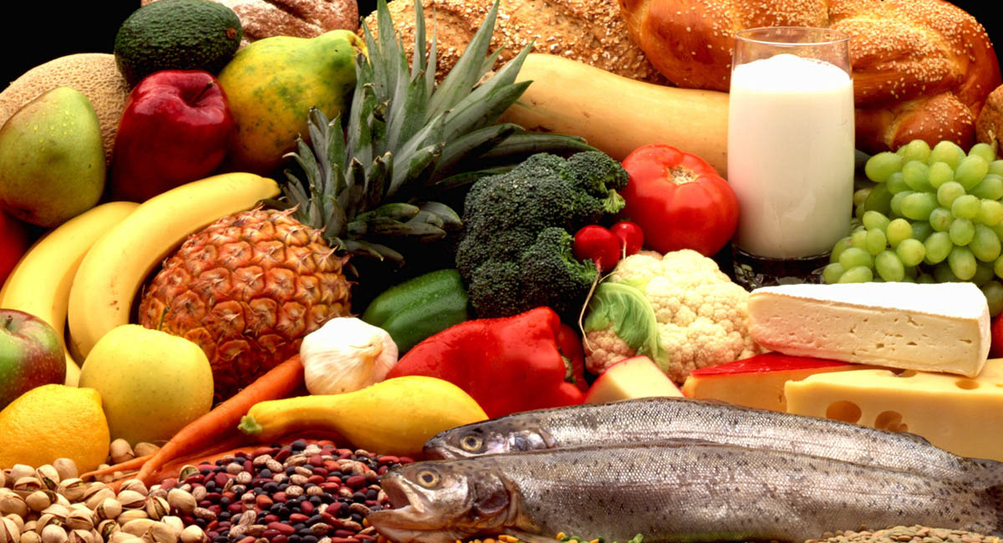
Lesson 3:
The Digestive System

Slide 2
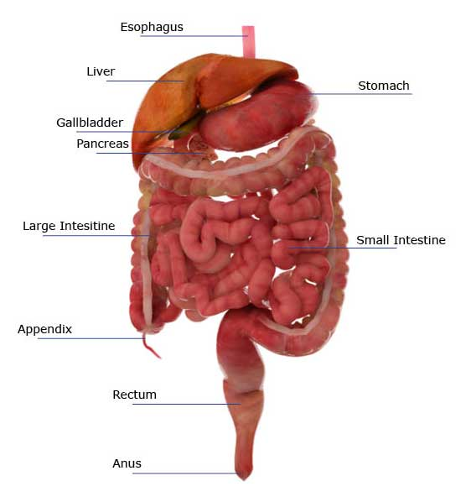
The digestive system is made up of the organs that carry out the process of digestion.

Slide 3
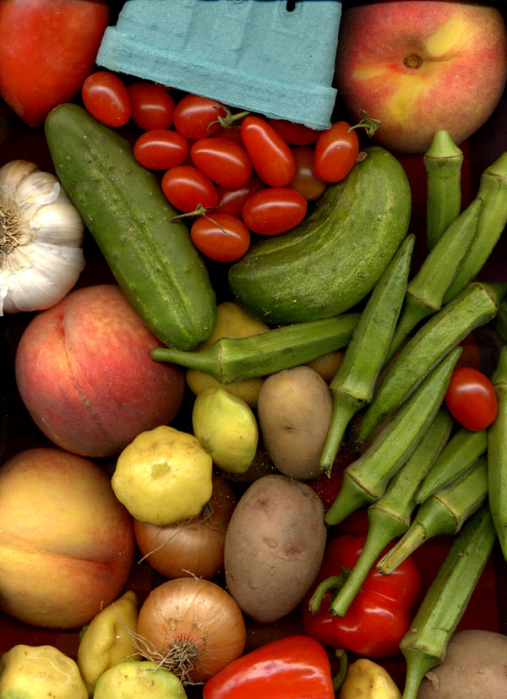
So what is digestion?
Digestion is the process by which our bodies break down food so that it can be used for energy.

Slide 4
Discovery Education Video:
Food Into Fuel: Our Digestive System

Slide 5
Our bodies break down
food in two ways:

Slide 6

Mechanical digestion is the breaking down of food into smaller pieces.
Chewing is
an example of mechanical digestion.

Slide 7
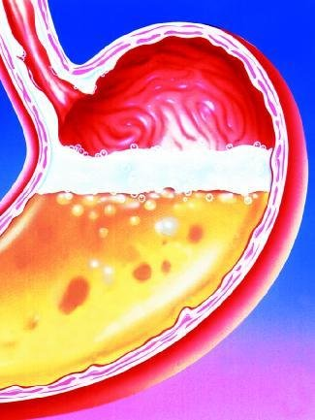
Chemical digestion is the process of breaking down food into nutrients that our bodies can use.
When the acid in our stomach breaks down food, this is an example of chemical digestion.

Slide 8
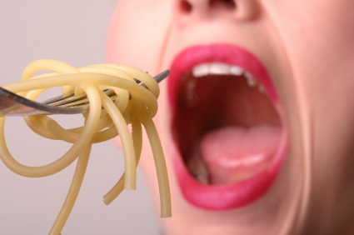
Digestion begins in the mouth.
The teeth crush the food into smaller pieces as we chew, while saliva begins to soften and break down the food.

Slide 9
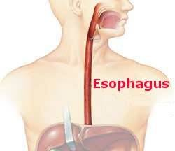
When we swallow, the food travels down our esophagus.
Muscles lining the esophagus help to move the food downward toward the stomach.

Slide 10
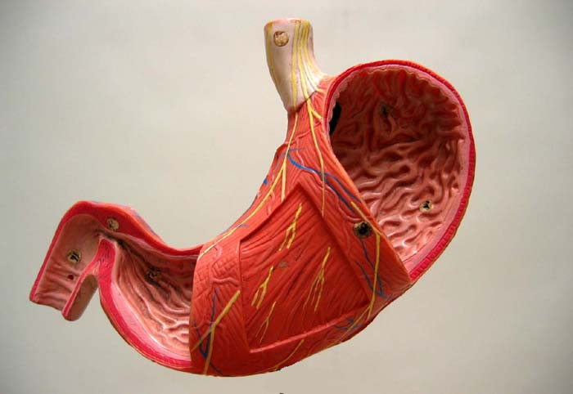
Inside the stomach, hydrochloric acid (HCl) and other digestive fluids continue to chemically break down food.
The stomach’s rough lining also works to break food into smaller pieces.

Slide 11
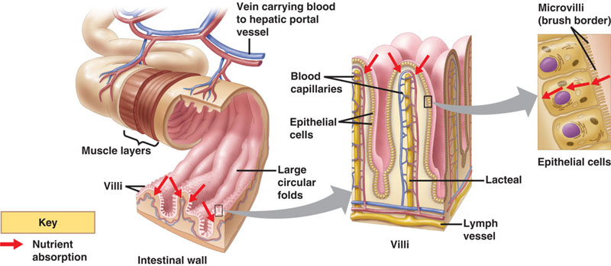
Next food moves into the small intestine. Villi inside the small intestine continue to break down food and absorb nutrients that our bodies can use.

Slide 12
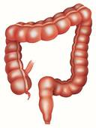
The remaining food passes through the large intestine.
At this point our body has absorbed all the energy that it can from the food, and what remains will be removed from the body as waste.

Slide 13
The Digestive System:
Key Questions
1. What are the important organs in the digestive system and what is their function?
2. How does the digestive system help the body?
3. How does food travel through the digestive system?

