Slide 1
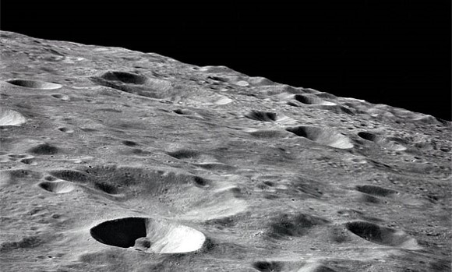
Lesson 3:
Earth’s Moon

Slide 2
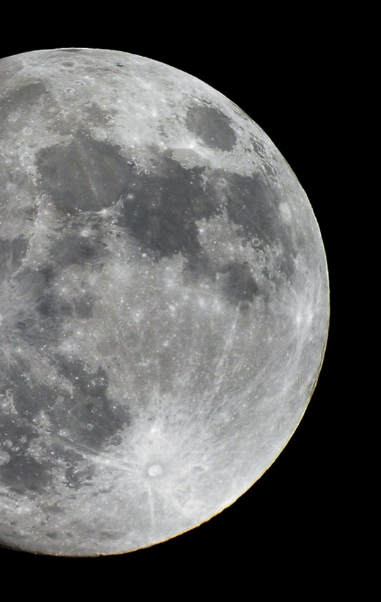
The moon is Earth’s only natural satellite.
A satellite is an object that orbits a planet.

Slide 3
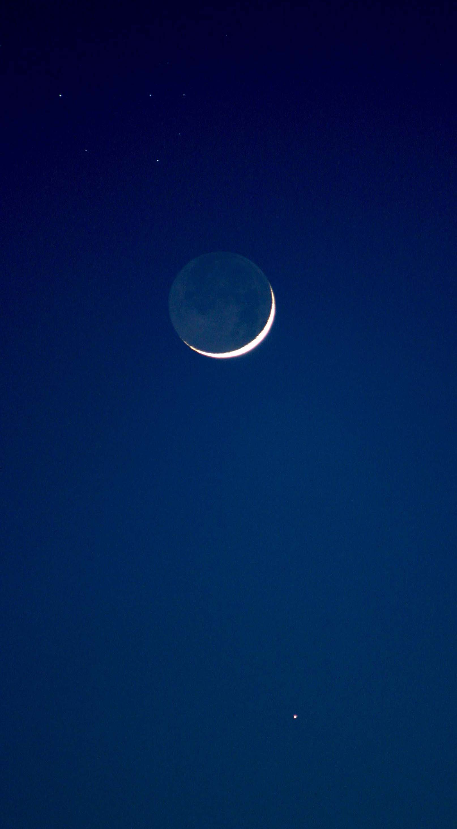
Space School: Moon
Discovery Education Video:
Describes the moon's origins, structure, and topography while highlighting Earth's unique relationship with its only natural satellite.

Slide 4
Just as Earth revolves around the sun, the moon revolves around Earth.
Earth’s moon completes one revolution every 28 days.

Slide 5
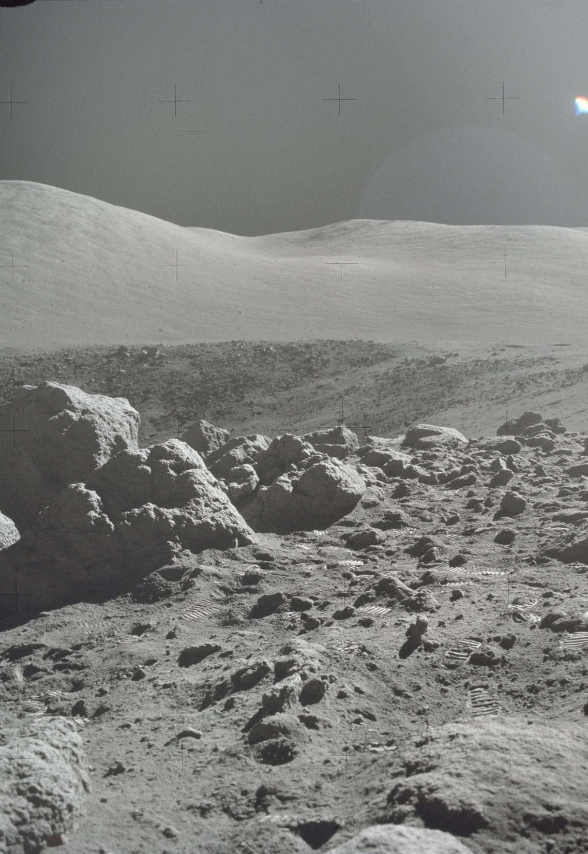
The moon’s surface is dry and covered with craters – marks left when the moon was hit by objects from space.
The surface of the moon is very different from the surface of Earth.

Slide 6
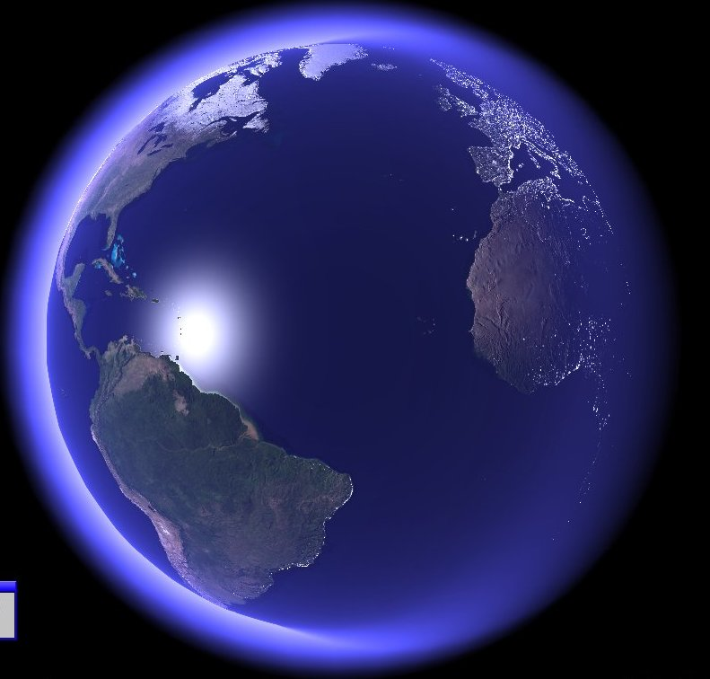
Earth has an atmosphere – a layer of gasses that covers a planet.
The earth’s atmosphere is over 200 miles thick. It helps to protect our planet and allows it to support life.

Slide 7
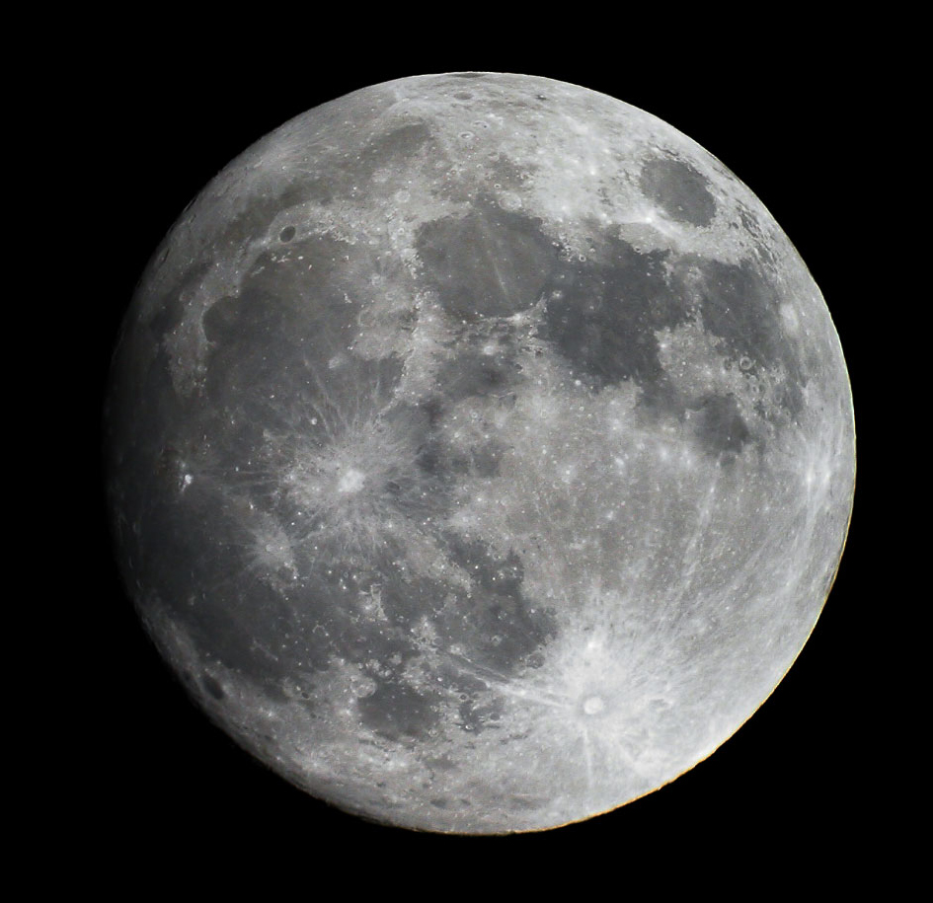
Earth’s moon has no atmosphere. Many objects from space have struck the moon causing many craters and shaping its surface.

Slide 8
Earth’s Moon: Key Questions
What is a satellite? What is the difference between a natural and man-made satellite?
How does the moon’s movement through space compare to the movement of the earth?
How would the moon’s surface likely be different if it had an atmosphere like Earth’s?

