Slide 1
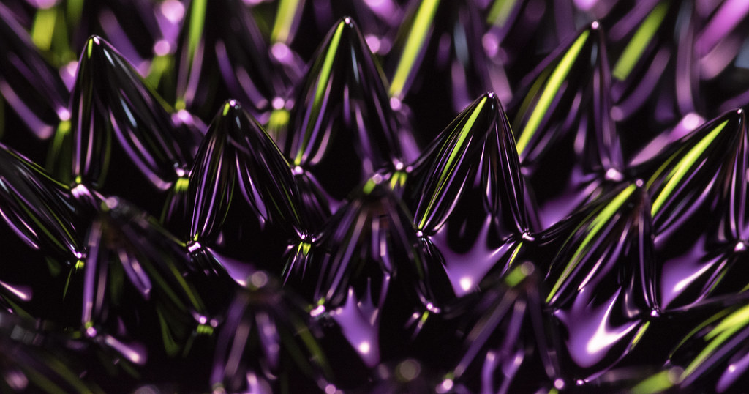
Lesson 3:
Magnetic Fields

Slide 2
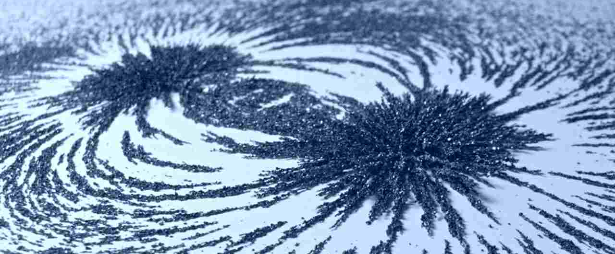
Characteristics of Magnets
An object that produces a magnetic field
Pulls on other ferromagnetic materials
Attracts or repels other magnets

Slide 3

A magnetic field is made up of the invisible lines of force surrounding a magnet.
Even though we cannot see magnetic fields, we can detect their presence.

Slide 4
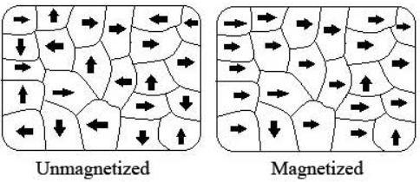
Magnetic fields are formed when the magnetic domains of the atoms that make up a substance line up in the same direction.
The more of these magnetic domains that are aligned, the stronger the magnetic field will be.

Slide 5
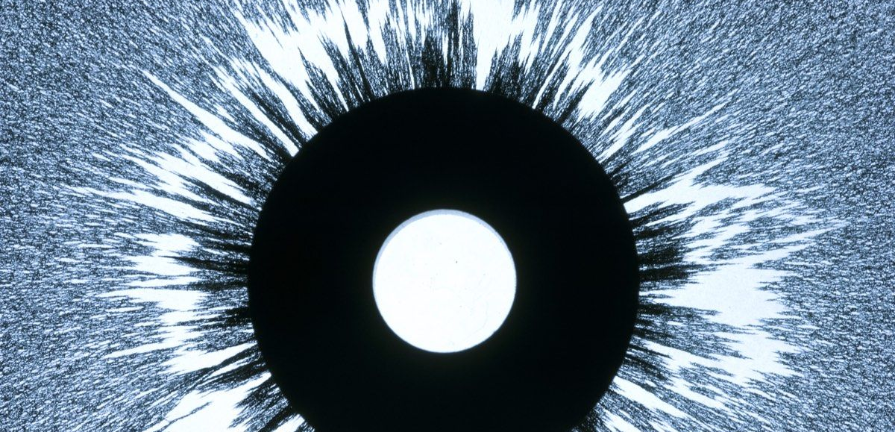
By using iron filings (small particles of iron) or other ferromagnetic particles, we can observe the shape and intensity of a magnetic field.

Slide 6
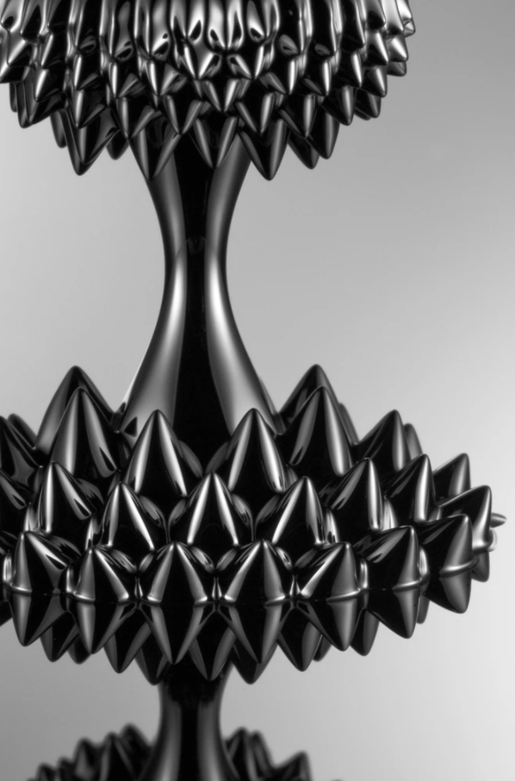
Ferrofluid is a ferromagnetic liquid containing iron oxide that can be attracted by a magnet and used to observe the presence of magnetic fields.

Slide 7
Magnetic Fields:
Key Questions
What is a magnetic field?
How can we determine whether an object produces a magnetic field?
Do you think that the magnetic field for every magnet would look the same? Explain.

