Slide 1
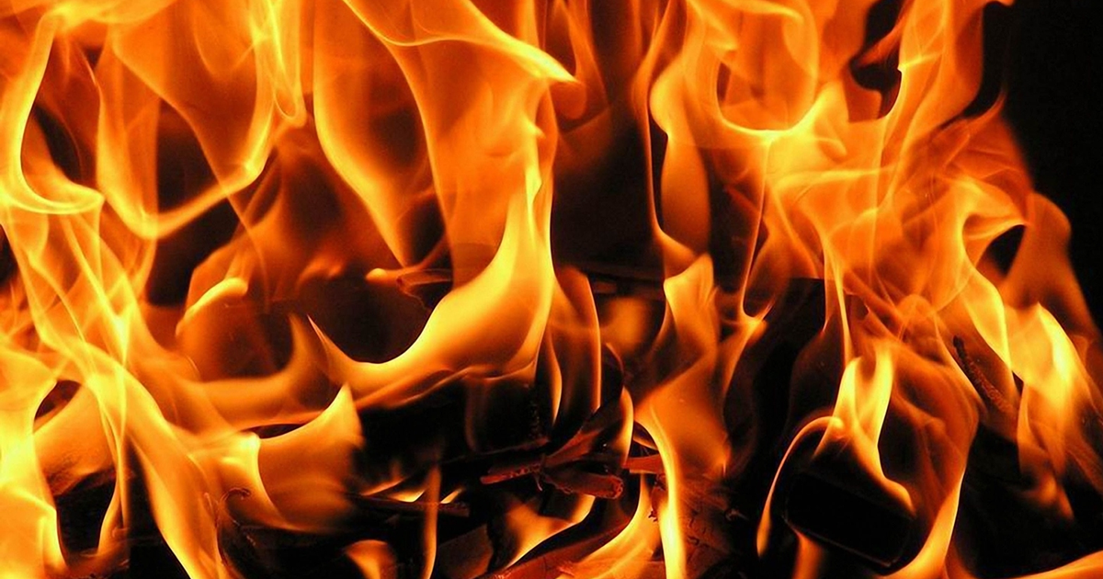
Lesson 4:
Heat Energy

Slide 2
Discovery Education Video
Thinking about Heat, Energy, and Temperature: An Introduction
This clip introduces heat, energy, and temperature. Some key terms and concepts are introduced.

Slide 3
Heat is a form of energy that we can feel.
What is Heat?

Slide 4
Heat is the transfer of thermal energy.
Thermal energy is the movement of molecules that make up an object or substance.

Slide 5
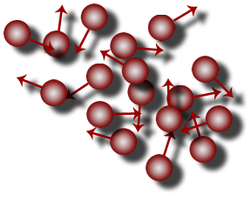
The faster the molecules move, the more thermal energy they are able to generate.
As molecules move they rub against one another. This creates friction which raises the temperature of the molecules.

Slide 6
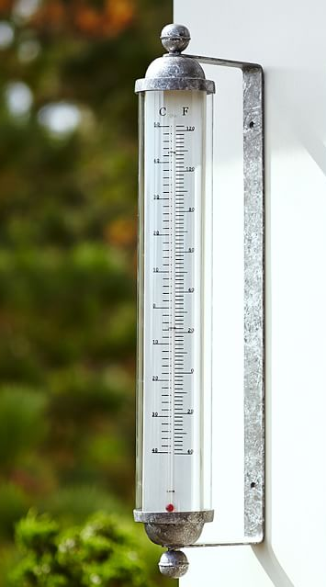
The measure of thermal energy in an object or substance is called temperature.
Temperature is most commonly measured using the Fahrenheit and Celsius scales. The Kelvin scale is also used by scientists – particularly for measurement of very low temperatures.

Slide 7
Discovery Education Video
Measuring Temperature
Temperature is the measurement of energy or heat of matter.

Slide 8
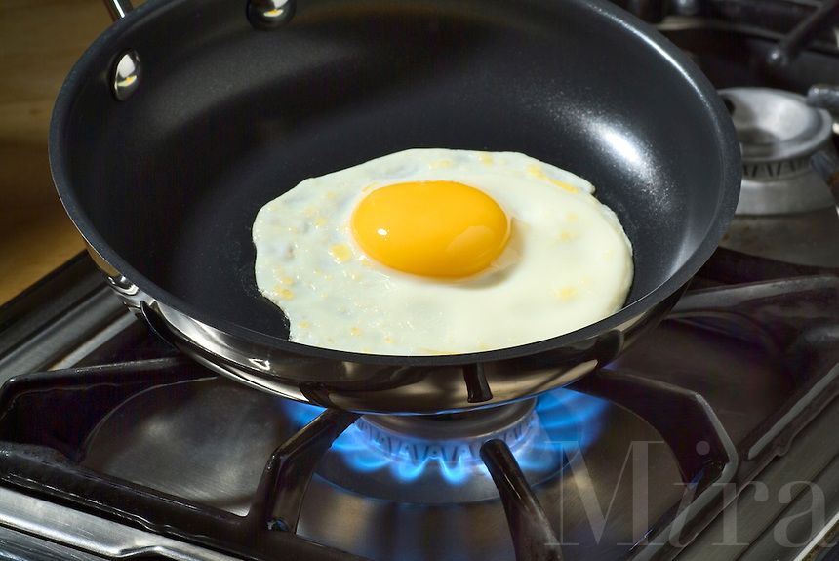
Heat energy always moves from a warmer object to a cooler object.
An object does not have to feel “hot” to be able to transfer heat.

Slide 9
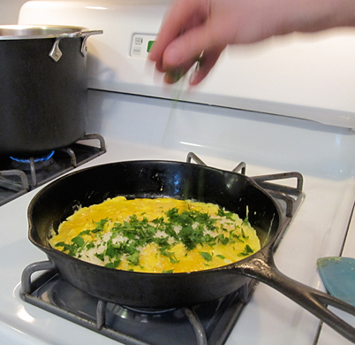
Heat energy can move, or transfer, between objects in three ways:
Conduction – Heat transfer between two objects that are touching
Radiation – Heat transfer through air or space by electromagnetic waves
Convection – Heat transfer by a current of water or air

Slide 10
Discovery Education Video
The Movement of Heat
Heat energy can be transferred in three ways: conduction, convection, and radiation.

Slide 11
Discovery Education Video
Heat and Temperature
Humans have always been feverish about temperature. But why? Learn how varying temperatures affect matter and see how pressure affects temperature. Find out why we need precise measurements of heat and why the Fahrenheit, Celsius, and Kelvin scales are so different. Produced by Discovery Channel School.

Slide 12
Heat Energy: Key Questions
What is heat energy? How is heat energy different from light and sound energy?
What are the three methods that heat moves or transfers? Give an example of each.
Why does heat always transfer from a warmer object to a cooler object?

