Slide 1
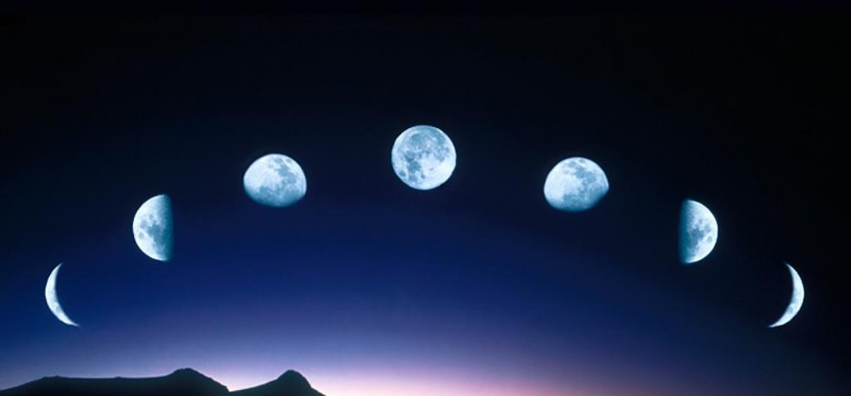
Lesson 4:
Phases of the Moon

Slide 2
Even though we often see the moon illuminated in the night sky, the moon does not produce light like the sun does.
The light that we see from the moon is actually the sun’s light being reflected by the moon’s surface.

Slide 3
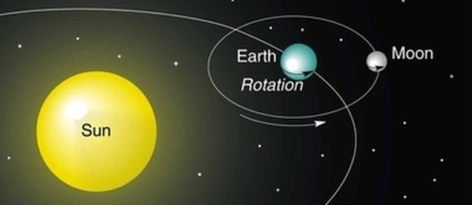
The moon orbits or revolves around the earth similarly to how the earth orbits the sun.
Earth’s moon completes one revolution about every 28 days.

Slide 4
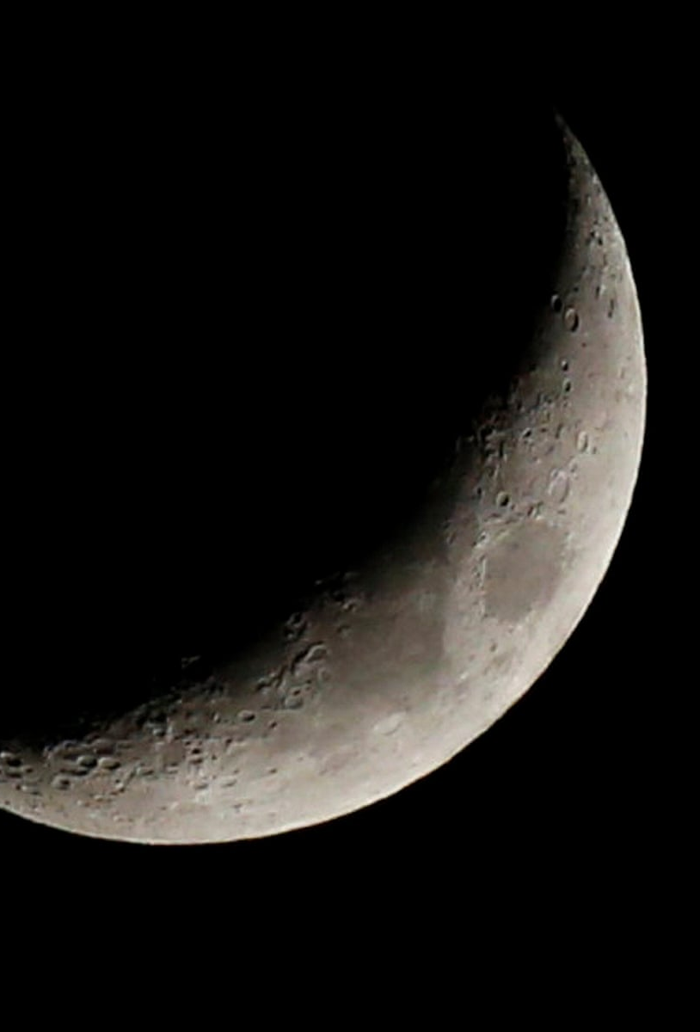
As the moon orbits the earth, its appearance in the sky changes.
This cycle of changes over the course of one revolution is called a lunar cycle.

Slide 5
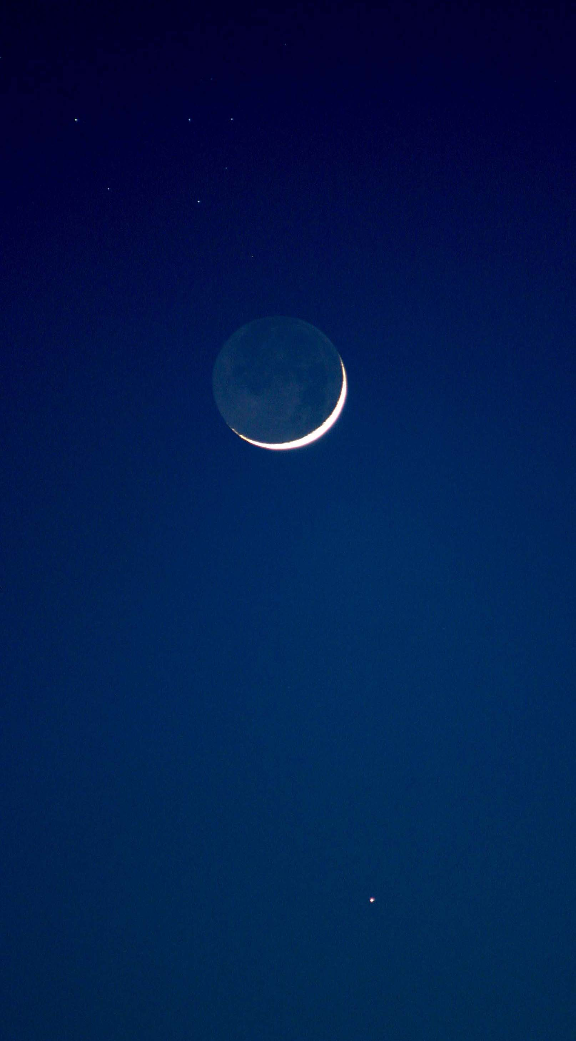
Phases of the Moon
Discovery Education Video:
Examines the sources of the moon's light. The moon reflects the light from the sun. Different parts of the moon are lit up at different times depending on the position of the sun which results in the phases of the moon.

Slide 6
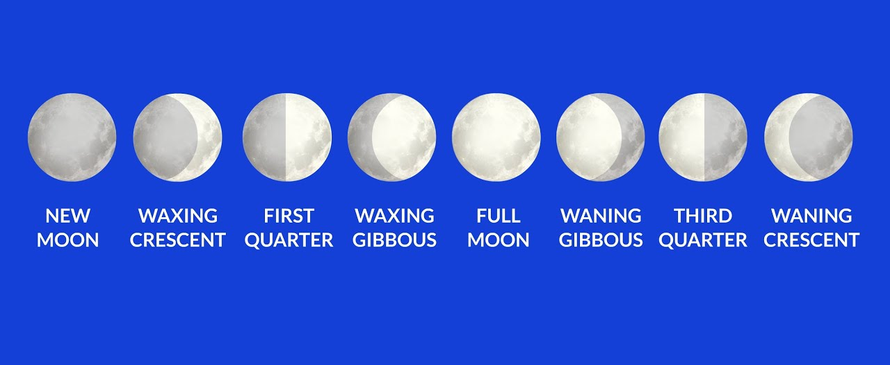
There are eight major phases, or shapes of the moon, that we see during the lunar cycle.
Because we see the moon from different angles at different points in the lunar cycle, the moon’s appearance in the sky changes over this 28 day period.

Slide 7
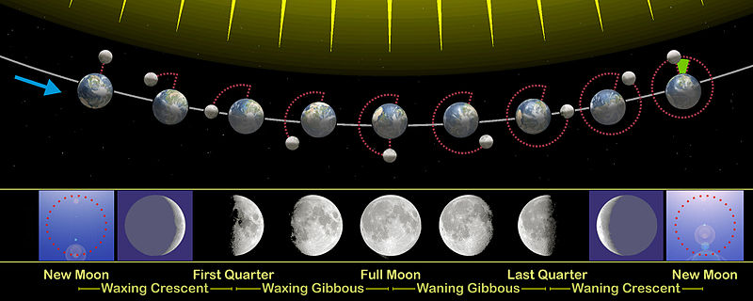
Even though the sun always illuminates half of the moons surface, just like it does Earth’s, we see different amounts of this illuminated portion at different points in the lunar cycle.

Slide 8
During the first half of the lunar cycle as more of the illuminated surface of the moon becomes visible, we say that the moon is waxing.
During the second half of the lunar cycle as less of the illuminated surface of the moon becomes visible, we say that the moon is waning.

Slide 9
What are the Phases of the Moon?
Discovery Education Video:
Presents the eight phases of the moon, and states that the phases of the moon are called the new moon, waxing crescent, first quarter, waxing gibbous, full moon, waning gibbous, last quarter, and waning crescent. The segment also provides a video quiz that is based on the content of the segment.

Slide 10
Phases of the Moon: Key Questions
What is a lunar cycle? What do we observe during one complete lunar cycle?
Beginning with a new moon, what is the order of the 8 major moon phases during the lunar cycle?
What is the difference between waxing and waning?

