Slide 1
Lesson 4:
The Skeletal and
Muscular Systems

Slide 2
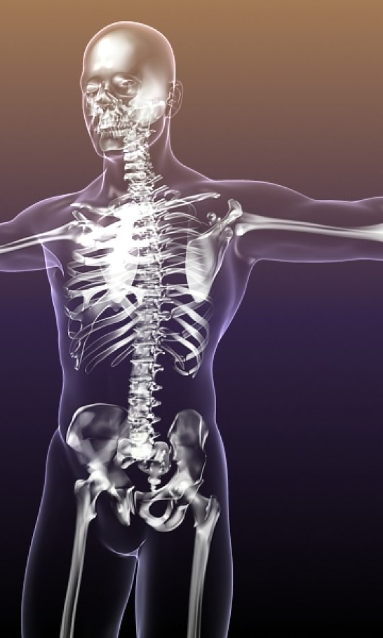
The skeletal system is made up of 206 bones.
The job of these bones is to give our bodies support and protection.

Slide 3
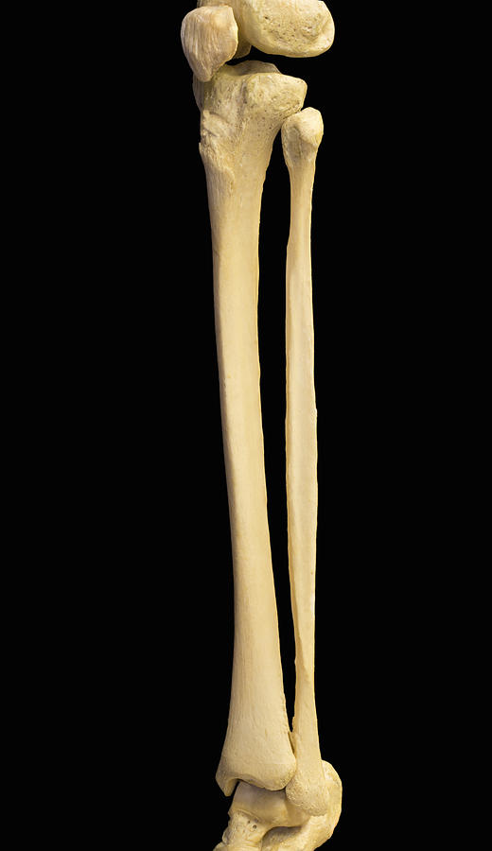
Long bones such as those in our arms and legs help to hold our bodies up, give our bodies their shape, and allow us to move.

Slide 4
Other bones such as our ribs and skull help to protect our internal organs.

Slide 5
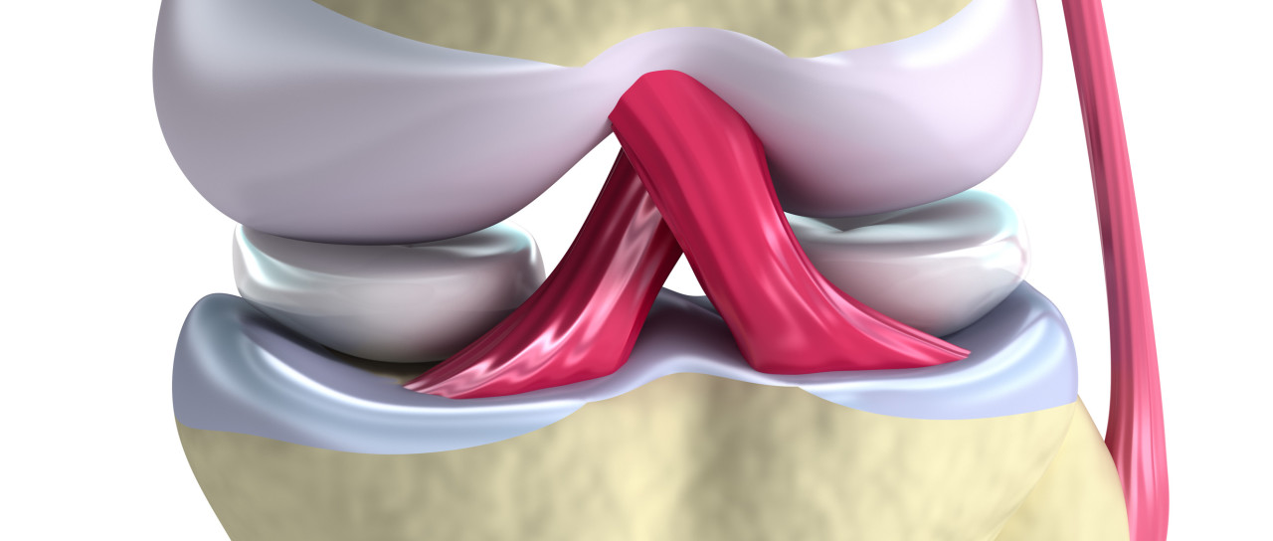
Bones are connected at joints. In most cases, these joints allow movement of the bones with the help of muscles and tendons.

Slide 6
Hinge joints like the elbow and knee are able to move in only one direction (like a door hinge)

Slide 7
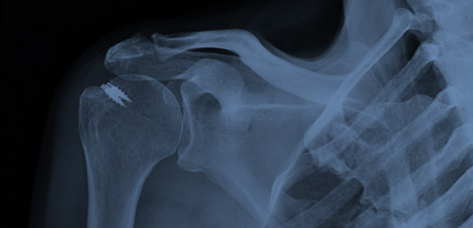
Ball and socket joints like the shoulder and hip can rotate for a wider range of motion.

Slide 8
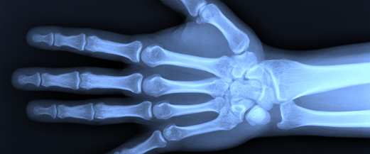
Gliding joints are found in our hands and feet and allow the bones to move more freely, giving us a wider range of motion.

Slide 9
The muscular system is made of over 650 muscles.
These muscles expand and contract to allow our bodies to move.

Slide 10
Muscles can be classified as either voluntary or involuntary
Voluntary muscles like those in our arms and legs are muscles that we can directly control.
Involuntary muscles like our heart and digestive muscles are controlled automatically by our bodies.

Slide 11
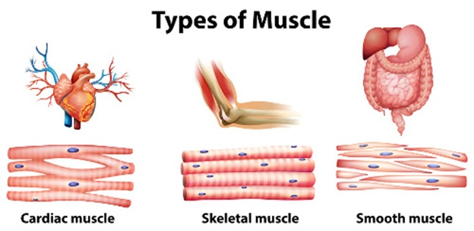
There are three different types of muscle tissue in our bodies.

Slide 12
The Skeletal and Muscular Systems: Key Questions
1. What are the two important jobs of the skeletal system?
2. What are the major types of muscles and their characteristics?
3. How do the skeletal and muscular systems work together to help our bodies?

