Slide 1
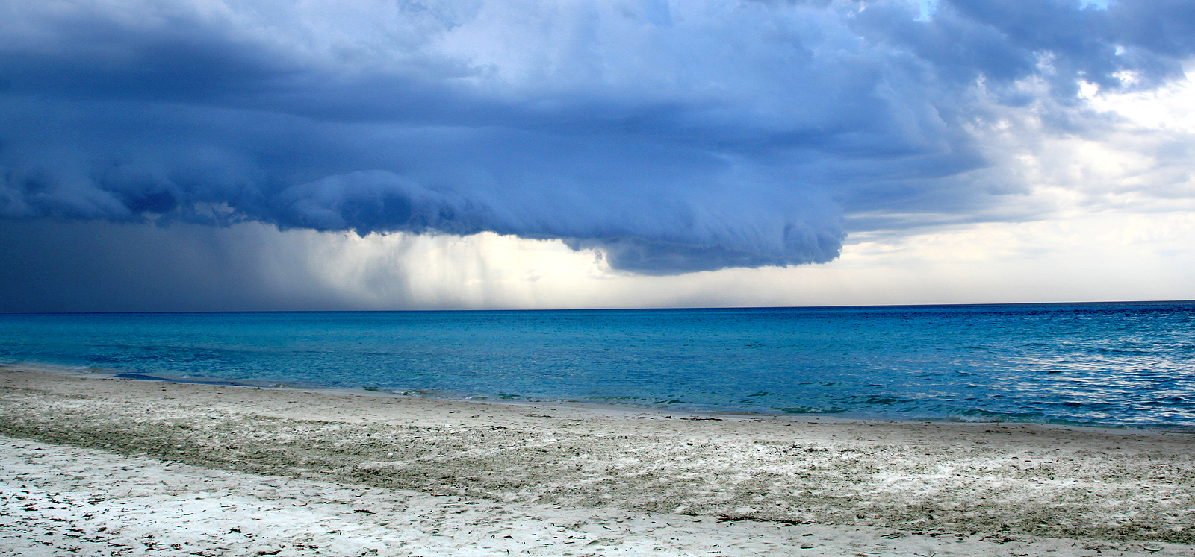
Lesson 1: What is Weather?

Slide 2
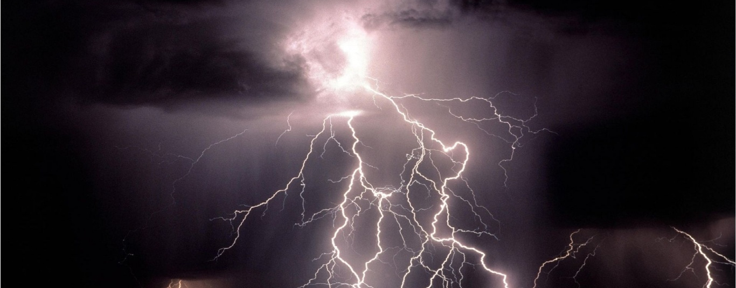
What is Weather?
Weather describes the properties of the atmosphere at a given time and location, including temperature, air movement, and precipitation.

Slide 3
Factors that Affect Weather
Major factors that affect weather patterns and weather in an area include temperature, humidity, and air pressure.

Slide 4
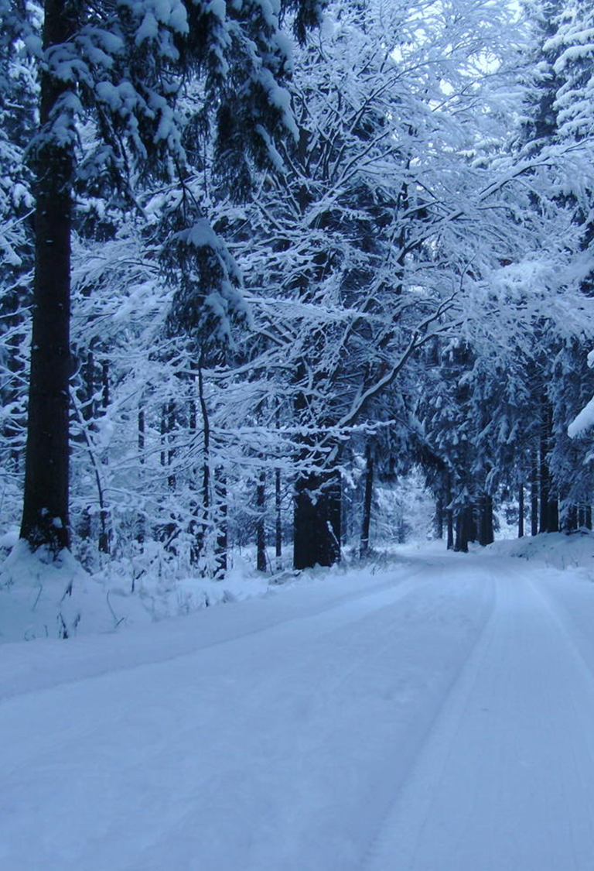
Measuring Weather
Tools can be used to measure a variety of weather factors. These factors can be used both to describe current weather conditions and to predict future weather events.

Slide 5
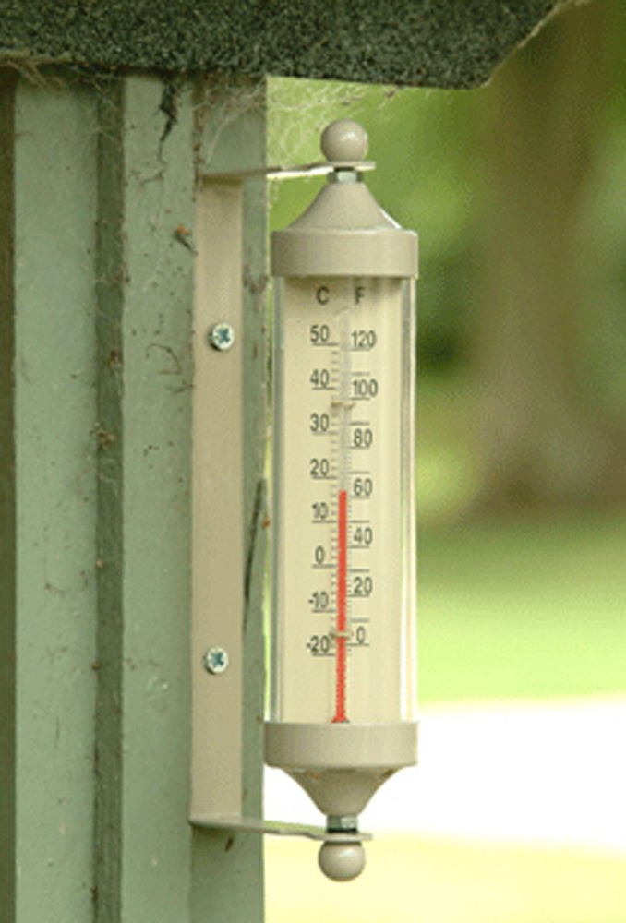
Temperature
Temperature describes how hot or cold the air is. Temperature is measured using a thermometer.

Slide 6
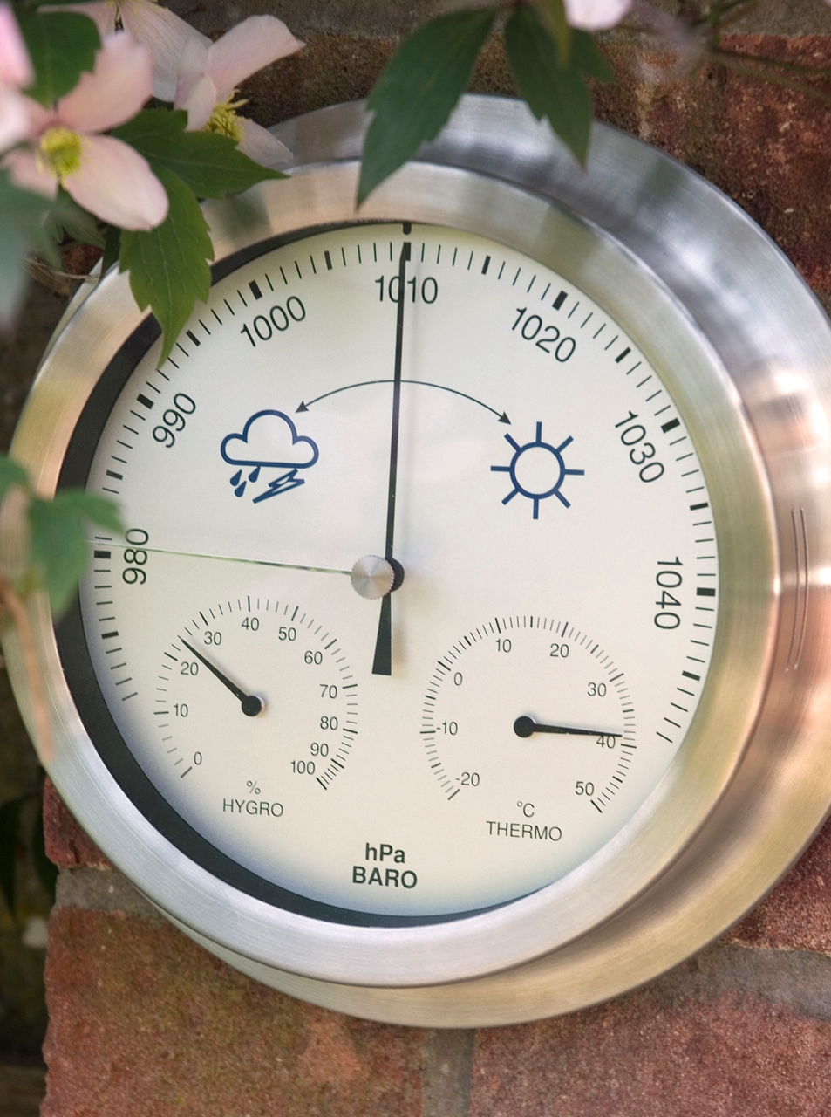
Air Pressure
Air pressure measures how close together the air molecules are. Air pressure is measured using a barometer.

Slide 7
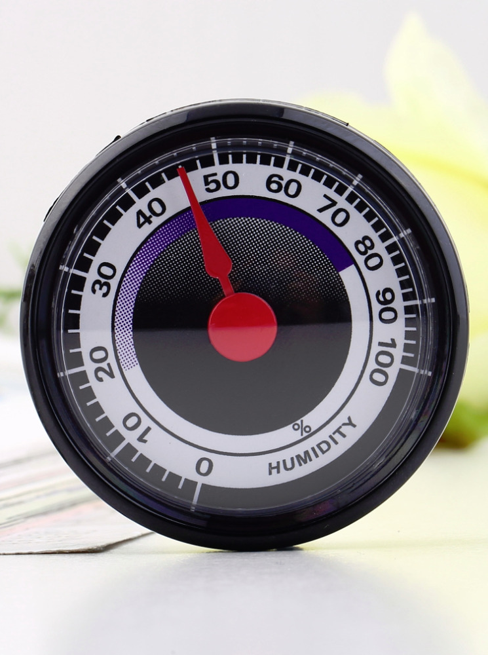
Humidity
Humidity describes the amount of water vapor in the air. Humidity is measured using a hygrometer.

Slide 8
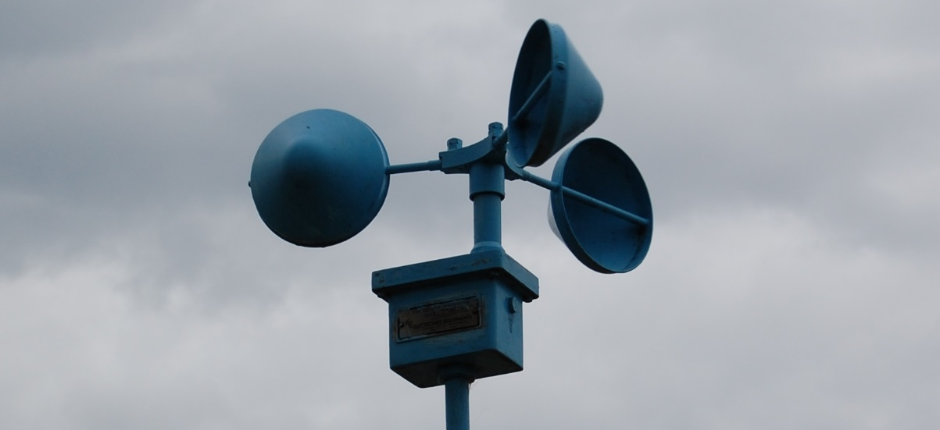
Wind Speed
Wind speed measures how fast the air is moving. An anemometer is used to measure wind speed.

Slide 9
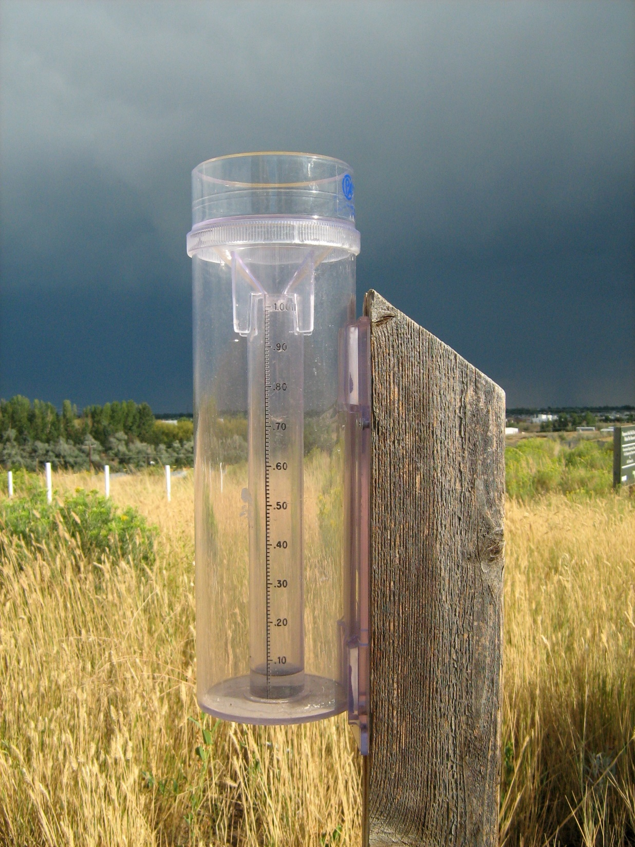
Precipitation
Precipitation is the amount of rain or snow that falls. A rain gage can be used to measure precipitation.

Slide 10
Wind Direction
Wind direction describes in which direction air is moving. A wind vane can be used to determine wind direction.

Slide 11
What is Weather: Key Questions
What is weather?
2. What factors of weather can we observe and measure?
3. What tools do we use to measure weather factors?

