Slide 1
Lesson 2:
Temperature, Pressure, and
Humidity

Slide 2
Temperature and Pressure
Air is made up of molecules that are constantly moving. As air warms up, these molecules move faster and bump into each other, increasing the space between molecules. Because the molecules occupy more space, the air expands and becomes less dense. When air molecules expand in the same sized space, air pressure increases.

Slide 3
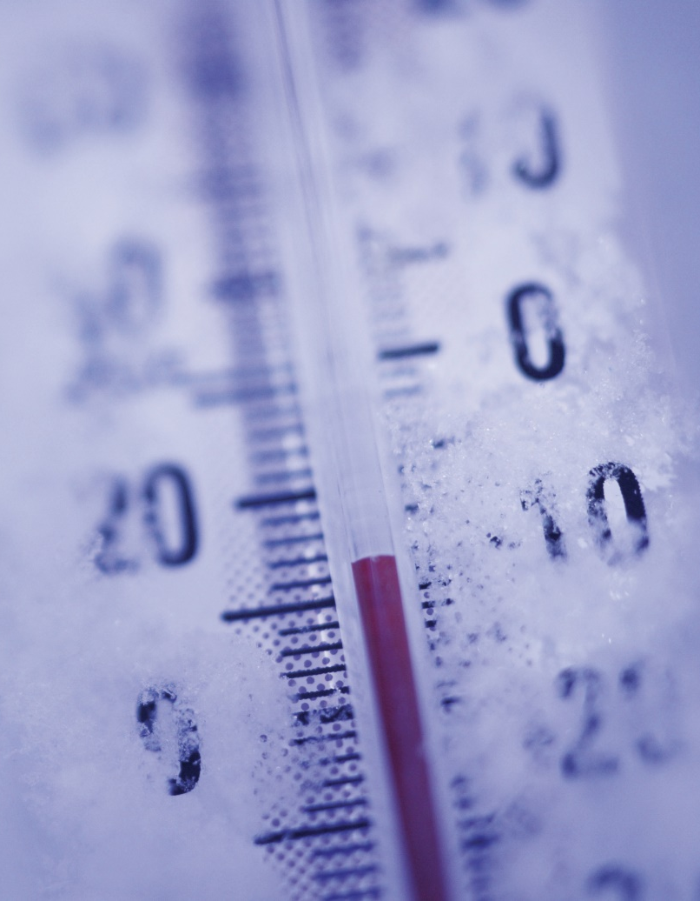
As air cools, the molecules move more slowly and take up less room. As this happens, air pressure decreases.

Slide 4
Discovery Education Video:
Weather Smart: Heat, Wind, and Pressure
The sun is highlighted as the driving force behind weather and the source of energy for our planet. Animations and video examples show the uniqueness of the Earth's atmosphere and how air is set into motion as wind when it is heated unevenly. Heat, wind, and pressure are all connected.

Slide 5
Relative Humidity
Humidity describes the amount of water vapor in the air. Relative humidity measure the percentage of water vapor compared the capacity of the air. Because the molecules in warm air are more spread out, warm air can hold more water vapor than cold air.

Slide 6
High Pressure
High pressure weather systems are usually associated with clear skies and sunny weather.

Slide 7
Low Pressure
Low pressure weather systems are usually associated with cloudy skies and stormy weather.

Slide 8
Temperature, Pressure, and Humidity: Key Questions
1. What is air pressure? What factors affect air pressure?
2. What is relative humidity? Why can warm air hold more water vapor than cold air?
3. How can changes in air pressure be used to forecast weather?

