Slide 1
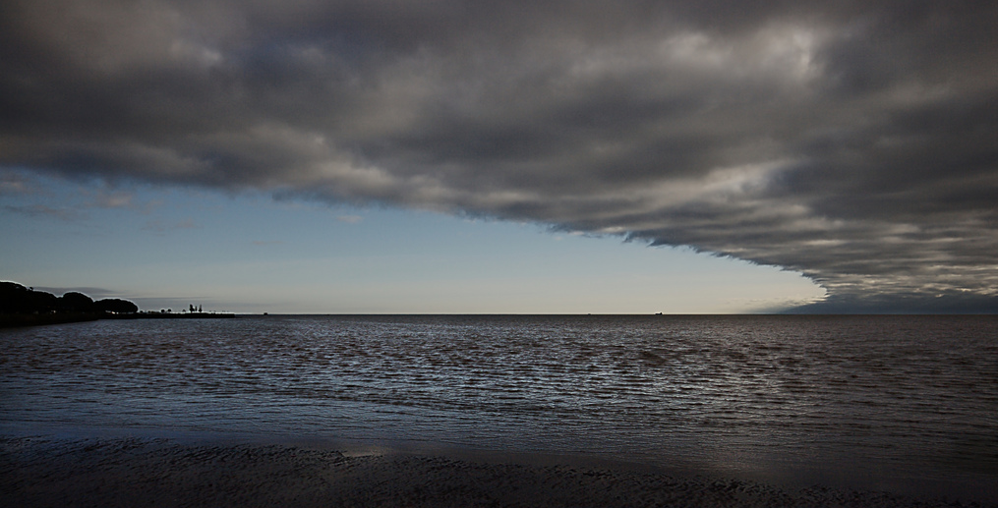
Lesson 4: Weather Fronts

Slide 2
Weather Fronts
When two air masses meet, they create a front. Fronts are classified based on the types of air masses. There are four major types of weather fronts. Different types of weather occur at each front.

Slide 3
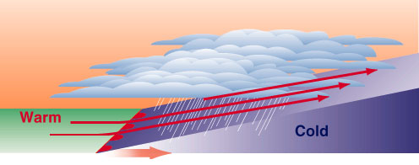
Warm Fronts
Warm fronts are associated with warm temperatures, high temperature, and light precipitation.

Slide 4
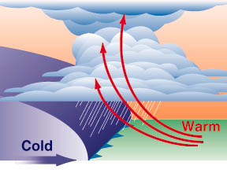
Cold Fronts
Cold fronts are associated with cool temperatures and thunderstorms.

Slide 5
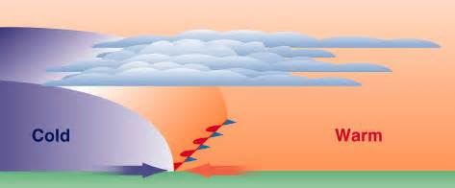
Stationary Fronts
Stationary fronts are associated with light precipitation and clouds.

Slide 6
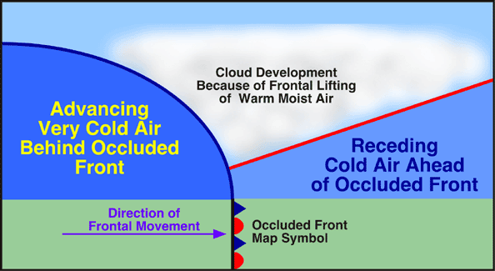
Occluded Fronts
Occluded fronts occur when a cold front overtakes a warm front and pushes it upward.

Slide 7
Discovery Education Video:
Fronts

Slide 8
Discovery Education Video:
Weather Fronts

Slide 9
Weather Fronts: Key Questions
What is a weather front?
2. Compare and contrast the different types of weather fronts
3. What happens to warmer air along a frontal boundary?

