Slide 1
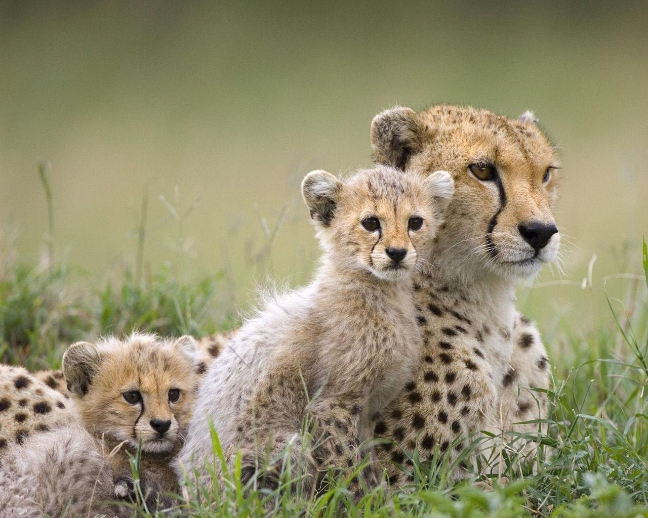
Lesson 1:
Organisms and Environments

Slide 2
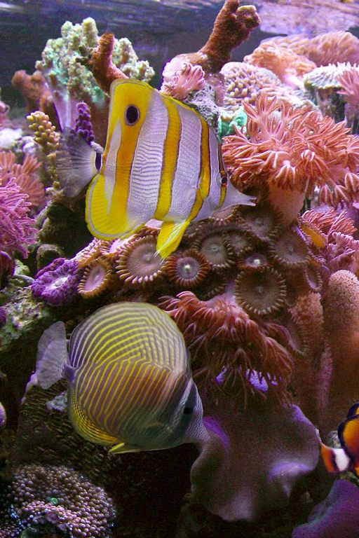
An ecosystem is a community of organisms interacting with their environment.
Ecosystems will have many different type of organisms and environmental factors that all work together to support one another.

Slide 3
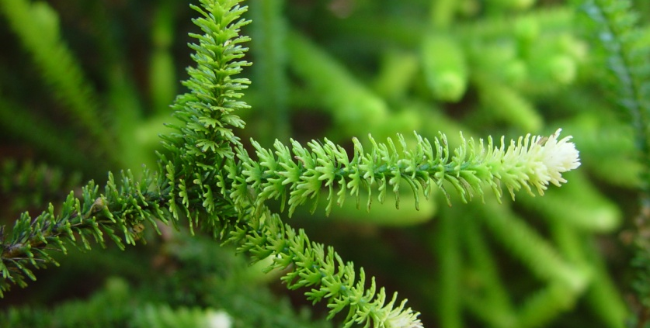
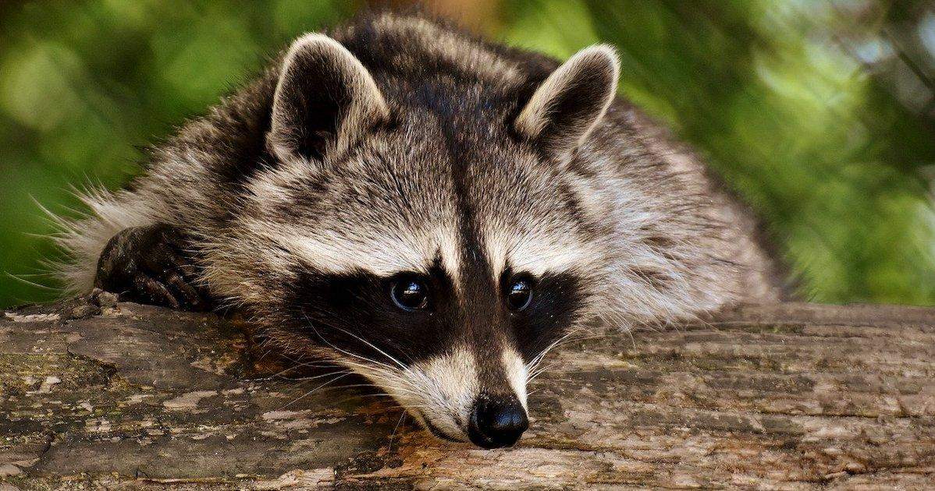
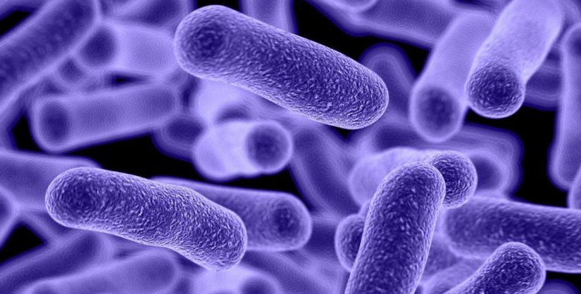
An organism is any individual living thing.
The three types of organisms in an ecosystem are plants, animals, and microbes.
Living organisms in an ecosystem are called biotic factors.

Slide 4
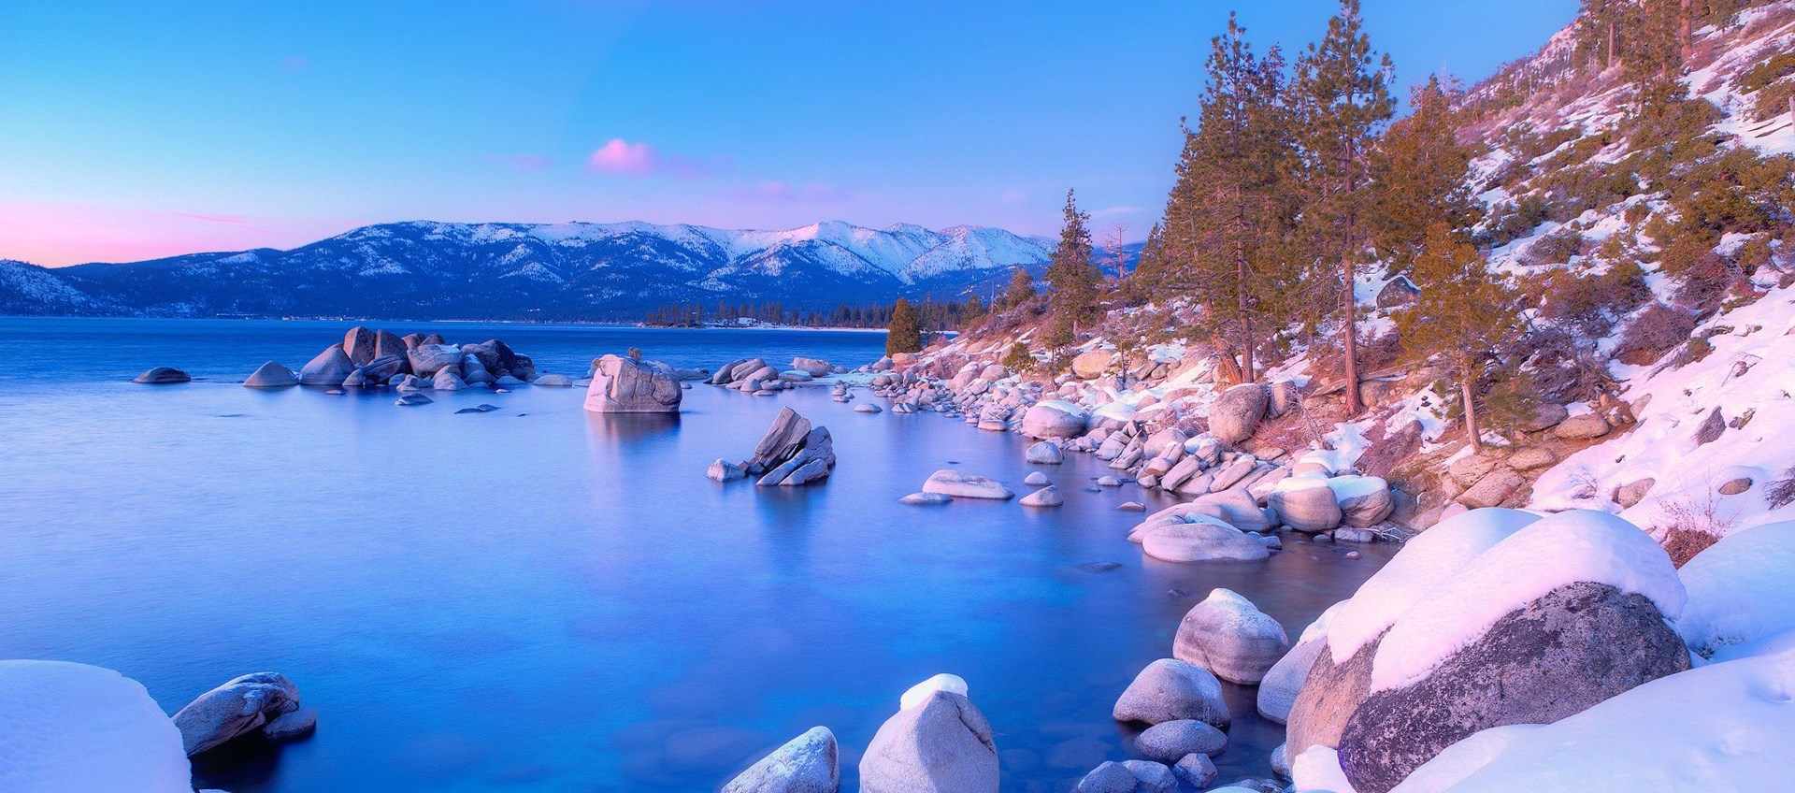
An organism’s environment is made up of the nonliving things that surround an organism.
Nonliving, abiotic factors include water, air, soil, rock, and climate.

Slide 5
A population is a group of organisms of the same species living in the same area.

Slide 6
A community is a group of different populations that live together and interact in an environment.

Slide 7
Discovery Ed. UK
What is a Habitat?
Explore four different habitats (rainforests, woodlands, seashores and oceans) and learn about the plants and animals that live there. Investigate food chains and the basic needs of living creatures.

Slide 8
Key Questions
1. What is an ecosystem? What types of things can be found in ecosystems?
2. What are biotic and abiotic factors?
3. What is the difference between a population and a community? Give examples of each.

