Slide 1
Lesson 2:
Changes in Ecosystems

Slide 2
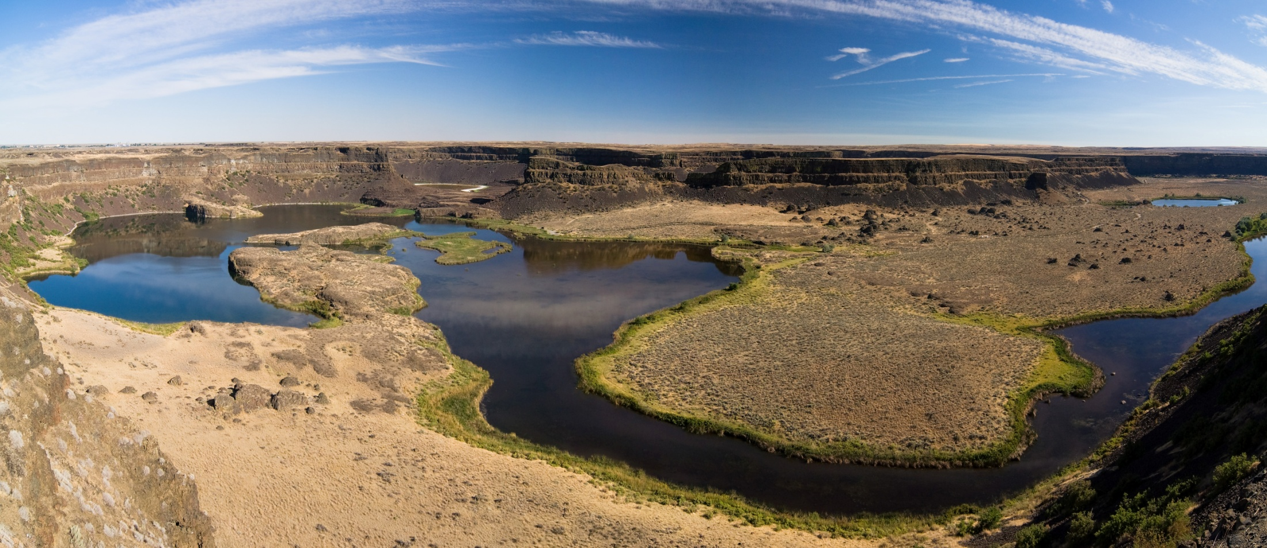
How are Ecosystems Changed?
Ecosystems can be changed by a variety of factors. These changes can be short-term or long-term.

Slide 3
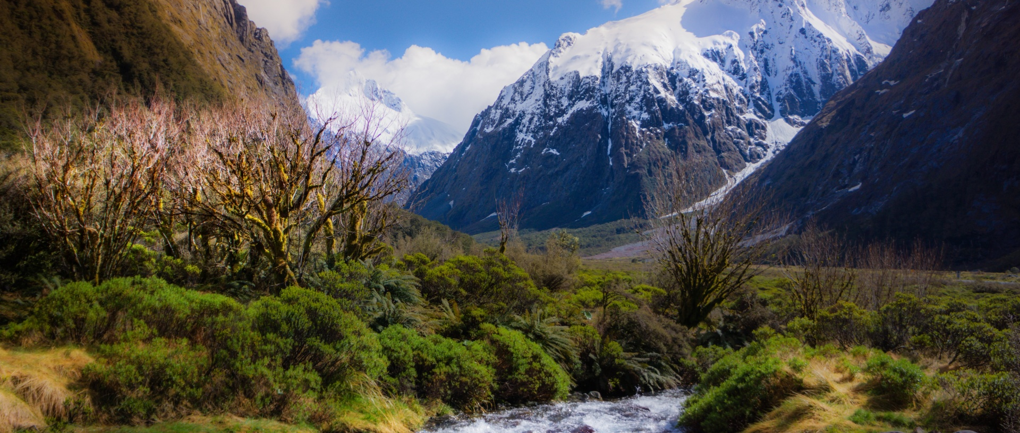
Changes that occur in an ecosystem can be either helpful or harmful to the ecosystem and its populations

Slide 4
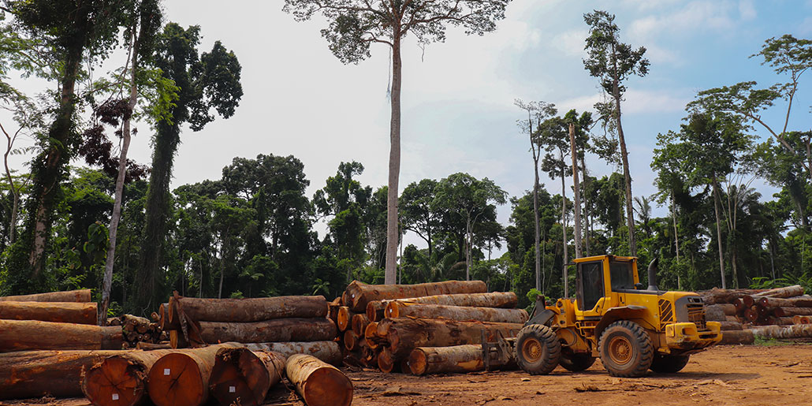
Some changes in ecosystems occur due to natural events, but many changes occur because of the actions of people.

Slide 5
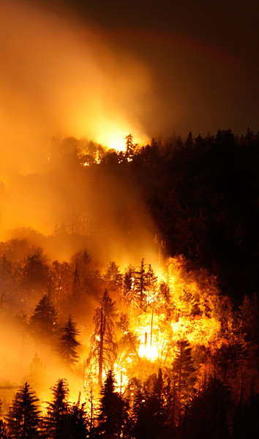
Short-Term Changes
Short-term changes are changes that can affect an ecosystem temporarily, but may eventually return to their original state.
Seasonal changes, forest fires, flooding, and drought are examples of short-term changes.

Slide 6
Long-Term Changes
Long-term changes are changes that can affect an ecosystem permanently, or may that may remain for very long periods of time.
Climate change, extinctions, weathering, and creation of new landforms are examples of long-term changes.

Slide 7
Key Questions
1. How can humans cause changes in an ecosystem?
2. How do short-term and long-term changes affect ecosystems?
3. What challenges might organisms in an ecosystem face as an ecosystem changes?

