Slide 1
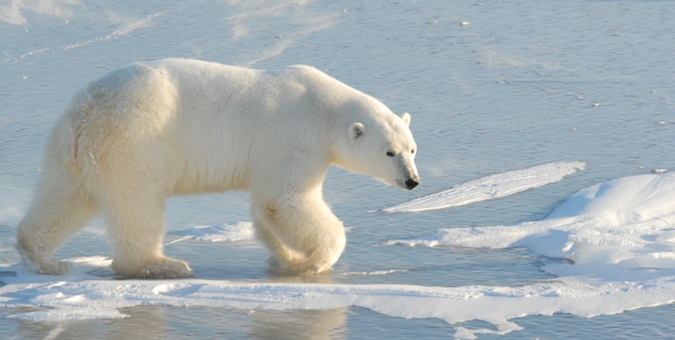
Lesson 3:
Adaptations

Slide 2
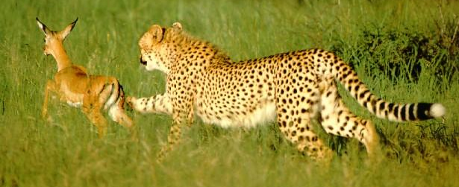
What are Adaptations?
Adaptations are the process by which the characteristics of a species change over many generations in response to the environment.

Slide 3
Adaptations help plants and animals survive in their environment.
These adaptations can help these organisms find food, protect themselves from predators, or survive extreme temperatures.

Slide 4
Examples of Adaptations:
Long necks of giraffes allow them to feed from taller trees or plants.
Lightweight bones of birds help them to fly with less effort.
Long, sharp teeth of carnivores allow them to eat meat more easily.

Slide 5
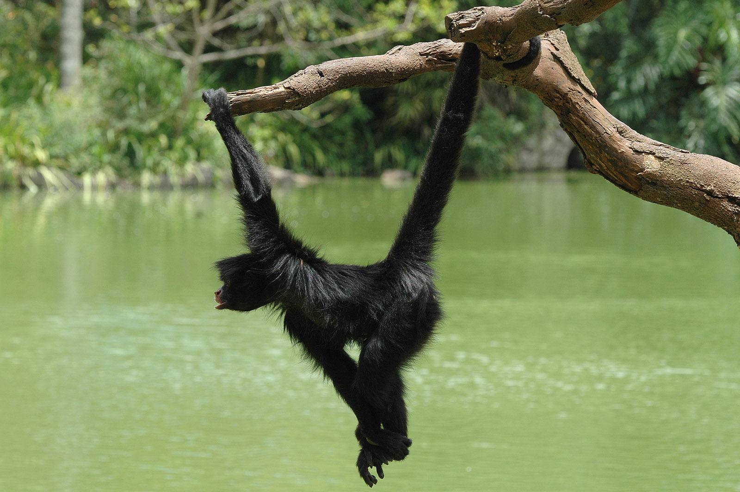
Observing Adaptations: Monkey

Slide 6
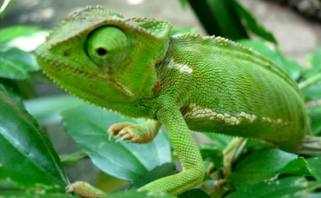
Observing Adaptations: Chameleon

Slide 7
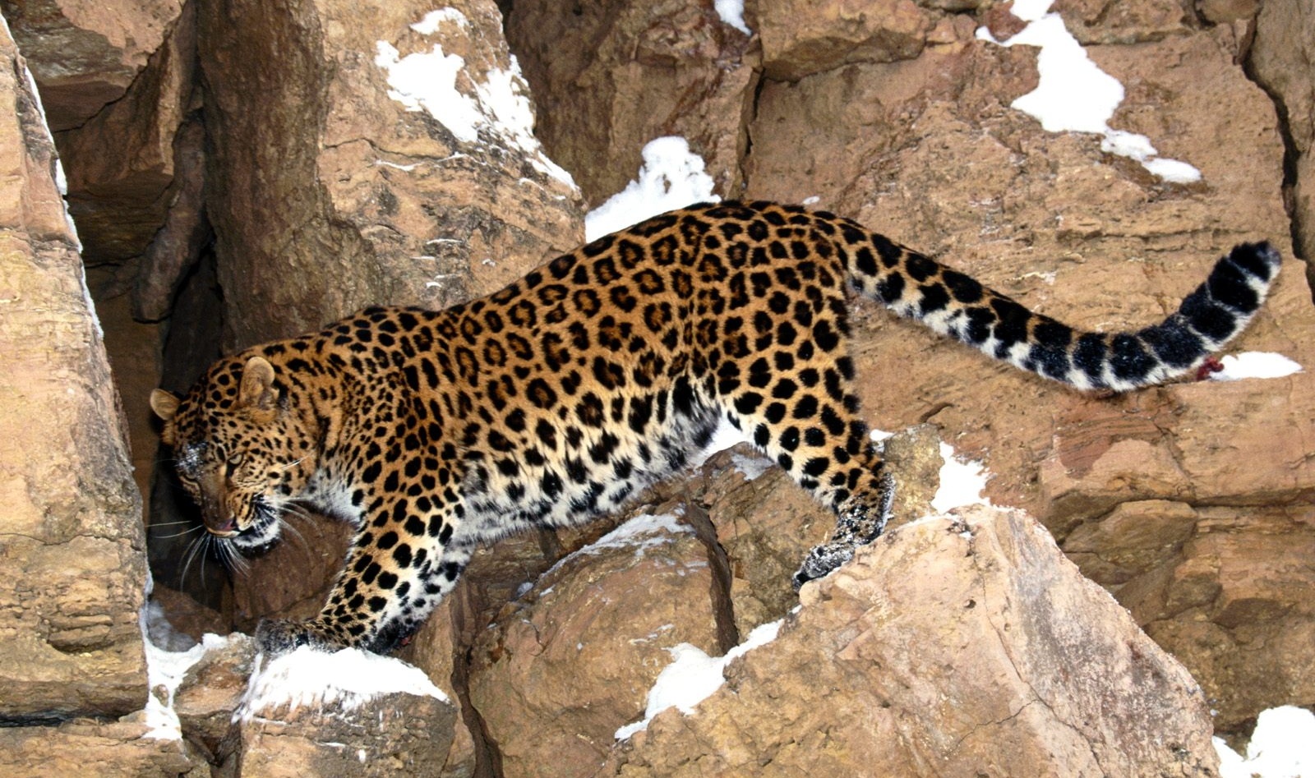
Observing Adaptations: Jaguar

Slide 8
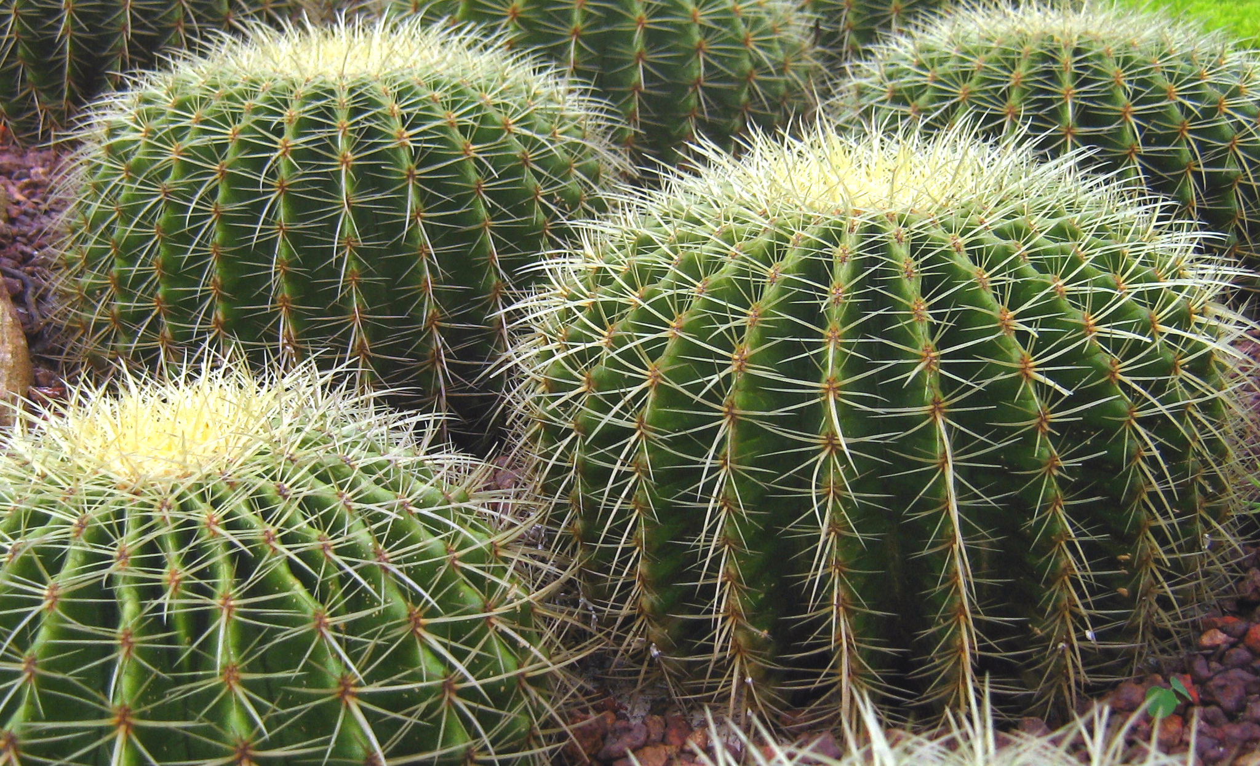
Observing Adaptations: Cactus

Slide 9
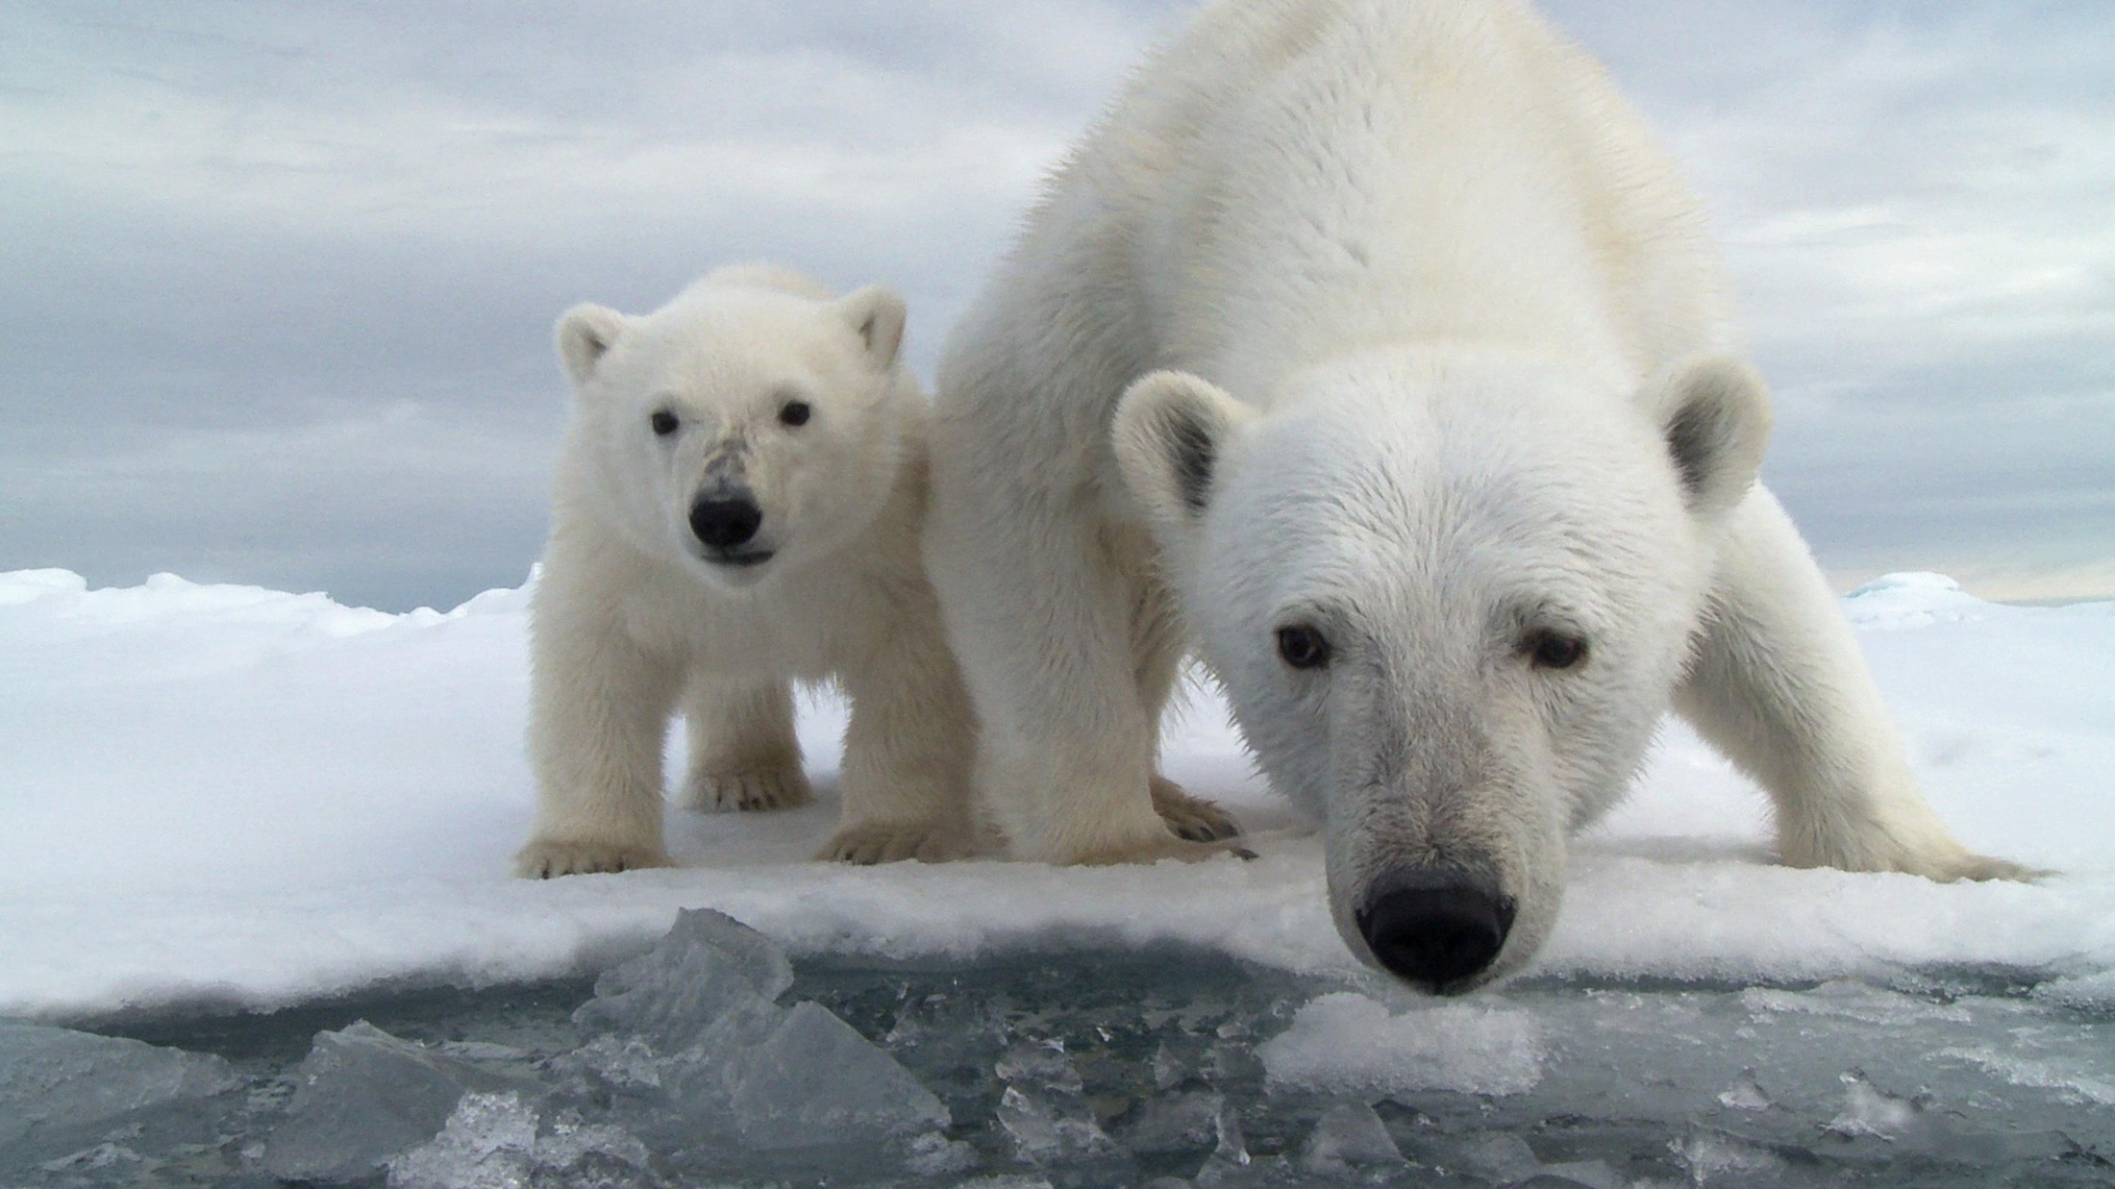
Observing Adaptations: Polar Bear

Slide 10
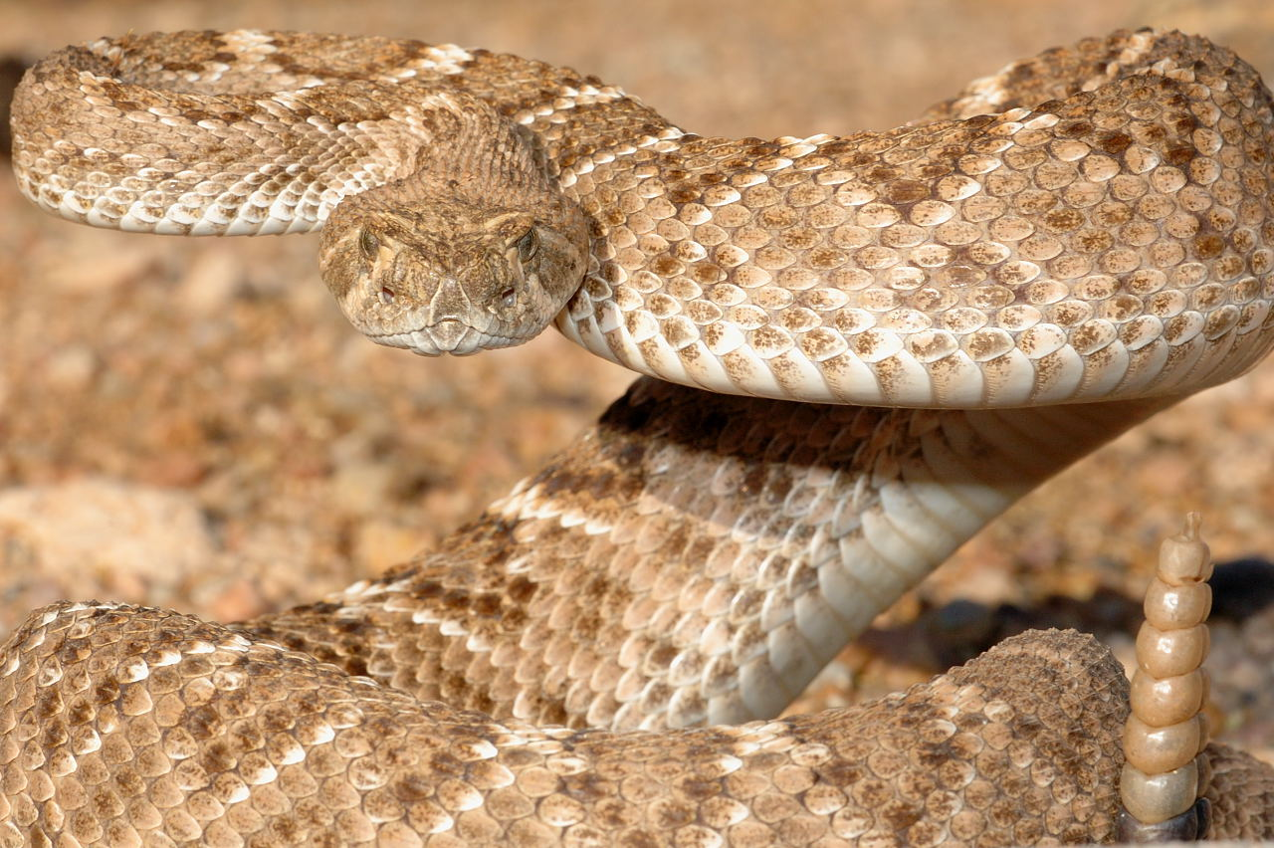
Observing Adaptations: Rattlesnake

Slide 11
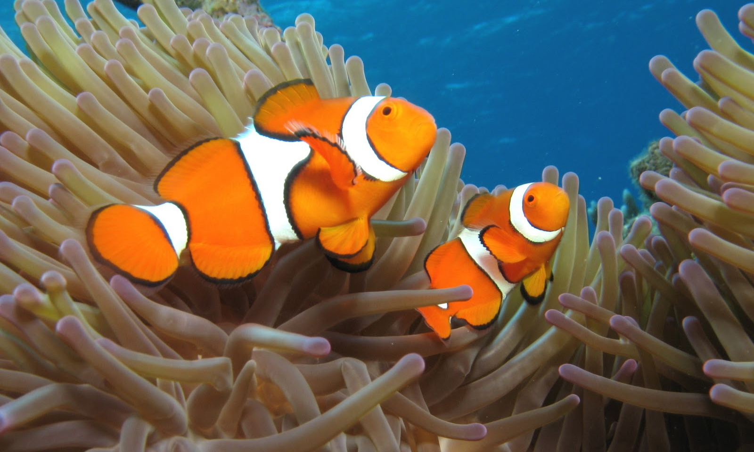
Observing Adaptations: Clown Fish

Slide 12
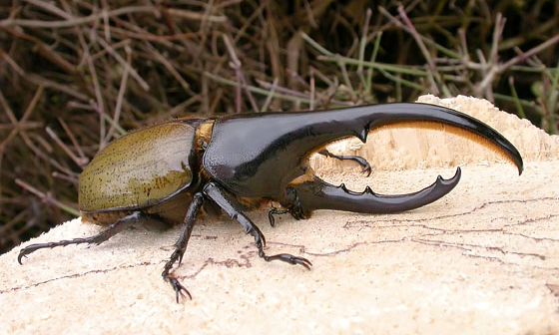
Observing Adaptations: Horned Beetle

Slide 13
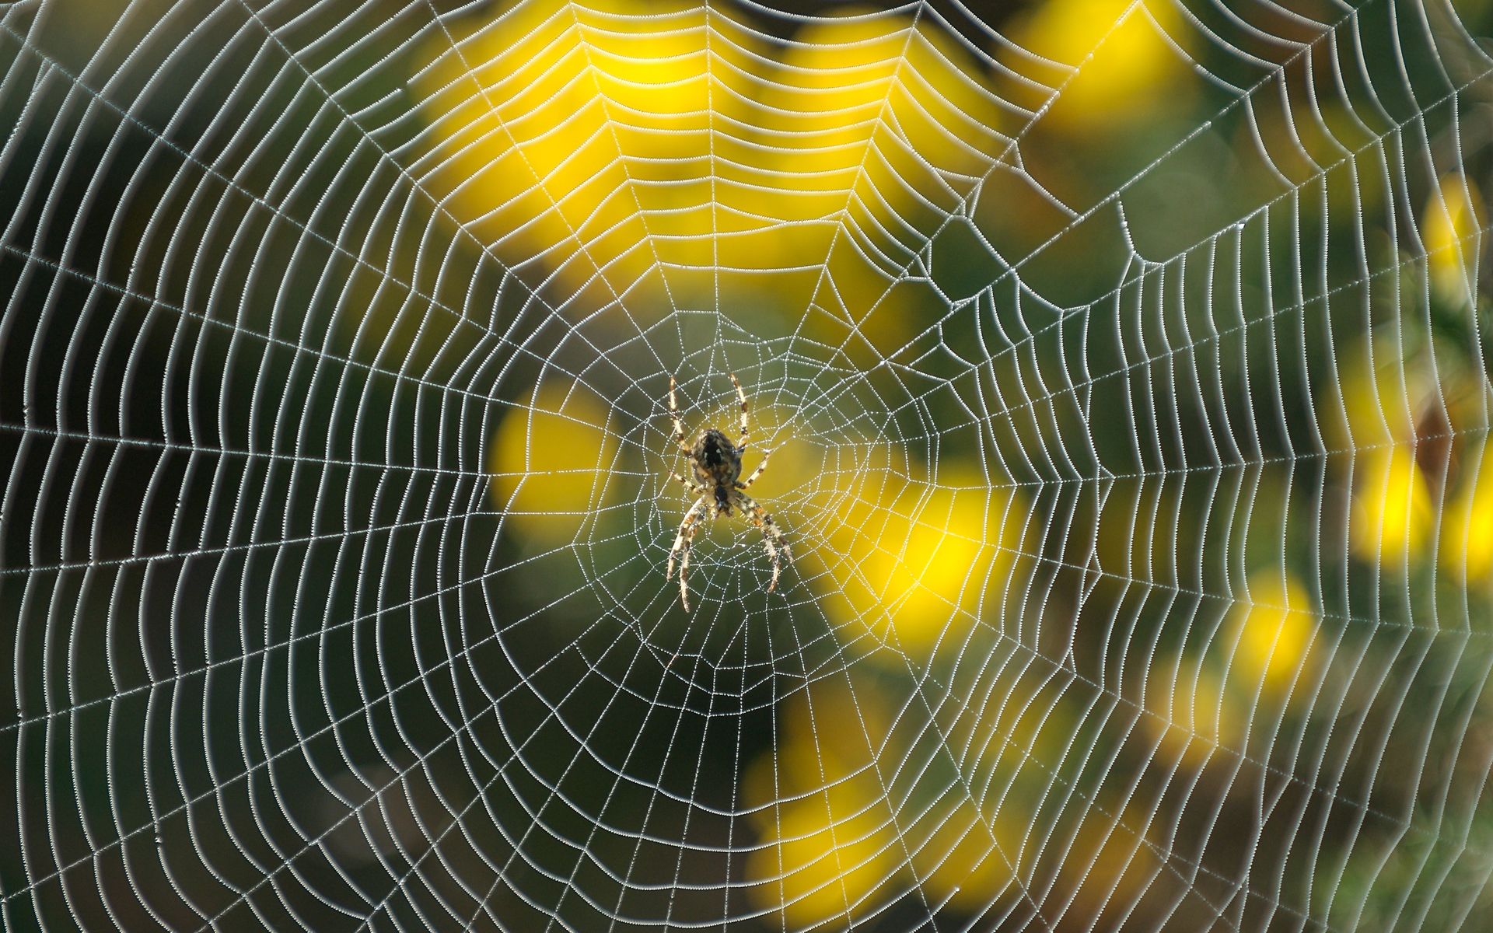
Observing Adaptations: Spider

Slide 14
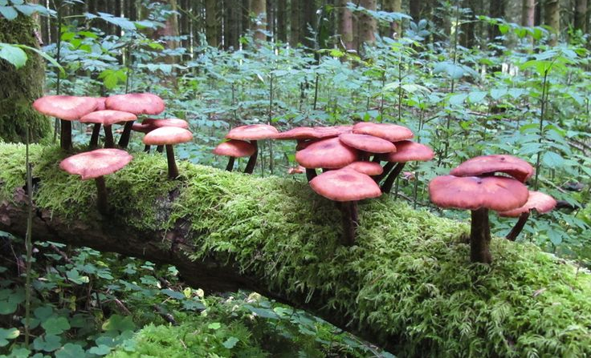
Observing Adaptations: Mushrooms

Slide 15
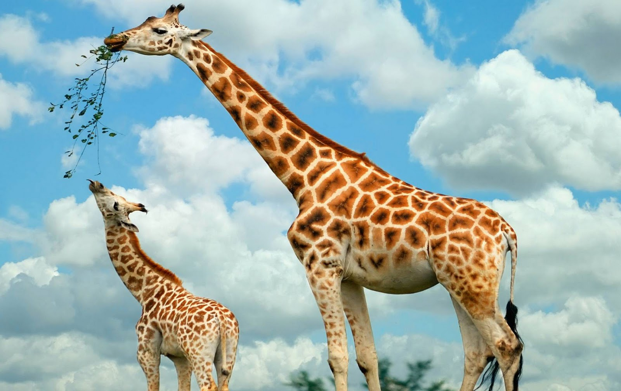
Observing Adaptations: Giraffe

Slide 16
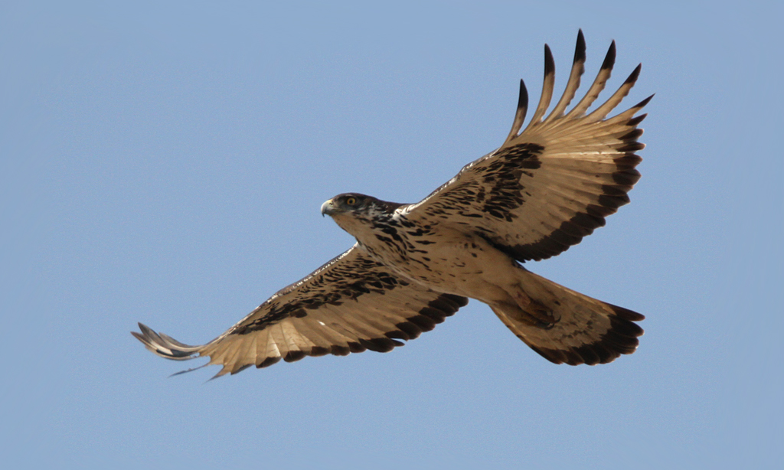
Observing Adaptations: African Hawk

Slide 17
Key Questions
1. What are adaptations? How do adaptations benefit an organism?
2. Choose an organism and give examples of some adaptations that it has.
3. What might happen to a plat or an animal placed in an environment that it is not adapted to? Why?

