Slide 1
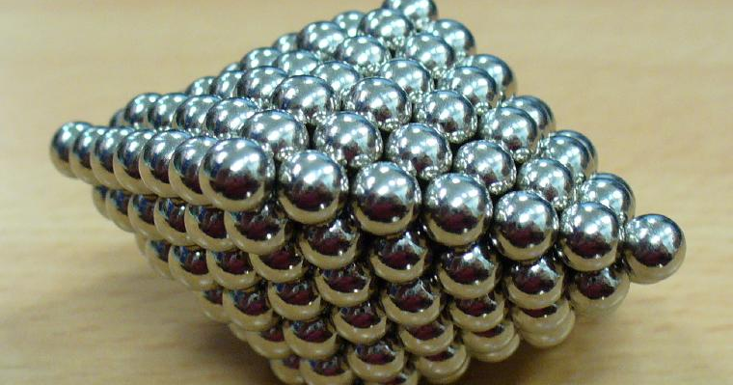
Lesson 4:
Magnetic Attraction and Repulsion

Slide 2
Discovery Education Video:
Maglev: Magnetic Levitation
This video discusses the principles behind magnetic levitation and how maglev trains operate.

Slide 3
A magnet can attract or repel other magnets.
This attraction or repulsion depends on how the poles of the two magnets are aligned.

Slide 4
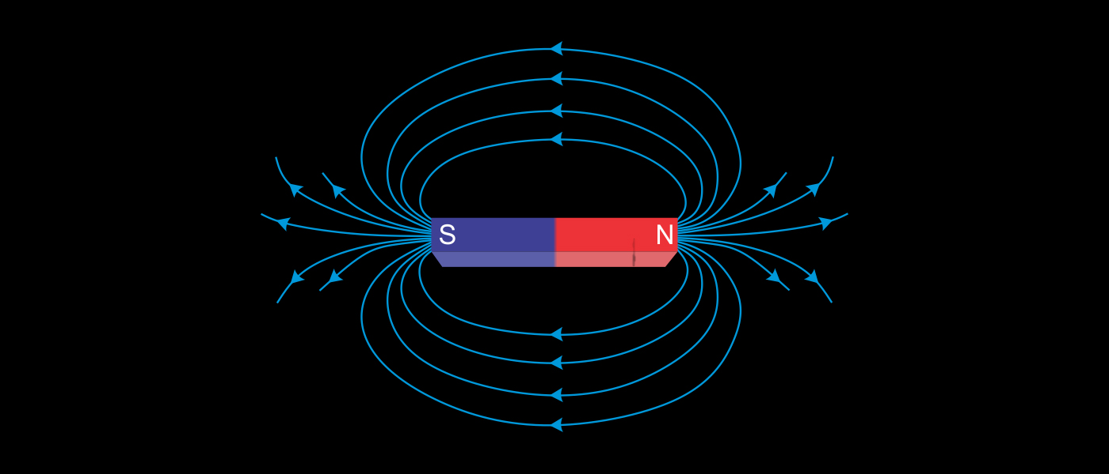
Each magnet has a north pole and a south pole. These poles are determined by the direction of the magnetic domain.
Attraction or repulsion occurs when the poles of two magnets are placed near one another.

Slide 5
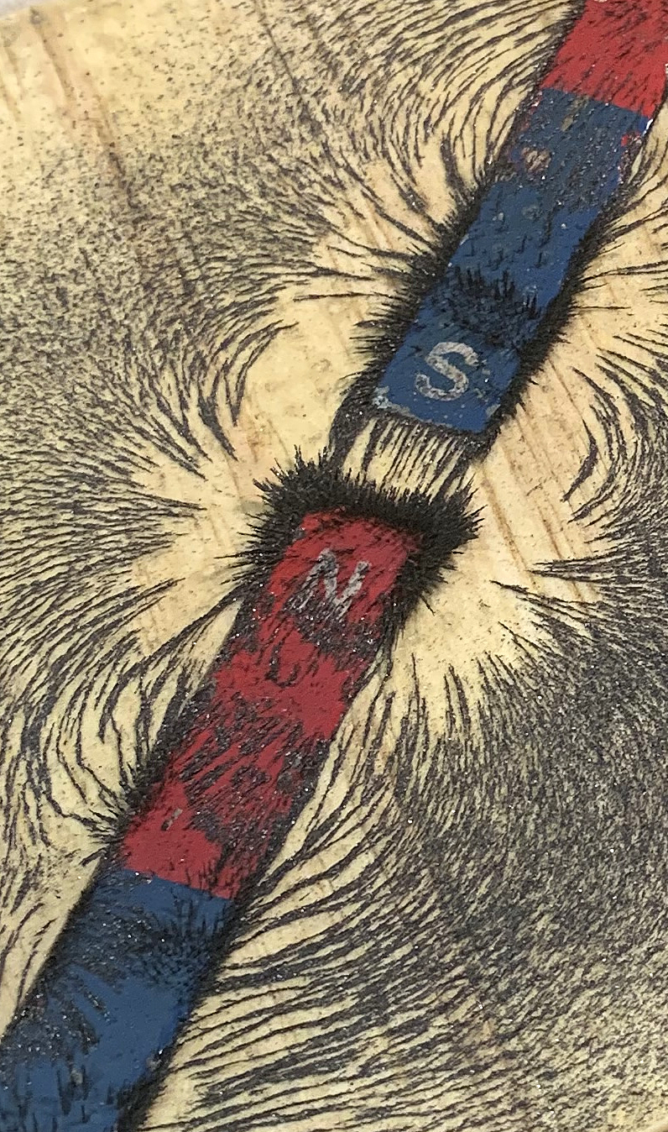
When a magnet attracts another magnet, it pulls the other magnet toward itself.
Magnets attract when their opposite poles face each other.

Slide 6
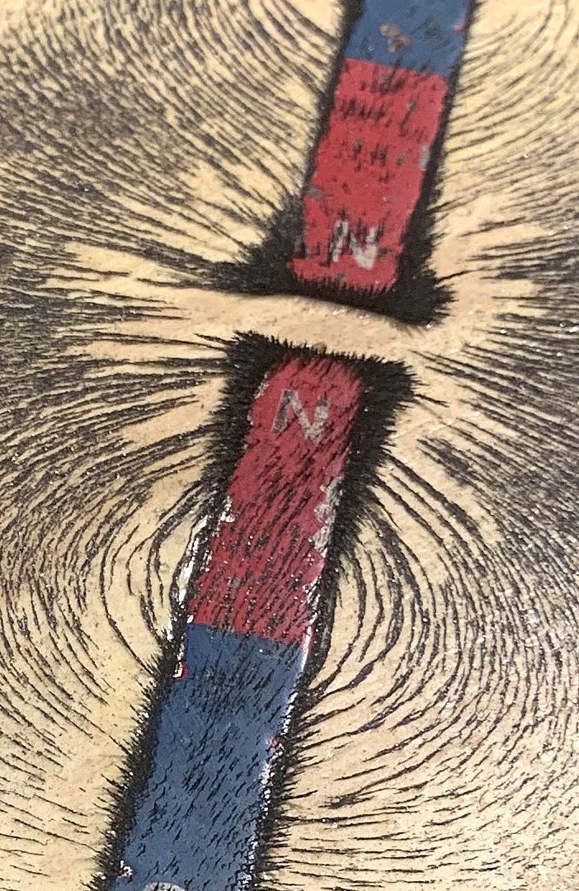
When a magnet repels another magnet, it pushes the other magnet away.
Magnets repel when their same poles face each other.

Slide 7
Attraction and Repulsion: Key Questions
What is magnetic attraction and repulsion?
When will two magnets attract one another? When will they repel?
Based on the Discovery Education video in the lesson, explain how a Maglev train uses magnetic attraction or repulsion to operate.

