Slide 1

Lesson 5:
Electromagnets

Slide 2
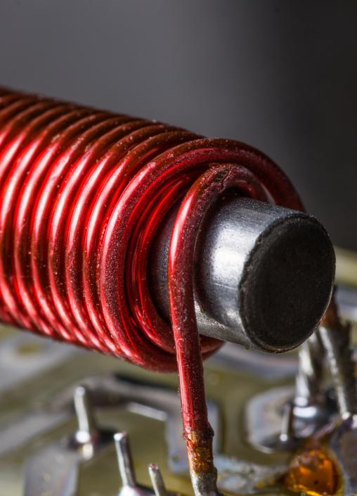
An electromagnet is a type of temporary magnet that uses an electric current to produce a magnetic field

Slide 3
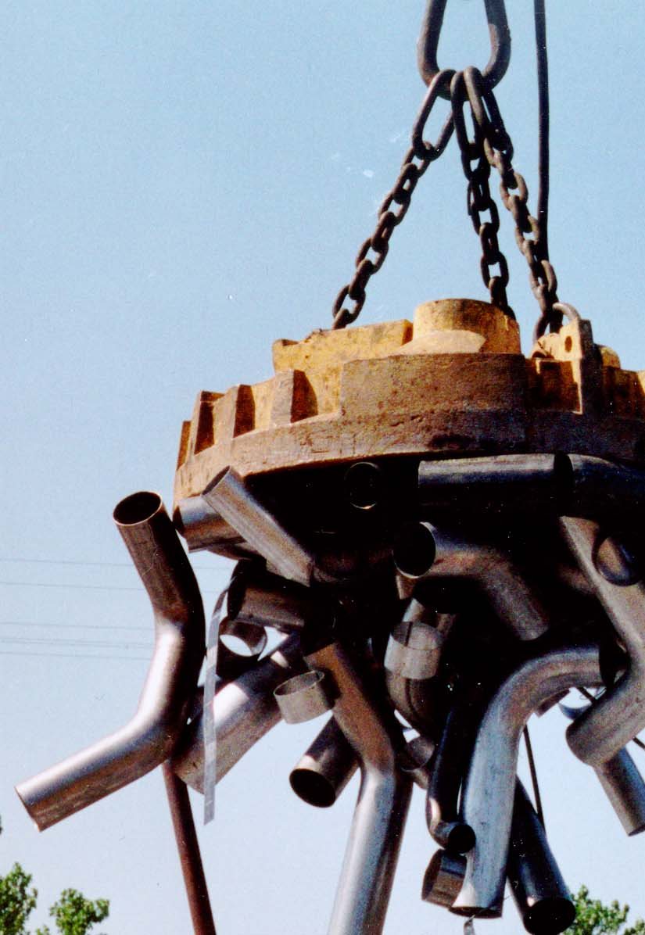
Discovery Education Video:
Junkyard Electromagnet
Lifts a 2,081-pound domino with a junkyard magnet and demonstrates the basics of electromagnetic power.

Slide 4
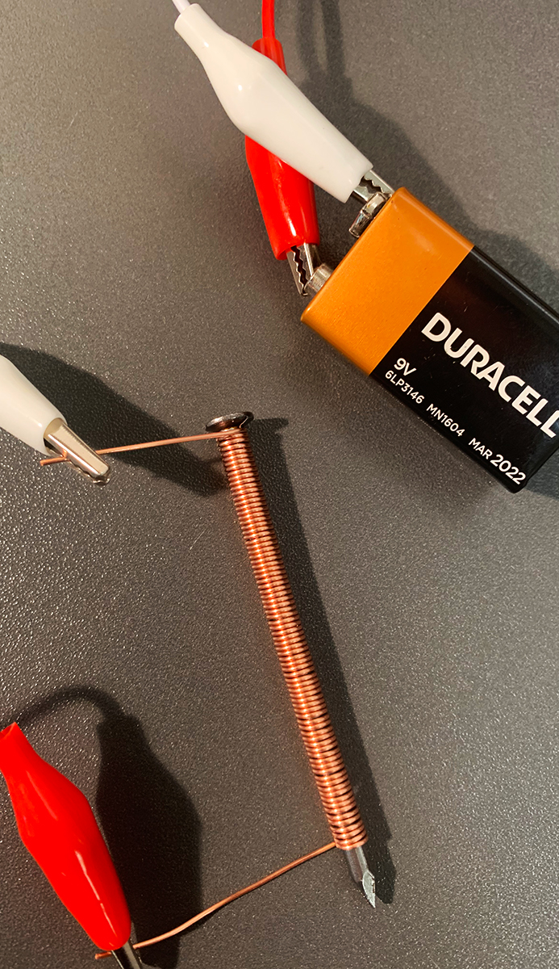
An electromagnet uses wire coiled tightly around a piece of ferromagnetic metal.
As electrical current passes through the wire, it creates a magnetic field.

Slide 5

Because an electromagnet is a temporary magnet that uses electrical current, its magnetic field can be turned on an off.
This is useful for small electromagnets in doorbells to large ones used in scrapyards.

Slide 6
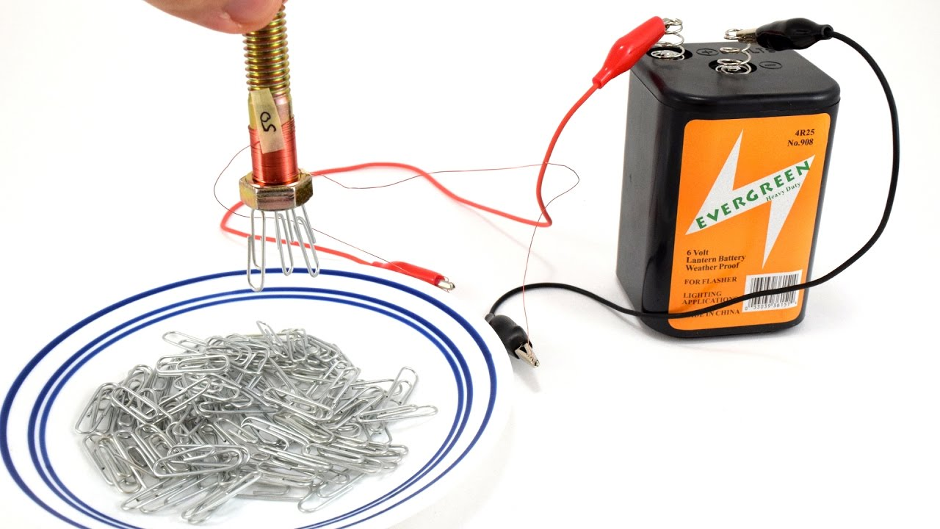
This type of temporary magnet gives us the ability to pick up and release objects or to turn switches on and off.

Slide 7
Electromagnets:
Key Questions
What is an electromagnet?
How is an electromagnet different from a permanent magnet?
In addition to the uses that were discussed in the lesson, what might be some other uses for electromagnets?

