Slide 1
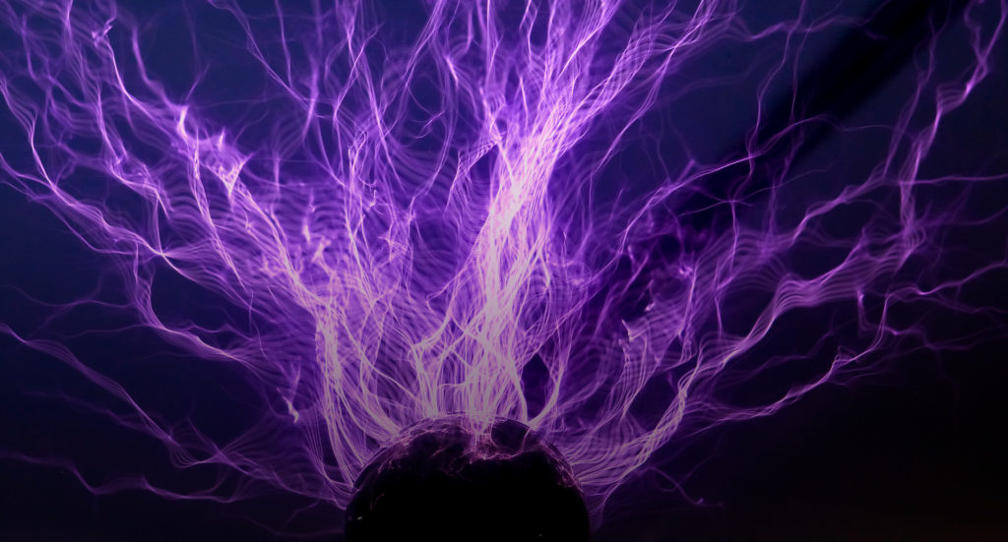
Lesson 6:
Static Electricity

Slide 2
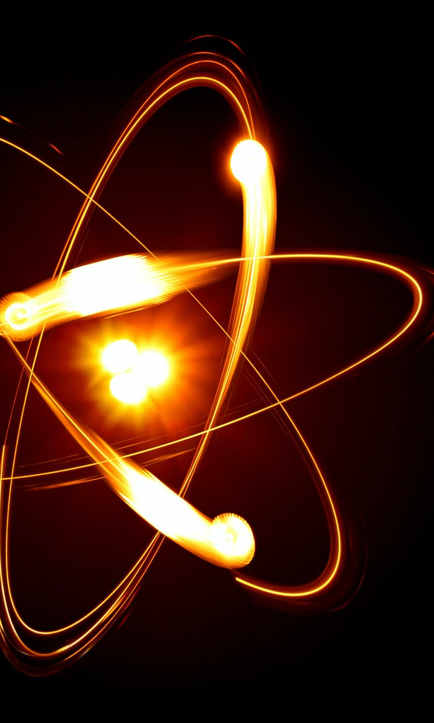
Electricity is a form of energy that results from the movement of electrons.
Electrons are negatively-charged subatomic particles found in atoms.
There are two basic types of electricity.

Slide 3
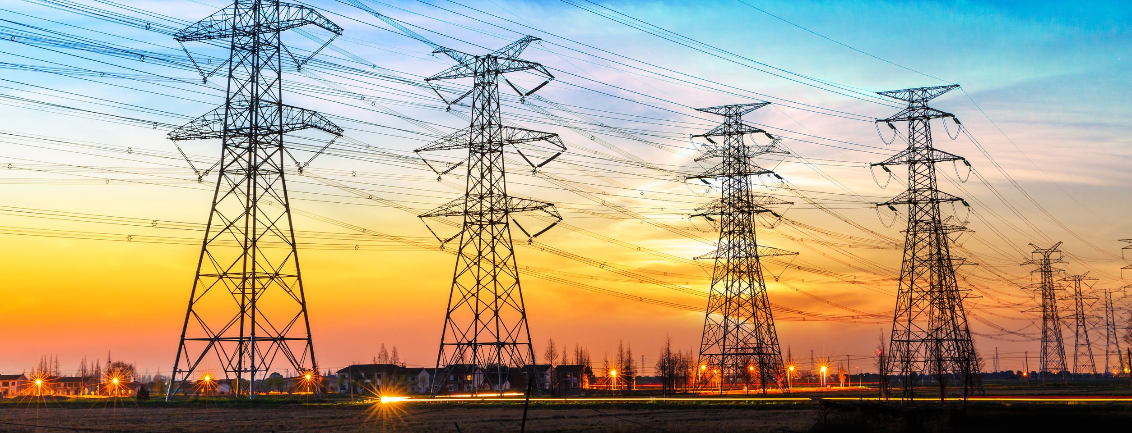
Electrical current is electricity that occurs when electrons move through a conductive material.
Electrical current is used to power electronic devices in our homes and businesses.

Slide 4
Static electricity is the buildup of electrons on an object.
This often is the result of friction, and these added electrons give the object a negative charge.

Slide 5
Discovery Education Video:
Static Electricity
Describes static electricity, which occurs between charged objects. The program discusses the composition of an atom, how electrons move from one object to another, and the friction that is required to generate static.

Slide 6
Static electricity can be discharged or jump from a charged object to a nearby conductive object.
This discharge can result in a small shock or the appearance of sparks.

Slide 7
Lightning bolts are an example of a large discharge of electricity.
A single lightning bolt can consist of up to one billion volts of electricity.

Slide 8
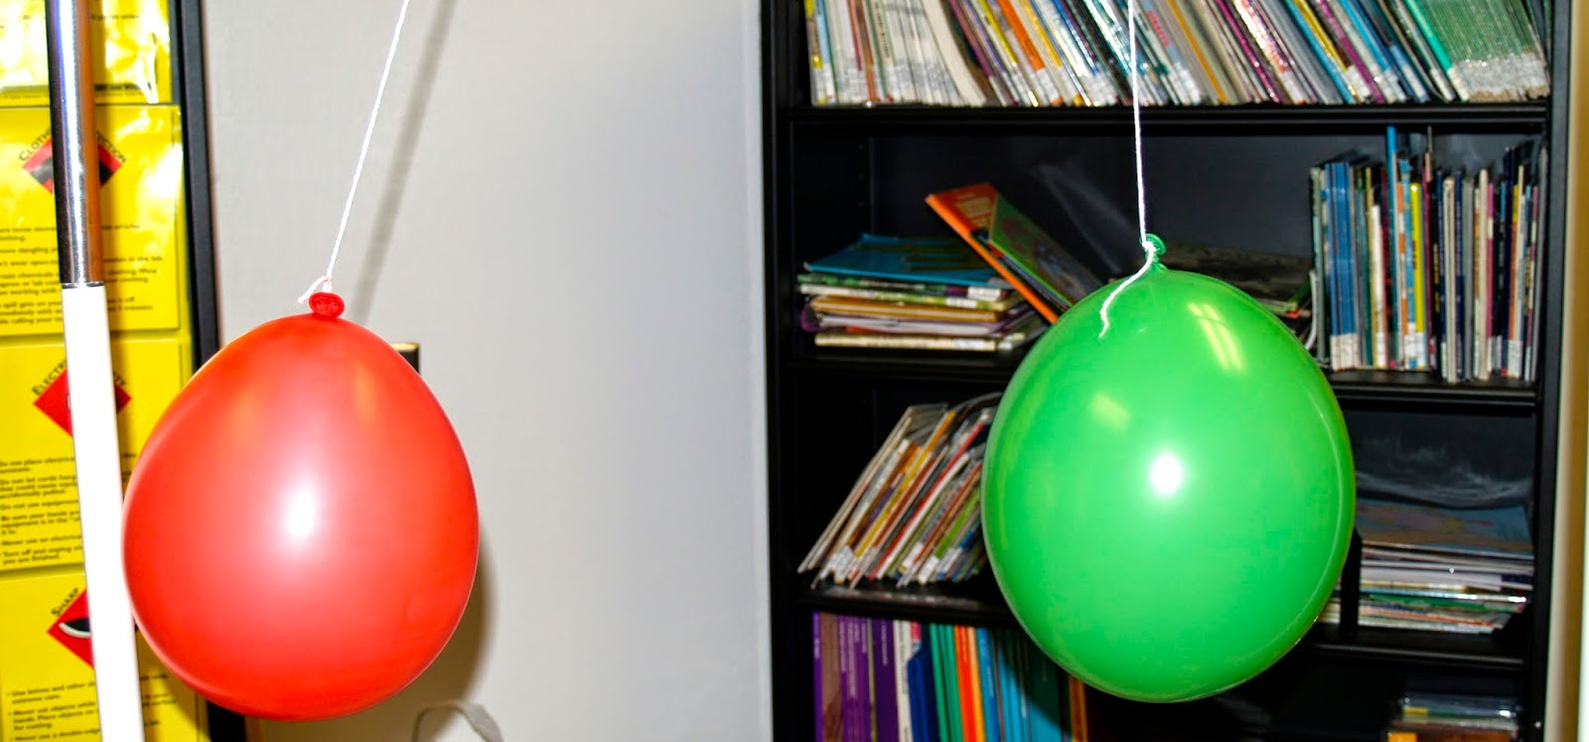
An electrically charged object can attract or repel another charged object, much like two magnets.
Two objects with a negative static charge will repel one another.

Slide 9
Electromagnets: Key Questions
What is static electricity?
Based on your experiences, what are some things that can cause a static charge?
How are electrically charged objects similar to magnets?

