Slide 1
The WWW head
The new kid in the block

Slide 2
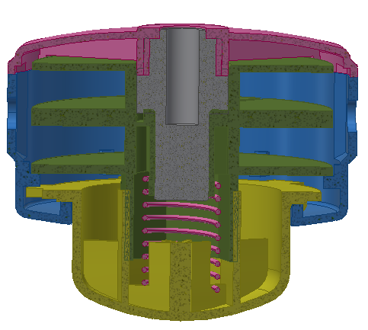
The WWW head is a member of a new generation of Externally Windable Trimmer heads protected under the US patent 11,632,903. The main distinction from the prior art is that the spool does not move axially within the housing, allowing for an unobstructed pathway for the trimmer line across the spool core when feeding the replacement line externally. The indexing and ratchet mechanism is confined to the bumping knob and the lower cover while the bumping knob is rotationally coupled to the spool. This type of layout prevents axial forces from the trimmer line to counteract the axial motion of spools as occurs in the prior art and to provide a repeatable performance due to the low friction of rotating and indexing elements.

Slide 3
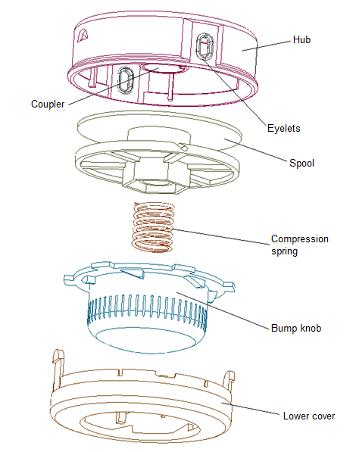
SIMPLICITY OF DESIGN
The WWW (Windable Weed Wacker) head is streamlined and comprised of the very minimum number of components which is equal or lesser than competitive units in the market. This means efficient manufacturing, lower cost and predictable function. Many competitive units have a complex design as a result of attempts to circumvent existing in-force patents or to avoid patentability issues involving the prior art.

Slide 4
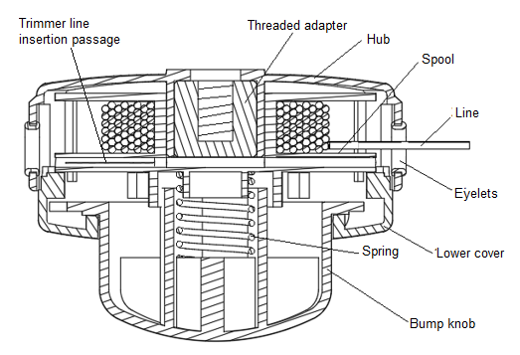
While maintaining the features that allowed the WWW head to be unique in design, it could be configured in several ways to accommodate various adaptations to current trimmer machines and to satisfy consumer preferences. The following configurations are described:
1.-The single chambered spool for machines with standard ¾” shaft with right of left threads.
The trimmer head design for a single chambered spool as shown in the right is a simple design comprised of four plastic components, one compression spring and one interchangeable adapter. The spool is pushed towards the adapter lower face creating a seal for the line passage crossing the spool core. Since the line feeding direction is independent of the head assembly rotation, the WWW head works on units with CW or CCW shaft rotation.

Slide 5
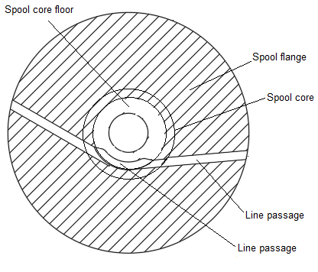
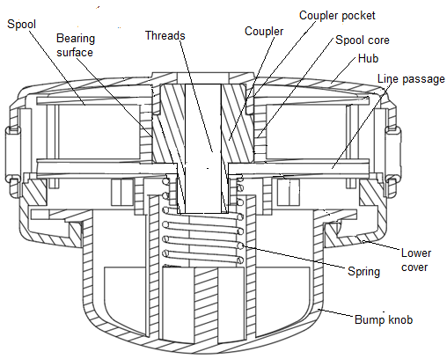
2.-A second configuration for the WWW head is very similar to the version previously shown, where a single chambered spool head is designed for units with drive shaft longer than ¾”. In this particular design the threaded adapter crosses through the spool core to allow the drive shaft to extend through. The internal line passage crossing the spool core has a special design that allows the line to be fed through the spool core without creating frictional resistance. The spool line passage is shown below along the cross section of the head to illustrate its configuration.

Slide 6
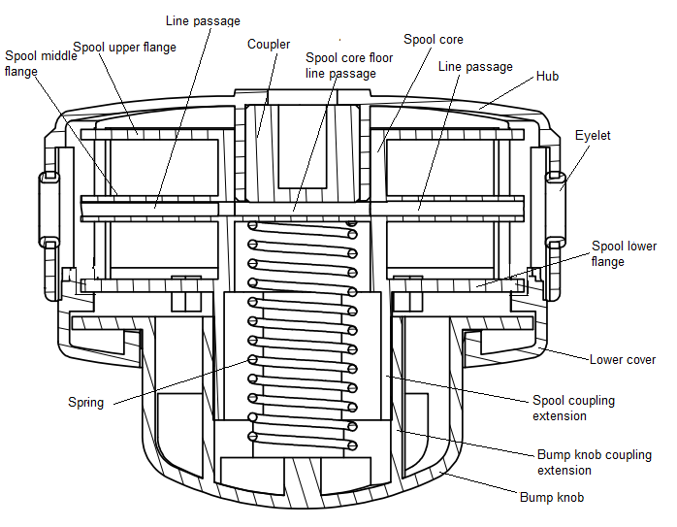
3.-A third configuration is similar to configuration #1 and instead of having a single chambered spool, this configuration has a double chambered spool. The remaining elements stay the same. In this configuration the line is fed through the spool middle flange and through the spool core floor. The coupler in contact with the spool core floor under the spring force, keeps the spool from moving axially. This configuration is described in a CIP of the US patent 11,632,903.

Slide 7
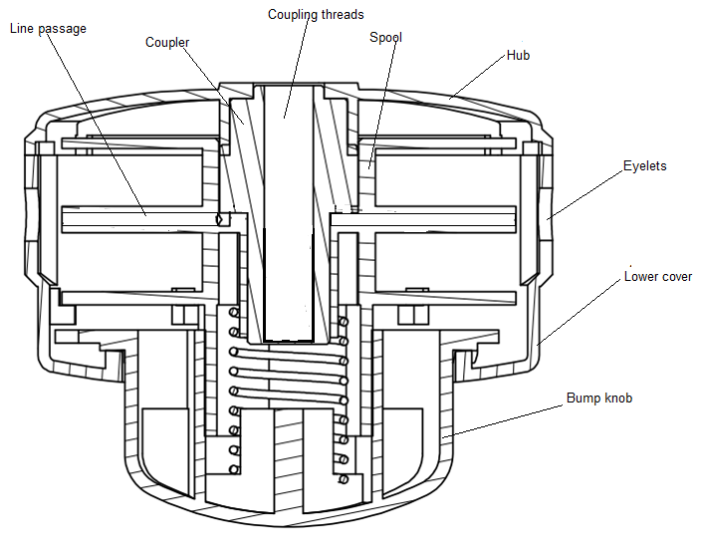
4.-A forth configuration also described by the CIP of US 11,632,903 is similar to the previous configuration #3 including a deeper coupler for drive units for short and long shafts. The line passage through the center core is similar to the curved line passage shown in the previous configuration #3.

Slide 8
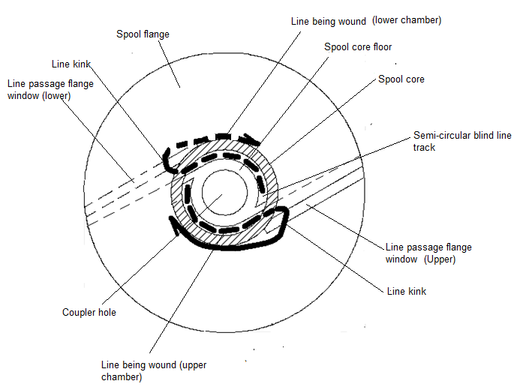
5.-A fifth configuration is provided by the spool design itself and could be used on all 4 previous configurations. The spool design for this configuration is to provide anchoring structures for the replacement line if it is preferred to insert the opposite ends of the replacement line through each eyelet without threading it completely through the spool. The spool in question has a couple of semicircular tracks over the spool core floor to provide sufficient friction to hold the line ends in place while it is wound into the spool core.

Slide 9
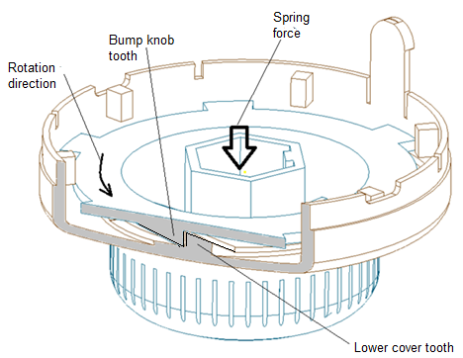
OPERATION DESCRIPTION
The WWW head operates as the traditional Tap-n-go head which will release the line when the center bump knob is bumped against the ground, thanks to its well known indexing mechanism. Traditional Tap-n-go head have the indexing mechanism elements built into the spool which has to be moved axially within the head to function. The WWW head breaks that traditional pattern and locates the indexing elements other than in the spool. Following is an explanation of its function.
When the head is in operation, the knob teeth vertical faces are engaged with the lower cover teeth vertical faces biased by the spring force, preventing relative rotation in the direction in which the windings of the line over the spool core are pulled by the centrifugal force acting over the line segments outside the head. Since the lower cover is rotationally and axially locked to the head housing, and the spool is rotationally coupled to the bump knob, there is no spool rotation, therefore line release is locked.

Slide 10
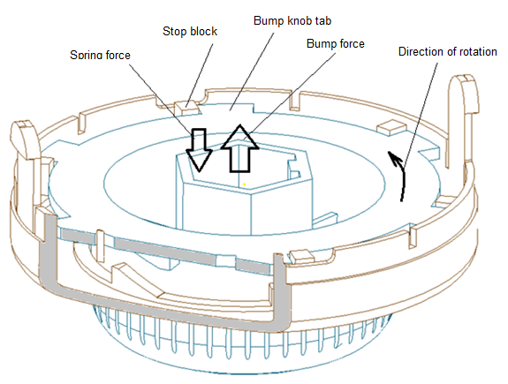
LINE RELEASE STAGE 1
When it is time to extend the cutting line outside the head, the operator proceeds to tap the head against the ground. This tapping action moves the bump knob against the spring force holding it in contact with the lower cover. This causes the disengagement of the knob teeth from the lower cover teeth, then the knob is pulled by the centrifugal force of the line wound over the spool, this allows a partial rotation of the spool till the bump knob tabs are stopped by the lower cover stop blocks. At this point a fraction of line is dispensed.

Slide 11
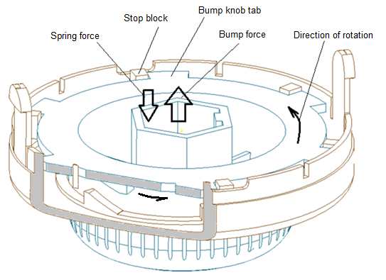
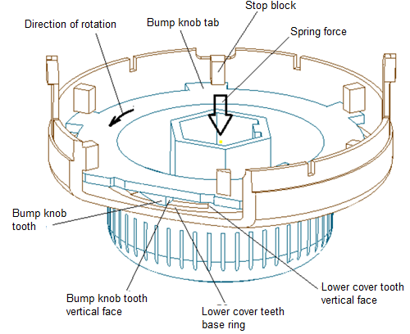
LINE RELEASE STAGE 2
As the head is lifted from contact with the ground, immediately the spring force moves the bump knob downwards in contact with the lower cover teeth base ring. This action disengages the bump knob tabs from the stop blocks and the centrifugal force of the line acting over the spool rotates the bump knob in the spool unwinding direction. The bump knob tabs move underneath the stop blocks and the bump knob stops rotating when the bump knob teeth vertical face engages the lower cover teeth vertical face one more time. An additional segment of line is released at this stage.

Slide 12
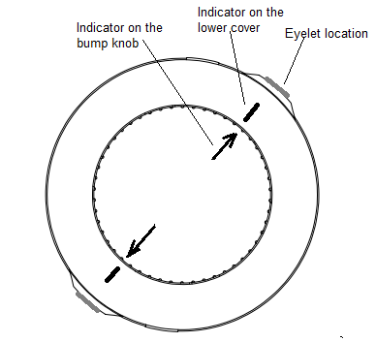
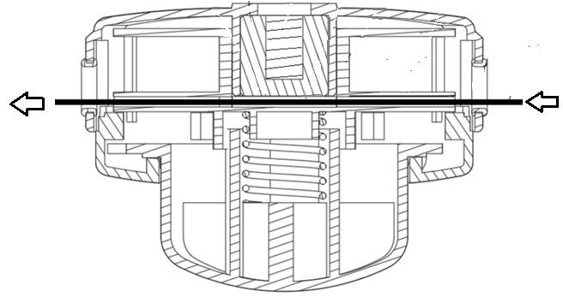
LINE REPLACEMENT-THREADING STAGE
When the line wound in the spool is gone, the replacement line needs to be re-wound into the spool. In the WWW head, this operation can be done without opening the head to extract the spool. First, the user will cut a predetermined length of weed eater line (Typically 6 to 8 ft).
Following, the user must turn the bump knob to a position where markings in the knob face aligns with markings in the lower cover face. This will allow the alignment of the entry point of the spool line passage with the eyelets. At this point, the user can push one end of the line through the line passage that crosses the spool diametrically till the end of the line shows at the opposite eyelet. Next, the user pulls the line out till both line lengths out of the head are approximately equal.

Slide 13
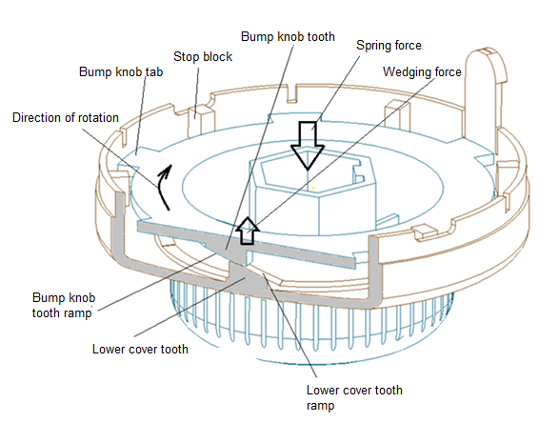
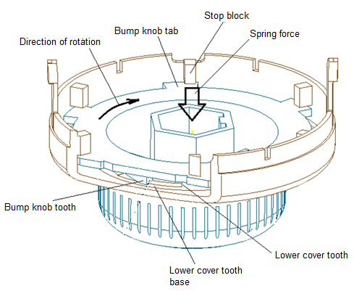
LINE REPLACEMENT-WINDING STAGE
Once the line is threaded through the head, the user can start winding the line onto the spool by turning the bump knob in the only direction it can rotate which is permitted by the internal ratchet mechanism. When the bump knob is manually rotated, the ramps of the bump knob teeth climb over the ramps on the lower cover teeth creating a lifting force against the spring force. This combination of actions allows the teeth of the bump knob to jump over the lower cover teeth which permits the rotation of the spool in the winding direction.

Slide 14
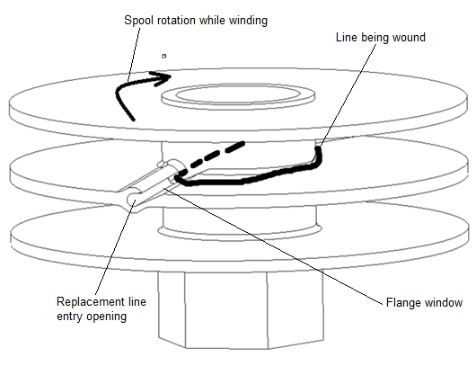
LINE REPLACEMNT-FINAL WINDING PHASE
As the bump knob is manually rotated in the spool winding direction, the section of line between the eyelet and the spool core escape from the line passage through the flange window to start wrapping around the spool core. The user stops winding when the segment of line outside the eyelets is approximately 4 to 5 inches. At this point, the unit is ready to operate.

Slide 15
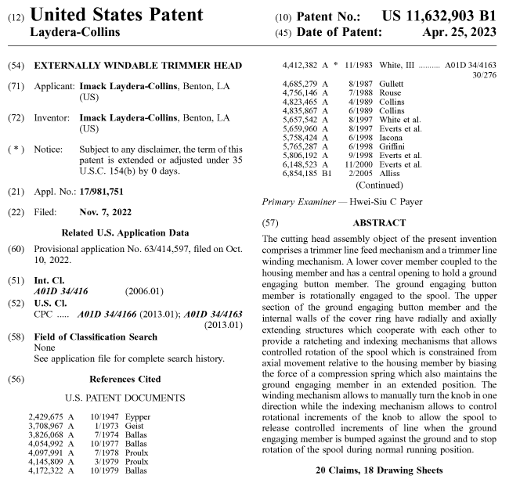

Slide 16
QUESTIONS, INQUARIES OR ADDITIONAL DETAILS ?
Contact information for Imack Collins
imackcollins@bellsouth.net
Imack@imackinations.com
(318) 934-3731
Https://imackinations.com

