Slide 1






Sustainability Leadership Team_________________
Background
“If everyone does a little we can change the world”
Notes:
Damian
The team has been meeting since early ‘23, in June ‘23 we initiated committee work
Committees met in July and August and…
In September, during our first official board of directors meeting, presented their initial thoughts

Slide 2

Sustainability Leadership Team_________________
Strategic Plan – Key Facts
Complex topic, no common framework
Many vested parties with varying messages
No one place operators can go to find resources
No one place resources can go to reach operators
Intermediaries filter/block/control operator access. “Bigs vs. Smalls”
Operator and resource organizations pressured to demonstrate sustainability
Operator and resource organizations, and consumers “want” it, but don’t fully “need” it…because don’t know how to “satiate” need and capture value…
…limiting organization’s and resource’s investment and consumer participation
“If everyone does a little we can change the world”
Notes:
Damian to lead this slide

Slide 3

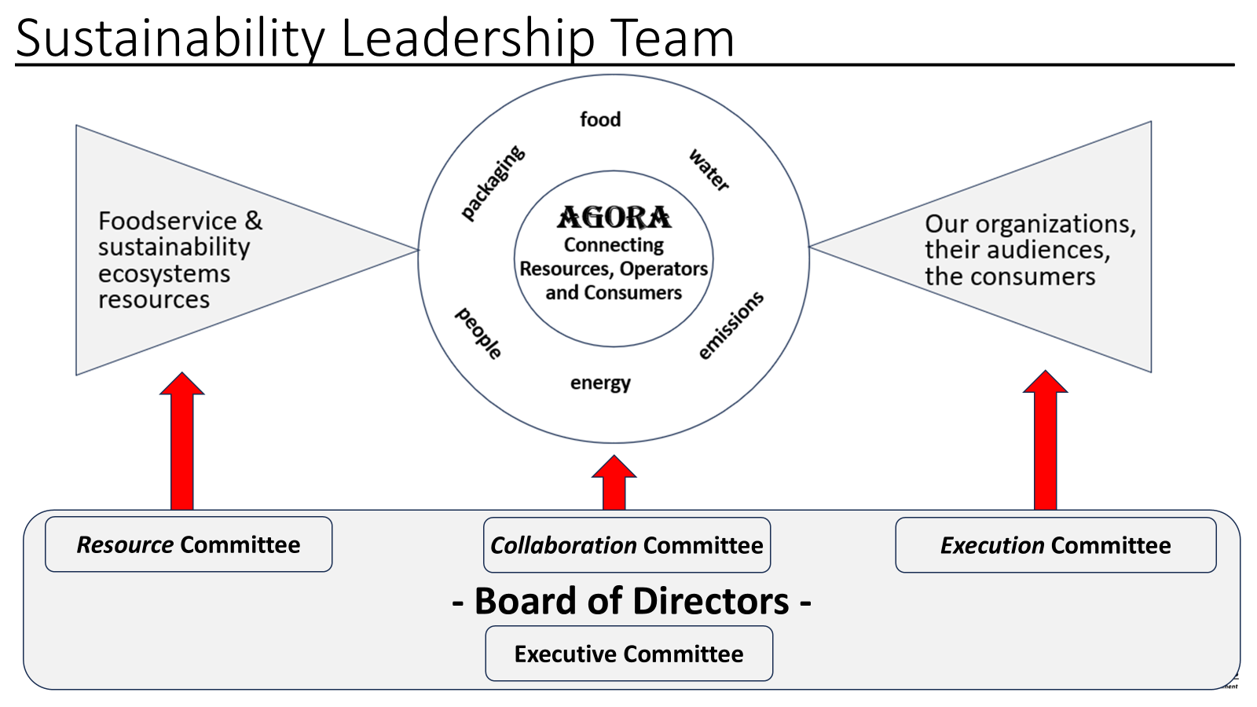
Sustainability Leadership Team_________________
2025 Initiatives
Sustainability Portal
Sustainability Forums
Sustainability Benchmarking Survey
Sustainability Planning Guide
Building local communities
Building culture of sustainability
AGORA LinkedIn Page
Associations, Groups & Organizations
“If everyone does a little we can change the world”
Notes:
(Damian)
There are 4 key initiatives the group is working on
…with our limited time today, we wanted to share some more about two
Before we get into details, a little more information about who we are.
(Turning it over to Kris)

Slide 4
Sustainability Leadership Team_________________
Collaboration Committee
Stephen O'Brien | NYC Schools
Carolyn Milea | New York University
Justin Williams | Wells Fargo
Midgie Cajayon | World Bank
Peter D'Angelo | Citi
Brittney Berling | Troup County School System
Alyssa Amarosa | Goldman Sachs
Renee Crampton | Grand Rapids Public Schools
Megan Varner | Michigan State University
Kaylee Swanson | Corewell Health
Carolyn Thomas | Macomb ISD
Execution Committee
Dan Ellnor | Jefferson Cnty Public Schools
Kevin D'Onofrio | SUNY Cobleskill
Kristine Cotton | JLL
Juan Gonzalez | Nutrition Services Dept
Bruce Kidney | Kettering Health
Graham Browning | John Hopkins
Keith Soster | University of Mich. Med.
Haleigh Savage | Kentwood Public Schools
Jim McGrody | Orlando Health
Denae Alva | Intermountain
Resource Committee
Jessica Shelly | Cincinnati Public Schools
Paige Ermer | Iowa State University
Anna Bohbot | Food Matters
Kaitlyn Welzen | Duke University
Richard A Green | Swarthmore College
David Mesagno | JPMorgan Chase
Nelson Quiles | New York City Schools
 | April | May | June
Resource | x | x
Collaboration | x | x
Execution | x | x
Executive |  |  | x
Board of Directors |  |  | x
Executive Committee
Notes:
Kris to Lead
Currently 33 members representing the 5 non-commercial segments
Erica, Damian and myself (along with Bertrand Weber) make up the current Executive Committee

Slide 5
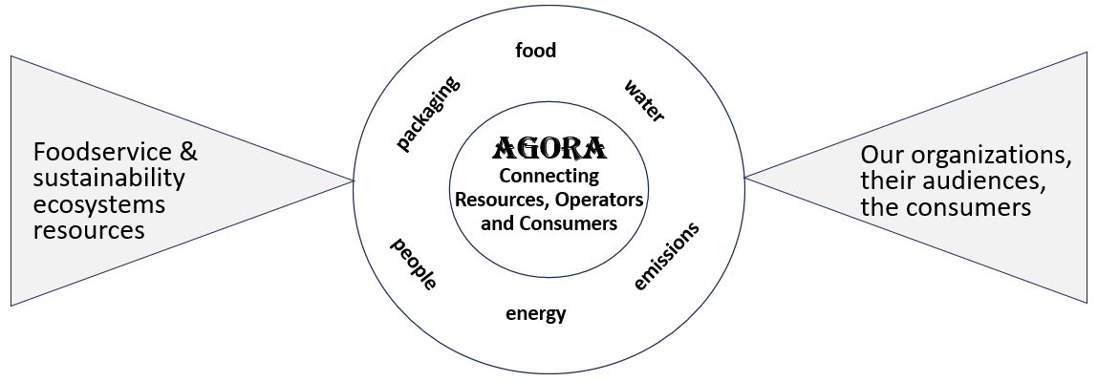
Sustainability Leadership Team_________________
- Board of Directors -
Resource Committee
Collaboration Committee
Execution Committee
Executive Committee
Notes:
Kris to lead this slide.

Slide 6
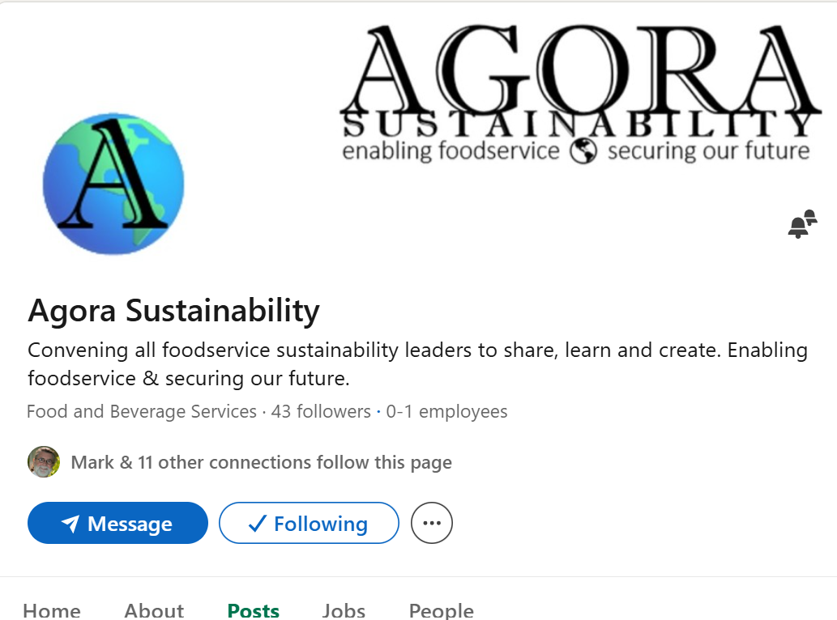
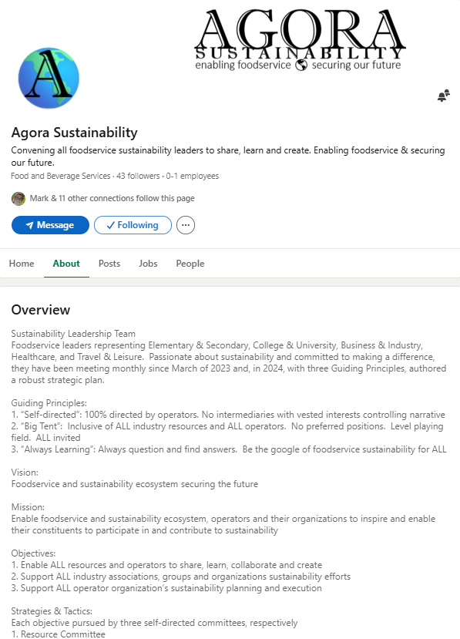
Sustainability Leadership Team_________________
“If everyone does a little we can change the world”
Notes:
Kris to lead
Thank Mark for being one of the first to follow our page
Review info in “Overview” section to describe who we are
Our page went live in February with our overview page, guiding principles, vision, mission, and objectives all laid out

Slide 7
Sustainability Leadership Team_________________
Perspective: The end-game
Non-commercial Locations People*
Elementary & Secondary 130K 60M
What need to do is…
Educate and inspire
Enable to participate
College & University 7K 20M
Business & Industry 20K 30M
Healthcare 6K 35M
Travel & Leisure 114K 61M**
Total 277K 206M
*Primary constituents only, e.g. Healthcare patients… and for every patient meal there are +3 served
**Greatly understated. 175M=number of people visiting Orlando annually for pleasure or business
“If everyone does a little we can change the world”
Notes:
(Kris)
According to industry sources, there are 227 thousand non commercial locations in the US touching over 200 million people annually
However, the number of people reached is greatly understated
These are just each segments primary audiences, e.g. healthcare and patients…
…in healthcare, for every patient meal served the are 3 or more meals served to staff and guests
And that T&L number is greatly understated…
…175 million Americans alone visit Orlando each year for business or pleasure
Anyway, non commercial foodservice runs through the very fabric of our society
Our opportunity…influence and enable
I would like to ask Erica to share some more information about one of our initiatives, the Sustainability Planning Template.
(Turn over to Erica)

Slide 8

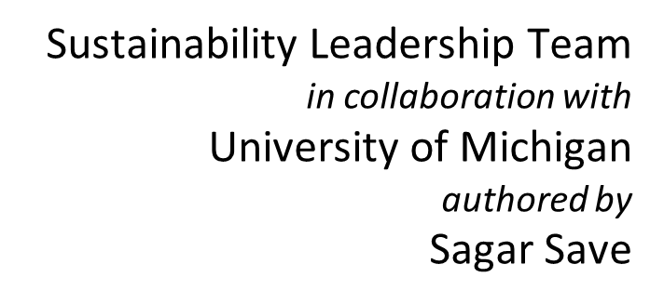

Sustainability Leadership Team_________________
Check out the guide here
“If everyone does a little we can change the world”
Notes:
Erica lead section on Sustainability Template
Created in conjunction with University of Micigan
A useful tool for those just starting out on their sustainability journey

Slide 9
Sustainability Leadership Team_________________
Structured around 5 pillars of Sustainability
Sustainable Sourcing
Waste Reduction
Menu Design
Operational Efficiency
Communications & Engagements
Purpose
Strengthen collaboration with supply chain partners
Align with and support organizations goals and initiatives
Allow foodservice leaders to proactively define strategies, streamline operations and drive long-term positive environmental and social impact
“If everyone does a little we can change the world”
Notes:
Erica

Slide 10
Sustainability Leadership Team_________________
AI Generated Strategic Plan
Step-by-step questionnaire produces strategic sustainability plan
SSGF Sustainable Procurement
SSGF Waste Reduction
SSGF Menu Design
SSGF Operational Efficiency
SSGF Community Engagement
“If everyone does a little we can change the world”
Notes:
Erica
Each link takes you to a specific questionnaire

Slide 11
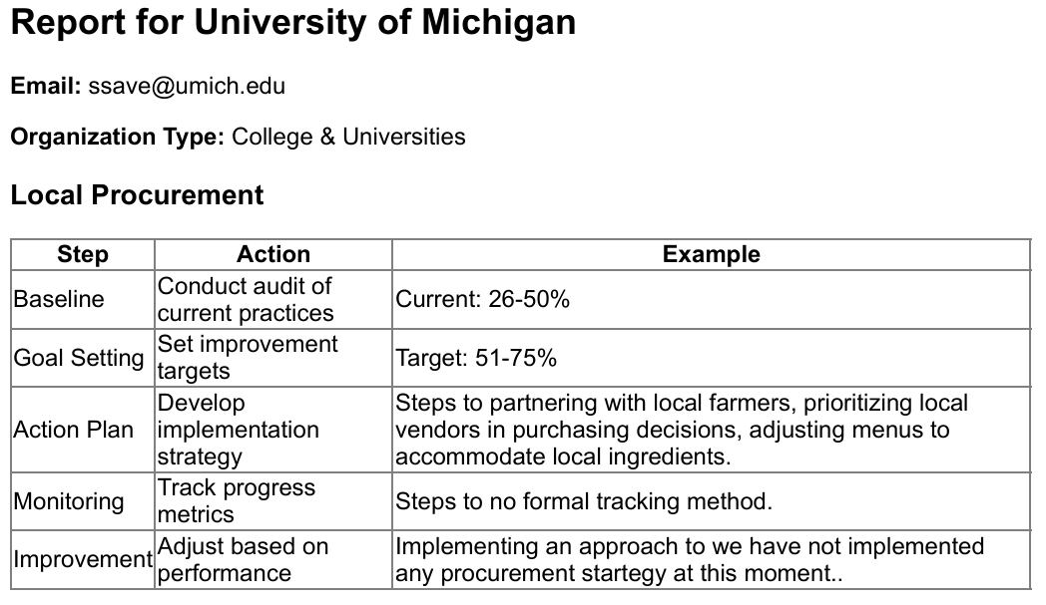
Sustainability Leadership Team_________________
“If everyone does a little we can change the world”
Notes:
Erica
Here is a sample of the output from the Local Procurement section

Slide 12
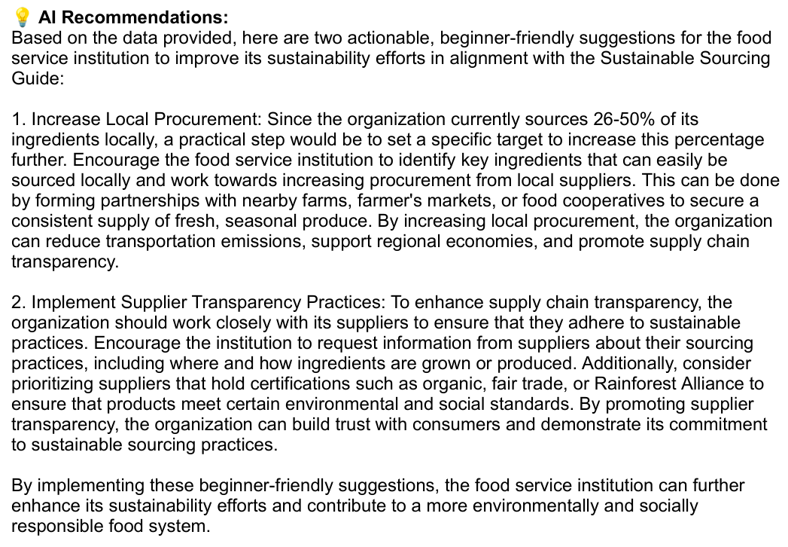
Sustainability Leadership Team_________________
“If everyone does a little we can change the world”
Notes:
Erica
Recommendations are generated with the help of AI.
Working with the University of Michigan team to integrate data from our Benchmarking Survey with the AI tool to help provide more focused and impactful recommendations.
Turn it over to Damian to talk about our other exciting project, the Sustainability Portal.

Slide 13
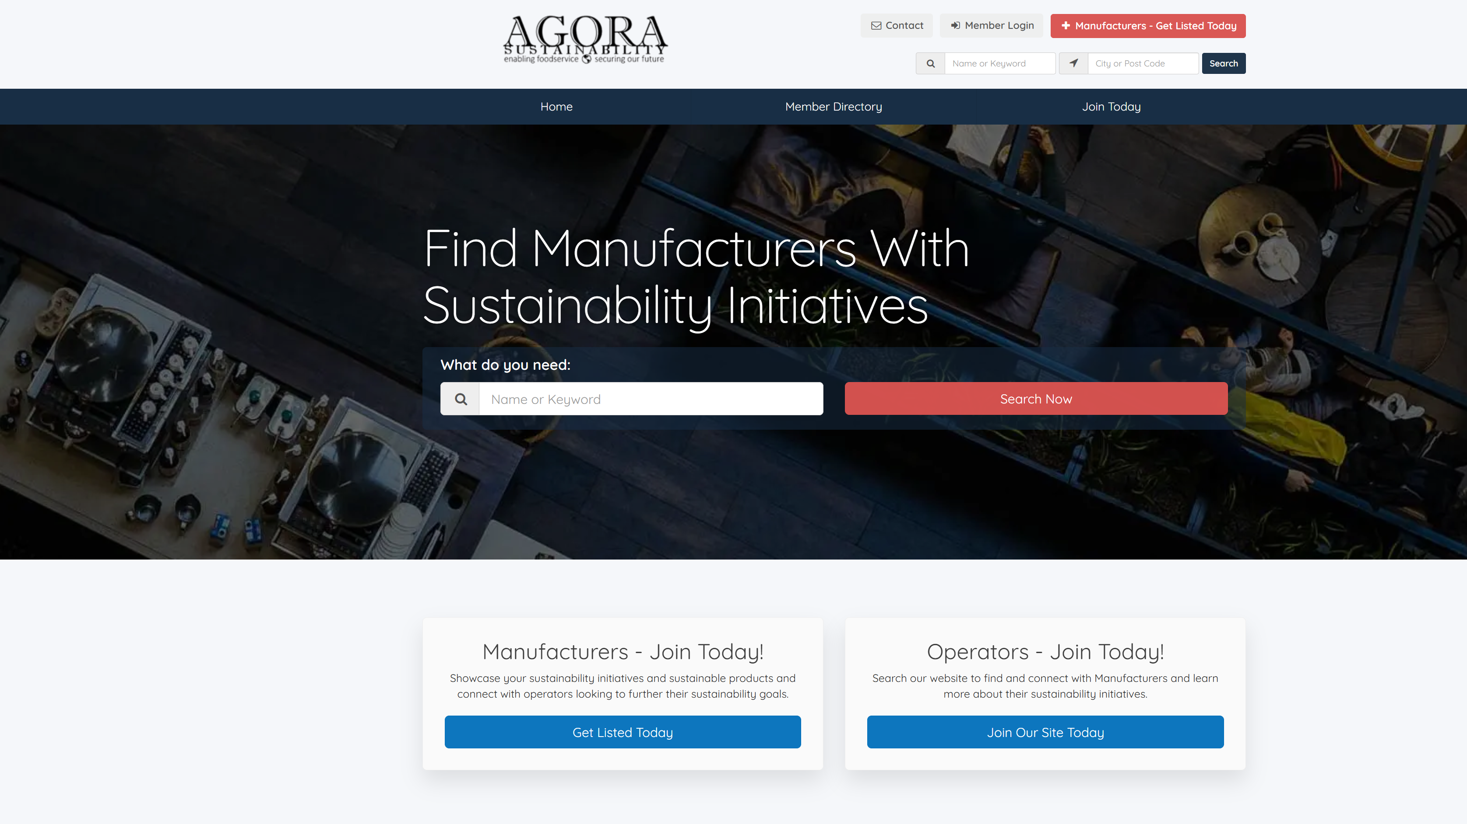

Notes:
Damian to lead section on Portal

Slide 14
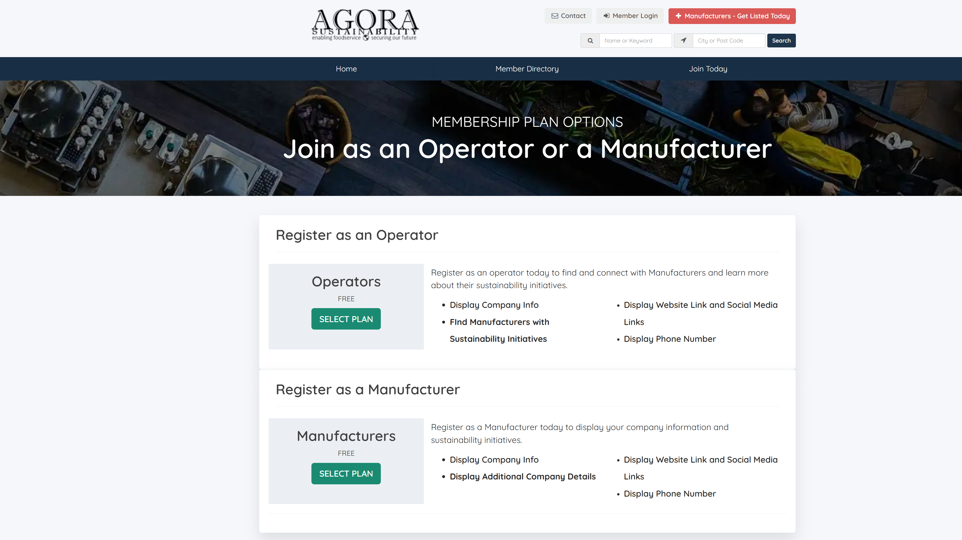
Notes:
Damian

Slide 15
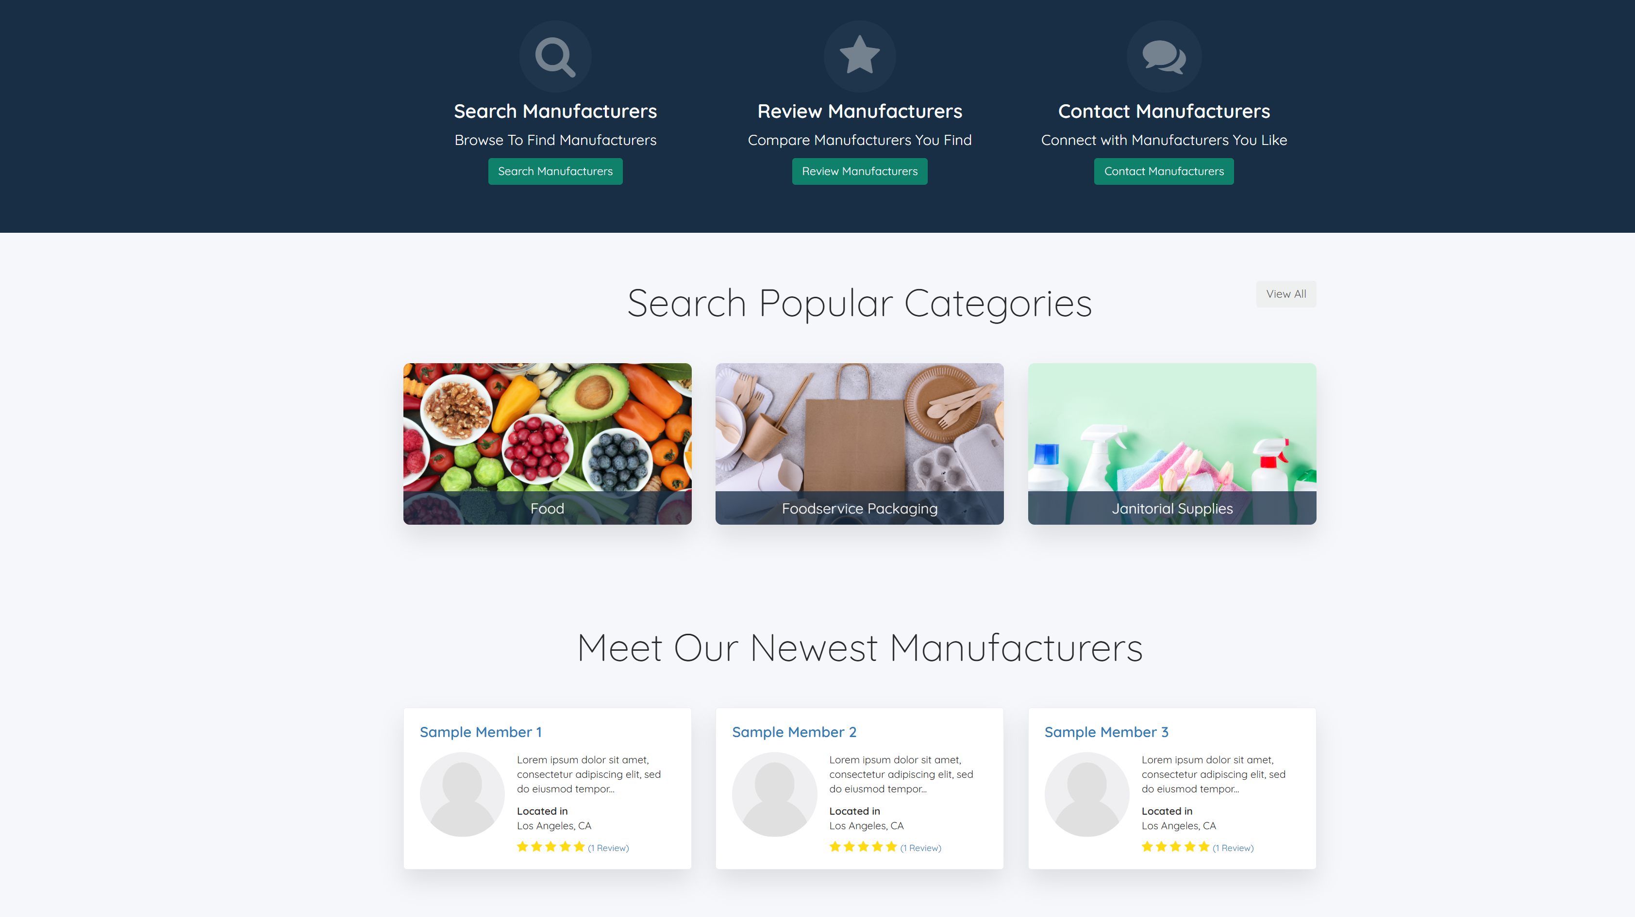
Notes:
Damian

Slide 16
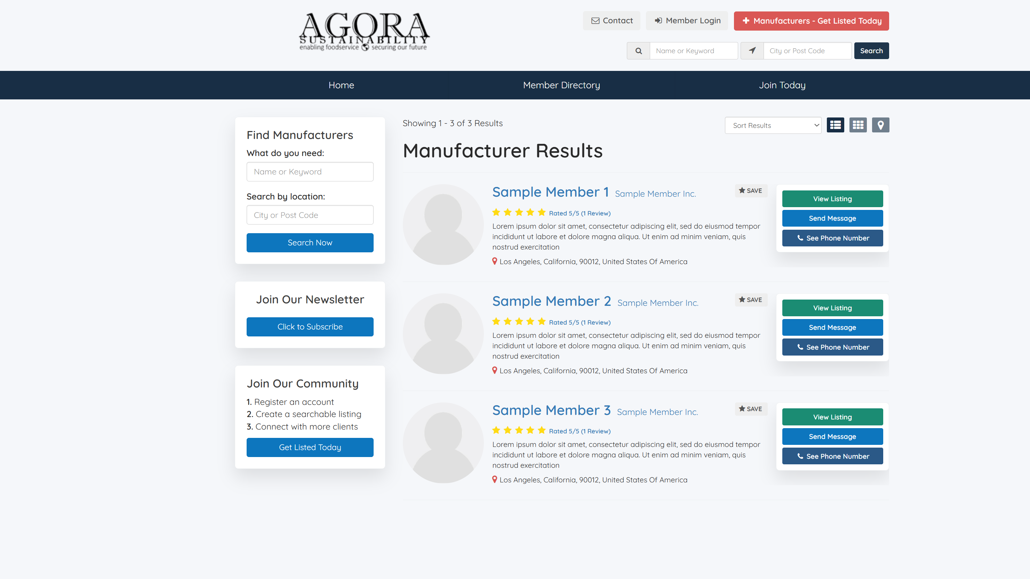
Notes:
Damian

Slide 17
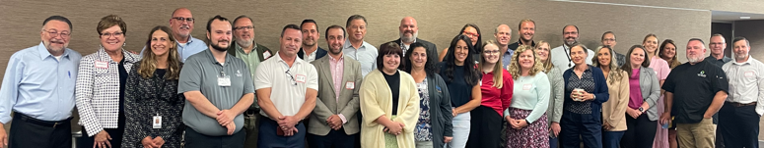
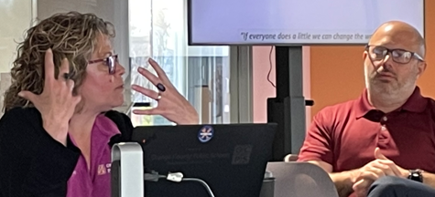
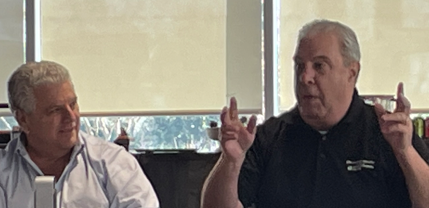
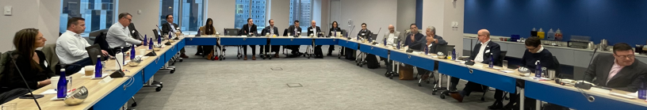
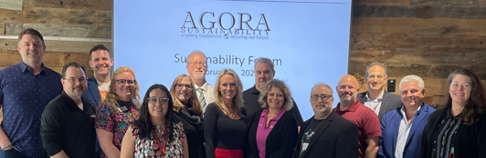

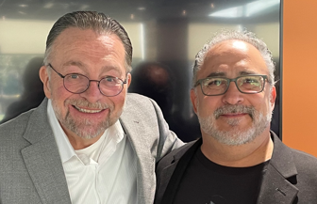
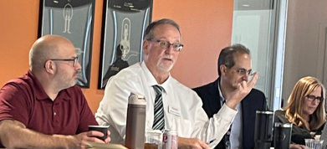
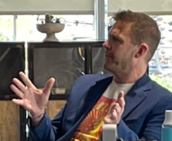
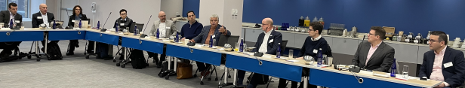
Sustainability Leadership Team_________________
Next Forums
May 1 Brooklyn
August 6 NYC
“If everyone does a little we can change the world”
Notes:
Kris to lead Upcoming Events and How To Get Involved
Next two Forums
May 1 Brooklyn at JP Morgan
August 6 at NYU
Other 2025 Forums being considered:
Chicago
Orlando

Slide 18
To Get Involved
Sustainability Leadership Team_________________
Contact Jim Green: jgspartan@aol.com
“If everyone does a little we can change the world”
Notes:
Open it up for Q&A

